Slide 1
Analysis of VirusTotal
Varun Patil (vcpatil)

Slide 2
Project Agenda
To calculate the number of false positives
Check the detection of Malicious Applications

Slide 3
About VirusTotal
Subsidiary of Google
Scans for Virus, worms, Trojans and other Malicious content
Web Application as well as an Android Application
Uses a Combination of 56 different Anti-Virus products
More than 6000 downloads on Google Play Store

Slide 4
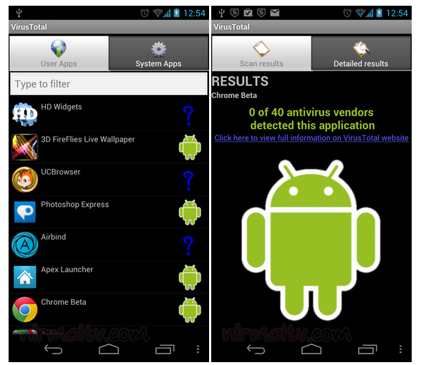
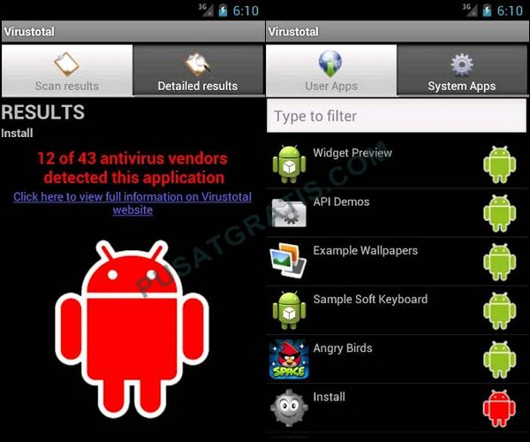
More on VirusTotal

Slide 5
Applications Chosen
All the applications were downloaded from the Play Store
Applications with more than 10 million downloads
Most Downloaded Applications of 2014
Reported Malicious Applications
227 Applications were scanned

Slide 6
Limitation
HTC Explorer
90 MB internal Storage, 512 MB RAM
Slower installation and compatibility issues

Slide 7
Statistics

Slide 8
False Positives
My Talking Tom
Reported by AegisLab
Over 5 million downloads on Play Store
Talking Tom Cat 2 Free
Reported by 6 antivirus vendors
Over 1 Million Downloads on Play Store
TV 90 SKYFIRE 5.0
Reported by NANO-AntiVirus
Pool Billiards Pro
Close to million downloads
Reported by Kingsoft
Angry Birds Go!
Over 2 million downloads
Reported Malicious by AegisLab
Everywhere for Tinder
Reported by AegisLab
Talking Tom Cat Talking Tom Cat 2 Free
Reported by 6 Anti-Virus vendors
Close to 2 million downloads

Slide 9
Malicious Applications
Wallpapers QHD
Any Video Converter
Subway Surfer Free Tips
LiveLocker
Finger Hockey
Dealers Scale Lite
ICC World Cup 2011
NFL Puzzle Game

Slide 10
Conclusion
Accurate detection for most of the applications
Few applications are declared safe without verification.
Some of the applications are not yet included in the database
Application force closes without accurate statistical analysis
Failure to detect reported malicious applications
Failure of Google to remove the reported malicious application from the Play Store

Slide 11
Thank You!
Safe (193, 7 force close)
Database (8)
Malicious (5)

