Slide 1
4. Managing System Development.
4.1. Technologies for Developing Systems
Management of Information Systems and Services InSy4102
BSC. Degree in Information Systems
2023
Source: Information Systems Management in Practice
7/8th Edition

Slide 2
Introduction
Developing new systems = difficult job
though there is progress in improving the process of buildings systems –
  1970s: system development life cycle
  1980s: friendly languages and automation of parts of development such as code generation
  1990s: reliance increased on packages
    Developer productivity & maintenance
By Mr. Zelalem S. Mizan Tepi university, Department of Information systems
Notes:
Code generation is a mechanism where a compiler takes the source code as an input and converts it into machine code. This machine code is actually executed .

Slide 3
Introduction cont.
Business process reengineering movement = growth on integrated enterprise systems & adoption of enterprise resource planning systems (ERP)
Late 1990s; sudden emergence of e-business and Internet based systems
2000s - Internet brought need for faster systems development and integrated enterprise systems,
  Hence new tools for rapid development became available –
    Relying on reusable components & open systems architecture
By Mr. Zelalem S. Mizan Tepi university, Department of Information systems
Notes:
ERP software typically integrates all facets of an operation — including product planning, development, manufacturing, sales and marketing — in a single database, application and user interface

Slide 4
Introduction cont.
These days, virtually every application is a network application, since the network is becoming the system
Web-based applications were the first generation of Internet-centric computing
The new field, “Web Services” (or whatever people are calling it), is touted as the second
In addition, the increasing interconnectedness of supply chains is leading companies to build inter-organizational systems
  Far more complex undertaking than any single-company systems
By Mr. Zelalem S. Mizan Tepi university, Department of Information systems
Notes:
Supply chain management is the handling of the entire production flow of a good or service — starting from the raw components all the way to delivering the final product to the consumer. To accomplish this task, a company will create a network of suppliers (the “links” in the chain) that move the product along from the suppliers of raw materials to the organizations who deal directly with users.

Slide 5
System Development
What mean Systems development ?
  is the process of defining, designing, testing, and implementing a new software application or program.
  It could include the internal development of customized systems,
  the creation of database systems, or the acquisition of third party developed software.
  Written standards and procedures must guide all information systems processing functions.
By Mr. Zelalem S. Mizan Tepi university, Department of Information systems

Slide 6
Managing System Development
System development has traditionally been aimed at procedure-based work
  Procedure-based activities are large-volume transactions where each transaction has a relatively low cost or value
  These activities, which consist mainly of handling data, are well defined, and the principal measure for determining their performance is efficiency
Information systems were, in most cases, first built to automate this kind of work, beginning initially with accounting, and then progressing into manufacturing, administration, sales and marketing, and so on
Development of these systems has been handled by IS professionals
By Mr. Zelalem S. Mizan Tepi university, Department of Information systems

Slide 7
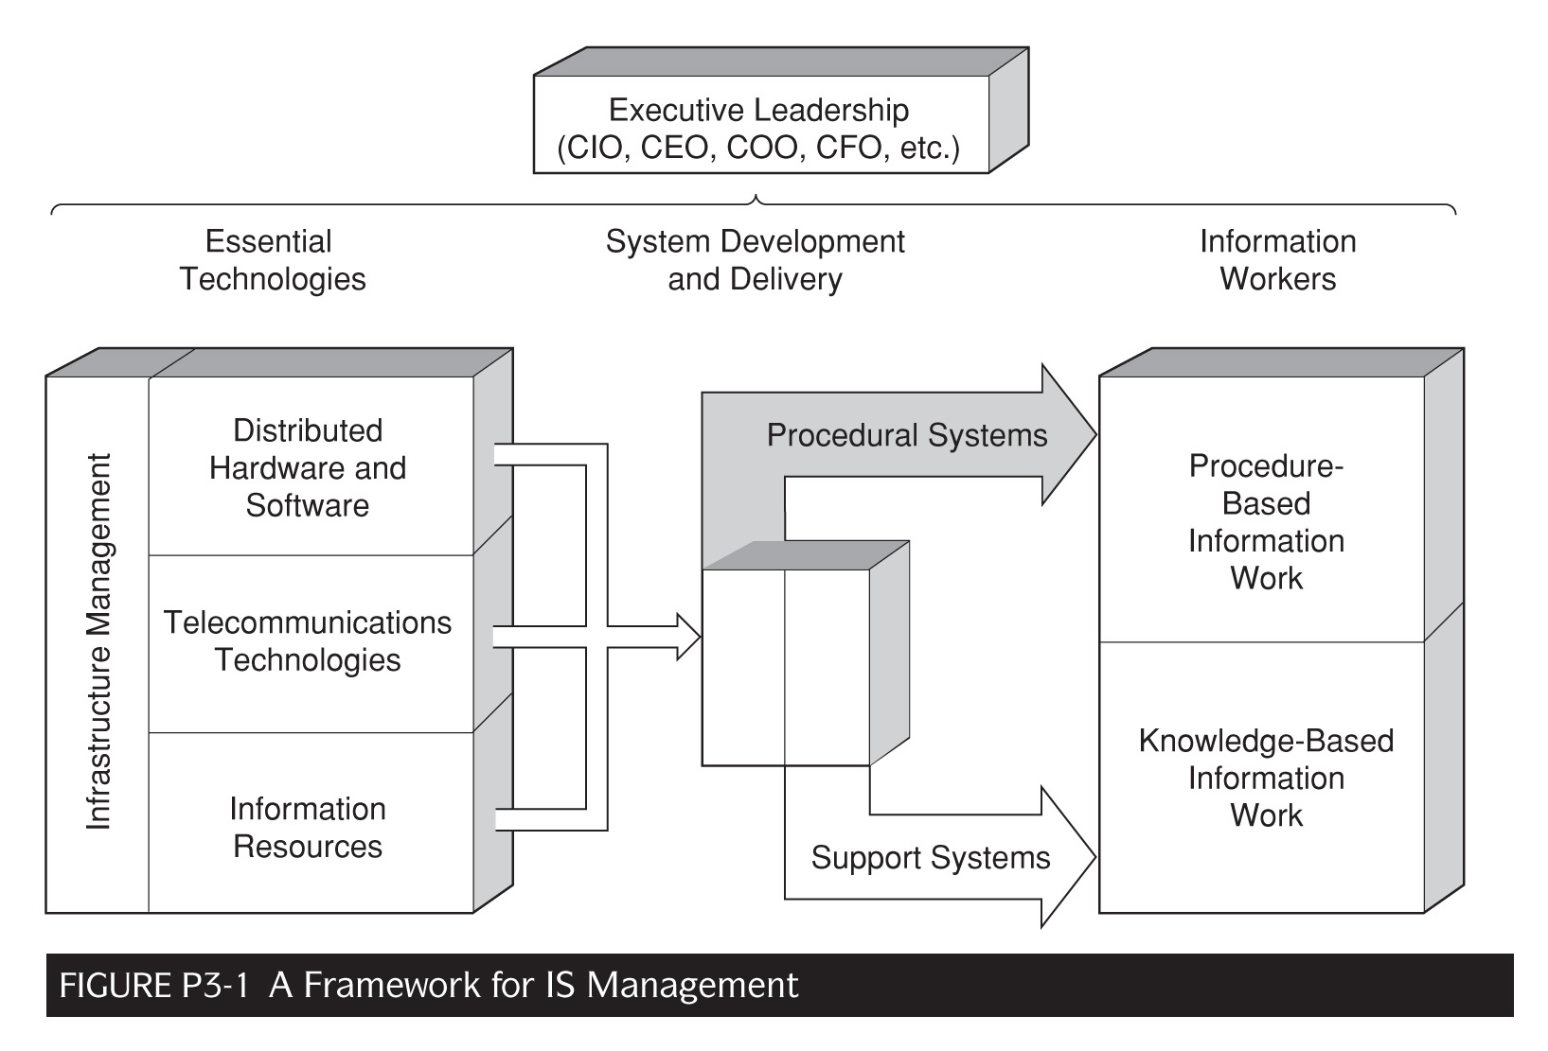
By Mr. Zelalem S. Mizan Tepi university, Department of Information systems

Slide 8
Foundations of Systems Development
In the early years, systems development was considered a ‘craft’
Then = Discipline through structured development
In the following figure 4.1 is the classic system development life cycle (waterfall approach)
  Much ‘touted’ but rarely (purely) used
  Developers really always followed the spiral approach as in Figure 4.2
By Mr. Zelalem S. Mizan Tepi university, Department of Information systems

Slide 9
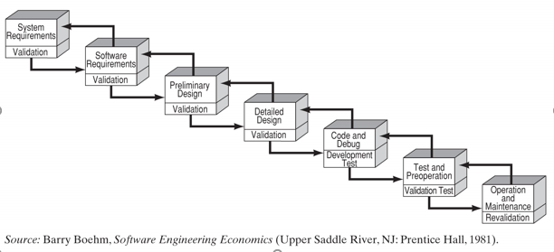
Figure 4.1 water fall system development lifecycle
By Mr. Zelalem S. Mizan Tepi university, Department of Information systems

Slide 10
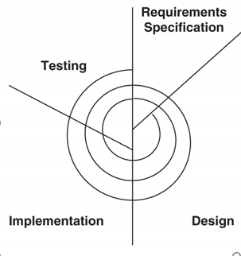
Figure 4.2. spiral model
By Mr. Zelalem S. Mizan Tepi university, Department of Information systems

Slide 11
Foundations of Systems Development cont.
The Traditional Application Development Approach (characteristics):
  Hand coding in third generation language, e.g. COBOL
  “Structured Programming” development methodology
  Automated Project management system
  A database management system
  A mix of online and batch applications in the same system
  Development of mostly mainframe applications
  Programming by professional programmers only
  Various automated, but not well integrated s/w tools
  A well-defined sign-off process for system delivery
  User participation mainly in require definition and installation phases
By Mr. Zelalem S. Mizan Tepi university, Department of Information systems

Slide 12
Foundations of Systems Development Fourth-Generation Languages
Early 1980s – 4GLs and Prototyping
4GLs are more than just a computer language, they are programming environments. As seen in Figure 4.3.
1980s development – fourth generation languages (4GLs). These allowed:
  End users to develop some programs
  Programmers to use different development method = Prototyping
By Mr. Zelalem S. Mizan Tepi university, Department of Information systems

Slide 13
What are G1L,G2L,G3L and G4l computer programming languages and when they invented?
By Mr. Zelalem S. Mizan Tepi university, Department of Information systems

Slide 14
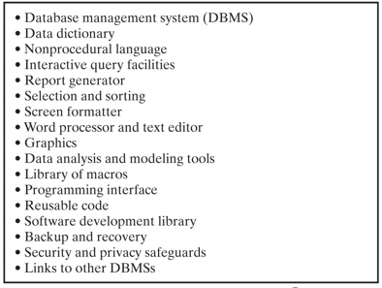
Figure 4.3. 4GLs
By Mr. Zelalem S. Mizan Tepi university, Department of Information systems

Slide 15
Foundations of Systems Development Computer-Aided Software Engineering (CASE)
The advent of Computer Aided Software Engineering (CASE) occurred to automate structured techniques and reduce tediousness of the 1970s structured programming and analysis techniques.
  Components:
    Information repository: stores and organizes all information needed to create, modify, and develop software system
    Front-end tools: used in all phases that lead up to coding, (“uppercase”) , analysis and design tools
    Back-end tools: used to automatically generate source code (“lowercase”), coding and implementation tools
    Integrated case tool: support the whole life cycle of the project , oracle designer/200, rational Rose
By Mr. Zelalem S. Mizan Tepi university, Department of Information systems

Slide 16
Foundations of Systems Development Computer-Aided Software Engineering (CASE) cont.
A late ’80s use of CASE (not ‘standard’!) is Timeboxing
  Timeboxing: Technique that uses CASE to guarantee delivery of a system within 120 days
Today, IS departments that aim for speed over complexity are turning to a development technique like:
  Rapid Application Development (RAD)
By Mr. Zelalem S. Mizan Tepi university, Department of Information systems
Notes:
RAD—a model in which a software project can be implemented using this model if the project can be broken down into small modules wherein each module can be assigned independently to separate teams. These modules can finally be combined to form the final product.

Slide 17
DUPONT CABLE MANAGEMENT SERVICES
Case Example: Rapid Application Development (RAD)
To manage its telephones and wiring in its many offices, DuPont needed a cable management system
No packages on the market could handle its needs, so it called on a DuPont subsidiary to use CASE and timeboxing to build a custom system
  Day One was the go-ahead
  Days 2-30 defined the components of the system
  Days 31-90 designed the specs, prototyped the system, and refined the prototype (which became the production system)
  Days 91-120 installed the system, and a second timebox followed
The resulting system, which took nine months, took others two to three years to develop in-house
By Mr. Zelalem S. Mizan Tepi university, Department of Information systems

Slide 18
Foundations of Systems Development
Object-Oriented Development
Object-oriented (OO) development was a revolutionary change in the late 1980s – develop objects that can be reused
It allowed point-and-click programming of graphical user interfaces
It is not so much a coding technique as a code-packaging technique
  Object:
    Receives request (message)
    Chooses and executes operation, then
    Returns the results to the requester
It is very modular, so a change in one part of a system need not affect the other parts
By Mr. Zelalem S. Mizan Tepi university, Department of Information systems

Slide 19
Foundations of Systems Development
Client-Server Computing and Web Based Development
In the 1990s, two developments became the major news:
  Client-server systems
  Web-based or network centric development
Underlying these two (continuing) trends is the increasing use of packages and system integration
  As much as possible, companies prefer to buy a package rather than build an application in-house
  To develop large applications, they integrate (various) hardware and software components
By Mr. Zelalem S. Mizan Tepi university, Department of Information systems

Slide 20
Foundations of Systems Development
Client-Server Computing
These systems split work between a client and a server
Far more flexibility than mainframe-based systems
  Desktop: graphics, animation, video
  Servers: production updating
Didn’t always live up to their promise!
Clever way to meld the pizzazz of the PC world with the necessary back-end production strengths of the ‘mainframe’ world
Which on is better using client-server or mainframe?
By Mr. Zelalem S. Mizan Tepi university, Department of Information systems

Slide 21
Mainframes vs client-server
Mainframes are replacing client-servers. They provide more horsepower for high volume transactions, and have more storage space than a server would have.
Although mainframes are more expenses they are said to be more reliable.
A disadvantage of a mainframe is that everything is held on the Mainframe - if the network is out or too many users logged on, there is nothing you can do.
In Client/Server (normally) all the computing happens at the users end i.e. on their own PC ('Client').
The 'Server' is used mainly for file & data storage and other 'common' resources (such as Printer & www access). So the Server has to check that the users have access rights & permissions to the data (e.g. emails) and resources.
By Mr. Zelalem S. Mizan Tepi university, Department of Information systems

Slide 22
Foundations of Systems Development
Summary
These technologies:
  Structured development
  4GLs
  Prototyping
  CASE
  OO development
  Client Server systems
have all proven to be foundations of today's system development environment
We now turn to that (today’s) environment, beginning first by discussing the main method of building systems: system integration
By Mr. Zelalem S. Mizan Tepi university, Department of Information systems

Slide 23
Systems Integration
Integration is by far the biggest software problems CIOs face
  = Why offerings that integrate systems generate so much interest
CIOs (and all CXOs!) have long strived to integrate the information systems in their organizations
Integration =
  Complex
  Expensive
  Risky
Three approaches stand out:
  Database Management Systems: allow applications to share data stored in a single or distributed database
  Enterprise Resource Planning (ERP) Systems: all applications come from a single vendor and are specifically designed to communicate with each other
  Middleware: applications communicate with each other through a third-party translation software
  Typically = use a combination of all three
By Mr. Zelalem S. Mizan Tepi university, Department of Information systems

Slide 24
Systems Integration
ERP
An ERP system aims to integrate corporate systems by providing a single set of applications from a single vendor operating with a single database
  The goal – provide the means to integrate business departments and functions across an organization
History of ERP contains both successes and failures, many of which have been especially notable:
  Average cost overrun – 179%
  Average schedule overrun 230%
  Functionally 59% below expectations
  10% projects completed on time & in budget
  35% projects cancelled
Common to hold systems large size and complexity responsible as well as:
  Too much attention to ‘technical’ aspects
  Not enough to organizational aspects
By Mr. Zelalem S. Mizan Tepi university, Department of Information systems

Slide 25
COLGATE PALMOLIVE
Case Example: Successful ERP
1990s = competitive crisis
Used a decentralized structure
  Expensive to coordinate
  Slow to respond to market changes
  Constraint on company growth
Vision:
“Become a truly global company, with an integrated business environment and standardized business processes.”
By Mr. Zelalem S. Mizan Tepi university, Department of Information systems

Slide 26
COLGATE PALMOLIVE
Case Example: Successful ERP cont.
After setting up a prototype environment in the US, SAP R/3 module convincingly proved itself as being functional and flexible worldwide for
  Sales & distribution
  Materials management
  Finance
  Human resources
Savings have been made in IT operations – complex decentralized IT infrastructure was streamlined
By Mr. Zelalem S. Mizan Tepi university, Department of Information systems

Slide 27
COLGATE PALMOLIVE
Case Example: Successful ERP cont.
Implementation took five years and cost $430 million, but it was a success. The product delivery cycle dropped and purchasing and other costs were cut
Data centers around the world were closed, from 75 down to 2
The complexity of its global data networks was also simplified
Success of ERP stems from senior management convincing employees that the company was in crisis and only dramatic change could remedy it
By Mr. Zelalem S. Mizan Tepi university, Department of Information systems

Slide 28
Systems Integration
Middleware
Most organizations have a wide range of applications
  New and old
  From a variety of vendors
  Running on numerous platforms
Replacing or rewriting these systems not an option
One option = employ a class of products known as middleware
  Software that works between and connects applications allowing them to share data
  Needed as wide range of applications used and run on numerous platforms
  Simplifies development by acting as the “glue” that binds the components together
  There is a wide variety available see on figure 4.4
By Mr. Zelalem S. Mizan Tepi university, Department of Information systems

Slide 29
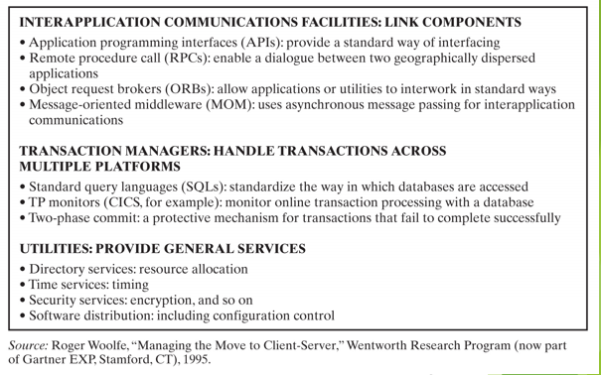
Figure 4.4 middle ware software
By Mr. Zelalem S. Mizan Tepi university, Department of Information systems

Slide 30
Systems Integration
Middleware cont.
One type of ‘middleware’ that has gained popularity: Enterprise Application Integration (EAI):
  Typically use a message broker to transfer data between applications
  Add a new level of functionality that distinguishes them
  Allow users to define business processes and make data integration subject to rules that govern those processes
    e.g. a rule might state that data can only move from purchasing to accounts receivable when ‘X’ has signed off on the purchase
By Mr. Zelalem S. Mizan Tepi university, Department of Information systems

Slide 31
A TELECOMMUNICATIONS FIRM Case Example: Enterprise Application Integration
Processing customer requests for new and updated services = major cost and source of customer dissatisfaction
  It has been estimated that 65 percent of new and change orders in the telephone industry have errors that must be corrected after the fact ($$$)
Rather than build a new system, the company looked to EAI to automate the process using three existing systems:
  The customer relationship management system (which contains the customer information)
  The ERP system (which retrieves information for the application to validate the request and ensures that the new service is compatible with the customer’s existing services), and
  The accounting system (which contains the pricing information)
By Mr. Zelalem S. Mizan Tepi university, Department of Information systems

Slide 32
A TELECOMMUNICATIONS FIRM
Case Example: Enterprise Application Integration cont.
Therefore resolution =
  Customer request service at the call center via the CRM
  Customer’s name and address passed onto ERP system, which retrieve necessary info
Mission accomplished
  Decreased processing costs
  Errors eliminated
  Reduced customer churn
  No new applications needed
  Existing applications not altered
By Mr. Zelalem S. Mizan Tepi university, Department of Information systems

Slide 33
Interorganizational System Development
One of the main business trends is the appearance of business ecosystems — “groupings” of businesses that work closely together
  Supply Chain Management systems integrate supply chains
These are now a major trend as they compete against one another on their ability to reduce costs and time across their entire chains
Development of such inter-organizational systems requires teams from the different organizations to work together
By Mr. Zelalem S. Mizan Tepi university, Department of Information systems

Slide 34
Interorganizational System Development cont.
Another type of inter-organizational system is a platform, which provides the infrastructure for the operation of a business ecosystem, a region, or an industry
  Sabre—airline booking
  Video game industry
By Mr. Zelalem S. Mizan Tepi university, Department of Information systems
Notes:
A platform is a group of technologies that are used as a base upon which other applications, processes or technologies are developed.

Slide 35
Internet-Based Systems: Application Servers
Originally conceived as a piece of middleware to link a Web server to applications on other company systems
  The application server has grown into a framework for developing Internet-based applications
Figure 4.5 shows the basic application server architecture. The virtual server takes requests from clients and Web servers (on the left), runs the necessary business logic & provides connectivity to the entire range of back-end systems (on the right)
The goal of the application server:
  automate
  manage technical tasks in the development and running of Internet based applications
The result:
  Developers can focus more on business issues, rather than technical detail
By Mr. Zelalem S. Mizan Tepi university, Department of Information systems

Slide 36
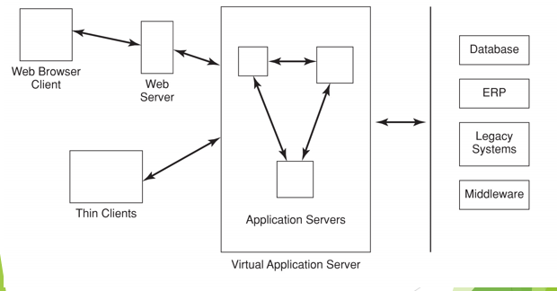
Figure 4.5 application server architecture
By Mr. Zelalem S. Mizan Tepi university, Department of Information systems

Slide 37
Internet-Based Systems:
Java Development Platform
Java has been in many cases the starting point for the development of Internet-based systems with an open system architecture.
  Originally – developed to provide applets that run on Web clients
    Evolved into a full programming language
    Goal = Platform for independent language that could run on any system
Promise applications portability: “write once, run anywhere”
Didn’t live up to promise = evolved into a standard platform for developing server-side applications
By Mr. Zelalem S. Mizan Tepi university, Department of Information systems

Slide 38
Internet-Based Systems:
Java Development Platform cont.
Major components in Java server-side platform
  Enterprise Java Beans (EJB)
    Preconfigured pieces of code that IS staff no longer have to build from scratch
  Java 2 Enterprise Edition (J2EE)
    Defines a standard for developing Internet-based enterprise applications
  Provide an alternative to building online business systems from scratch or buying packaged online business systems because of their multi-vendor platform capability and pre-built, reusable components
Microsoft competes with its own versions:
  Component Object Model (COM)
  Distributed Component Object Model (DCOM)
By Mr. Zelalem S. Mizan Tepi university, Department of Information systems

Slide 39
Internet-Based Systems:
Web Services
The vision of Web Services is that modules of code can be assembled into services, which, in turn, can be linked to create a business process at the moment it is needed and run across enterprises, computing platforms, and data models
There are two development modes:
  One is to wrap an XML wrapper around an existing piece of code that performs a specific function
    Exposes it
    Then = give it a Internet address and let others use it – for a fee!
  Second way to build a Web Service = use one someone else has already exposed
The following case illustrates the basics of building a Web Service
By Mr. Zelalem S. Mizan Tepi university, Department of Information systems
Notes:
The term Web services describes a standardized way of integrating Web-based applications using the XML, SOAP, WSDL and UDDI open standards over an Internet protocol backbone. ... Developers can then add the Web service to a GUI (such as aWeb page or an executable program) to offer specific functionality to users

Slide 40
BUILDING A WEB SERVICE
Case Example
Currency converter
The steps involve:
  Exposing the code
  Writing a service description
  Publishing the service
  Finding the service, and
  Invoking a Web Service
By Mr. Zelalem S. Mizan Tepi university, Department of Information systems

Slide 41
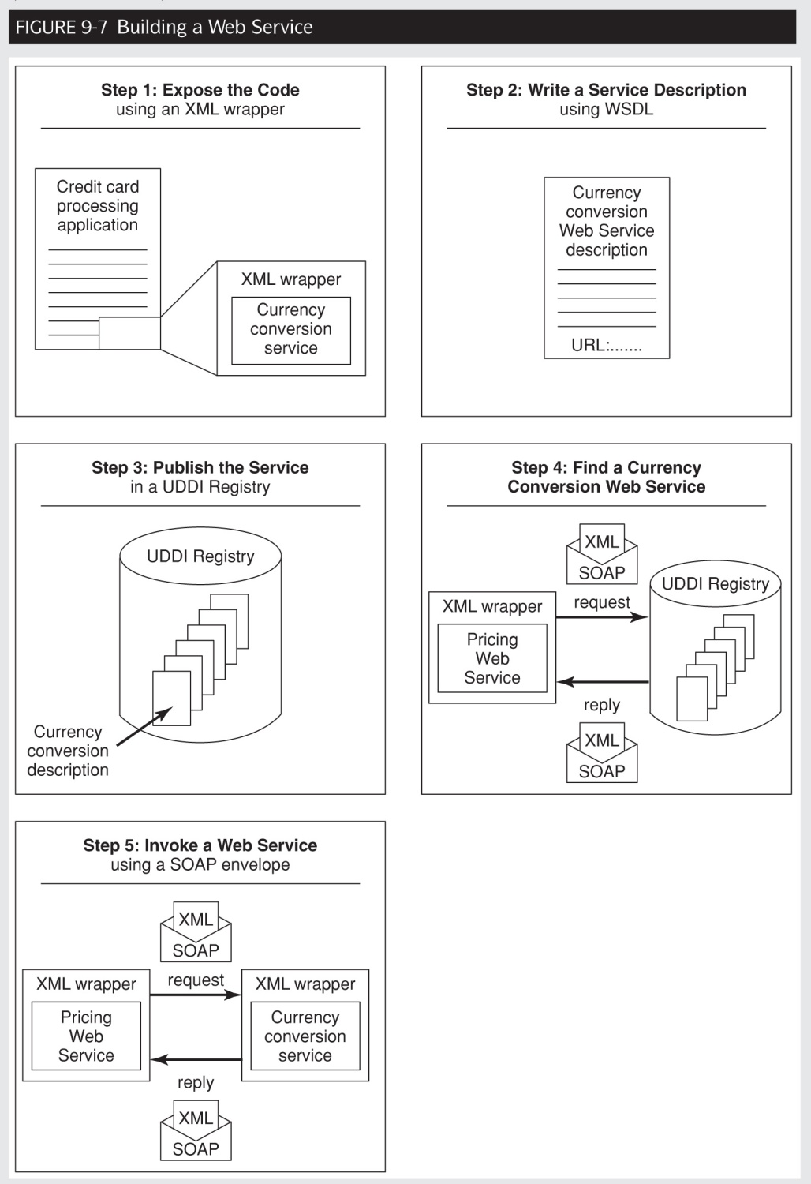
By Mr. Zelalem S. Mizan Tepi university, Department of Information systems

Slide 42
Conclusion
Traditional approach from the 1960s evolved to give more discipline, control, and efficiency.
  Moved programming from an “art” to a “craft.”
  Problems:
    Development times
    Low user involvement
    Lack of flexibility
1970s and 1980s: data-driven development, stressed improving early phases in development:
  4GL and software prototyping permitted more rapid development
  CASE and object oriented (software re-use)
By Mr. Zelalem S. Mizan Tepi university, Department of Information systems

Slide 43
Conclusion cont.
1990s:
  Client-server
  Internet-based systems
  Integration of components and packages
The 1990s brought the need for integrated enterprise systems and Internet-based systems
Development now focuses on the Internet, interorganizational development, and ecosystem applications
  Systems where project management skills are even more important due to the complexity of the systems
By Mr. Zelalem S. Mizan Tepi university, Department of Information systems

