Slide 1
Terraform Training

Slide 2
Challenges in current infrastructure
Planning Changes
Executing Changes
Working Together
Keeping up to date (useable) Inventories

Slide 3
What is Infrastructure as Code?
Infrastructure as Code (IaC) is the process of managing and provisioning cloud infrastructure with machine-readable definition files.
Think of it as executable documentation.

Slide 4
Infrastructure as Code Allows Us To...
Provide a codified workflow to create infrastructure
Change and update existing infrastructure
Safely test changes using terraform plan in dry run mode
Integrate with application code workflows (Git, CI/CD tools)
Provide reusable modules for easy sharing and collaboration
Enforce security policy and organizational standards
Enable collaboration between different teams

Slide 5
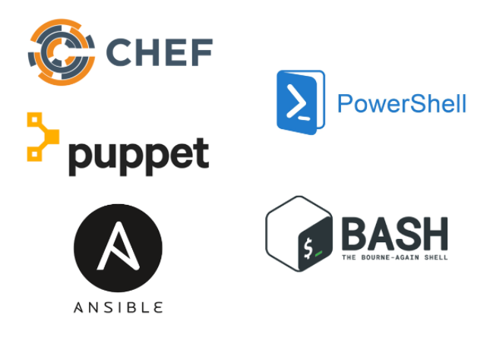
Other Infrastructure as Code Tools
These tools work well for configuring the operating system and application. They are not purpose-built for provisioning cloud infrastructure and platform services.

Slide 6
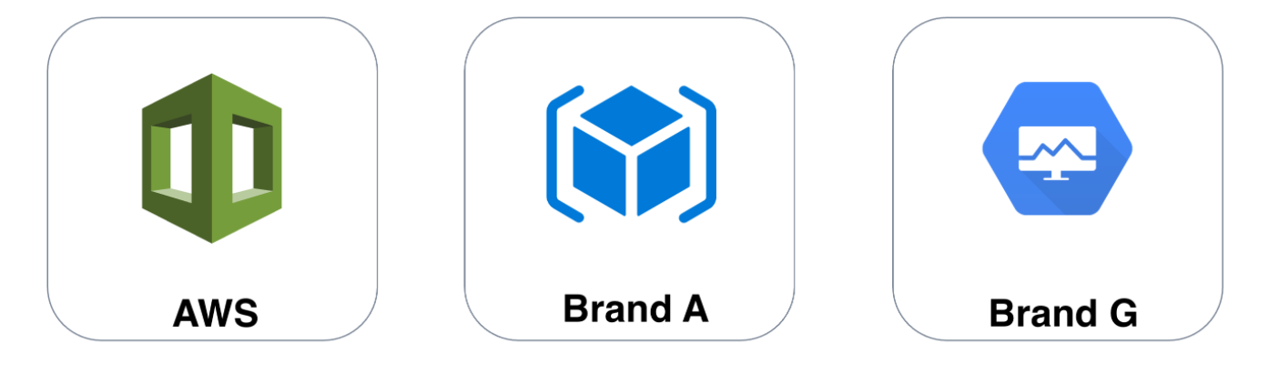
Native Cloud Provisioning Tools
Each cloud has its own YAML or JSON based provisioning tool.
Terraform can be used across all major cloud providers and VM hypervisors

Slide 7
Why Terraform ??
Supports multi-cloud & hybrid infrastructure
Migrate from other cloud providers
Increase provisioning speed
Improve efficiency
Reduce risk
Apply incremental changes
Destroy when needed
Preview Changes
Scale Easily

Slide 8
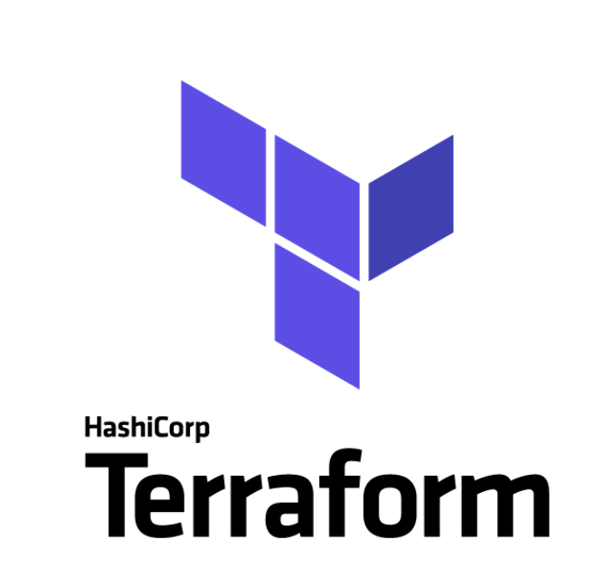
What is Terraform ?
Terraform is an open source provisioning tool.
It ships as a single binary which is written in Go. Terraform is cross platform and can run on Linux, Windows, or MacOS.
Installing terraform is easy. You simply download a zip file, unzip it, and run it.

Slide 9
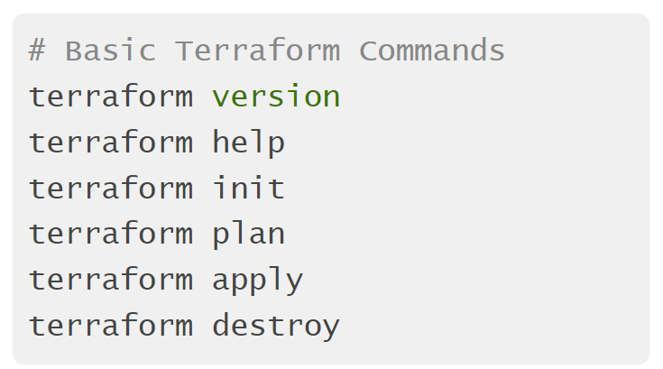
Terraform Command line
Terraform has subcommands that perform different actions.
Terraform is a command line tool.
Terraform commands are either typed in manually or run automatically from a script.
The commands are the same whether you are on Linux or Windows or MacOS.

Slide 10
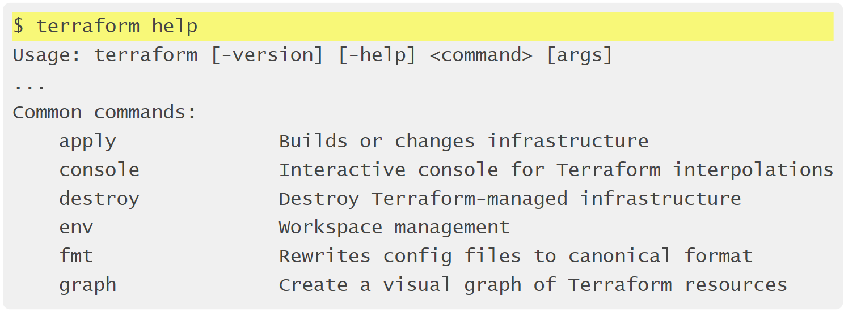
Terraform Help
Type terraform subcommand help to view help on a particular subcommand.

Slide 11
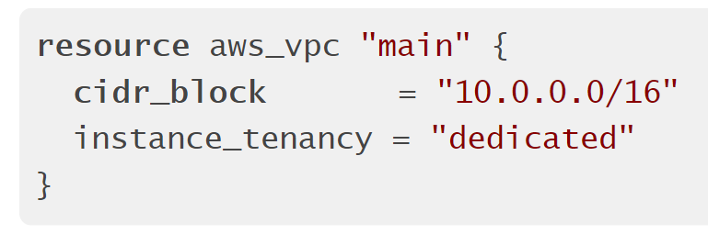
Terraform Code
Terraform code is based on the HCL2 toolkit. HCL stands for HashiCorp Configuration Language.
Terraform code, or simply terraform is a declarative language that is specifically designed for provisioning infrastructure on any cloud or platform.

Slide 12
Terraform Comments
Line Comments begin with a pound symbol: #
# This is a line comment.
Block comments are contained between /* and */ symbols.
/* This is a block comment.
Block comments can span multiple lines.
The comment ends with this symbol: */

Slide 13
Terraform Workspaces
A terraform workspace is simply a folder or directory that contains terraform code.
Terraform files always end in either a *.tf or *.tfvars extension.
Most terraform workspaces contain a minimum of three files:
main.tf - Most of your functional code will go here.
variables.tf - This file is for storing variables.
outputs.tf - Define what is shown at the end of a terraform run.

Slide 14
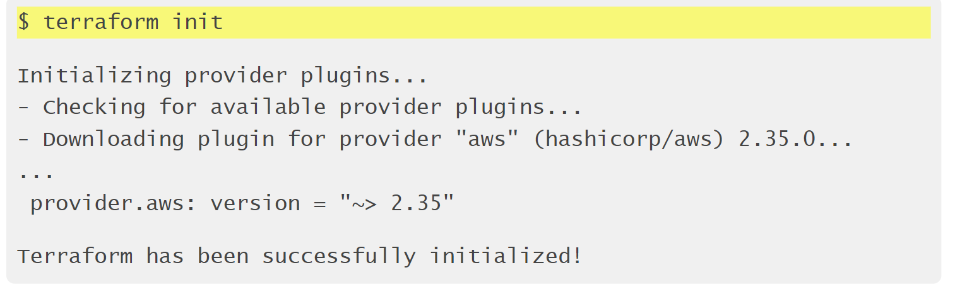
Terraform init
Terraform fetches any required providers and modules and stores them in the .terraform directory. If you add, change or update your modules or providers you will need to run init again

Slide 15
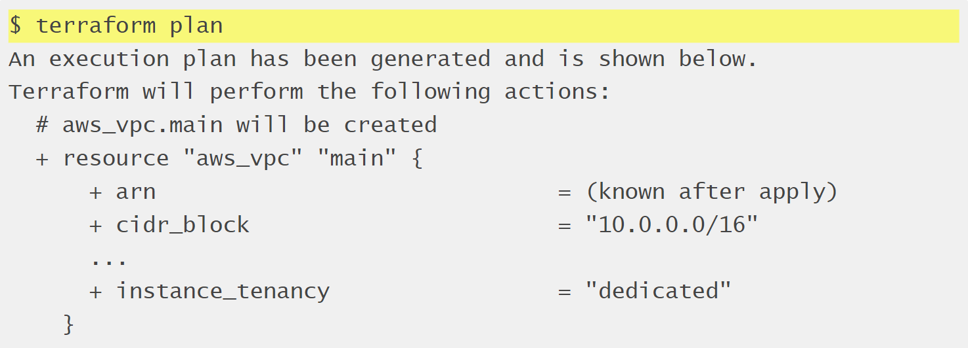
Terraform plan
Preview your changes with terraform plan before you apply them.
+ - New changes
- deletions
~ - updation

Slide 16
Where are Variables Defined?
variable "prefix" {
description = "This prefix will be included in the name of most resources."
}
variable "instance_tenancy" {
description = "A tenancy option for instances launched into the VPC."
default = "dedicated"
}
Terraform variables are placed in a file called variables.tf. Variables can have default settings. If you omit the default, the user will be prompted to enter a value. Here we are declaring the variables that we intend to use.

Slide 17
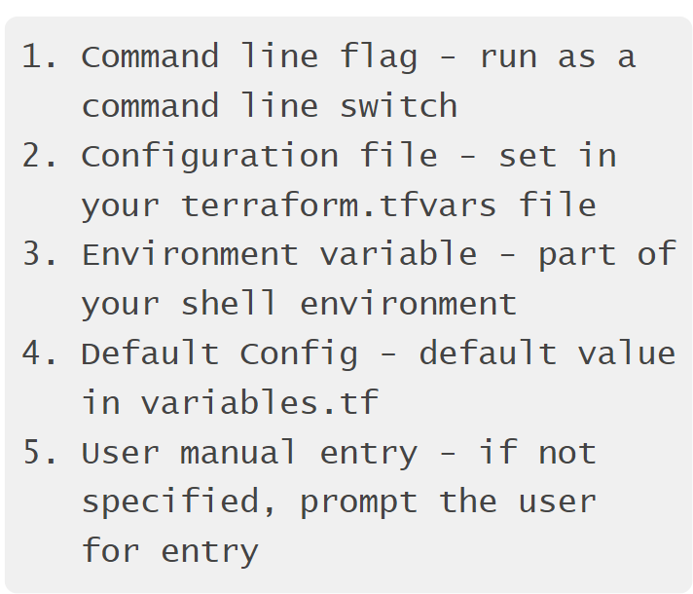
How are Variables Set?
Once you have some variables defined, you can set and override them in different ways. Here is the level of precedence for each method.
This list goes from highest precedence (1) to lowest (5).

Slide 18
Variable types
Primitive Types
string: a sequence of Unicode characters representing some text, such as "hello".
number: a numeric value. The number type can represent both whole numbers like 15 and fractional values such as 6.283185.
bool: either true or false. bool values can be used in conditional logic.

Slide 19
Variable types
Complex Types
There are two categories of complex types: collection types (for grouping similar values), and structural types (for grouping potentially dissimilar values).
Collection Types
A collection type allows multiple values of one other type to be grouped together as a single value. The type of value within a collection is called its element type
list(…): a sequence of values identified by consecutive whole numbers starting with zero.
map({…}): a collection of values where each is identified by a string label
set(…): a collection of unique values that do not have any secondary identifiers or ordering.

Slide 20
Variable types
Structural Types
A structural type allows multiple values of several distinct types to be grouped together as a single value. Structural types require a schema as an argument, to specify which types are allowed for which elements.
object({…}): a collection of named attributes that each have their own type.
tuple([..]): a sequence of elements identified by consecutive whole numbers starting with zero, where each element has its own type.
Dynamic Types: The "any" Constraint
The keyword any is a special construct that serves as a placeholder for a type yet to be decided. any is not itself a type: when interpreting a value against a type constraint containing any

Slide 21
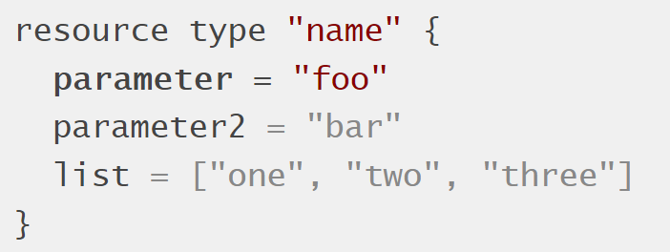
Anatomy of a Resource
Every terraform resource is structured exactly the same way
resource = Top level keyword
type = Type of resource. Example: aws_instance.
name = Arbitrary name to refer to this resource. Used internally by terraform. This field cannot be a variable.

Slide 22
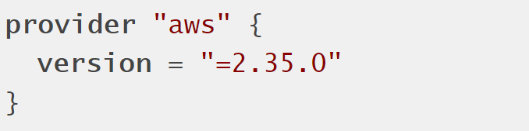
Terraform Provider Configuration
The terraform core program requires at least one provider to build anything.
You can manually configure which version(s) of a provider you would like to use. If you leave this option out, Terraform will default to the latest available version of the provider.
Multiple providers can be provided in the single configuration file

Slide 23
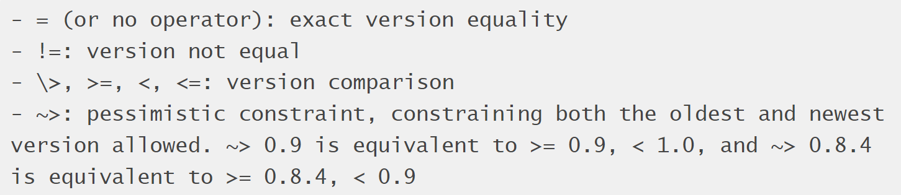
Versioning Operators
Re-usable modules should constrain only the minimum allowed version, such as >= 2.35.0.

Slide 24
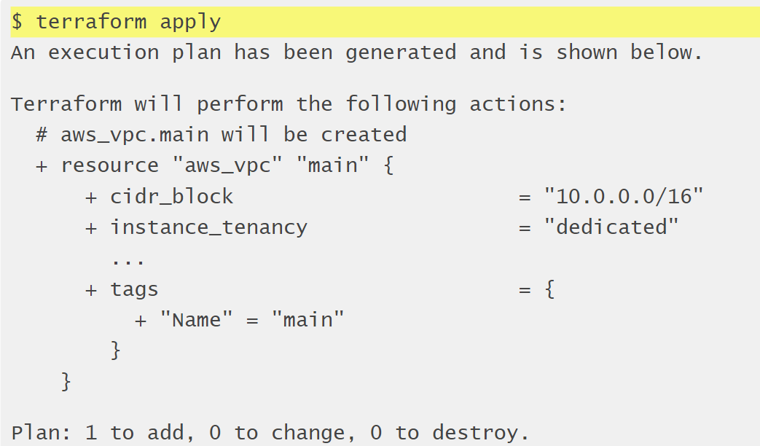
Terraform Apply
terraform apply runs a plan and then if you approve, it applies the changes.

Slide 25
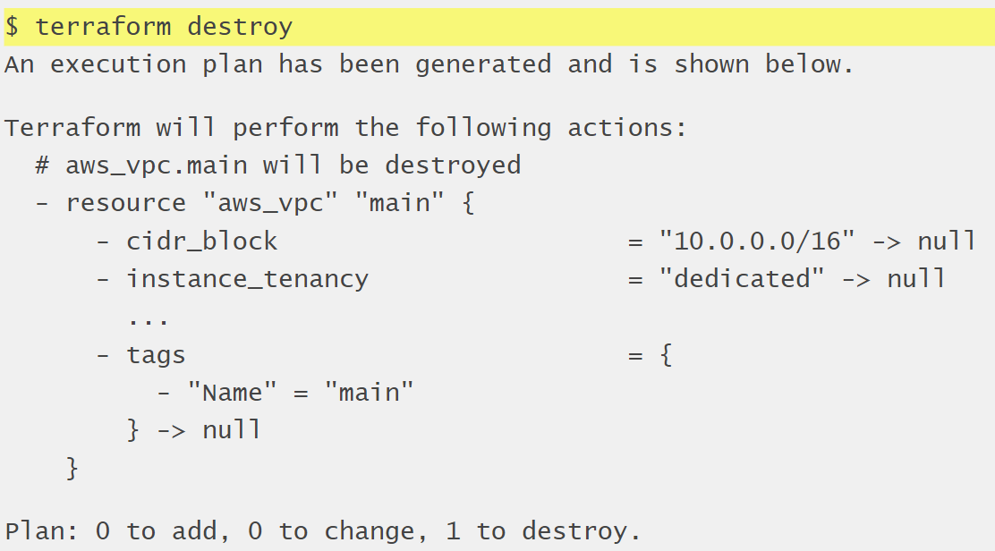
Terraform Destroy
terraform destroy does the opposite. If you approve, your infrastructure is destroyed.

Slide 26
Terraform Format
Terraform comes with a built in code formatter/cleaner. It can make all your margins and list indentation neat and tidy. Beauty works better.
terraform fmt
Simply run it in a directory containing *.tf files and it will tidy up your code for you.

Slide 27
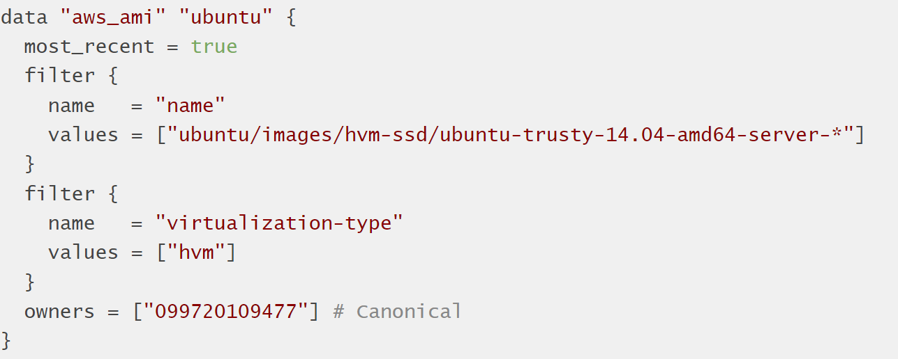
Terraform Data Sources
Data sources are a way of querying a provider to return an existing resource, so that we can access its parameters for our own use.

Slide 28
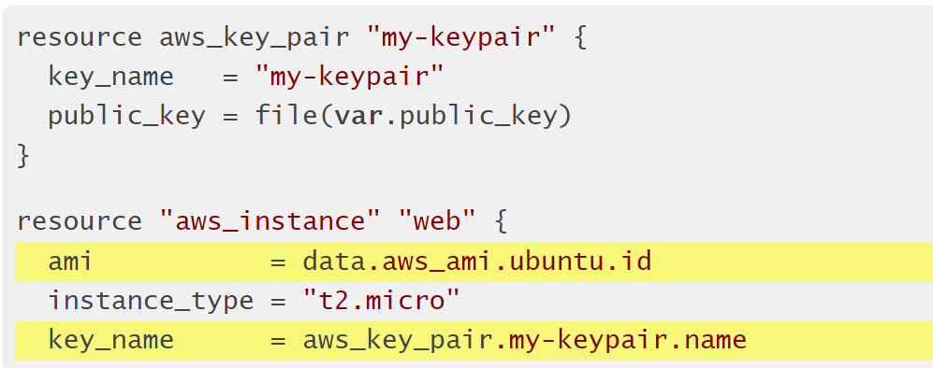
Terraform Dependency Mapping
Terraform can automatically keep track of dependencies for you. Look at the two resources below. Note the highlighted lines in the aws_instance resource. This is how we tell one resource to refer to another in terraform.

Slide 29
Organize Your Terraform Code
Terraform will read any file in your workspace that ends in a .tf extension, but the convention is to have a main.tf, variables.tf, and outputs.tf. You may add more tf files if you wish.
main.tf
variables.tf
outputs.tf
Let's take a closer look at each of these files.

Slide 30
Organize Your Terraform Code
Terraform will read any file in your workspace that ends in a .tf extension, but the convention is to have a main.tf, variables.tf, and outputs.tf. You may add more tf files if you wish.
main.tf
variables.tf
outputs.tf
Let's take a closer look at each of these files.

Slide 31
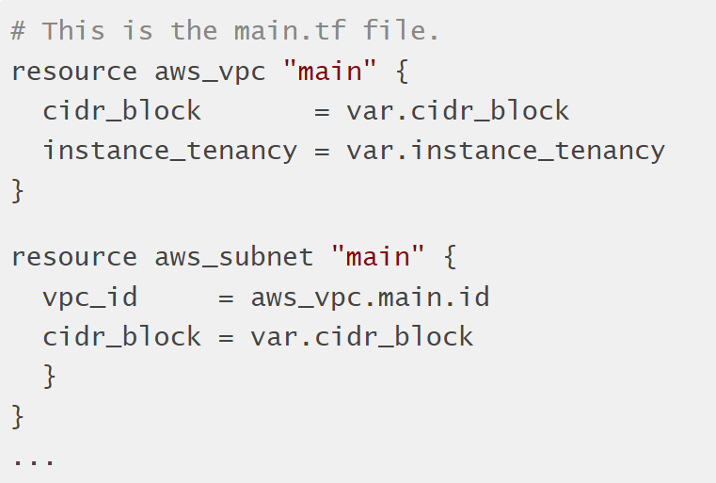
The Main File
The first file is called main.tf. This is where you normally store your terraform code. With larger, more complex infrastructure you might break this up across several files.

Slide 32
The Variables File
variable "cidr_block" {
description = "The address space that is used within the VPC. Changing this forces a new resource to be created."
}
variable "instance_tenancy" {
description = "A tenancy option for instances launched into the VPC. Acceptable values are 'dedicated' and ''"
default = "dedicated"
}
The second file is called variables.tf. This is where you define your variables and optionally set some defaults.

Slide 33
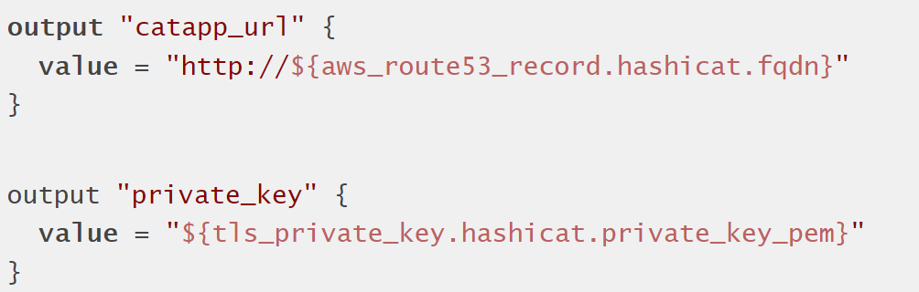
The Outputs File
The outputs file is where you configure any messages or data you want to show at the end of a terraform apply.

Slide 34
Conditional Expressions
A conditional expression uses the value of a bool expression to select one of two values.
condition ? true_val : false_val
Example
var.a != "" ? var.a : "default-a"

Slide 35
for Expressions
A for expression creates a complex type value by transforming another complex type value.
For example, if var.list were a list of strings, then the following expression would produce a tuple of strings with all-uppercase letters:
[ for s in var.list : upper(s) ]
Filtering Elements
A for expression can also include an optional if clause to filter elements from the source collection, producing a value with fewer elements than the source value:
[for s in var.list : upper(s) if s != ""]

Slide 36
Dynamic Blocks
A dynamic block acts much like a for expression, but produces nested blocks instead of a complex typed value. It iterates over a given complex value, and generates a nested block for each element of that complex value.
resource "aws_elastic_beanstalk_environment" "tfenvtest" {
name = "tf-test-name"
application = "${aws_elastic_beanstalk_application.tftest.name}"
solution_stack_name = "64bit Amazon Linux 2018.03 v2.11.4 running Go 1.12.6"
dynamic "setting" {
for_each = var.settings
content {
namespace = setting.value["namespace"]
name = setting.value["name"]
value = setting.value["value"]
}
}
}

Slide 37
Using Terraform Provisioners
Once you've used Terraform to stand up a virtual machine or container, you may wish to configure your operating system and applications. This is where provisioners come in. Terraform supports several different types of provisioners including: Bash, Powershell, Chef, Puppet, Ansible, and more.
https://www.terraform.io/docs/provisioners/index.html

Slide 38
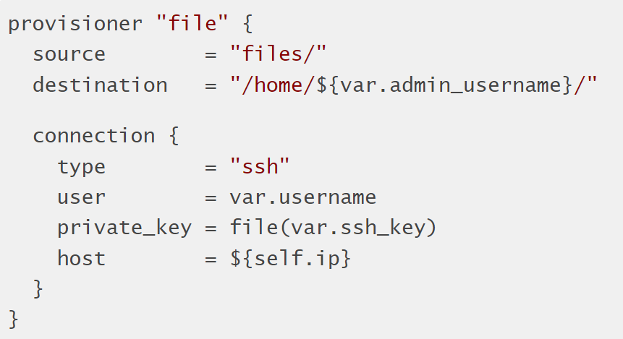
The File Provisioner
Note the connection block of code inside the provisioner block. The file provisioner supports both SSH and WinRM connections.

Slide 39
The Remote Exec Provisioner
The remote exec provisioner allows you to execute scripts or other programs on the target host. If it's something you can run unattended (for example, a software installer), then you can run it with remote exec.
provisioner "remote-exec" {
inline = [
"sudo chown -R ${var.admin_username}:${var.admin_username} /var/www/html",
"chmod +x *.sh",
"PLACEHOLDER=${var.placeholder} WIDTH=${var.width} HEIGHT=${var.height} PREFIX=${var.prefix} ./deploy_app.sh",
]
...
}
In this example we're running a few commands to change some permissions and ownership, and to run a script with some enviroment variables.

Slide 40
Terraform Provisioner Tips
Terraform provisioners like remote-exec are great when you need to run a few simple commands or scripts. For more complex configuration management you'll want a tool like Chef or Ansible.
Provisioners only run the first time a Terraform run is executed. In this sense, they are not idempotent. If you need ongoing state management of VMs or servers that are long-lived, we recommend using a config management tool.
On the other hand, if you want immutable infrastructure you should consider using our Packer tool.

Slide 41
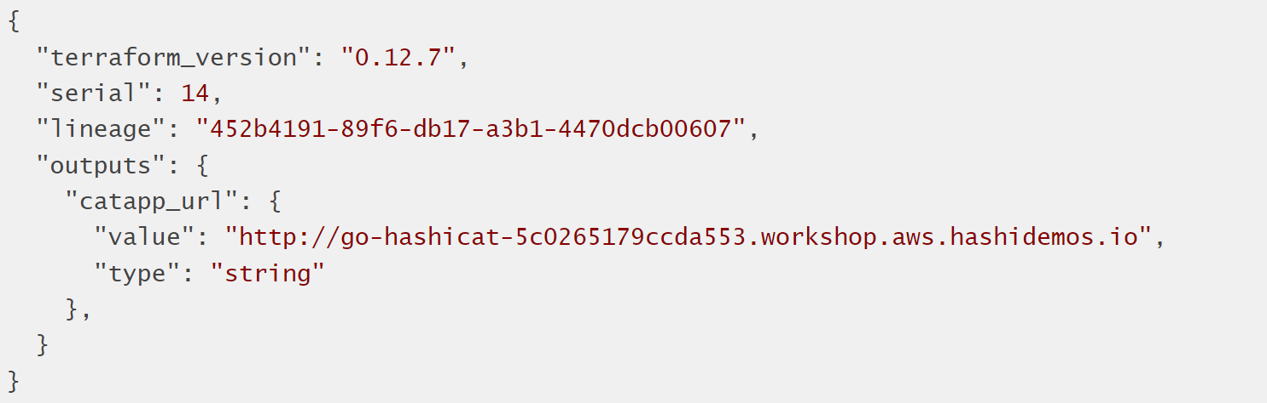
Terraform State
Terraform is a stateful application. This means that it keeps track of everything you build inside of a state file. You may have noticed the terraform.tfstate and terraform.tfstate.backup files that appeared inside your working directory. The state file is Terraform's source of record for everything it knows about

Slide 42
Terraform Refresh
Sometimes infrastructure may be changed outside of Terraform's control.
The state file represents the last known state of the infrastructure. If you'd like to check and see if the state file still matches what you built, you can use the terraform refresh command.
Note that this does not update your infrastructure, it simply updates the state file.
terraform refresh

Slide 43
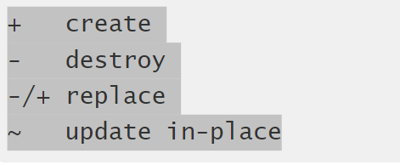
Changing Existing Infrastructure
Whenever you run a plan or apply, Terraform reconciles three different data sources:
What you wrote in your code
The state file
What actually exists
Terraform does its best to add, delete, change, or replace existing resources based on what is in your *.tf files. Here are the four different things that can happen to each resource during a plan/apply:

Slide 44
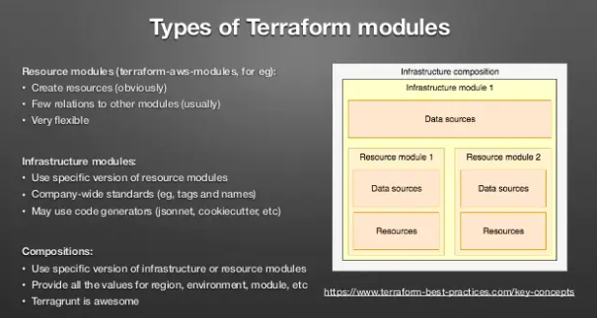
Terraform modules

Slide 45
Terraform modules – Traits of good modules
Clean Code
Feature rich
Sane Defaults
Test
Examples
Documentation
Lifecycle readiness

Slide 46
Terraform Configuration/Settings
The special terraform configuration block type is used to configure some behaviors of Terraform itself, such as requiring a minimum Terraform version to apply your configuration.
terraform {
required_providers {
aws = {
version = "= 2.7.0"
source = "hashicorp/aws"
}
}
}

Slide 47
Terraform Backends
Each Terraform configuration can specify a backend, which defines where and how operations are performed, where state snapshots are stored, etc.
Backend Configuration documents the form of a backend block, which selects and configures a backend for a Terraform configuration.
Where Backends are Used
Backend configuration is only used by Terraform CLI. Terraform Cloud and Terraform Enterprise always use their own state storage when performing Terraform runs, so they ignore any backend block in the configuration
What Backends Do
There are two areas of Terraform's behavior that are determined by the backend:
Where state is stored.
Where operations are performed.

Slide 48
Terraform Backends
State
Terraform uses persistent state data to keep track of the resources it manages.
The local backend stores state as a local file on disk
Operations
"Operations" refers to performing API requests against infrastructure services in order to create, read, update, or destroy resources.
Only two backends actually perform operations: local and remote.
The local backend performs API operations directly from the machine where the terraform command is run.
The remote backend can perform API operations remotely, using Terraform Cloud or Terraform Enterprise.

Slide 49
Terraform Backends
Backend Types
Terraform's backends are divided into two main types, according to how they handle state and operations:
local : The local backend stores state on the local filesystem, locks that state using system APIs, and performs operations locally.
terraform {
backend "local" {
path = "relative/path/to/terraform.tfstate"
}
}

Slide 50
Terraform Backends
remote:
The remote backend stores Terraform state and may be used to run operations in Terraform Cloud.
terraform {
backend "remote" {
hostname = "app.terraform.io"
organization = "company"
workspaces {
name = "my-app-prod"
}
}
}
Standard Backends
artifactory
azurerm
consul
kubernetes
s3
etcd

Slide 51
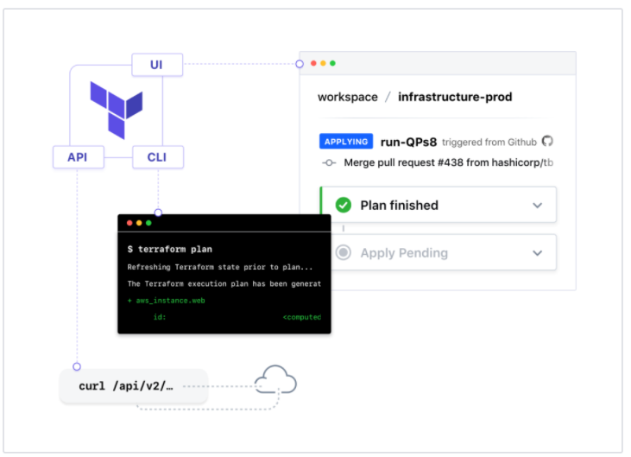
Terraform Cloud
Terraform Cloud is a free to use SaaS application that provides the best workflow for writing and building infrastructure as code with Terraform.
State storage and management
Web UI for viewing and approving Terraform runs
Private module registry
Version Control System (VCS) integration
CLI, API or GUI driven actions
Notifications for run events
Full HTTP API for automation

Slide 52
Terraform Cloud or Terraform Enterprise?
Terraform Cloud is a hosted application that provides features like remote state management, API driven runs, policy management and more. Many users prefer a cloud-based SaaS solution because they don't want to maintain the infrastructure to run it.
Terraform Cloud for Business utilizes the same hosted environment as Terraform Cloud, but you get the features more applicable to larger teams. Single Sign-on, Audit Logging, and the ability to Terraform on-prem resources from the cloud.
Terraform Enterprise is the same application, but it runs in your own cloud environment or data center. Some users require more control over the Terraform Cloud application, or wish to run it in restricted networks behind corporate firewalls.
The feature list for these offerings is nearly identical.

Slide 53
Terraform Remote State
By default Terraform stores its state file in the workspace directory on your laptop or workstation. This is ok for development and experimentation, but in a production environment you need to protect and store the state file safely.
Terraform has an option to store and secure your state files remotely. Terraform Cloud accounts now offer unlimited state file storage even for open source users.
All state files are encrypted (using HashiCorp Vault) and stored securely in your Terraform Cloud account. You'll never have to worry about losing or deleting your state file again.

Slide 54
Terraform Cloud Execution Modes
Local Execution - Terraform commands run on your laptop or workstation and all variables are configured locally. Only the terraform state is stored remotely.
Remote Execution - Terraform commands are run in a Terraform Cloud container environment. All variables are stored in the remote workspace. Code can be stored in a Version Control System repository. Limited to 1 concurrent run for free tier users.

