Slide 1
Mobile Development Made Easy with MVC4
MADExpo 2012

Slide 2

About Kevin Jones
Team Lead At LogicBoost
Agile Enthusiast
Strong proponent of Functional Programming
ASP.NET MVP
Twitter/Github: vcsjones

Slide 3
Mobile
IN 2010, 10 million+ requests from mobile devices were created
Source: AdMob
The mobile platform is exploding
MVC4 + jQuery Mobile make it simple to create mobile views
Source: http://metrics.admob.com/wp-content/uploads/2010/06/May-2010-AdMob-Mobile-Metrics-Highlights.pdf

Slide 4
Mobile Is Fragmented
Competing Mobile Ideas
  WAP + WML (Wireless Markup Language)
    A butchered form of HTML
    People actually use this stuff (BlackBerry)
  Device Resolution

Slide 5
New Generation
Support Desktop-class processing power
Support Desktop-class browser features
Commonly use touch instead of a mouse
  mouseenter, mouseleave?
Real estate is precious

Slide 6
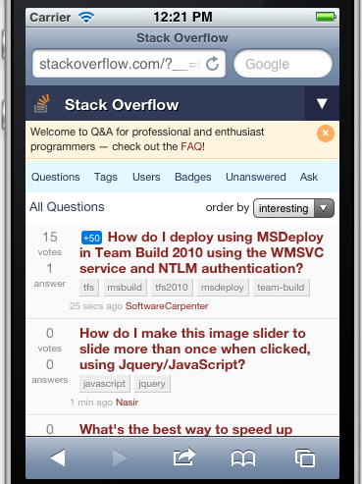
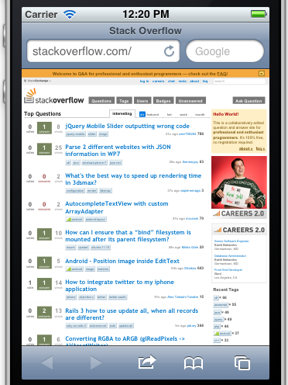
Mobile Requires A Different Experience

Slide 7
Barriers
More to maintain - Add a feature, you have to add it to mobile and desktop sites
Transitioning between the two - Send a link from a mobile device to a friend on a desktop.
What about other views?
  Desktop vs. Mobile

Slide 8
Other Views
“Downgraded” experience for old browsers, like IE 6.
Legacy mobile devices
  Windows Mobile 6 (PIE)
  BlackBerry 5

Slide 9
Common Mechanisms Today
Different pages, or domains
  http://mysite.com
  http://m.mysite.com
  http://mysite.com/m
“Control Adapters”
  Render a control differently by device
  Flawed idea
Different Rendering by Page

Slide 10
MVC Makes It Easier
Model
Data or information to be displayed
View
Decides how to display the Model
Controller
Handles interaction from the View
Provider and consumer of the Model

Slide 11
Different Views
Create a different View by target device
Controller / Model has no idea which View is being used.
Possible in MVC3, required hijacking a lot in the plumbing.

Slide 12
Introducing:
Display Modes
A Display Mode allows you to choose which View is displayed depending on Context.

Slide 13
Display Mode Contexts
A Display Mode could be triggered by many things:
  User Agent, IP Address, etc...
  User Name, Identity
  Your own information and requirements

Slide 14
Display Mode Views
MVC historically is based on convention.
A display Mode “suffix” uses a view that ends in that suffix, or the default if none is found.
The “mobile” suffix is provided out-of-box.

Slide 15
Building a Mobile MADExpo
We’ll start simple using the out-of-box mobile support
jQuery Mobile is for awesomeness.

Slide 16
jQuery Mobile Overview
Makes writing mobile pages incredibly simple.
Works on most mobile platforms.
Built on top of jQuery
Theme-able, customizable.
Plays very well to MVC, even all versions.
Unlike jQuery, not a lot of JavaScript has to be written.

Slide 17
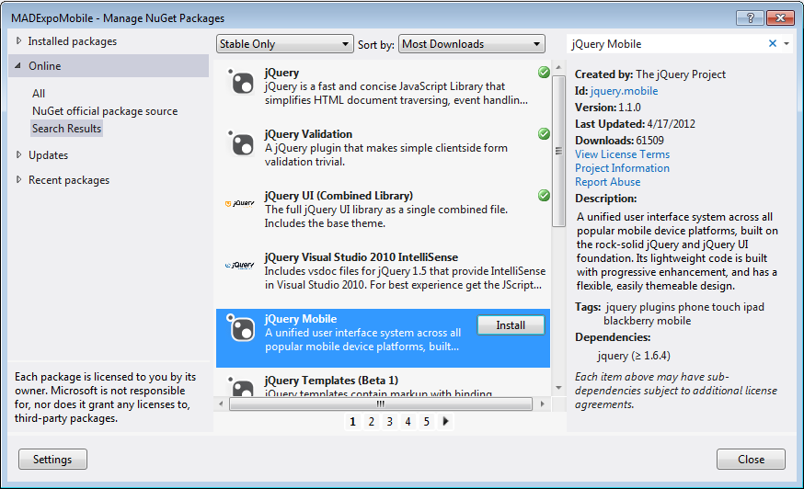
jQuery Mobile on NuGet

Slide 18
Common Roles
jQuery applies magic to divs with certain data-roles.
  Page - The container of the virtual page.
  Header - The header for the page.
  Content - The contents of the page.
  Footer - The footer.

Slide 19
A Small Example
<div data-role="page">
<div data-role="header">
<h1>@ViewBag.Title</h1>
</div>
<div data-role="content">
@RenderBody()
</div>
<div data-role="footer">
Footer
</div>
</div>

Slide 20
Additional Roles
navbar - Contain an unordered list of links for navigation.
collapsable - A collapsable section
button - A button
listview - A list of menu items

Slide 21
DOM Ready
Don’t use
$(document).ready(function() {});
Use
$(document).bind('pageinit', ↩
function() {});

Slide 22
Mobile Best Practices
Don’t obsess with getting 100% content in the mobile view.
Don’t make transitioning between mobile and desktop hard or impossible.
Not everyone owns an iPhone / Android. Try to make the UX agnostic as possible.
Set a viewport.

Slide 23
Display Modes
Create a custom display mode
  Down level browsers?
  Usually done in Application_Start

Slide 24
An Example
new DefaultDisplayMode("IE6")
{
ContextCondition = context => ↩
context.GetOverriddenUserAgent() ↩
.IndexOf("MSIE 6", ↩
StringComparison.InvariantCultureIgnoreCase) > -1
};

Slide 25
Questions?

