Slide 1

RavenDB
Really Simple Stuff

Slide 2


What Is RavenDB?
RavenDB is a simple, yet scalable document database system built on JSON
Open Source
Targeted toward .NET, but isn’t required

Slide 3
Nails and Hammers
Raven is for when a relational database isn’t the correct solution
Traditionally, all data-storage problems were nails and the relational database is the hammer
Not everything is a nail

Slide 4
First-Class Citizenship
Traditionally, most applications have some sort of data layer.
Some of them use an ORM ([N]Hibernate, Entity Framework / L2S, ActiveRecord, Homegrown)
Why?

Slide 5
Harmony
Your data objects just “go” into Raven DB
No complex query language, no query plan inspection
Look them up by a key to get them back out

Slide 6

Getting Started
Decision Time: What is your needs?
  Client
  Server
  Embedded

Slide 7
Server
RavenDB is an HTTP server
CRUD operations are simple HTTP requests with JSON
JSON objects are the “records”

Slide 8
Client
Can be simple JSON requests with JavaScript
Rich .NET API if you want it
Support with LINQ (If you use .NET)

Slide 9
Embedded
A client that works directly with the data repository
Windows Phone 7 / Silverlight / IsolatedStorage
Mostly requires .NET

Slide 10

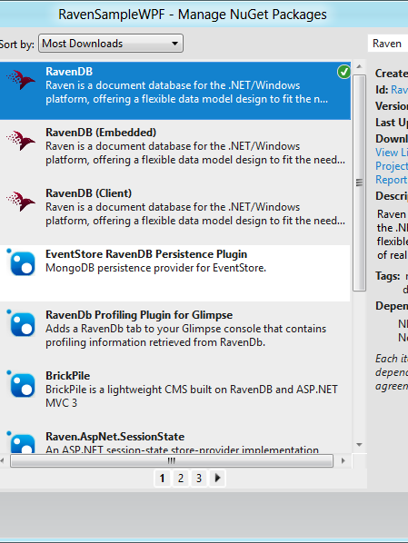
Getting It
NuGet

Slide 11
Wrenches and Bolts
RavenDB isn’t a replacement for a relational database
Switching from a one tool to another doesn’t work
Use two different tools

Slide 12

Show Time

Slide 13
Wrap Up
Contact:
  kevin@vcsjones.com
  http://github.com/vcsjones

