Slide 1
Mobile Development Made Easy with MVC4
By Kevin Jones
RockNUG 5.7

Slide 2

About Me
Senior Consultant at LogicBoost
ASP.NET MVP
Agile / Lean Enthusiast
Website: http://vcsjones.com
Twitter: @vcsjones
GitHub: vcsjones

Slide 3
IN 2010, 10 million+ requests from mobile devices were created
Source: AdMob
The mobile platform is exploding
MVC4 + jQuery Mobile make it simple to create mobile views
Source: http://metrics.admob.com/wp-content/uploads/2010/06/May-2010-AdMob-Mobile-Metrics-Highlights.pdf

Slide 4
Mobile Is Fragmented
Competing Mobile Ideas
  WAP + WML (Wireless Markup Language)
    A butchered form of HTML
    People actually use this stuff (BlackBerry)
  Device Resolution

Slide 5
New Generation
Support Desktop-class processing power
Support Desktop-class browser features
Commonly use touch instead of a mouse
  mouseenter, mouseleave?
Real estate is precious

Slide 6
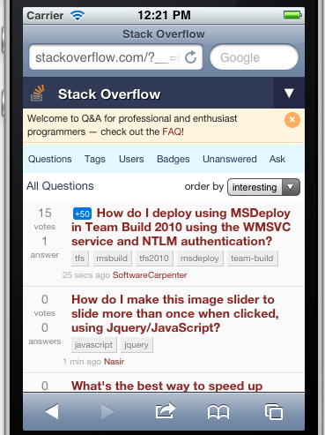
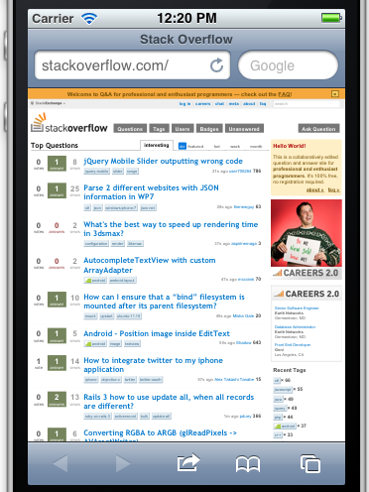
Mobile Requires A Different Experience

Slide 7
Barriers
More to maintain - Add a feature, you have to add it to mobile and desktop sites
Transitioning between the two - Send a link from a mobile device to a friend on a desktop.
What about other views?
  Desktop vs. Mobile

Slide 8
Other Views
“Downgraded” experience for old browsers, like IE 6.
Legacy mobile devices
  Windows Mobile 6 (PIE)
  Any BlackBerry

Slide 9
Common Mechanisms Today
Different pages, or domains
  http://mysite.com
  http://m.mysite.com
  http://mysite.com/m
“Control Adapters”
  Render a control differently by device
  Flawed idea
Different Rendering by Page

Slide 10
MVC Makes It Easier
Model
Data or information to be displayed
View
Decides how to display the Model
Controller
Handles interaction from the View
Provider and consumer of the Model

Slide 11
Different Views
Create a different View by target device
Controller / Model has no idea which View is being used.
Possible in MVC3, required hijacking a lot in the plumbing.

Slide 12
Introducing:
Display Modes
A Display Mode allows you to choose which View is displayed depending on Context.

Slide 13
Display Mode Contexts
A Display Mode could be triggered by many things:
  User Agent, IP Address, etc...
  User Name, Identity
  Whatever your heart desires

Slide 14
Display Mode Views
MVC historically is based on convention.
A display Mode “suffix” uses a view that ends in that suffix, or the default if none is found.
The “mobile” suffix is provided out-of-box.

Slide 15
Building a Mobile RockNUG
We’ll start simple using the out-of-box mobile support
jQuery Mobile is for awesomeness.

Slide 16
jQuery Mobile Overview
Makes writing mobile pages incredibly simple.
Works on most mobile platforms.
Built on top of jQuery
Theme-able, customizable.
Plays very well to MVC, even all versions.
Unlike jQuery, not a lot of JavaScript has to be written.

Slide 17
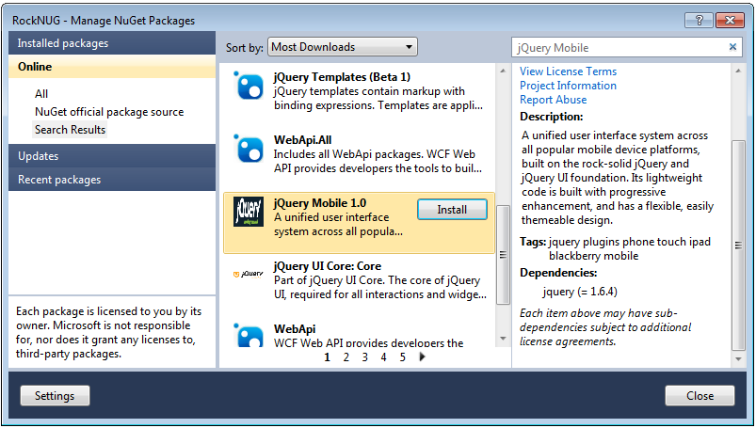
jQuery Mobile on NuGet

Slide 18
Data Roles
jQuery applies magic to divs with certain data-roles.
  Page - The container of the virtual page.
  Header - The header for the page.
  Content - The contents of the page.
  Footer - The footer.

Slide 19
A Small Example
<div data-role="page">
<div data-role="header">
<h1>@ViewBag.Title</h1>
</div>
<div data-role="content">
@RenderBody()
</div>
<div data-role="footer">
Footer
</div>
</div>

Slide 20
Bonus
navbar - Contain an unordered list of links for navigation.
collapsable

Slide 21
Mobile Best Practices
Don’t obsess with getting 100% content in the mobile view.
Don’t make transitioning between mobile and desktop hard or impossible.
Not everyone owns an iPhone / Android. Try to make the UX agnostic as possible.
Set a viewport.

