Slide 1

WPF4
RockNUG - November

Slide 2
Before We Start…

Slide 3
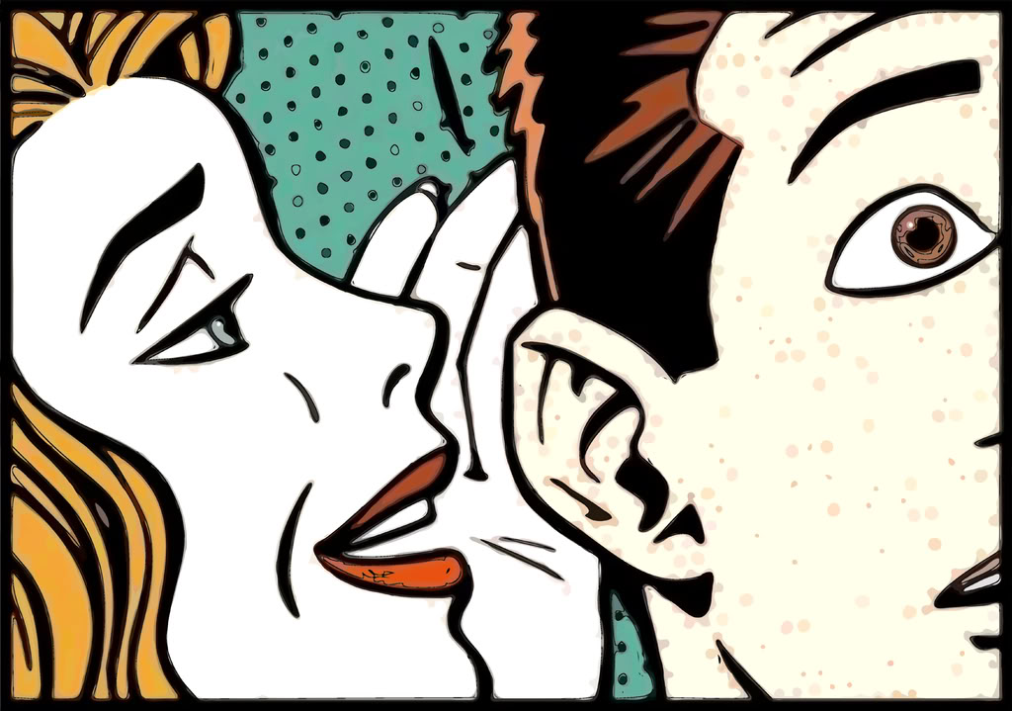
Rumors
WPF is dead.
Microsoft has no direction for WPF
WPF doesn’t have a project manager.
Silverlight will take over WPF.

Slide 4
What’s the merit?
Silverlight is absorbing a lot of WPF’s functionality.
Microsoft has done little to market WPF.
No one really uses WPF.
There really is no dedicated project manager to WPF.
To name of a few…

Slide 5
Really?
Silverlight is has lots of WPF’s features
WPF gained new ones too.

Slide 6
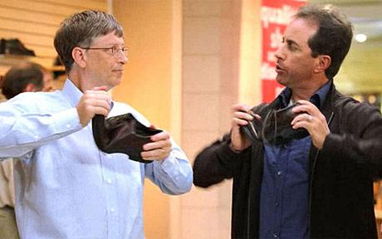
Really??
Microsoft doesn’t market anything right.

Slide 7

Really???
Management?

Slide 8
My Point
All products have internal issues that eventually get resolved.
WPF isn’t suffering any more than anything else has.
If you want it to become popular so you can use it, then use it.

Slide 9
Recap
WPF is a powerful framework
Built on top of DirectX
Fully hardware accelerated
XAML (XML) for UI
Controls break free from Windows UI, want a drop down list in a button? Sure! (Don’t do that)

Slide 10
Different Containers
Most containers in WPF are Panels.
Common Containers
Grid
StackPanel
WrapPanel
Grid and StackPanel suit most needs

Slide 11
WPF Doesn’t Like Coordinates
Makes device-independent display difficult
It’s a pain to think about
Leads to inconsistent UI
Resizing isn’t easy, anchors only provided so much.
WPF uses greedy / non-greedy (and still supports coordinates)

Slide 12
Reserving Space
Greedy
The control will consume as much space as it can
Non- Greedy
The control will use only as much space as it needs
Knowing when each will kick-in is key.

Slide 13
Greediness
When each will happen isn’t straight forward
Children of Stack Panels will be non-greedy opposite of their orientation.
Children of Grids will be greedy.
Attributes (such as alignment) can change greediness.
Greed can be constrained by margins, padding, max width, height; etc.
Sometimes those rules break.

Slide 14
When the UI changes
If something changes in the UI, the rest will re-adjust to use less, or consume, more space (size).
If something changes, the UI will be updated for position. (Visibility)

Slide 15
It’s not quite right, but close to HTML
Some people compare the layout and positioning to HTML
It has some oddities, but they are consistent.

Slide 16
A Better Framework
WPF’s binding is superior to classic Windows Forms.
Binding allows a control to know when something changes.
How does the control know when a property changes?

Slide 17
Dependency Properties
Augments properties that we are familiar with.
GetValue
SetValue
Use a static declaration for the property.
Let’s see!

Slide 18
Rules
Don’t do anything in the property other than GetValue and SetValue
WPF may bypass the property all together.
Always keep DependencyProperty static.
Since it’s static, you only have to declare it once.

Slide 19
Routed Events
Routed Events are a powerful way of handling events
Tunnel Events
Bubble Events
Often there are two events from the same thing: one tunnels and one bubbles.

Slide 20
Bubble Events
Window
Grid
StackPanel #1
Button #1
Button#2
StackPanel #2
Button #3
Notification starts are the deepest child and “bubble” up to the top
Example of bubbles:
KeyUp
KeyDown
MouseClick

Slide 21
Tunnel Events
Window
Grid
StackPanel #1
Button #1
Button#2
StackPanel #2
Button #3
Notification starts at the top and “tunnels” it’s way down

Slide 22
Routed Events
Events that start with “Preview” will always tunnel.
A higher order event can cancel a lower one.
This is a very powerful feature.
If you wanted to know when a key was pressed anywhere in a window in WinForms, how would you do that?

Slide 23
Binding
Binding allows you to bind a control’s property to something else
It must be a dependency property
Different types of bindings

Slide 24
Binding to Resources
Resources play an important role in WPF
Themes
Code de-duplication
External Content
Not actually a real “binding”.
Resources have scope.

Slide 25
Theming
WPF itself is nothing but a theme
Very easy to replace it, or parts of it.
Can be done in windows, user controls, etc.
Complex theming can be done in a resource dictionary.

Slide 26
Theming
Use a Style as a resource
Styles can inherit from one another
Styles can be global to named.

