Slide 1
Federated Identity
Kevin Jones

Slide 2

About Me
Website: http://vcsjones.com
Twitter: @vcsjones
GitHub: vcsjones

Slide 3
What is Identity?
Can be a user
Can be an application
Can be a service within an application

Slide 4
Typically...
We think of identity as a user
  Identify
  Authenticate
  Authorize

Slide 5
Identification
A user provides something they know
  Password
  Pin
A user may provide something they have (second factor)
  Token
  Fingerprint

Slide 6
Authentication
Is this someone I know?
Did they supply evidence of it?
Supply a means of proven authentication
  A ticket

Slide 7
Authorize
Determine the identity’s roles
Verify access to component in system

Slide 8
The Humble Cookie
A login form (Identity)
Successful identification issues a cookie (Ticket)
Browser supplies cookie for continued identification (Agent)

Slide 9
Cookies
Pros
Easy to use
Widely used
Less machinery
(less to go wrong)
Cons
Restricted to browsers
Fixed to a domain
Focused on a particular platform
(lacking a contract)

Slide 10
One Identity to Rule Them All
  Identify
  Authenticate
  Authorize
  These don’t have to be in the consumer

Slide 11
Separating Identity
Identification / Authorization by an external system
Agree on a common protocol between systems

Slide 12
The POST
ASP.NET App
PHP App
POST
login.aspx
authservice.php

Slide 13

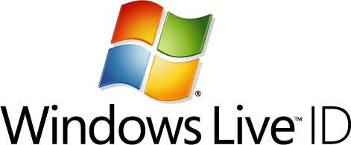

Notable First Attempt(s)
.NET Passport
Microsoft Passport
Microsoft Passport Network
Windows Live ID
Live ID
Microsoft Account

Slide 14
Identity Providers
Pros
Easy to use
Widely used
Less machinery
(less to go wrong)
Cons
Restricted to browsers
Fixed to a domain
Focused on a particular platform
(lacking a contract)

Slide 15
Who?
ASP.NET App
PHP App
?
authservice.php
Node App
login.aspx
services/auth/

Slide 16
Where?
ASP.NET App
login.aspx?callback=/othersite/authservice.php

Slide 17
Oops
ASP.NET App
login.aspx?callback=/phishingsite/stealtoken.php

Slide 18
Making a Protocol of it
Different options to choose from
  SAML
  OAuth
  Open ID

Slide 19
SAML 2.0
Security Assertion Markup Language
Built on the SOAP Protocol
XML based, designed to work over HTTP
And many other WS-Security protocols

Slide 20
Using Azure
Azure makes this pretty easy
Recommend using .NET 4.5 for WIF

Slide 21
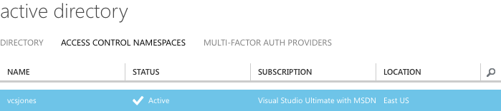
Making a Namespace

Slide 22
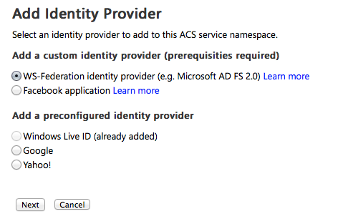
Add an Identity Provider

Slide 23
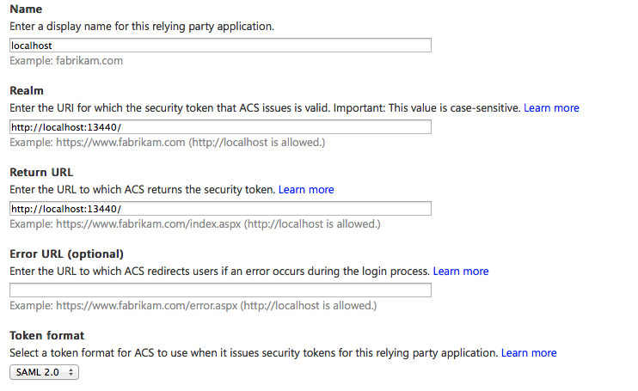
Configure Your Application

Slide 24
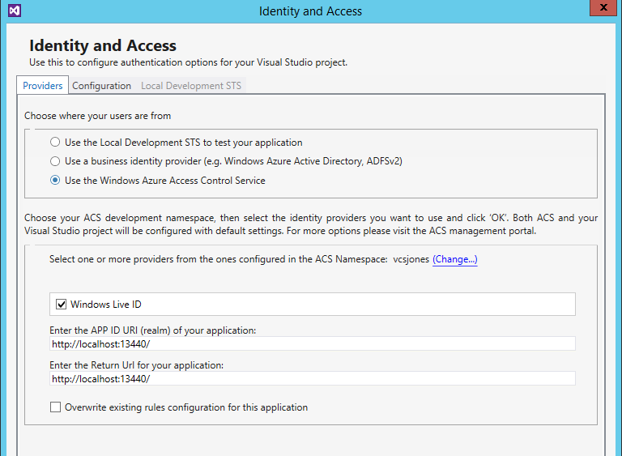
Visual Studio

Slide 25
Claims
What is user is (or is not)
Does not always say who the user is in the context you care.
Claims are similar to Roles.

Slide 26
Seeing It in Action

Slide 27
SAML’s Weaknesses
Not particularly proliferate outside of Enterprise
Complex technology stack to get working.
(Visual Studio can automagically make it work)
Hard if < .NET 4.5 (Possible with WIF)
3rd party another possible solution

Slide 28
What I Learned About SAML
X509 certificates are annoying.
Don’t bother with ECDSA or ECDH certificates.
Plan on having more than one identity provider. Even if you don’t, it makes changes easier.
DIY is a terrible idea. Use an SDK.

Slide 29
OAuth
Stemmed from OpenID and Twitter
Somewhat controversial
Very popular
Not as popular in the .NET Community (growing)

Slide 30
OAuth
  Simpler to implement, not encumbered by Enterprise needs.
  Relies on HTTPS for security. SAML is designed to operate in insecure channels.

Slide 31

OAuth
OAuth does not like localhost
It does not like 127.0.0.1 or ::1.
Local Dev = Use HOSTS (yuck)

Slide 32
Why Bother With This?
Independent Infrastructure
Infrastructure As A Service (IAAS)

Slide 33
QUESTIONS?

