Slide 1
Azure + Node.js
Kevin Jones
RockNUG 7.2

Slide 2

About Me
Website: http://vcsjones.com
Twitter: @vcsjones
GitHub: vcsjones

Slide 3
What is Node.js?
An asynchronous, event-driven framework
Developed using JavaScript
You develop with JavaScript
Built on top of Google’s V8 JavaScript engine

Slide 4
Why Another Web Platform
Cross platform.
  OSX + Linux
  Microsoft is making a big effort into it
  Supported for IIS
JavaScript is a good language!

Slide 5
Obligatory Hello World
var http = require('http');
var port = process.env.PORT || 8080;
var server = http.createServer(function (request, response) {
response.writeHead(200, {"Content-Type": "text/plain"});
response.end("Hello World");
});
server.listen(port);
Import HTTP module
The environment’s port
Start listening on the port

Slide 6
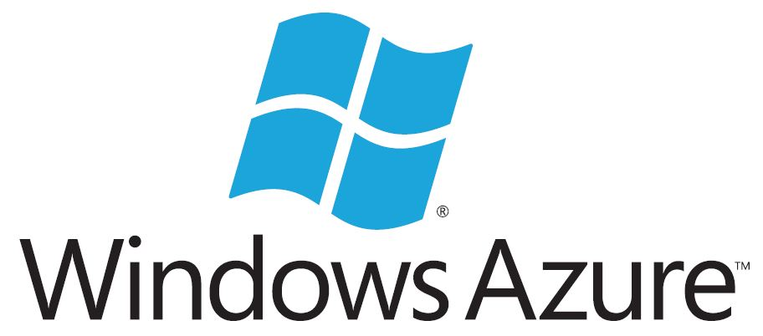
Why Azure?
Cost competitive
Rapid improvements, big investments from Microsoft
Platform holds its own against AWS and AppEngine

Slide 7
Different Offerings
Web Sites
  Hosted web applications (ASP.NET, Node.js, PHP)
  Automatic scaling, completely transparent
Virtual Machines
  Access to a full Windows / *nix environment

Slide 8
Web Sites
Think of Elastic BeanStalk from AWS or Google AppEngine
Supports source control releases

Slide 9
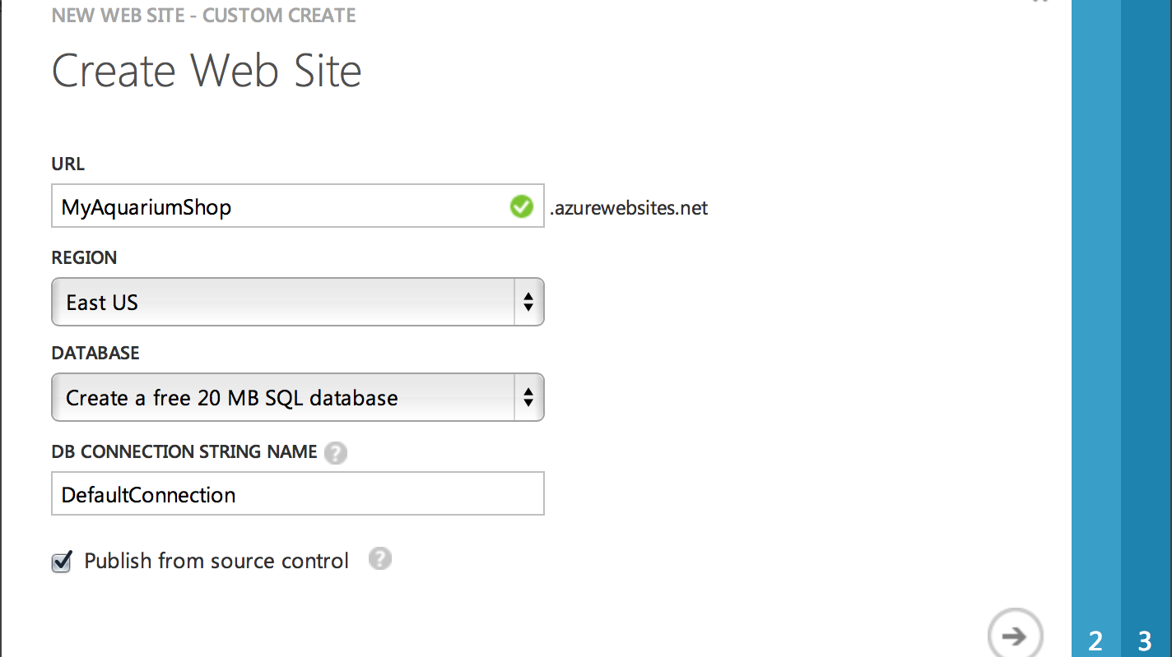
Getting Started

Slide 10
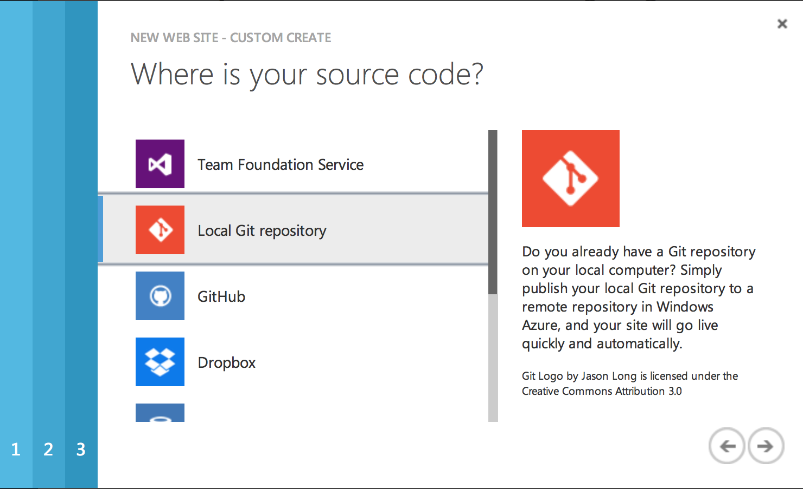
Source Options

Slide 11
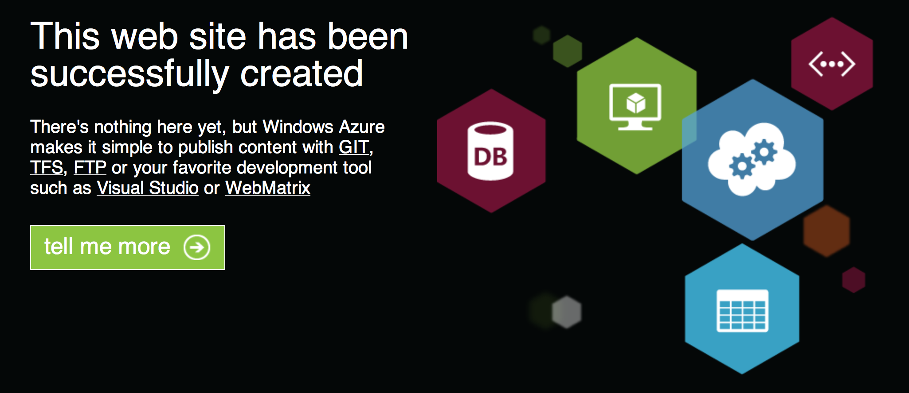
That Easy

Slide 12
packages.json
Identifies your project, version, and dependencies
A simple JSON file:
{
"name": "MyAquariumShop",
"version": "0.0.1",
"private": "true"
}

Slide 13
Express.js
Extremely helpful in all aspects
  Routing
  Static Content
  Compression
  Etc

Slide 14
npm
Like NuGet + Chocolately for node.js
Accomplishes what many other package managers do.

Slide 15
Adding Dependencies
Adding to your package.json
Use npm install
{
"name": "MyAquariumShop",
"version": "0.0.1",
"private": "true",
"dependencies": {
"express": "3.2.5"
}
}
Static version

Slide 16
Configuring Express
var app = express();
app.configure(function() {
app.use(express.static(__dirname + '/public'));
app.use(express.methodOverride());
});
Content in “public” directory

Slide 17
Routing
Route parameter
app.get('/services/getUser/:id', function(req, res) {
res.setHeader('Content-Type', 'application/json');
res.send(JSON.stringify({"name": "kevin jones", "id": req.params.id}));
});

Slide 18
Routes
? makes a route value optional:
app.get('/services/getUser/:id?'...
Undefined when not specified
Can be placed in separate JS files, sort of like ASP.NET MVC

Slide 19
Express.js
Flexible
Follow the MVC, MVVM, MVP, “get it done” pattern of your choice
JavaScript
It’s not like classic ASP with server side scripting
Pluggable with middleware

Slide 20
Adding support for LESS
LESS(CSS) is a superset of CSS
Includes middleware for Express.js.

Slide 21
Adding Middleware
Add middleware with NPM
Require them.
var less = require('less'),
var lessMiddleware = require('less-middleware');
Register your middleware
Profit!

Slide 22
Customizing the Deployment on Azure
Start with
azure site deploymentscript --node
Customize deploy.cmd
Let’s delete our old .css

Slide 23
The Jade View Engine
Jade is weird
Fun, getting use to it.
Good templating engine

Slide 24
Other Tips
Use supervisor
npm install supervisor -g
supervisor server.js
Supervisor watches for changes and restarts node

