Slide 1
DeepHAR-MLOps
Foundation-Model-Inspired Human Activity Recognition with Prompted Explanations
Vineeth Chandra Sai Kandukuri | Siddharth Rao Kartik | Arshan Bhanage | Soham Jain
DeepHAR-MLOps | CMPE Project | 1

Slide 2
Motivation
Smartphones already collect accelerometer and gyroscope signals.
HAR can support fitness tracking, fall-risk research, elderly care, and context-aware apps.
Sensor-only prediction avoids GPS, camera, microphone, and manual user labels.
DeepHAR-MLOps | CMPE Project | 2

Slide 3
Problem Statement
Input: 2.56-second IMU window with 128 timesteps and 9 channels.
Output: one of six activities: walking, stairs up/down, sitting, standing, laying.
Goal: train models that generalize to unseen subjects, not just random windows.
DeepHAR-MLOps | CMPE Project | 3

Slide 4
Dataset and Preprocessing
UCI Human Activity Recognition dataset with waist-mounted smartphone signals.
Subject-based train/test split prevents person-level leakage.
Per-channel z-score normalizer is fitted on training data only.
Training saves a reference signal profile for inference-time drift checks.
DeepHAR-MLOps | CMPE Project | 4

Slide 5
End-to-End MLOps Pipeline
Download
Normalize
Train
Evaluate
Track
Deploy
Monitor
→
→
→
→
→
→
Training saves checkpoint, normalizer, metrics, plots, model summary, and reference drift profile.
Inference website returns prediction, confidence, probabilities, sensor plot, prompt explanation, and drift status.
CI, Docker, TensorBoard/MLflow hooks, and artifact manifest support reproducibility.
DeepHAR-MLOps | CMPE Project | 5

Slide 6
Model Families
Baselines
Advanced models
MLP: nonlinear baseline without temporal bias
1D CNN: local movement motifs
CNN-LSTM: convolutional features plus sequence memory
TCN: residual dilated temporal convolutions
CNN-BiLSTM-Attention: bidirectional sequence context
Sensor Transformer: self-attention plus positional embeddings
DeepHAR-MLOps | CMPE Project | 6

Slide 7
Foundation Model / Prompting Connection
Sensor-transformer adds a foundation-model-inspired encoder for time-series windows.
Prompt layer turns prediction context into an LLM-ready system/user prompt.
Deterministic fallback explanation keeps the demo reproducible without API keys.
Prompt includes confidence, top probabilities, sensor stats, caveat, and reliability next step.
DeepHAR-MLOps | CMPE Project | 7

Slide 8
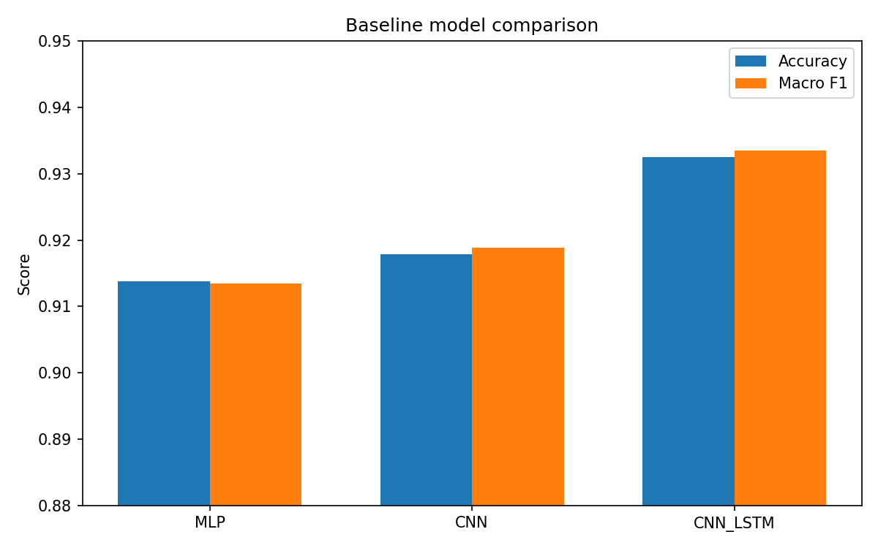
Baseline Results
UCI HAR subject-based test split
Model | Accuracy | Macro F1 | Train time
MLP | 91.38% | 0.9135 | 82s
CNN | 91.79% | 0.9189 | 529s
CNN-LSTM | 93.25% | 0.9335 | 829s
Takeaway: sequence-aware CNN-LSTM improves over flattened MLP. Final work should compare TCN, attention, and sensor-transformer under the same split.
DeepHAR-MLOps | CMPE Project | 8

Slide 9
Experiments and Ablations
Architecture comparison: MLP, CNN, CNN-LSTM, TCN, attention, sensor-transformer.
Sensor ablation: all sensors vs body accelerometer vs gyroscope vs total acceleration.
Augmentation ablation: no augmentation vs jitter/scaling/time masking.
Sweep: learning rate and batch size; report macro F1, latency, and parameter count.
DeepHAR-MLOps | CMPE Project | 9

Slide 10
Error Analysis
Expected major confusion: SITTING vs STANDING due to similar low-motion patterns.
Walking classes are easier because periodic motion creates clearer temporal signatures.
Use normalized confusion matrix and per-class F1 to identify weak classes.
DeepHAR-MLOps | CMPE Project | 10

Slide 11
MLOps Evidence
Reusable CLIs for training, evaluation, inference, ablations, and sweeps.
TensorBoard and optional MLflow tracking.
Dockerfile, GitHub Actions, Makefile, DVC-style pipeline, artifact manifest.
Reference drift profile supports monitoring and retraining discussion.
DeepHAR-MLOps | CMPE Project | 11

Slide 12
Gradio Demo
Upload CSV/NPY or use the included sample window.
Show predicted activity, confidence, probabilities, and sensor-signal plot.
Show prompt-engineered explanation and the exact LLM prompt artifact.
Show drift-monitoring status for production-readiness narrative.
DeepHAR-MLOps | CMPE Project | 12

Slide 13
Team Contributions
Vineeth: model architectures, training pipeline, metric interpretation.
Siddharth: MLOps structure, Docker, CI, MLflow/TensorBoard, deployment plan.
Arshan: Gradio app, inference UX, prompt explanation display, demo flow.
Soham: ablations, sweeps, visualizations, report, slides, error analysis.
DeepHAR-MLOps | CMPE Project | 13

Slide 14
Conclusion and Next Steps
Sequence-aware models improve HAR over a flattened baseline.
The repo is now a runnable MLOps project rather than a Colab-only artifact.
Before final submission: run final ablations/sweeps, add screenshots, record videos, publish GitHub URL.
Future: cloud pipeline, drift-triggered retraining, real-time mobile inference, phone-placement robustness.
DeepHAR-MLOps | CMPE Project | 14

