Slide 1

CMPE 258 SHORT STORY ASSIGNMENT
Time-Series Foundation Models
Promise, limits, and better evaluation
Are TSFMs truly foundational—or just strong when the benchmark is familiar?
Survey + critical review + reproduction plan
Notes:
Open with the big framing: foundation models moved from language into vision and multimodal AI, and now into time series. The thesis is not anti-TSFM. The thesis is that TSFMs are promising, but the word foundational needs careful evidence.

Slide 2
THE SHORT STORY
Three beats of the argument
The story is not just bigger models. It is promise, evidence, and evaluation hygiene.
1. Promise
2. Reality check
3. Evaluation
Pretrain once, adapt across many forecasting domains.
Zero-shot strength depends on pretraining-domain match.
Leakage can make benchmarks look cleaner than they are.
Takeaway: TSFMs are promising, not proven universal.
CMPE 258 Short Story | 2
Notes:
Preview the narrative. First: why the field is excited. Second: why transfer is conditional. Third: why leakage and clean evaluation are central in time-series foundation models.

Slide 3

WHY TIME SERIES IS HARDER
Time series is not one world
A stock chart, ECG trace, weather series, and sensor stream are all sequences—but they come from different systems.
•
Different scales and units
•
Different noise and seasonality
•
Different causal mechanisms
•
Different leakage risks
That makes “one model for everything” much harder than it sounds.
CMPE 258 Short Story | 3
Notes:
Explain the key difference between text and time series. Language has a shared symbolic structure. Time series may be sequences, but the underlying processes can be unrelated. This is the core reason universal transfer is hard.

Slide 4
DEFINITION
What is a TSFM?
A pretrained sequence model intended to transfer across forecasting tasks, datasets, and domains.
1
2
3
4
Large temporal corpus
Pretraining objective
Foundation model
Forecast / adapt / fine-tune
many domains
masking, next-step, likelihood
shared representation
zero/few-shot or tuned
The claim: temporal patterns learned at scale can become reusable.
CMPE 258 Short Story | 4
Notes:
Define a time-series foundation model in simple terms. Emphasize the pipeline: broad data, pretraining, reuse. This is the idea borrowed from language and vision.

Slide 5
SURVEY PAPER: ARXIV:2504.04011
Survey taxonomy: how TSFMs differ
Input representation
raw sequence
patch / tokenized segments
Prediction style
deterministic
probabilistic
Data handling
univariate
multivariate
Training objective
forecasting
masked / likelihood / contrastive
The field is already diverse. “TSFM” is a category, not a single architecture.
CMPE 258 Short Story | 5
Primary source: Foundation Models for Time Series: A Survey, arXiv:2504.04011
Notes:
Use this slide to explain taxonomy. The survey helps organize the field: input representation, prediction type, univariate versus multivariate support, and training objective.

Slide 6
HYPE VS EVIDENCE
The promise is real—but conditional
The recent papers turn the story from “one model forecasts all” into a more careful question.
What people hope
What the papers suggest
Zero-shot transfer everywhere
→
Transfer depends on domain match
Large scale always wins
→
Smaller tuned models can compete
Benchmarks prove generalization
→
Leakage can inflate benchmark scores
Pretrain once, reuse anywhere
→
Reusability needs clean evidence
Thesis: the word “foundational” is an aspiration, not yet a settled fact.
CMPE 258 Short Story | 6
Notes:
This is the core contrast slide. The field has real promise, but recent papers suggest that claims must be made carefully.

Slide 7

CRITICAL PAPER: ARXIV:2510.00742
Reality check: domain alignment drives transfer
•
Zero-shot strength is tied to pretraining domains
•
Unseen domains can weaken the “foundation” claim
•
Model size and memory cost matter in deployment
•
Smaller specialized models can remain competitive
Question to ask: Did the model generalize—or was the target domain familiar?
CMPE 258 Short Story | 7
Source: How Foundational are Foundation Models for Time Series Forecasting?, arXiv:2510.00742
Notes:
Explain that the foundationality paper does not dismiss TSFMs. It asks when zero-shot transfer is real, and whether it depends too heavily on the pretraining domain.

Slide 8
MENTAL MODEL
Transfer depends on overlap between worlds
The practical value of TSFMs rises when the downstream domain resembles pretraining—and falls when it does not.
Pretraining
world
Familiar
targets
New
domain
higher risk
The farther the downstream task is from pretraining, the weaker the transfer claim becomes.
CMPE 258 Short Story | 8
Notes:
Use the circle visual to explain domain overlap. A TSFM can be excellent in familiar domains while still being fragile in new domains.

Slide 9
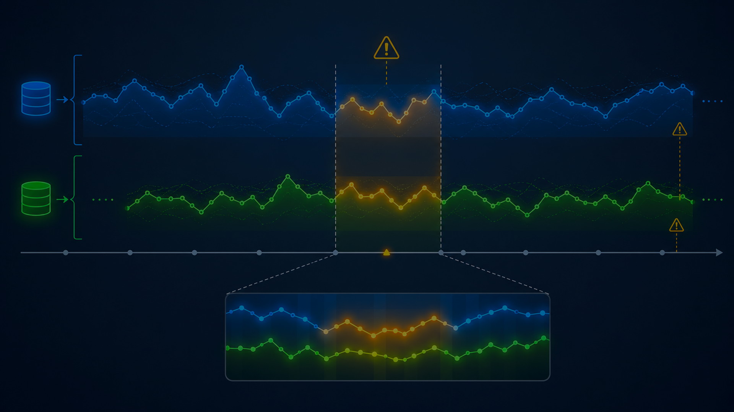
EVALUATION PAPER: ARXIV:2510.13654
Leakage can fake generalization
Two leakage modes highlighted in the paper:
•
Train-test sample overlap
•
Temporal overlap of correlated series
In time series, the model does not need to see the exact same row to benefit from future-adjacent or correlated information.
CMPE 258 Short Story | 9
Source: Rethinking Evaluation in the Era of Time Series Foundation Models, arXiv:2510.13654
Notes:
Explain leakage as the major evaluation risk. The point is not that models are bad. The point is that inflated benchmark scores can weaken claims about true generalization.

Slide 10
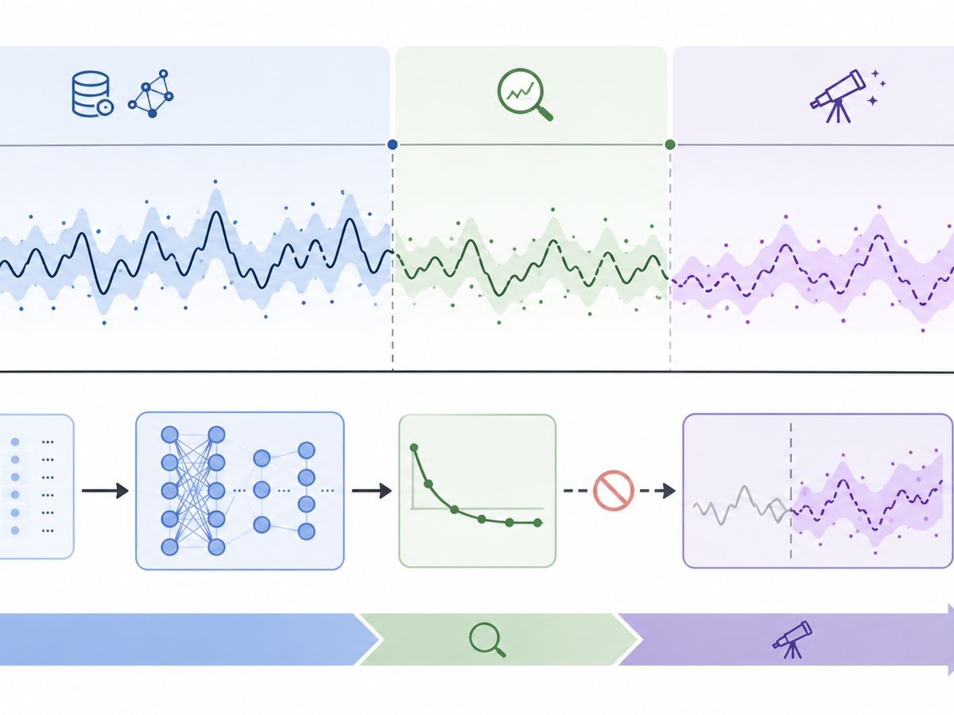
CLEAN EVALUATION PROTOCOL
What better evaluation looks like
•
Respect chronology
•
Separate pretraining and benchmark data
•
Audit correlated overlap
•
Compare against strong smaller baselines
•
Report compute and memory tradeoffs
Benchmark design is part of the scientific claim.
CMPE 258 Short Story | 10
Notes:
Transition from problem to solution. Better evaluation means chronology-respecting splits, pretraining-data transparency, leakage audits, and strong baselines.

Slide 11
GITHUB REPRODUCTION PLAN
AutoResearch-style experiment
A small reproduction focuses on the paper’s core message: do gains survive clean evaluation?
Dataset
Split
Models
Metrics
Audit
ETT / Weather / Electricity
strict temporal validation + test
naive + classical + TSFM
MAE, RMSE, MAPE
leakage notes + limits
What to report in the repo
•
configuration + runs
•
metric tables and plots
•
split details and leakage checks
CMPE 258 Short Story | 11
Notes:
Describe the reproduction as a scoped experiment. It is not trying to reproduce every paper result. It is designed to test the main lesson: clean evaluation and strong baselines.

Slide 12
RESULTS SLIDE TEMPLATE
Fill this after running your experiments
Model
MAE
RMSE
MAPE
Observation
Naive / seasonal naive
TBD
TBD
TBD
TBD
Classical baseline
TBD
TBD
TBD
TBD
Small neural model
TBD
TBD
TBD
TBD
TSFM zero-shot
TBD
TBD
TBD
TBD
TSFM fine-tuned
TBD
TBD
TBD
TBD
Interpretation prompts
Did TSFM gains survive strict temporal splitting? Did a smaller baseline compete? Were results domain-dependent?
CMPE 258 Short Story | 12
Notes:
This is intentionally a placeholder results slide. After the GitHub experiment is run, replace TBD values with actual metrics and add the key observation.

Slide 13
PRACTICAL TAKEAWAYS
How to use TSFMs responsibly
The safest interpretation is not “ignore TSFMs.” It is “evaluate them like the benchmark can lie.”
Trust, but audit
Match the domain
Check pretraining data and possible overlap.
Transfer is strongest when worlds are similar.
Use strong baselines
Report tradeoffs
Small tuned models are not automatic strawmen.
Accuracy needs context: compute, memory, robustness.
The best TSFM result is not the highest number—it is the highest number that survives honest evaluation.
CMPE 258 Short Story | 13
Notes:
Close the applied advice. TSFMs are valuable, but we should use them with careful baselines, domain matching, and evaluation transparency.

Slide 14
BOTTOM LINE
TSFMs are promising, not proven universal.
Their real value depends on domain alignment, clean evaluation, and whether gains justify model cost.
Main references
Foundation Models for Time Series: A Survey — arXiv:2504.04011
How Foundational are Foundation Models for Time Series Forecasting? — arXiv:2510.00742
Rethinking Evaluation in the Era of Time Series Foundation Models — arXiv:2510.13654
Thank you
CMPE 258 Short Story | 14
Notes:
End with the one-sentence conclusion. Re-state that the assignment is an original review grounded in the three listed papers, plus the GitHub reproduction plan.

