Slide 1

Benchmarking DNS resolvers
using realistic workload
Vladimír Čunát (+colleagues) • 2019-11-26
vladimir.cunat@nic.cz

Slide 2
Talk outline
motivation
classic approach
classic pitfalls
DNS Shotgun: new tool for realistic benchmarking
results of first experiments (examples)

Slide 3
Motivation
running DNS resolver ⇒ HW, electricity
HW, electricity ⇒ €€€
benchmarking ⇔ optimization
  ⇒ cost reduction (for similar level of service)
also verify how much HW you need

Slide 4
DNS resolving recap
cache
miss
Auth 1
cache hit
Client
Resolver
Auth 2
Cache
Auth 3

Slide 5
Inside a resolver: cache hit
query parsing
cache search
answer serialization
configured filters
rate-limiting, …

Slide 6
Inside a resolver: cache miss
authoritative server selection: whom to ask?
socket management: reuse, randomization?
retransmit strategy
DNSSEC validation
cache write & eviction
other policies

Slide 7
Too many variables
CPU: # of cores, speed per core
memories: CPU caches, NUMA, RAM
network: card & drivers, connection quality
cache hit rate, # of clients
replay speed, TTL limits
UDP/TCP/TLS/DoH ratio

Slide 8
Classic benchmarking: QPS QPS QPS!
$ man resperf
query list: QNAME + QTYPE
ramp-up query traffic
find max. QPS
  when response rate drops
QPS
time

Slide 9
Classic pitfalls 1/2
arbitrary query timing
  ignores TTL ⇒ unrealistic cache hit rate
text query list
  EDNS info lost ⇒ unrealistic TCP fallbacks, signatures
QPS ramp-up
  waits for cache hit rate increase ⇒ unrealistic
  resolver restart!

Slide 10
Classic pitfalls 2/2
small # of clients
  affects workload distribution
no fallback to TCP
  TrunCated bit
no connection management
  TCP, TLS, DoH!
over-focuses on QPS

Slide 11
DNS Shotgun: introduction
new toolset
  based on dnsjit by DNS-OARC
  https://www.dns-oarc.net/tools/dnsjit
realistic DNS benchmarking
open-source
  https://gitlab.labs.nic.cz/knot/shotgun/

Slide 12
DNS Shotgun: client-based approach
How many clients can the resolver handle?
performance depends on clients
  IoT, mobile, desktop, mail server, …
phase 1: analyze traffic patterns in PCAPs
phase 2: simulate N of your clients

Slide 13
DNS Shotgun: traffic analysis
query stream for each IP/DNS client
  IoT – mobile – desktop – mail server …
  beware: NAT
pre-generate test data
  N clients with S seconds
  S = 60 seconds
  N = 100k, 200k, 300k, …, 1M

Slide 14
DNS Shotgun: 3 => 6 clients – generation
Time ⇒ | 1 | 2 | 3 | 4 | 5 | 6 | 7 | 8
Client 1 | Q11 |  |  |  | Q15
Client 2 | Q21 | Q22 | Q23 | Q24 | Q25 |  |  | Q28
Client 3 | Q31 |  | Q33 |  |  |  | Q37
Time ⇒ | 1 | 2 | 3 | 4
Client 1 | Q11
Client 2 | Q21 | Q22 | Q23 | Q24
Client 3 | Q31 |  | Q33
Client 4 | Q15
Client 5 | Q25 |  |  | Q28
Client 6 |  |  | Q37

Slide 15
DNS Shotgun: client simulation
replay pre-generated traffic
socket/connection per query/client
keep ± 1 second query timing
  realistic cache hit rate
  ⇒ QPS varies over time
Want higher "QPS"? Configure more clients!

Slide 16
DNS Shotgun: performance testing
simulate N clients
  analyze respose rate + RCODEs
  monitor resource usage
increase N and start resolver anew
  … as long as resolver can keep up
N = maximum # of clients
  for given input PCAP & connection parameters

Slide 17
DNS Shotgun: experiment example
input: anonymized traffic from a Czech university
empty cache
measure response rate over 120 s
monitor NOERROR/NXDOMAIN/SERVFAIL ratios
increase # of clients
4 CPUs, no qname minimization, same cache params

Slide 18
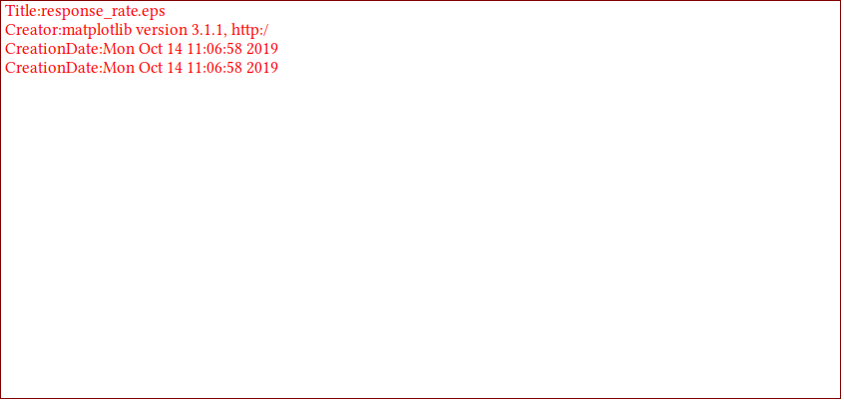
PowerDNS Recursor 4.2.0: defaults

Slide 19

PowerDNS Recursor 4.2.0: max-mthreads?

Slide 20

PowerDNS Recursor 4.2.0: reuseport?

Slide 21
PowerDNS Recursor 4.2.0: reuseport?
Do not generalize!
Measure it yourself!
Use your traffic capture!

Slide 22
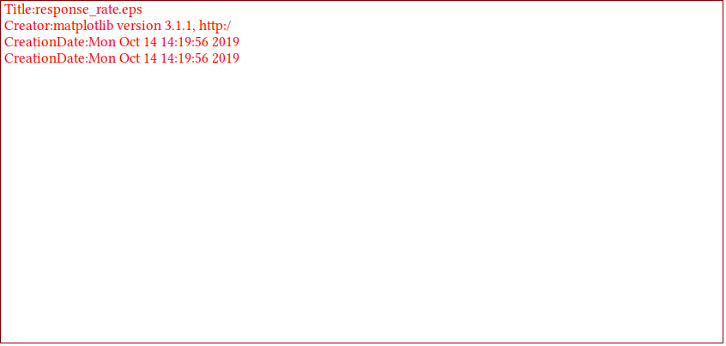
BIND 9.14.6: --tuning=default

Slide 23

BIND 9.14.6: --tuning=?

Slide 24

BIND 9.14.6: --tuning=default, synth-from-dnssec ?

Slide 25
BIND 9.14.6: --tuning=default, synth-from-dnssec ?
Do not generalize!
Measure it yourself!
Use your traffic capture!

Slide 26

Knot Resolver 4.2.2 defaults

Slide 27

Knot Resolver 4.2.2 vs. to-be-4.3.0

Slide 28
Knot Resolver 4.2.2 vs. to-be-4.3.0
Do not generalize!
Measure it yourself!
Use your traffic capture!

Slide 29

Unbound 1.9.4

Slide 30
Unbound 1.9.4
Do not generalize!
Measure it yourself!
Use your traffic capture!

Slide 31
DNS Shotgun: limitations
requires a lot of PCAPs
  1 hour, 1k clients
  = 6 minutes, 10k clients (simulated)
  and old PCAPs might skew results
results depend on input traffic capture
  … simulates your own clients
TCP/TLS/DoH not supported yet

Slide 32
DNS Shotgun: try it
very much work-in-progress
try it anyway: https://gitlab.labs.nic.cz/knot/shotgun
sponsors needed
  large DNS traffic captures (anonymized)
  TCP/TLS/DoH support
  configurable connection reuse (pipelining, keepalive)

Slide 33
Closing remarks
DNS micro-benchmarks do not reflect real world
HW & OS changes invalidate results
generalization is hard
  compare using your config and your traffic
Interested in benchmarking? Get in touch
  vladimir.cunat@nic.cz
  https://gitlab.labs.nic.cz/knot/shotgun

