Slide 1
RFID Card Reader on the SPI Interface

Slide 2
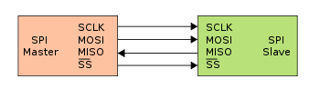
SPI Connection
Dedicated line for each direction of communication

Slide 3
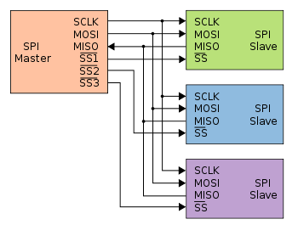
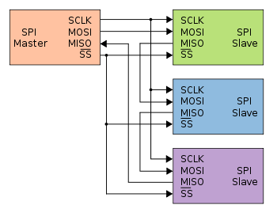
Multiple slaves
How SPI can work with multiple slaves

Slide 4
Configuring the Pi
sudo raspi-config
  Interfaces -> Enable SPI
reboot the Pi

Slide 5
What is RFID?
Radio Frequency IDentification
https://youtu.be/gEQJxNDSKAE
No battery, wireless communication

Slide 6
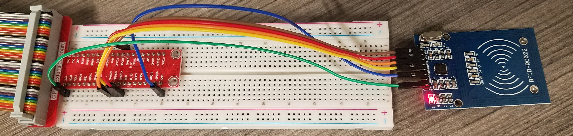
Wiring RC522 -> Pi
3.3V -> 3v3
GND -> GND
MISO -> SPIMISO
MOSI -> SPIMOSI
SCK -> SPISCLK
SDA -> SPICE0
python3 readrfid.py

Slide 7
Messing around with RFID
python3 writeToRFID.py
python3 display_rfid_data.py
  Connect LCD screen to I²C to see display

Slide 8
Uses of RFID
Where have you seen it?
Where could it be used?
Factor of authentication

Slide 9
Multifactor Authentication
Something you know
  passwords, pins, security questions
Something you have
  RFID card, cell-phone app
Something you are
  Fingerprint scanner, face scan
Somewhere you are
  Geofence, IP address

Slide 10
Potential problems with RFID
Speed
Security
Privacy

Slide 11
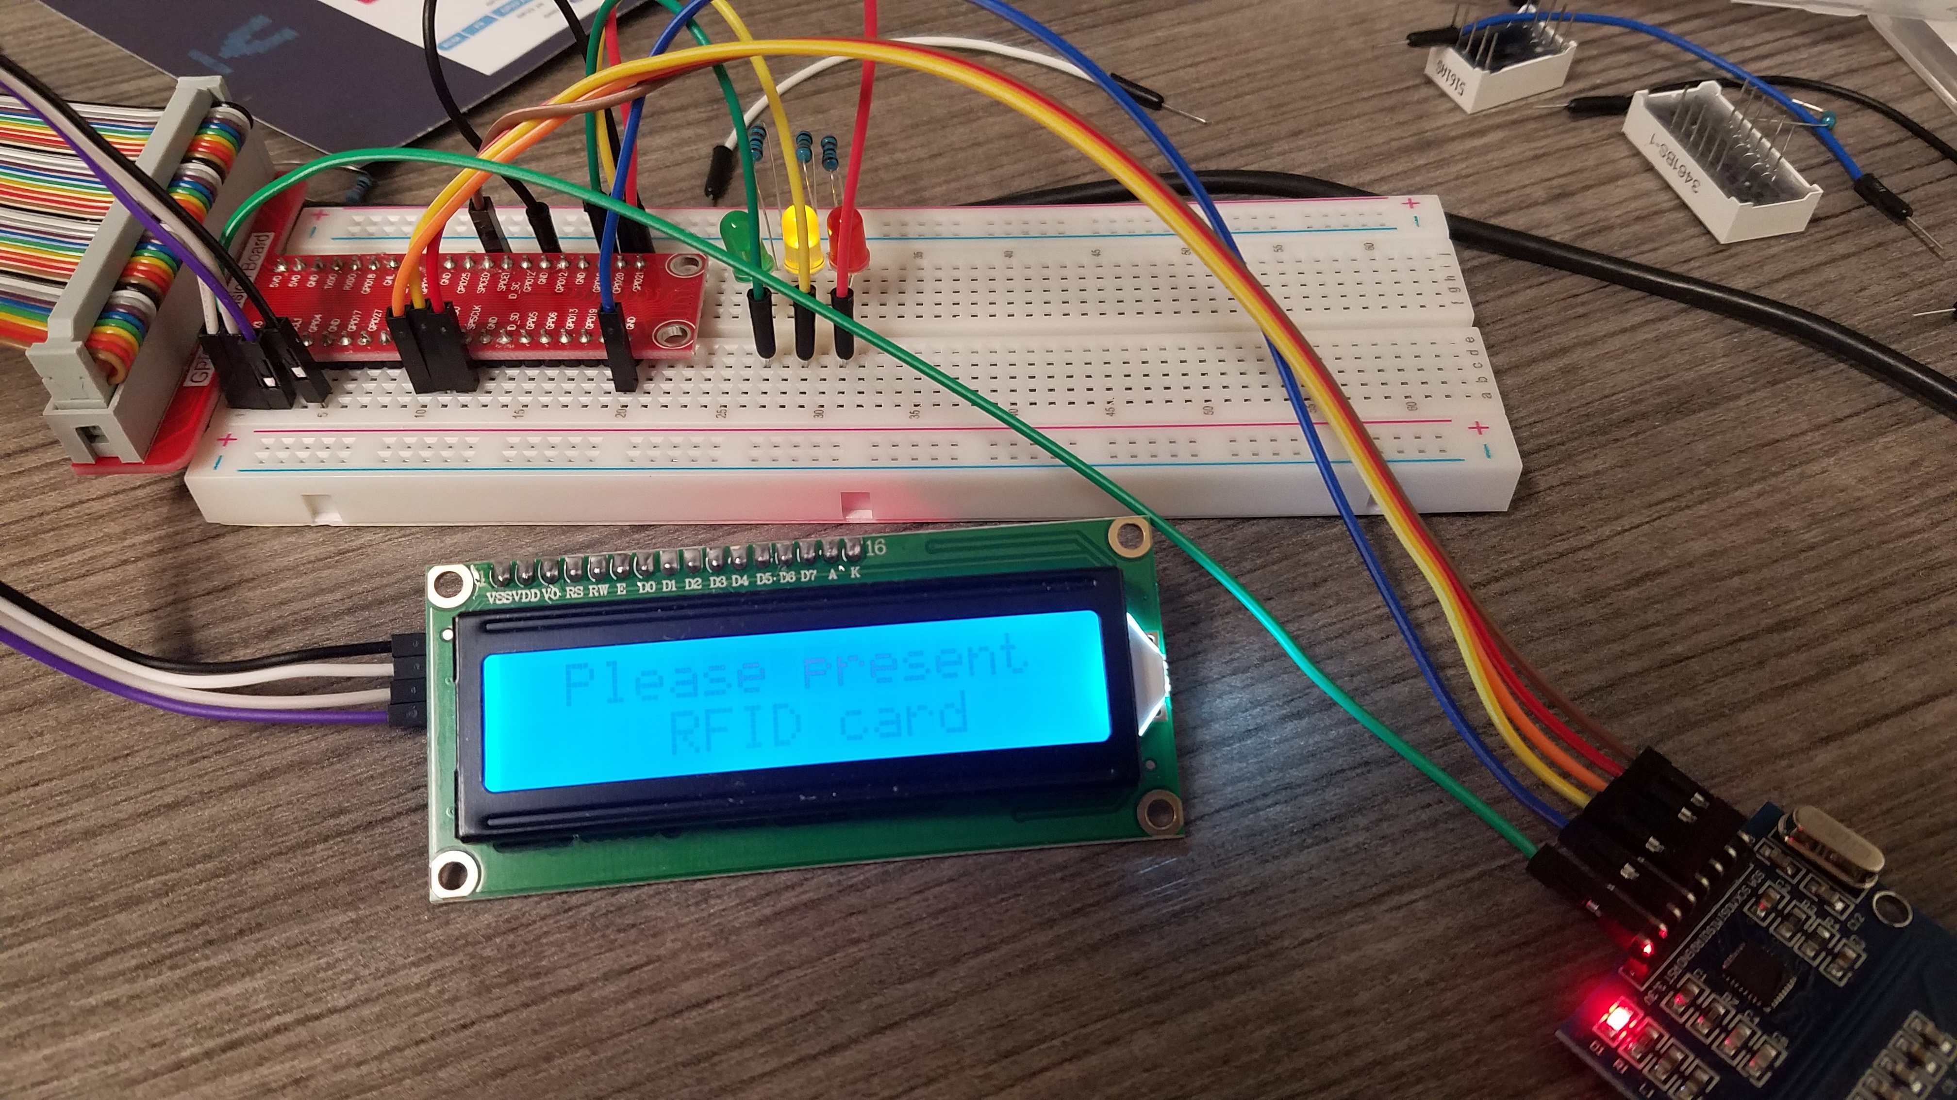
Access Cards
Connect LEDs
(with resistors)
  Red to GPIO 21
  Yellow to GPIO 20
  Green to GPIO 16
Enter RFID numbers as separate lines in validcards.txt
python3 access_card.py

Slide 12
Access Attempts
How can you tell if someone attempted to gain access?

