Slide 1
Sending data over a wire

Slide 2
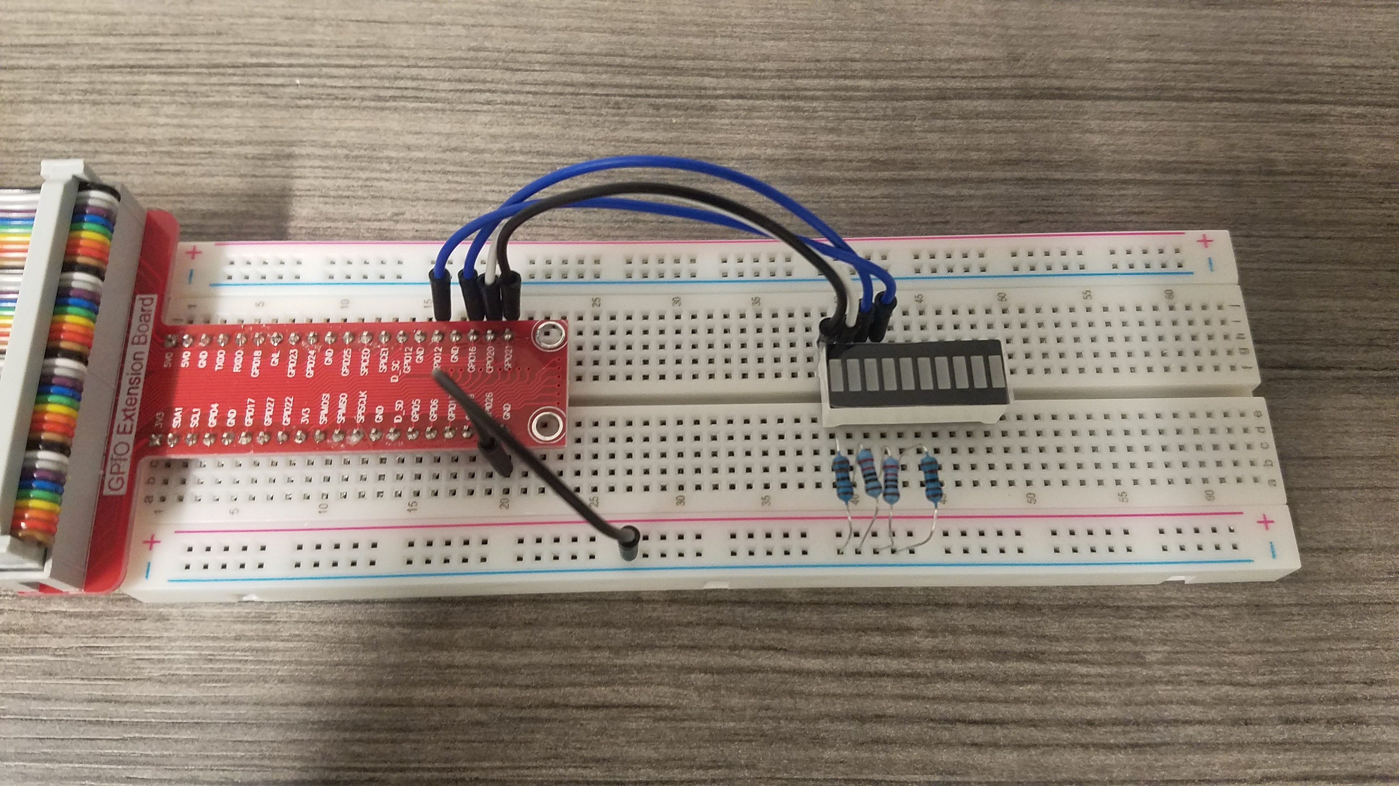
LED Bar Graph
10 Individual LEDs
How can we control all of them?

Slide 3
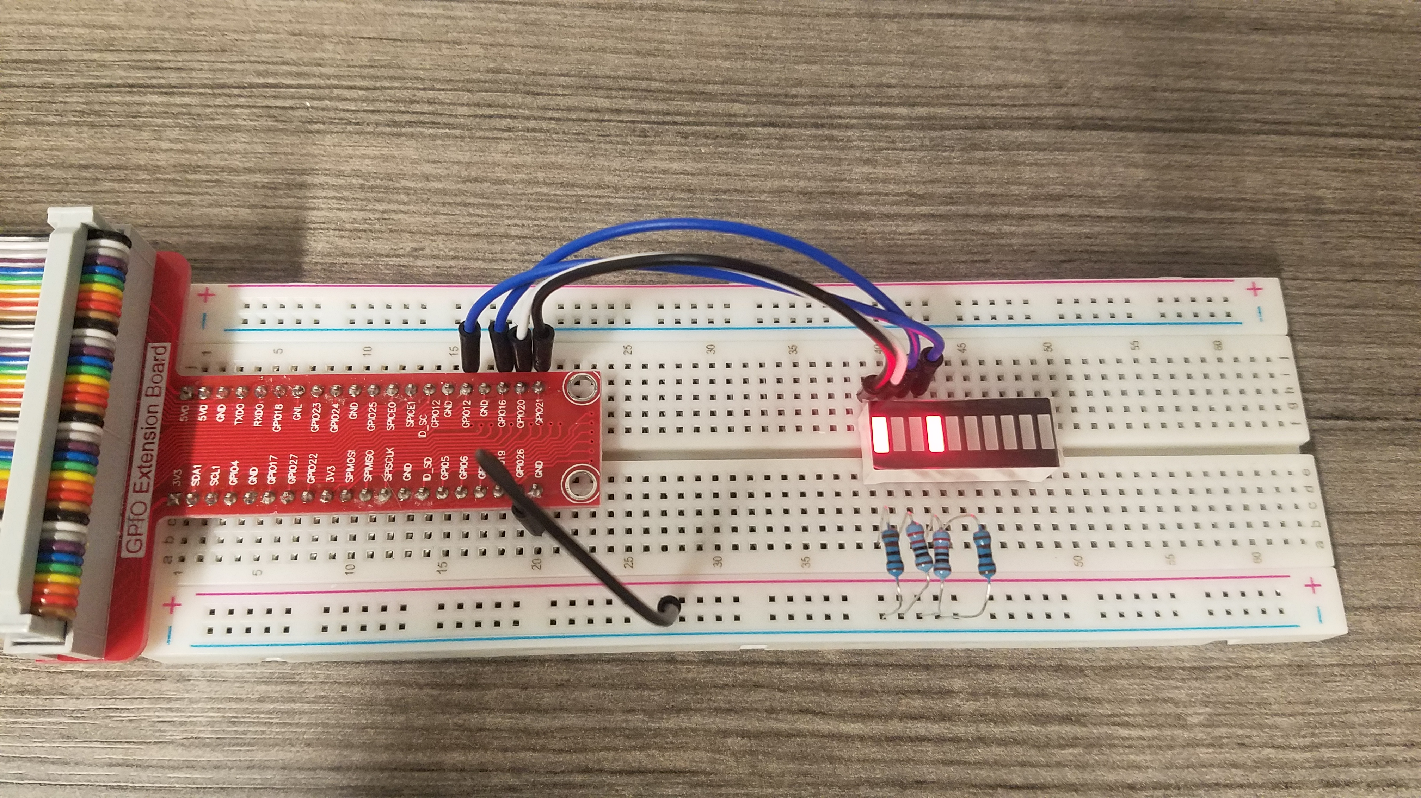
Is it good?
Individually control LEDs
Lots of wires
Lots of GPIO pins

Slide 4
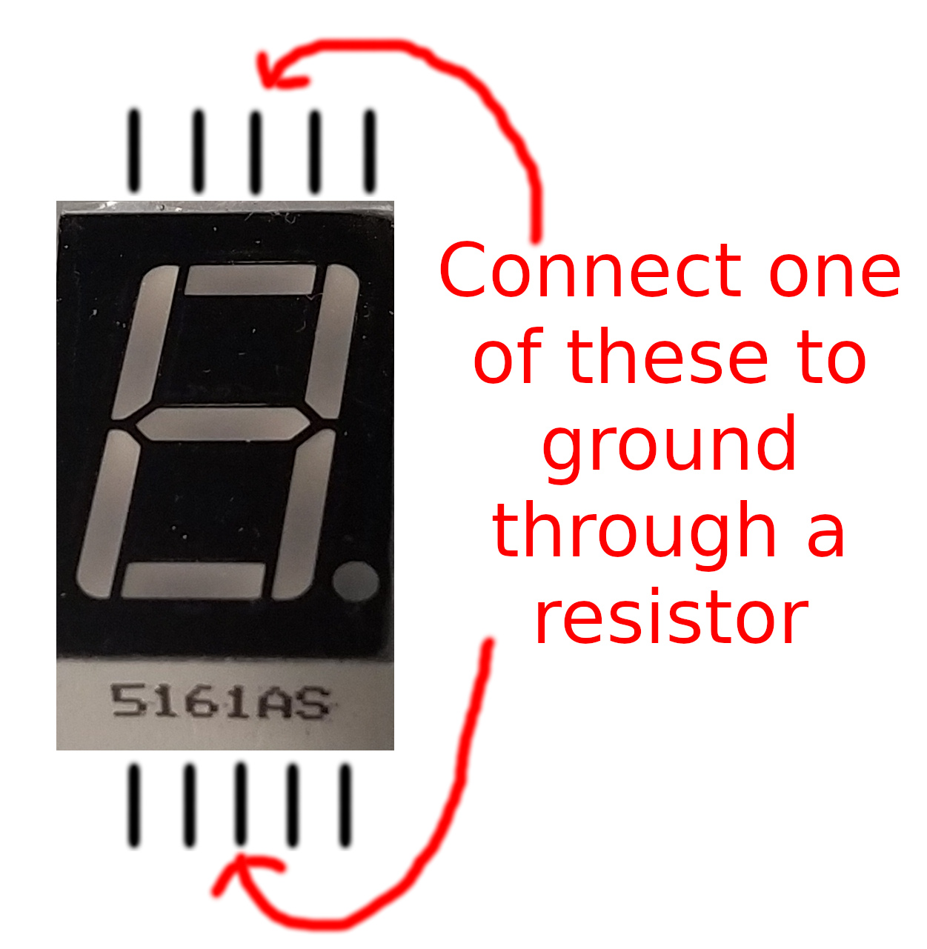
7-segment display
We can combine all the connections on one side
Still uses one GPIO pin per LED

Slide 5
Parallel Communication
How could we send more data?
  Set all the pin values, then read
  Set all the pin values, then read
  Repeat until message is sent
Difficulties
  Need to be sure to stay synchronized
  Can’t start reading until all pins are set

Slide 6
Communicating over a single wire
Morse Code
  Letters based on combination of tones
Changing intensity can represent more complexity
  Difficult/unclear to read
Sequence of on/off voltages (binary)
  Voltage on for 1, Voltage off for 0
  How can you tell two ones or just slow?

Slide 7
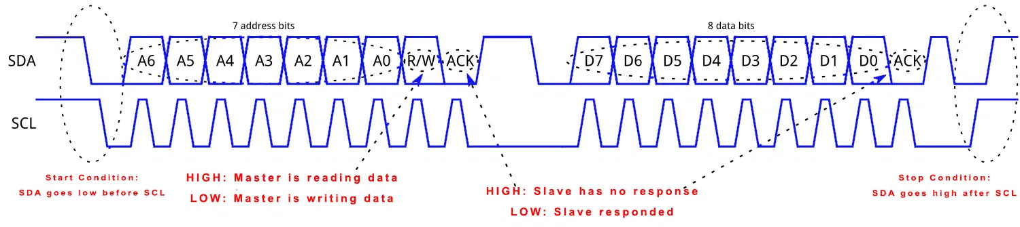
I²C Interface
One wire for message, one wire for clock
Uses two signal wires for many devices
  7 address bits means 128 devices theoretically
    It can support even more
  Speeds from 100kbit/s to 5Mbit/s
Image source: www.teachmemicro.com

Slide 8
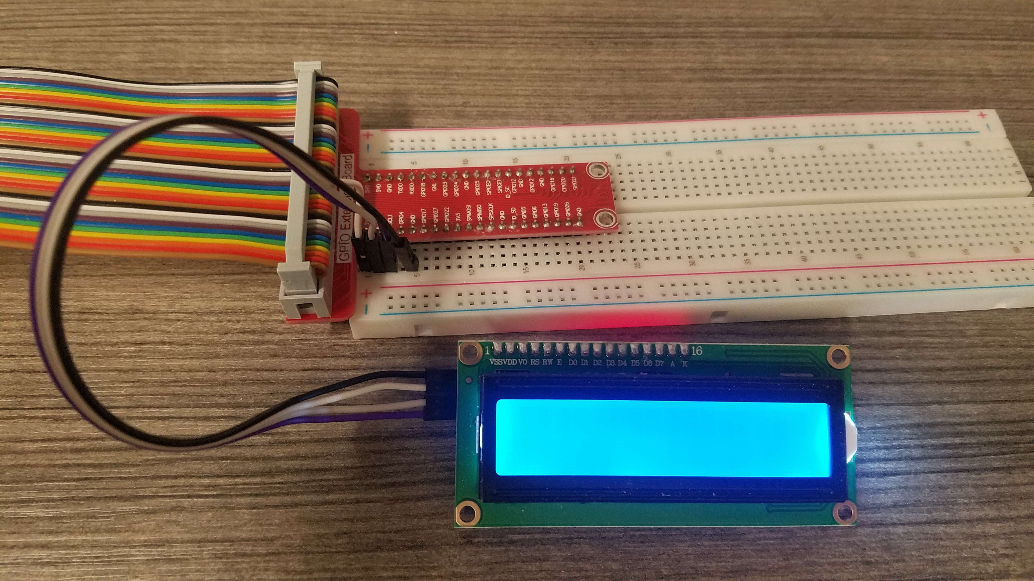
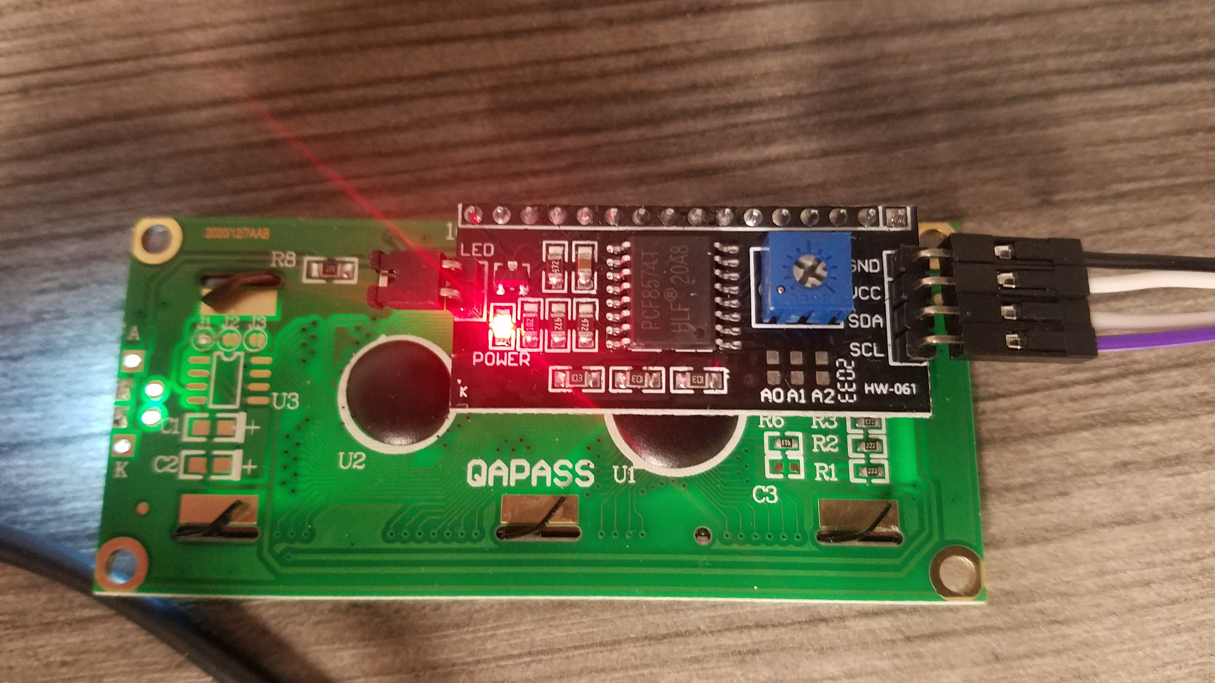
Connecting the wiring
LCD -> Pi
  GND -> GND
  VCC -> 3.3V
  SDA -> SDA1
  SCL -> SCL1
I know we’re connecting 4 wires, but only 2 are used for the signal

Slide 9
Setup the Pi
In your terminal:
  sudo raspi-config
In Interface options
  Select I2C and enable it
  Save and quit
Back in terminal:
  i2cdetect -y 1
There should be a chart with a 27 in it
If not, you may need to reboot and try again

Slide 10
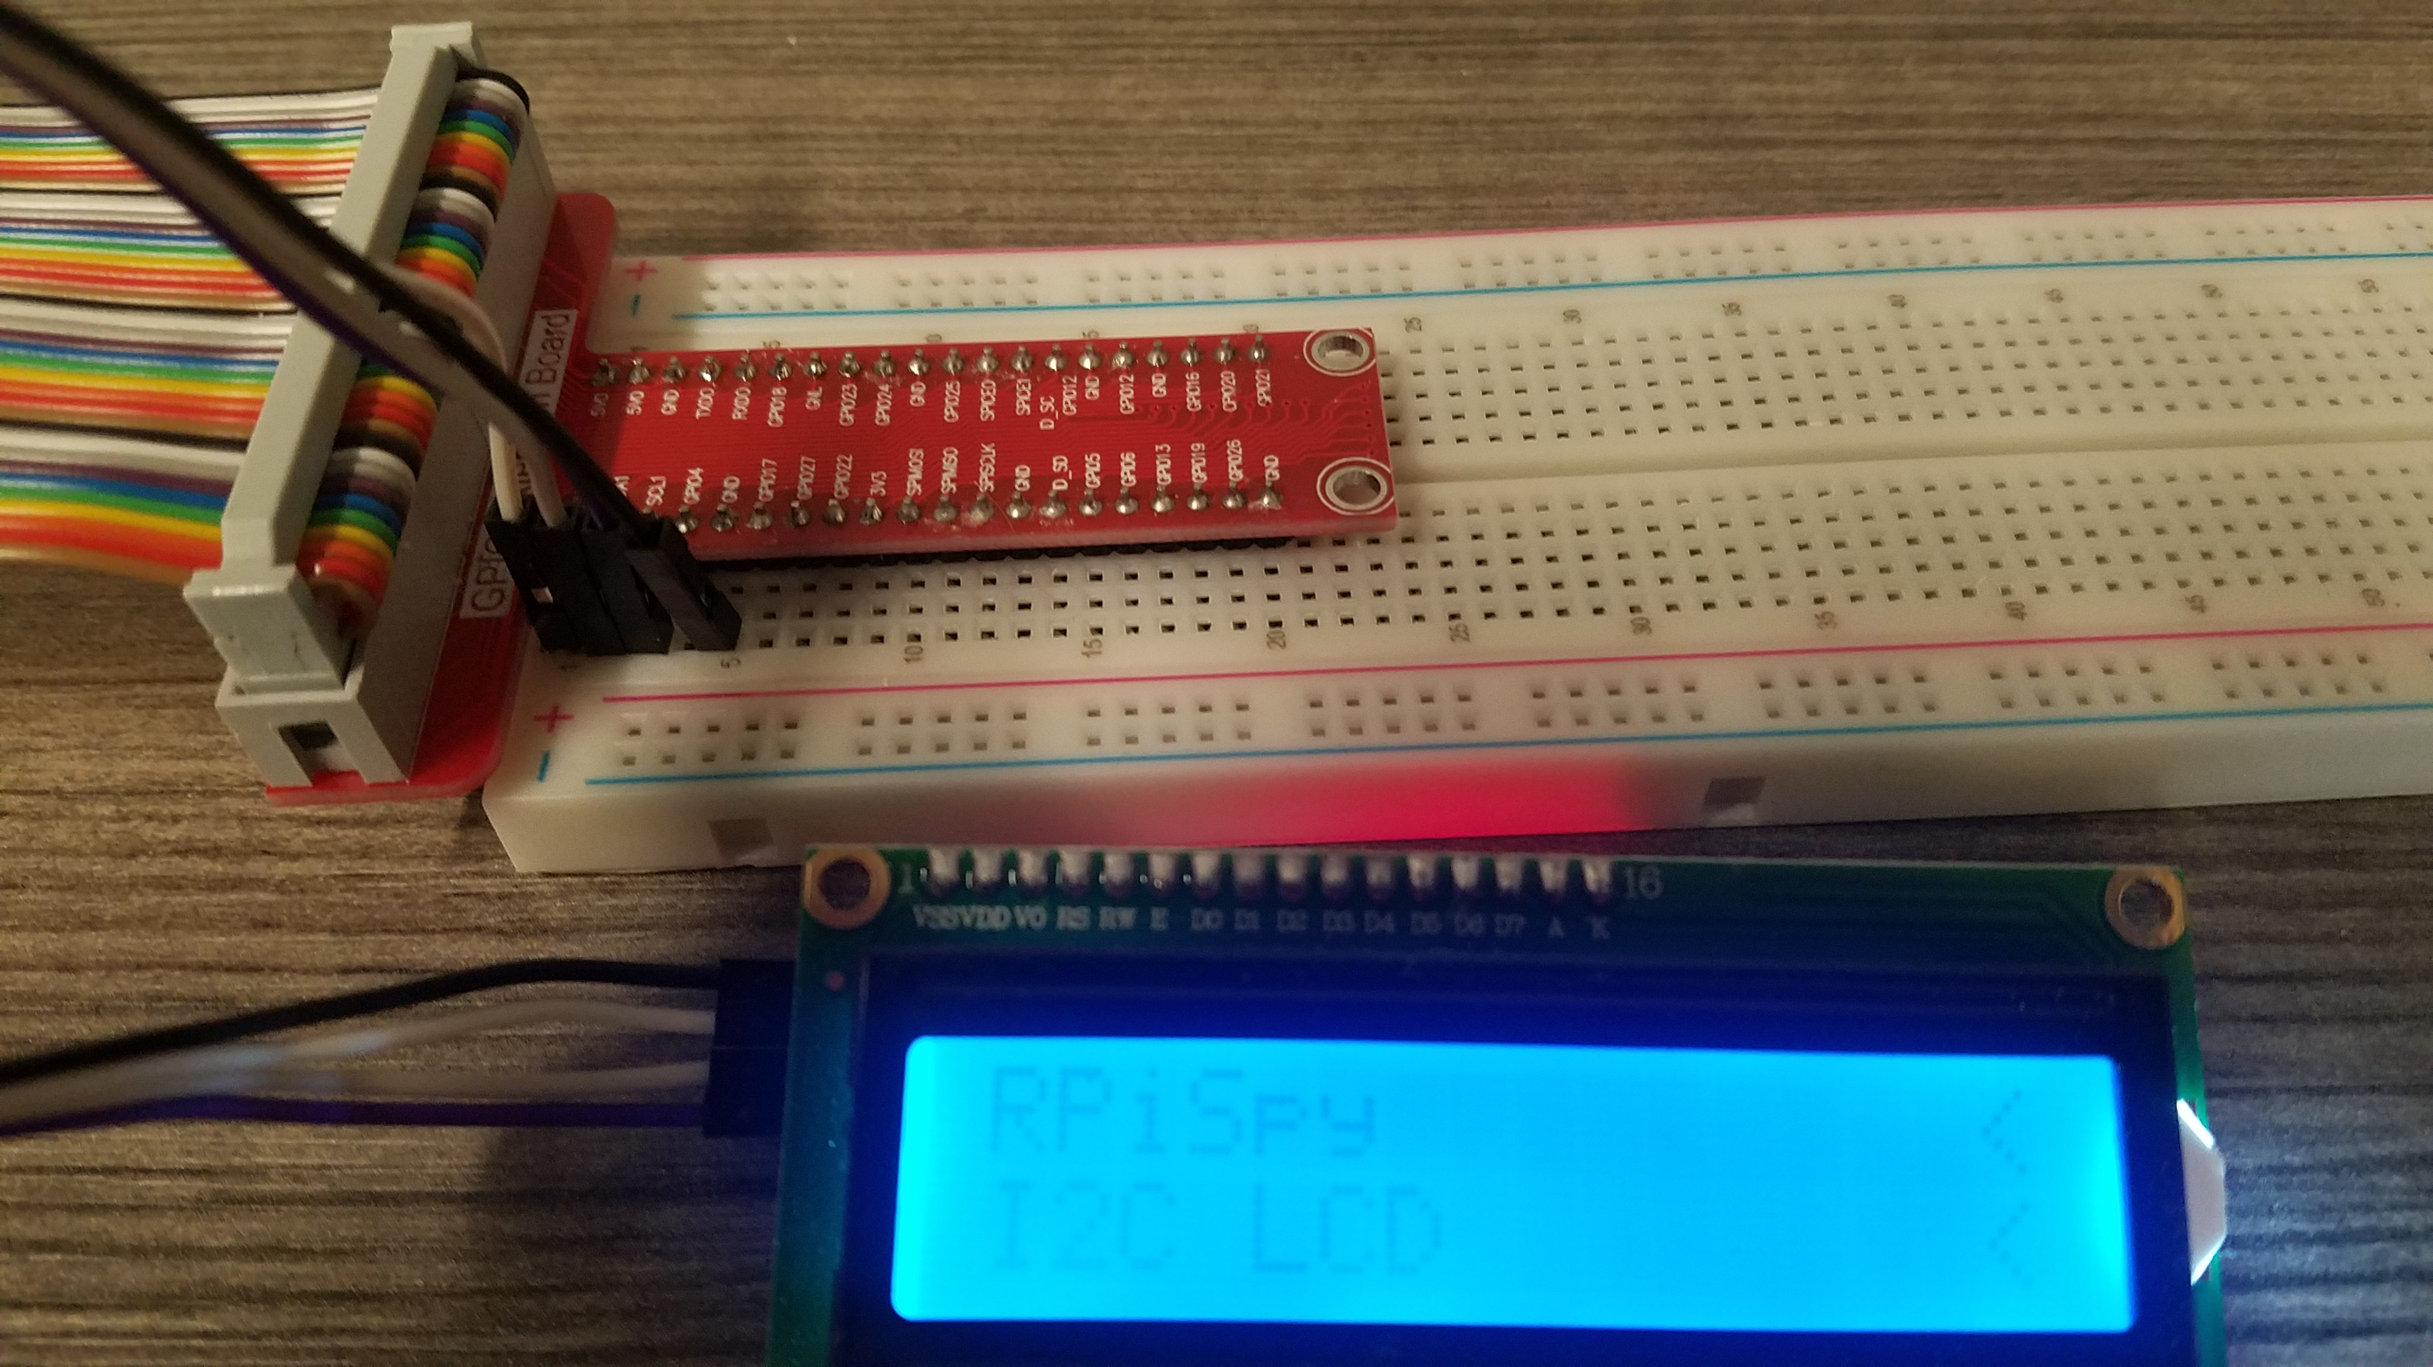
LCD Contrast
In the terminal run:
cd ~/projects/.../day2
python3 lcd_i2c.py
Use a screwdriver to adjust contrast (plastic screw on back) until you can see it

Slide 11
Multiple displays
Try connecting two or more LCD screens at the same time
What happens when you try to display a message now?

Slide 12
Using a shared medium
I²C is very similar to how computer talk over a network
Devices only listen to their address
  This isn’t enforced
Security implications
  Privacy
  Posing as another device
Examples of shared media?

Slide 13
Sending your own message
In the day2 directory, there is a file: lcd_display.py
  Try running it (python3 lcd_display.py)
Edit the file to display your own custom message (nano lcd_display.py)
  Change the values of line1 and lin2
  Keep the quotes around your text

