Slide 1
Motion Sensors

Slide 2
What about physical security
If a physical device can be reached, this bypasses a lot of security measures
Password hashes can be broken without any alarms being tripped
Encryption only lasts for a certain length of time

Slide 3
Physical Security
Door locks
Motion sensors
Cameras
Security guards

Slide 4
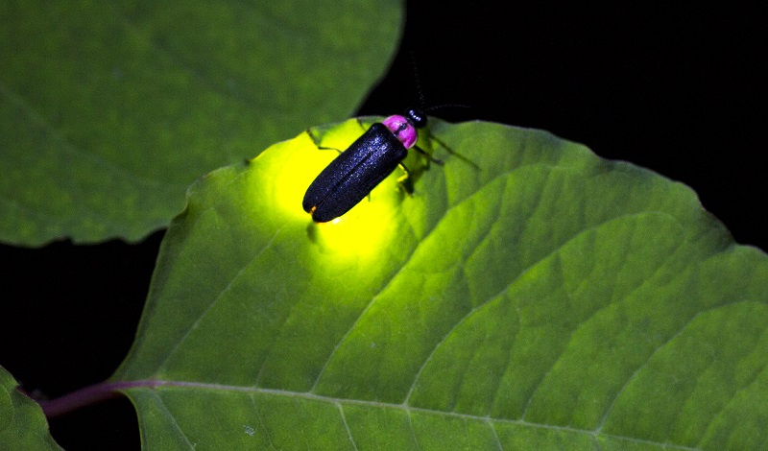
How do we detect people?
Animals that emit light are a lot more visible in the dark
Can you tell the direction of the sun with your eyes closed?

Slide 5
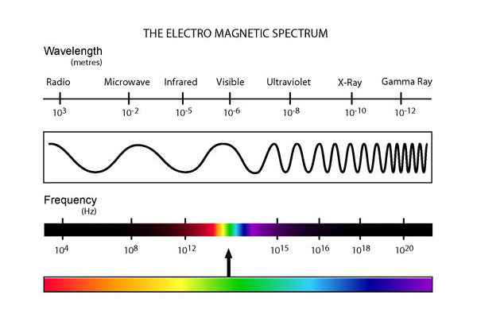
Infrared Light
Visible light makes up a small portion of possible wavelengths of light

Slide 6
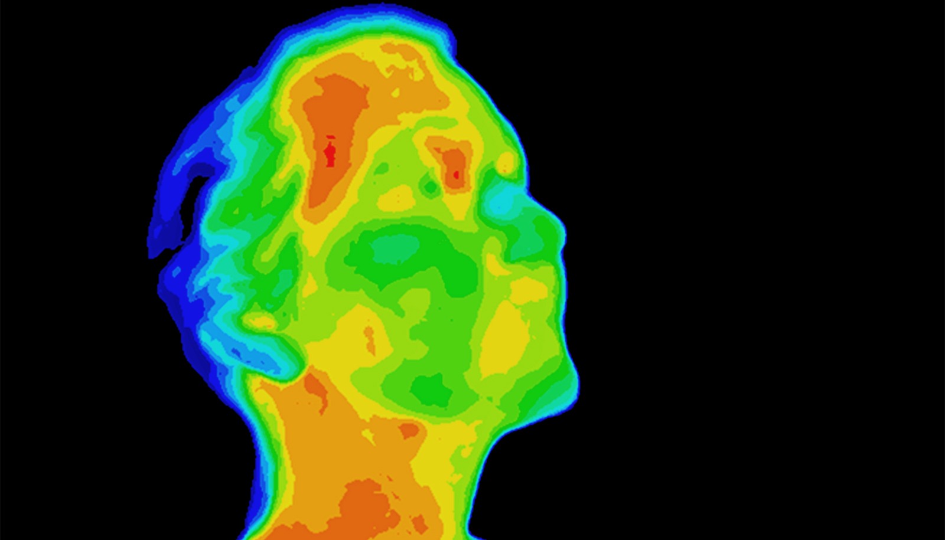
Glow-in-the-dark
We emit light, for those who care to look

Slide 7
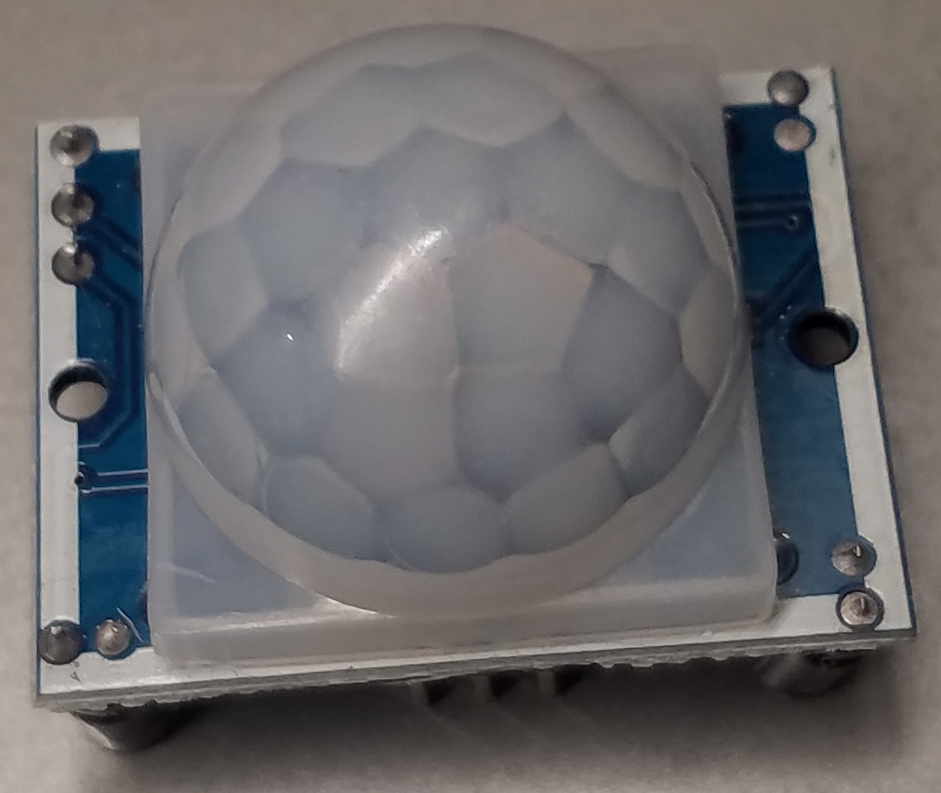
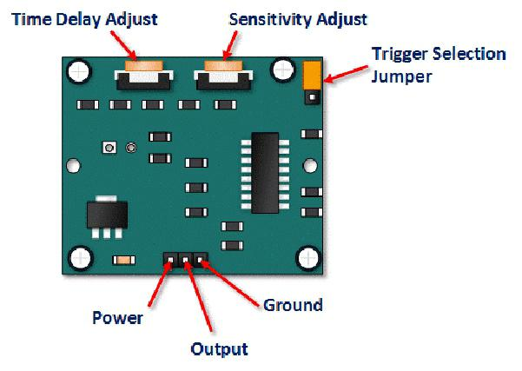

Slide 8
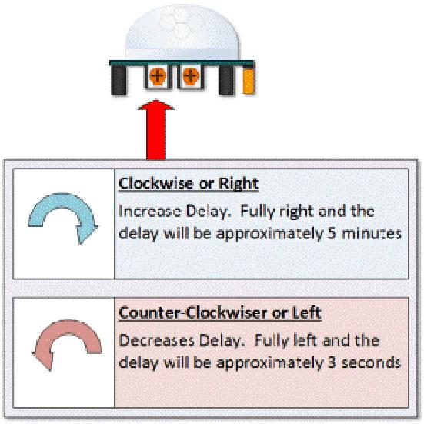
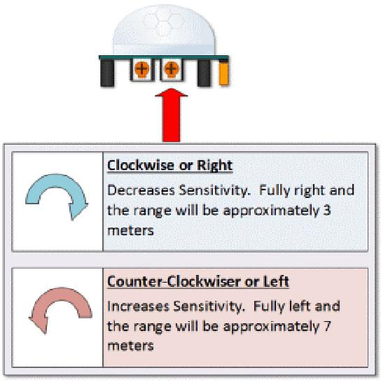
Making adjustments

Slide 9
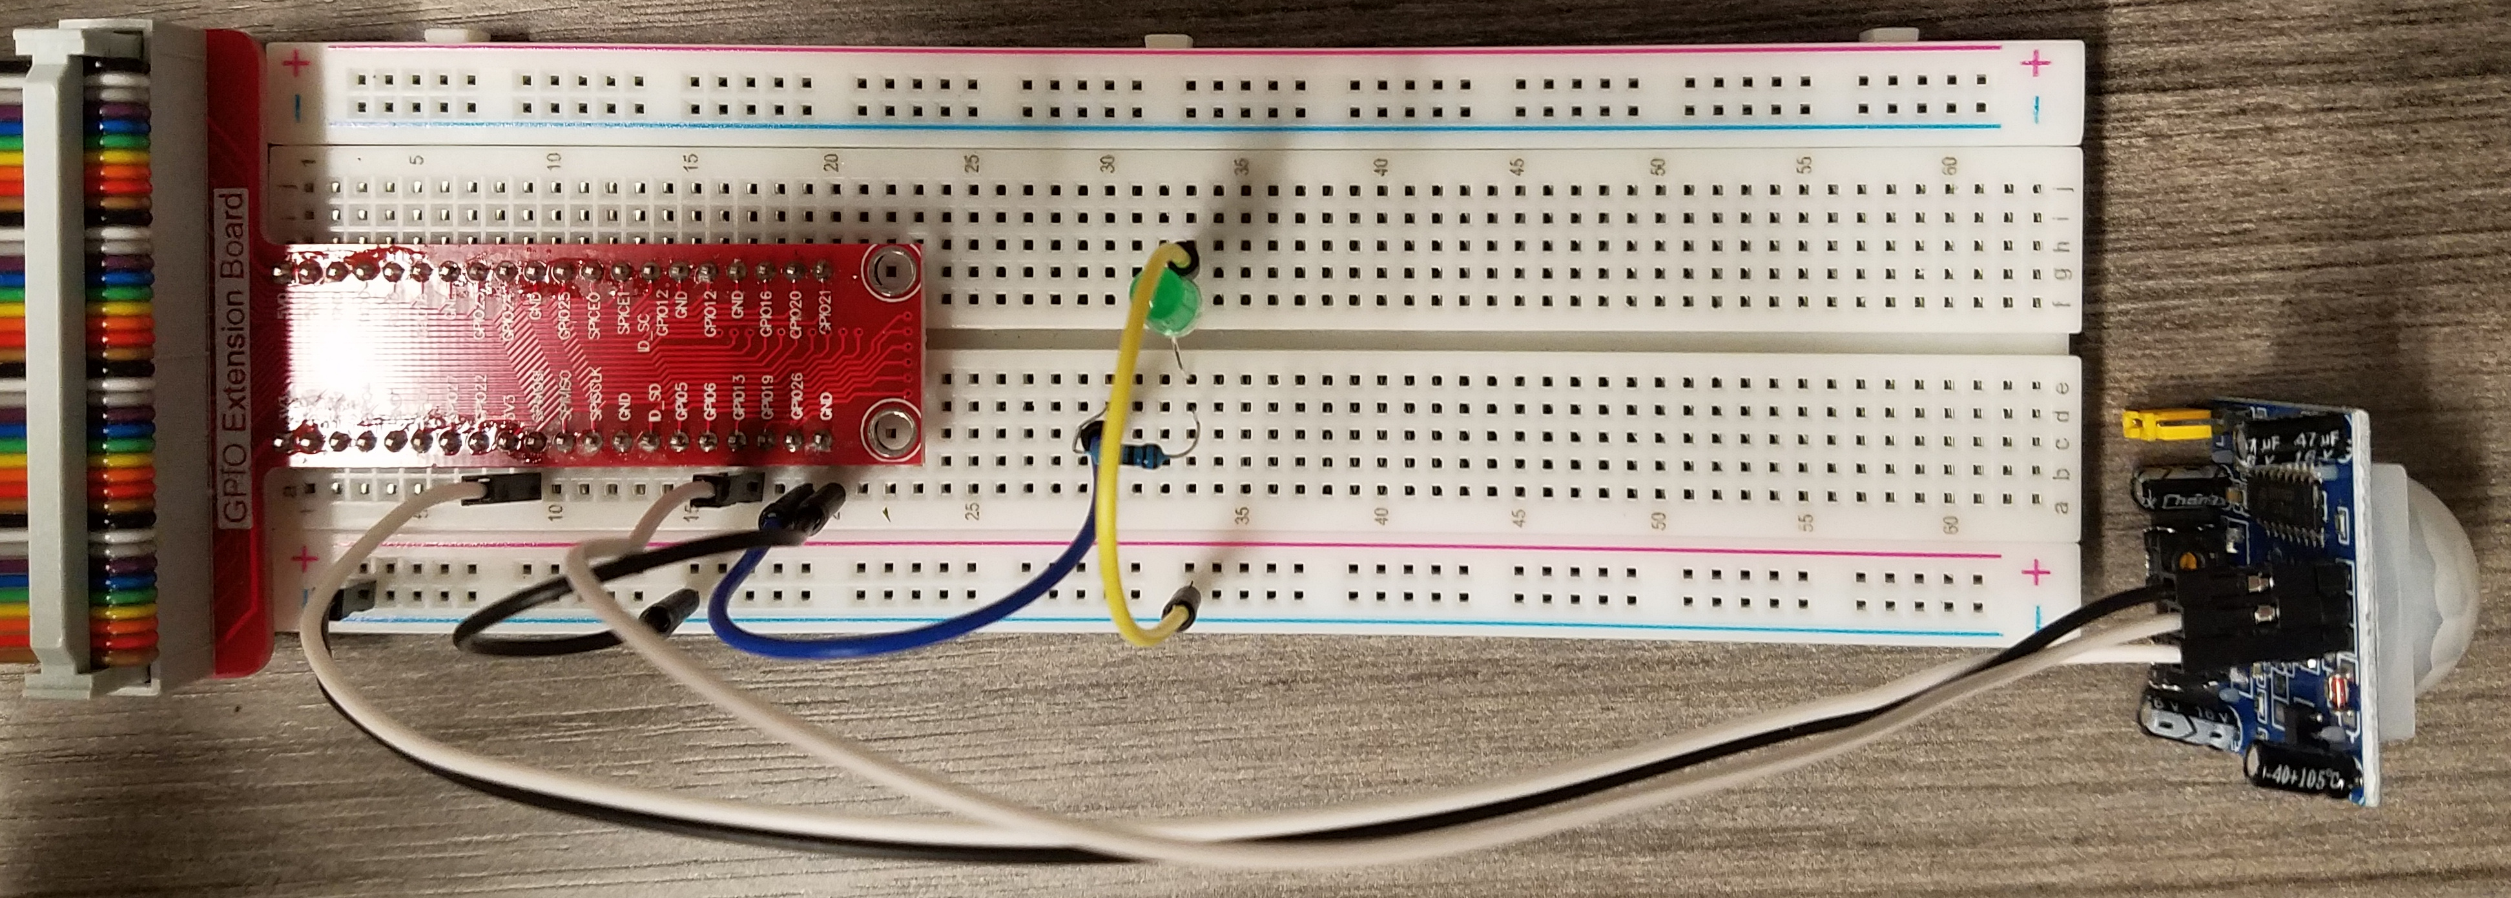
Sensor with LED
Connect sensor to GPIO 13
Connect LED to GPIO26
python3 motiondetect.py

Slide 10
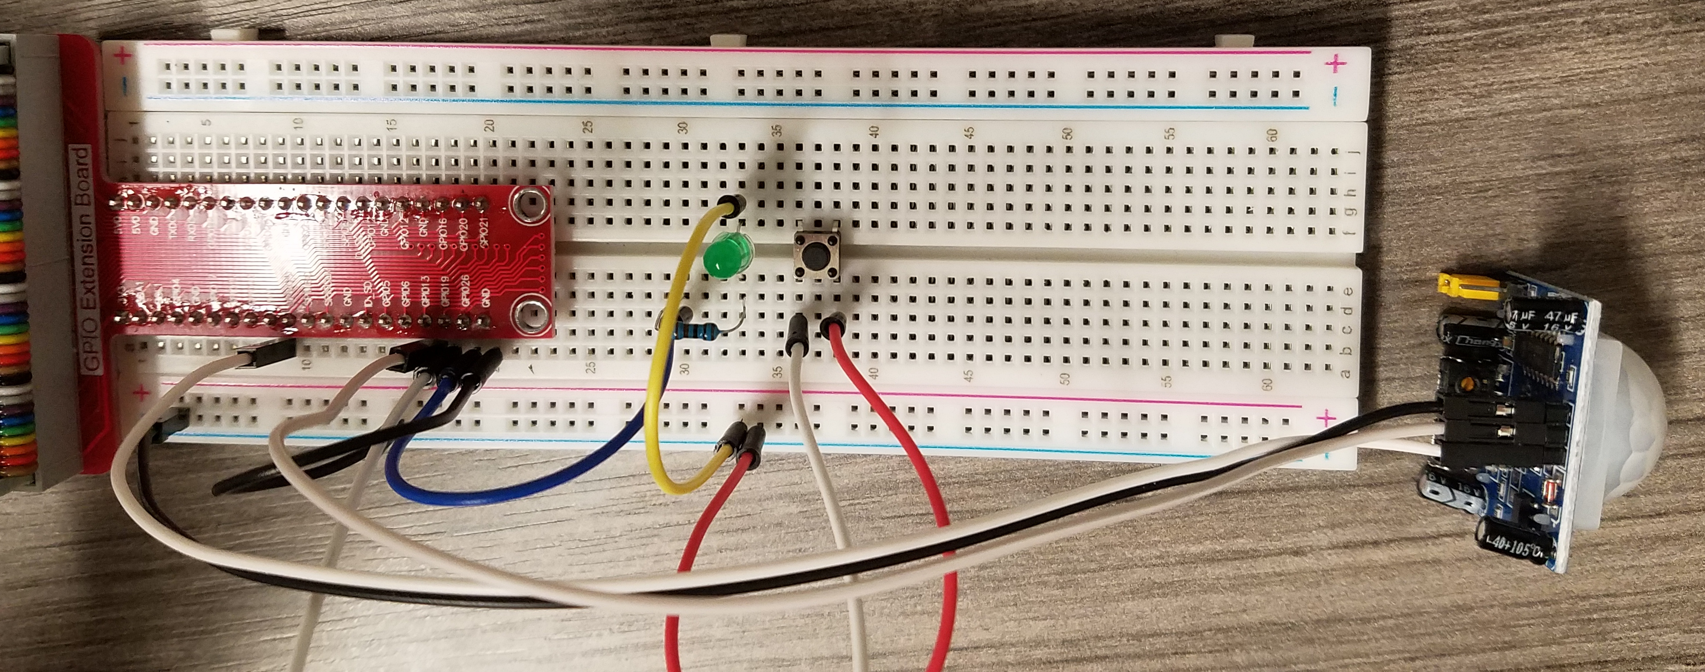
Sensor to GPIO 13
LED to GPIO26
Button to GPIO19
python3 maze.py

Slide 11
Cron
Periodic tasks can be run with cron
crontab -e
  Scroll to the bottom and add:
@reboot /home/pi/project/2021_gencyber_summer_camp/resources/day5/maze.py
Reboot the pi with:
sudo shutdown -r 0
The script will now run without connecting keyboard/mouse/monitor

Slide 12
Maze
5 teams defend while 1 attacks
Defending teams place sensors (max 1 per table).
Defending teams must retrieve 5 objects. False alarms earn other teams points
Attacking teams must retrieve 5 objects while triggering as few alarms as possible. Earn 5 points per item retrieved.
Correctly triggered alarms earn points

