Slide 1
Raspberry Pi Setup

Slide 2
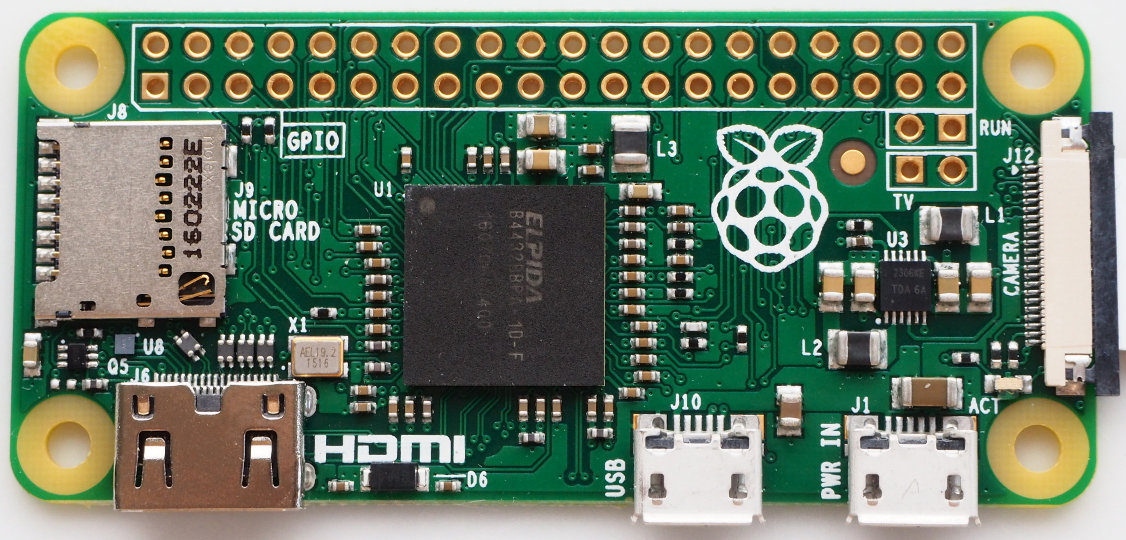
Raspberry Pi Zero
A full computer on a single circuit board
Ability to control GPIO pins

Slide 3
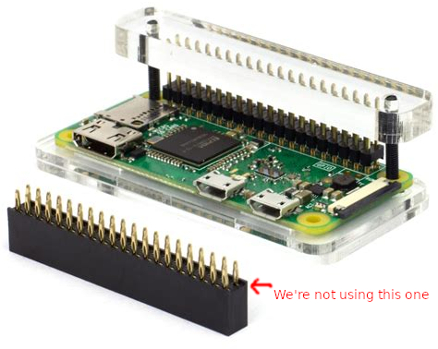
Hammer Header
Install the hammer header to the Pi Zero

Slide 4
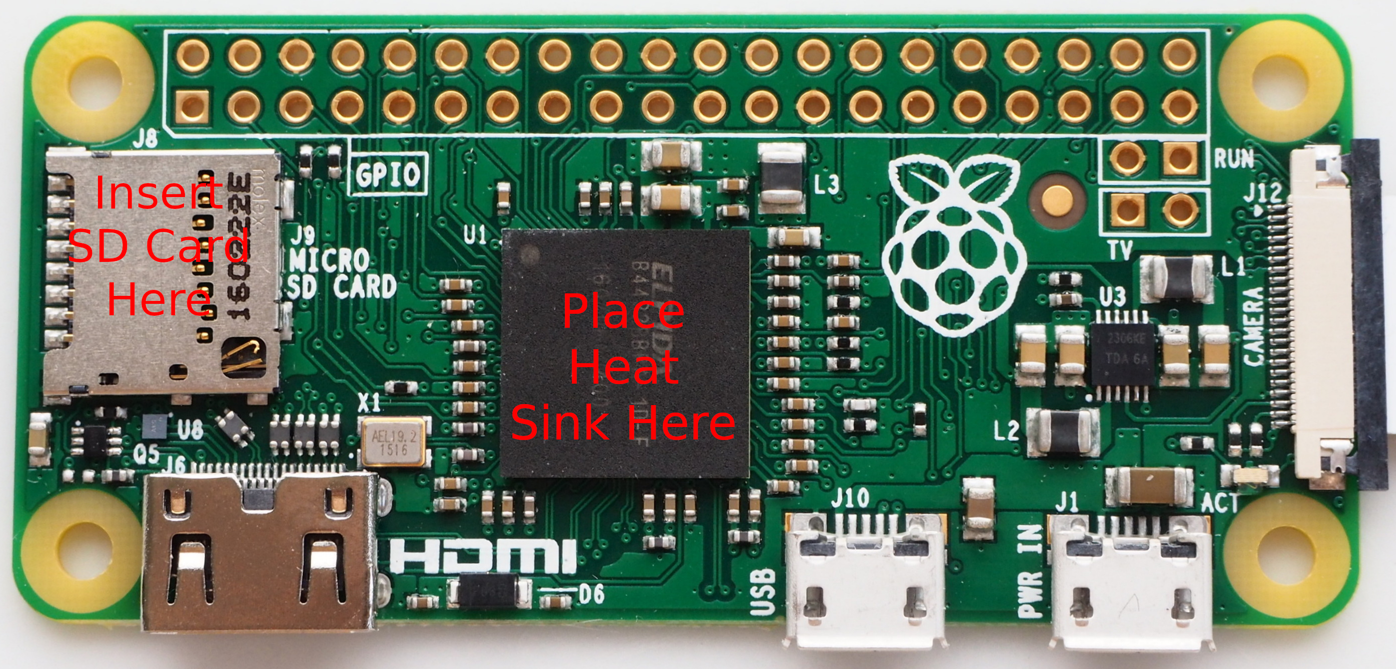
SD Card and Heat Sink
Insert the SD Card into the slot
The heat sink will stick right to the largest chip
Use the case top with the slit for the GPIO pins

Slide 5
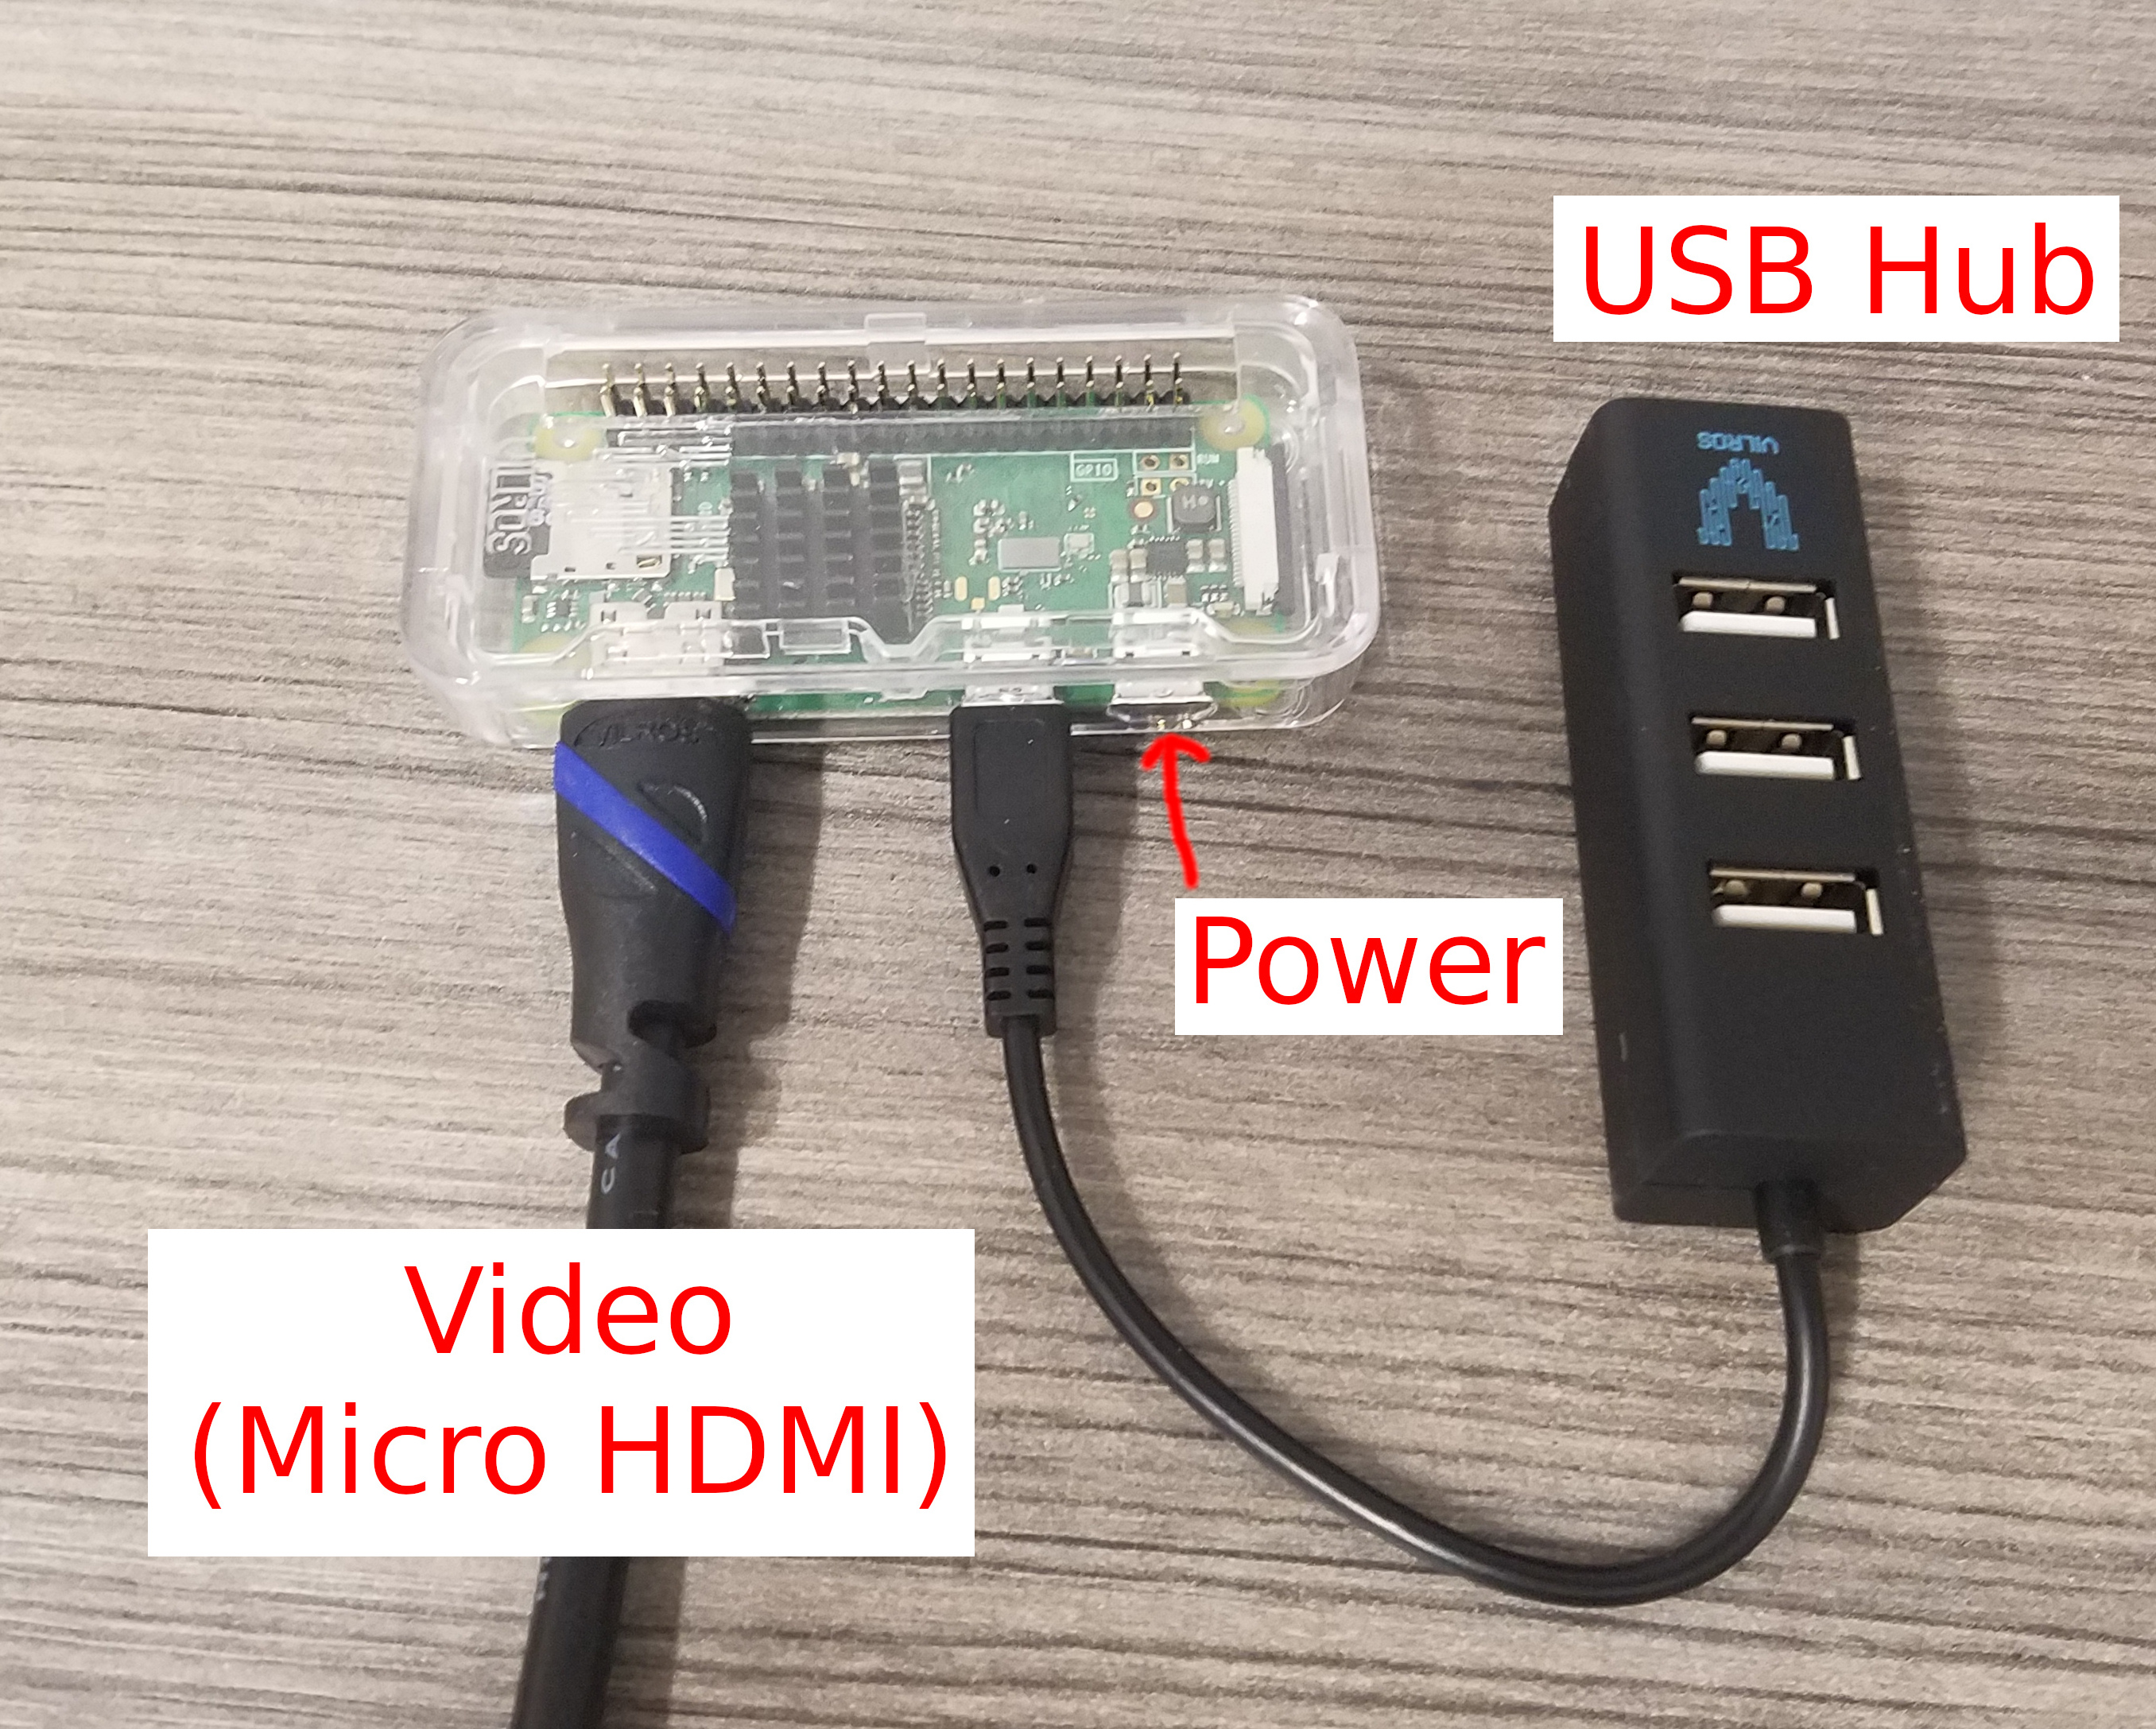
Case and connections
Use the case top with the slit for the GPIO Pins
The video needs an adapter to plug in to the monitor
Keyboard and mouse plug in to the USB hub
Connect the power last

Slide 6
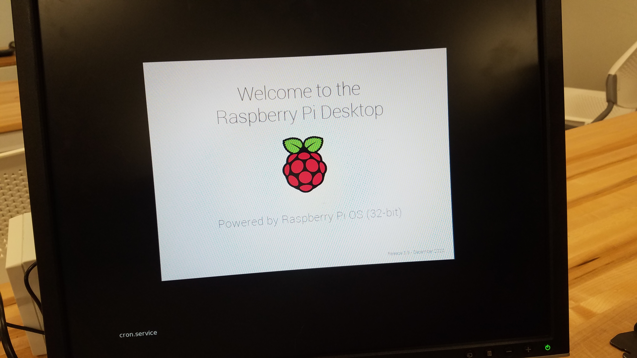
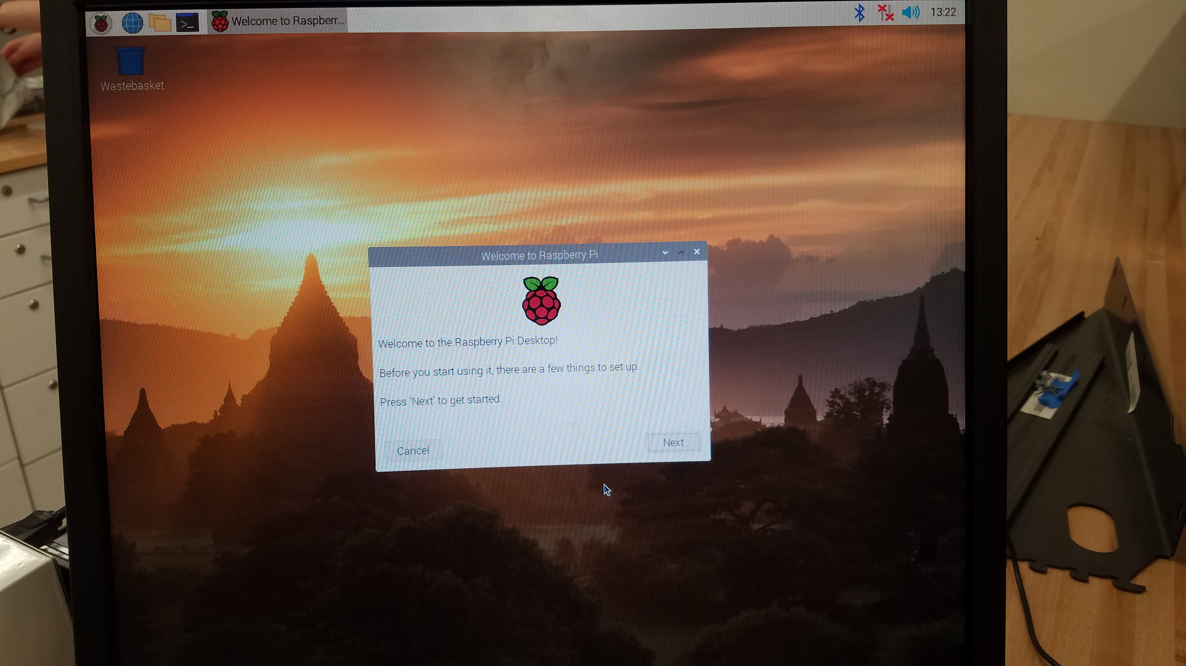
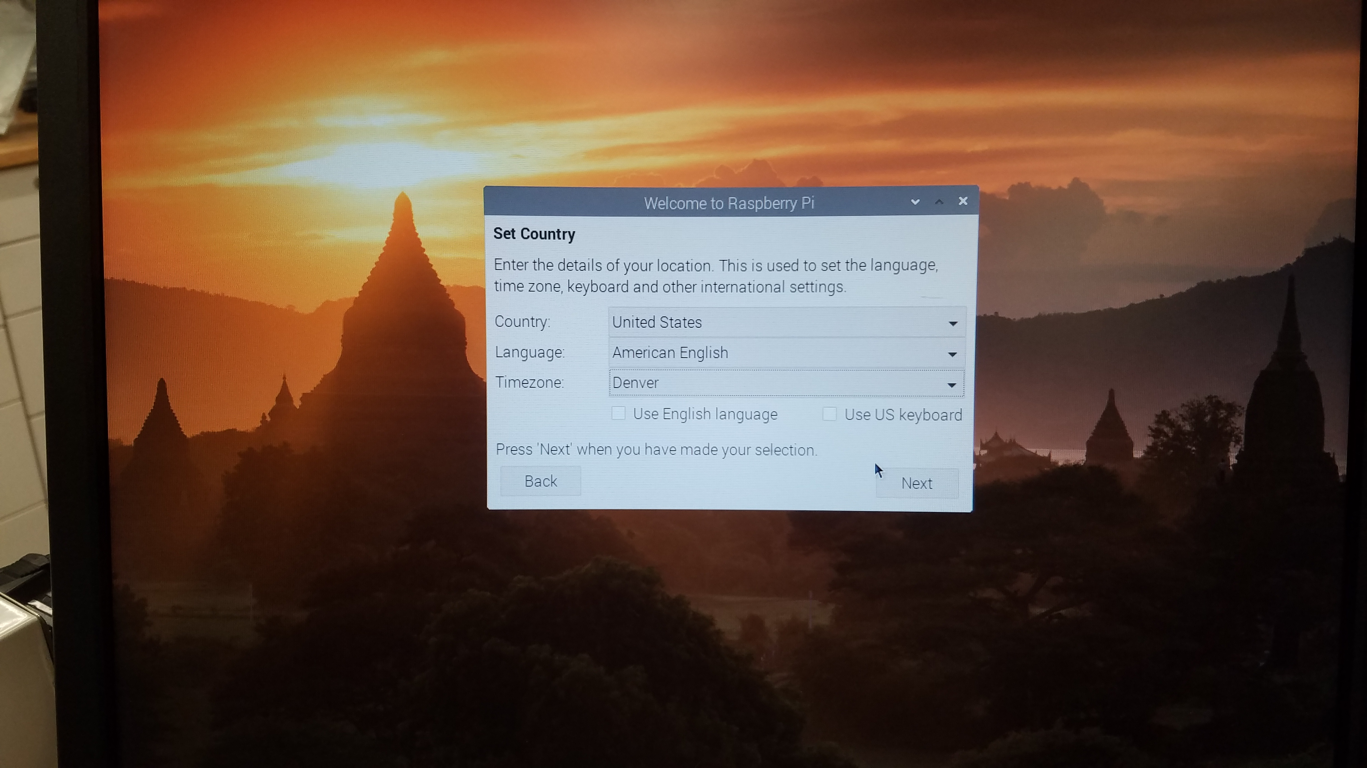
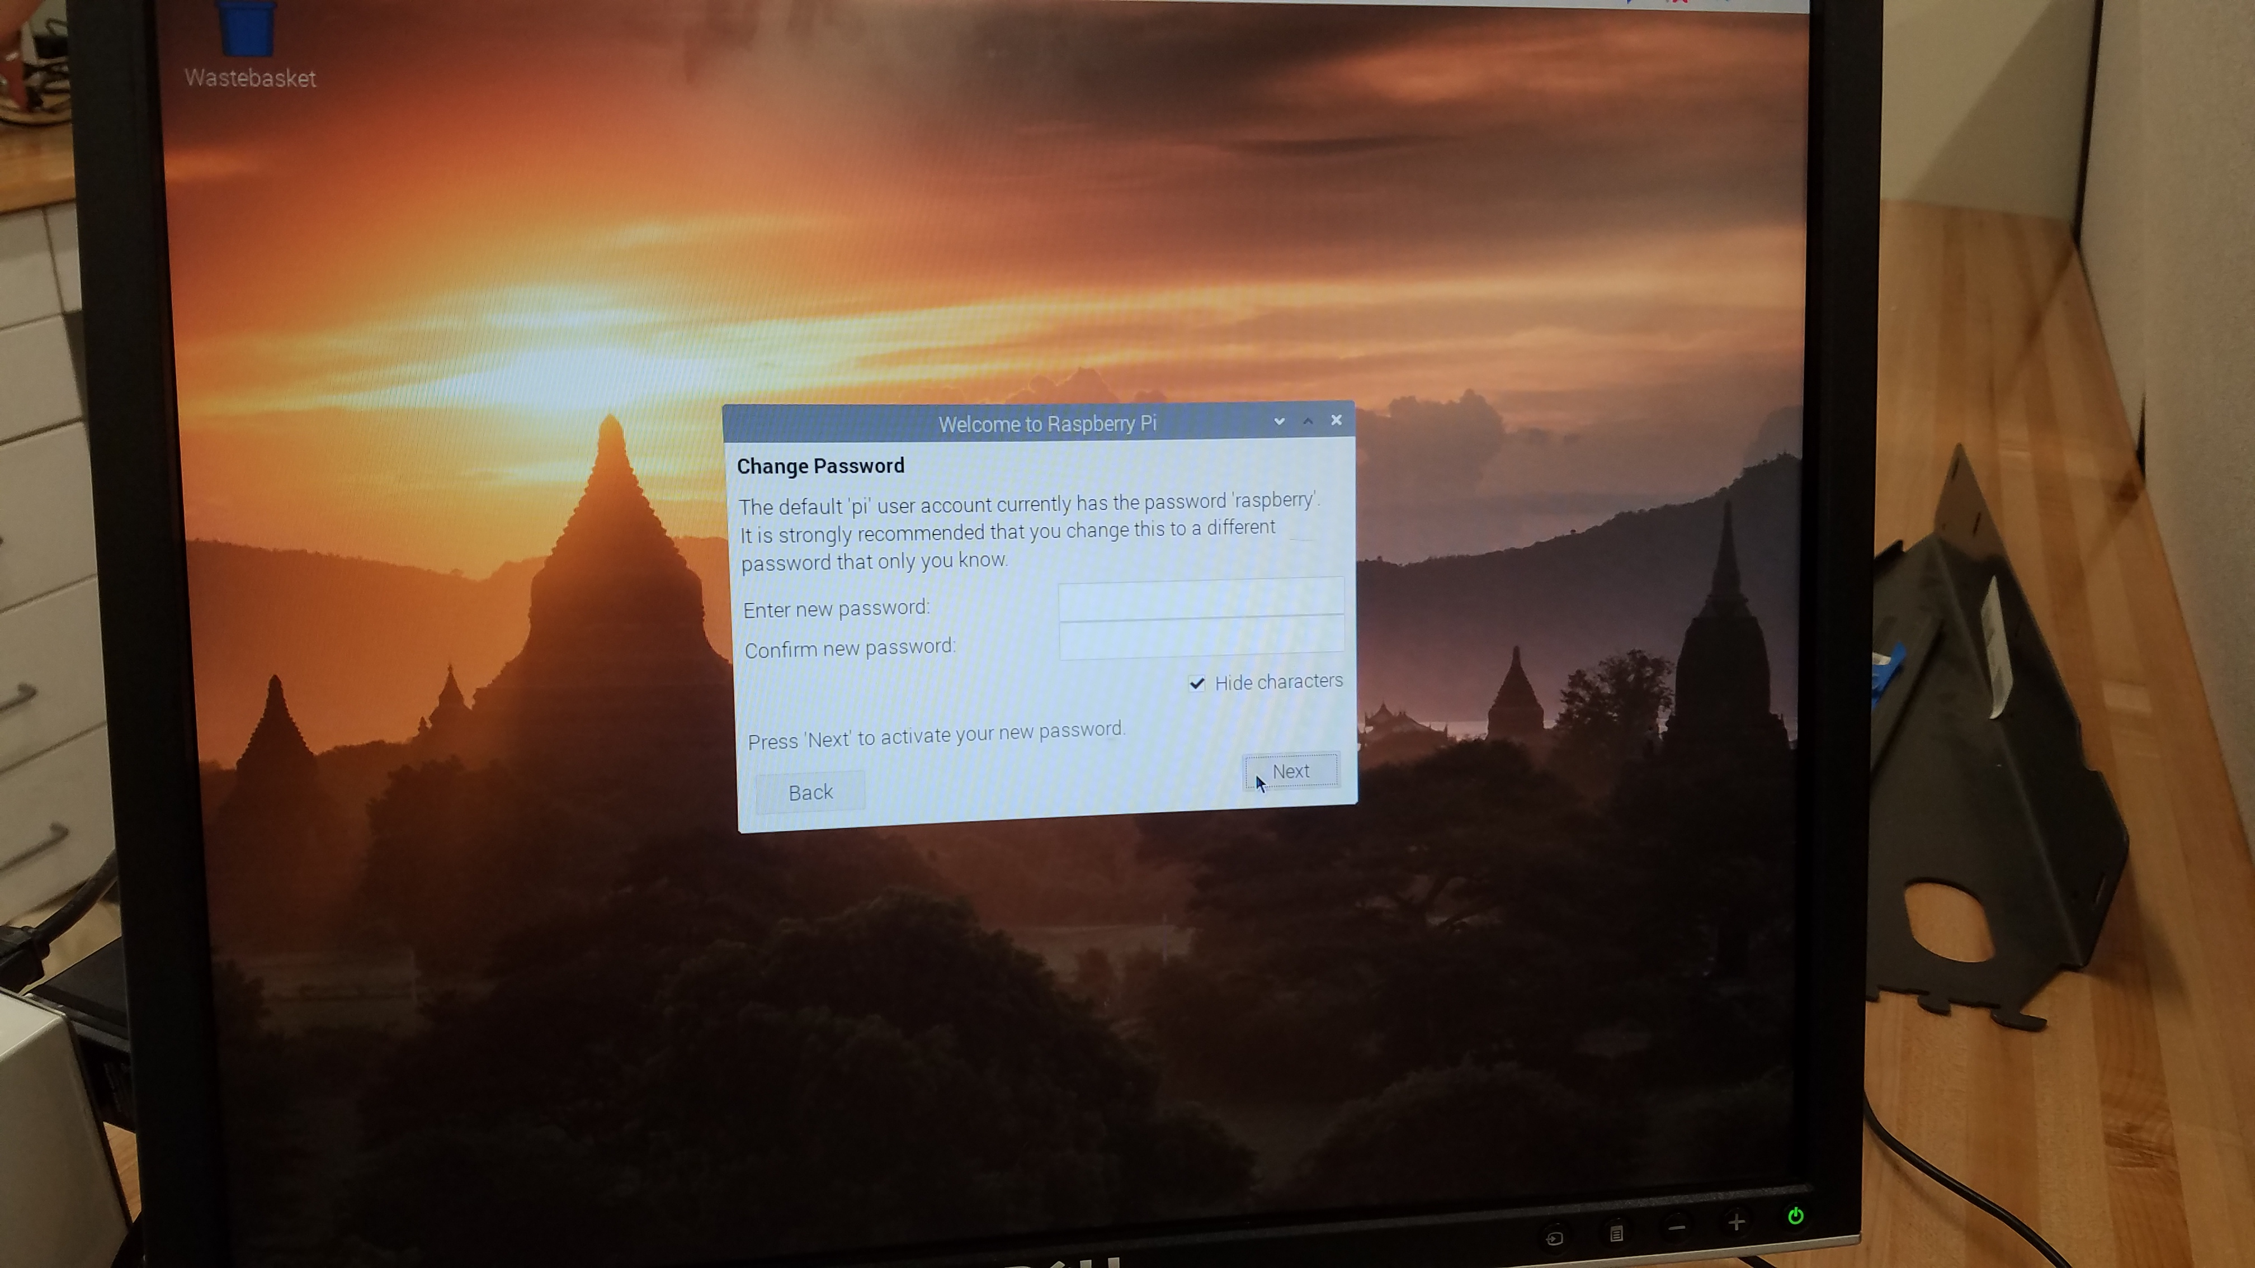
Initial startup

Slide 7
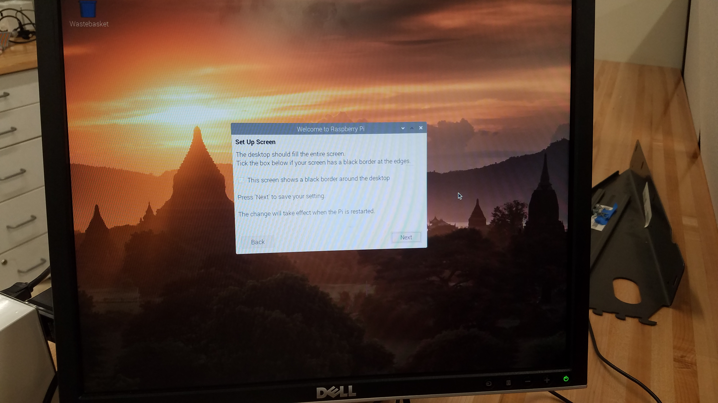
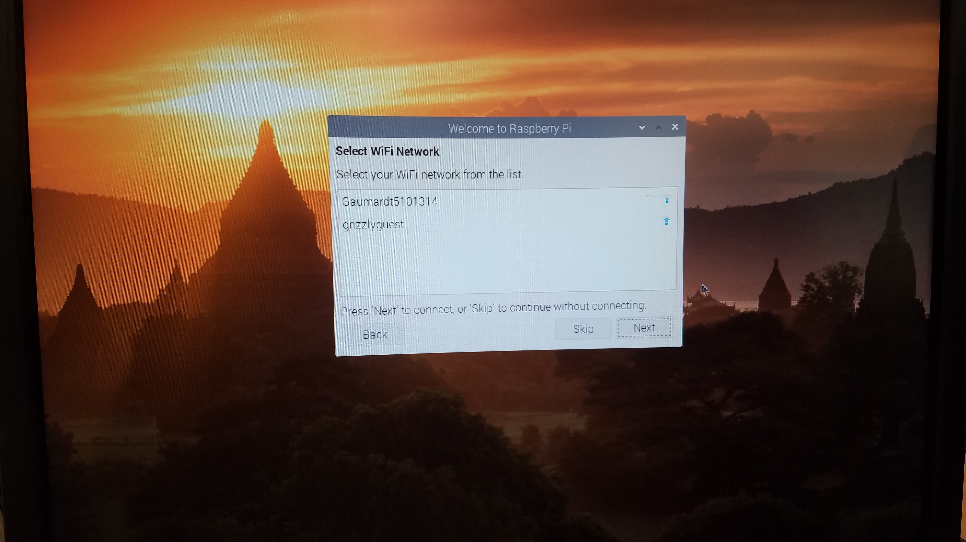
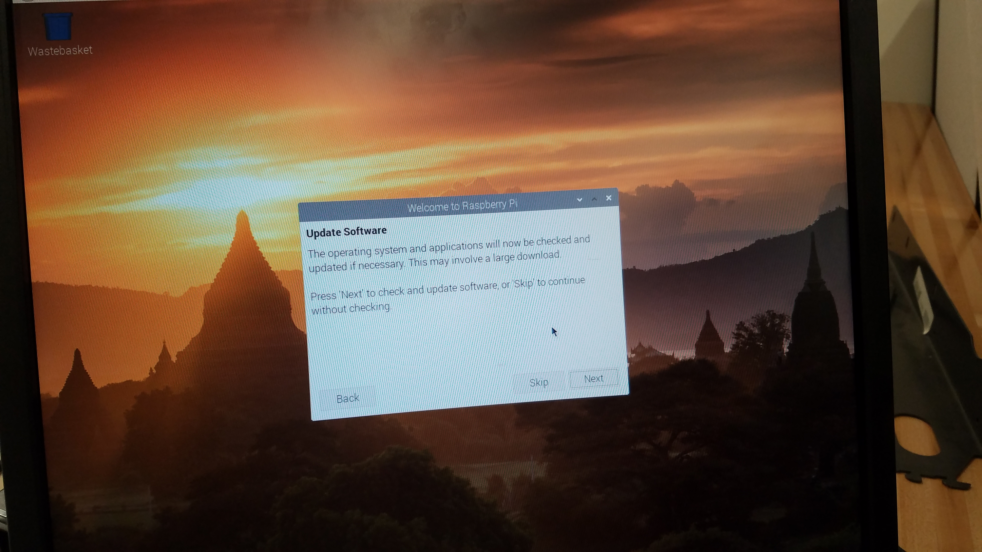
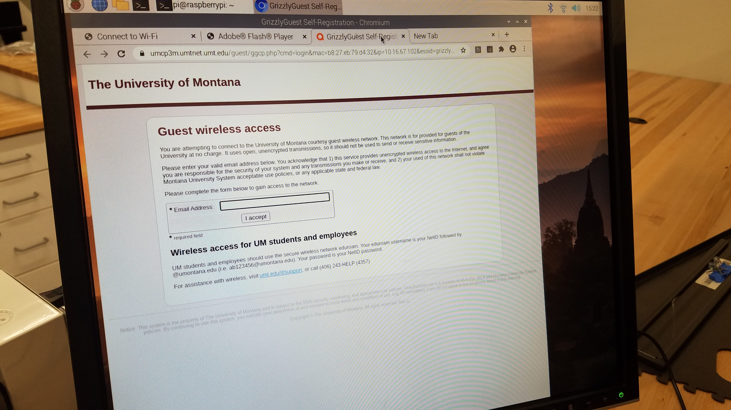
Initial startup part 2

Slide 8
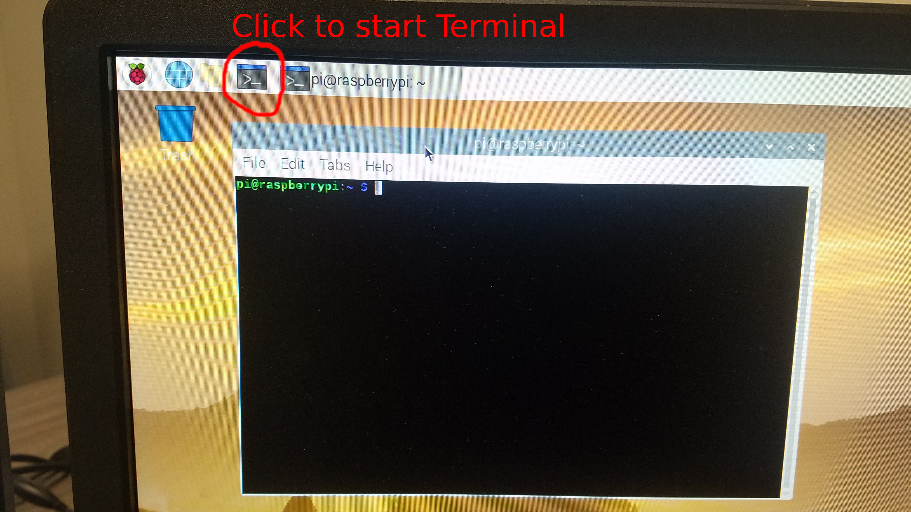
Set time
Open terminal with
the icon or
CTRL+ALT+t
Run the command
sudo date –set “Jul 12 2021 09:00”
(but with the current date/time)

Slide 9
Download the code
git clone http://github.com/vcv-missoula-college/projects
Now we will go to MC04 for a soldering demo

