Slide 1
Graphs - Implementation

Slide 2
Overview
Theory
  What is a graph?
Implementation
Notes:
What is a graph?
Basic vocab, and theory
Uses for a graph
Implementation
Different ways to implement a graph
Example code in Java

Slide 3
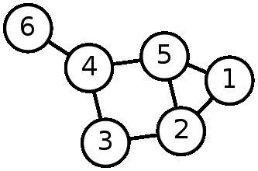
Vocab
Nodes
Edges
  -directed/undirected
  Weighted/unweighted
Path
Cycle
Notes:
Nodes – a vertex, can have info associated with it
-order = # of nodes
Edges- link between two vertices
-directed/undirected
-weighted/unweighted
-numeric val associated with it like cost or time, can be negative in some cases
-size - # of edges
Path – usually, a route alternating between vertices and edge where starting/ending vertices are different and no edges are repeated
Cycle – a path where the starting/ending vertices are same

Slide 4
Uses
Concrete
  Flights and ticket prices
  Locations and distance
Abstract
  Webpages and hyperlinks
  4 color map problem
Notes:
Flights and ticket prices
-I want to get from LA to New York at the lowest price.
Locations and Distance
-I am going to the museum with some friends I'll
Be picking up, what's the quickest way?
Webpages and Hyperlinks
-Wikipedia Game – start to goal article within shortest number of clicks
Four color map problem
-I have a map. I want to color the map using only four colors, without colors touching.

Slide 5
Implementation
Adjacency List
Adjacency Matrix

Slide 6
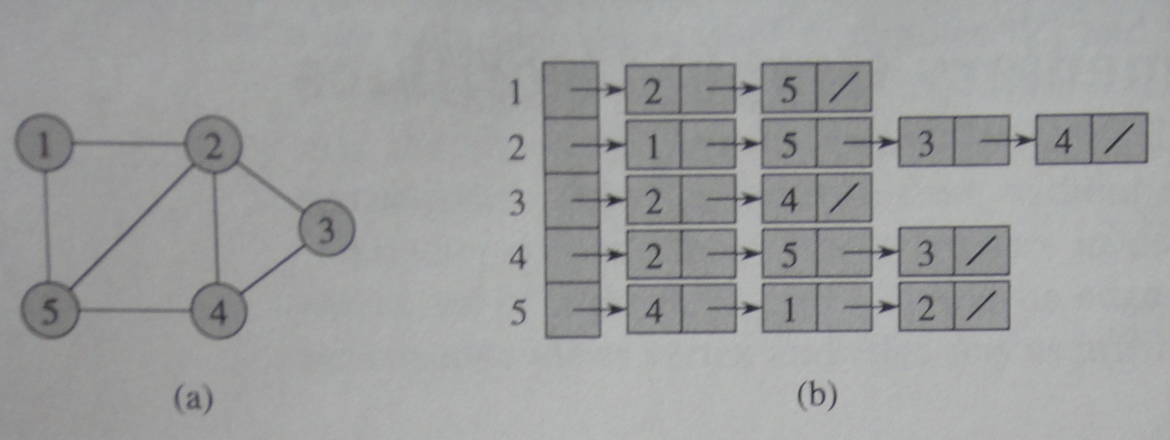
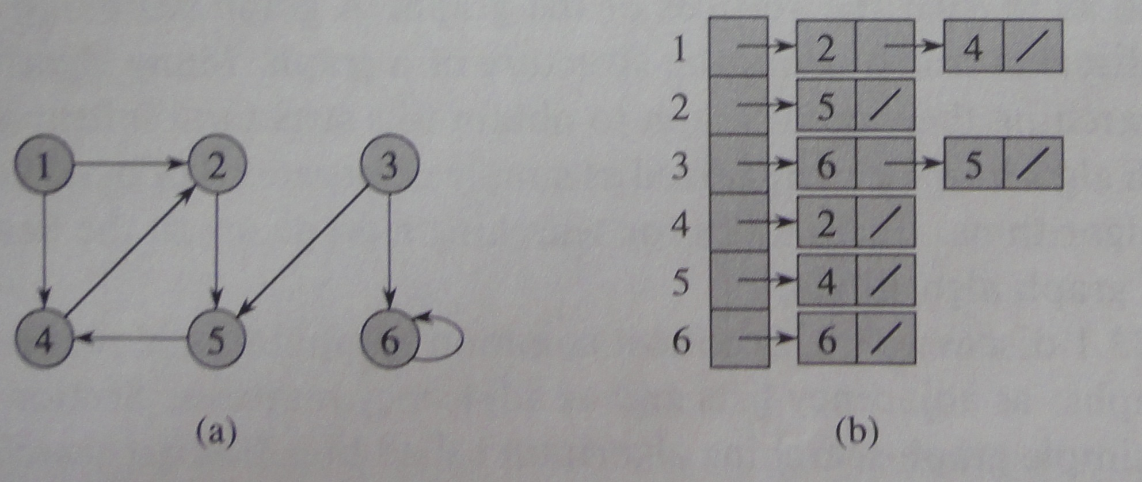
Adjacency list
Undirected
Directed
Source: Introduction to Algorithms, CLR
Notes:
Adjacency list
Each node is entry in a list, which has a list of its own of its neighbors
Usually, it's only for undirected graphs
Disadvantage – can't store info about edges – weights??

Slide 7
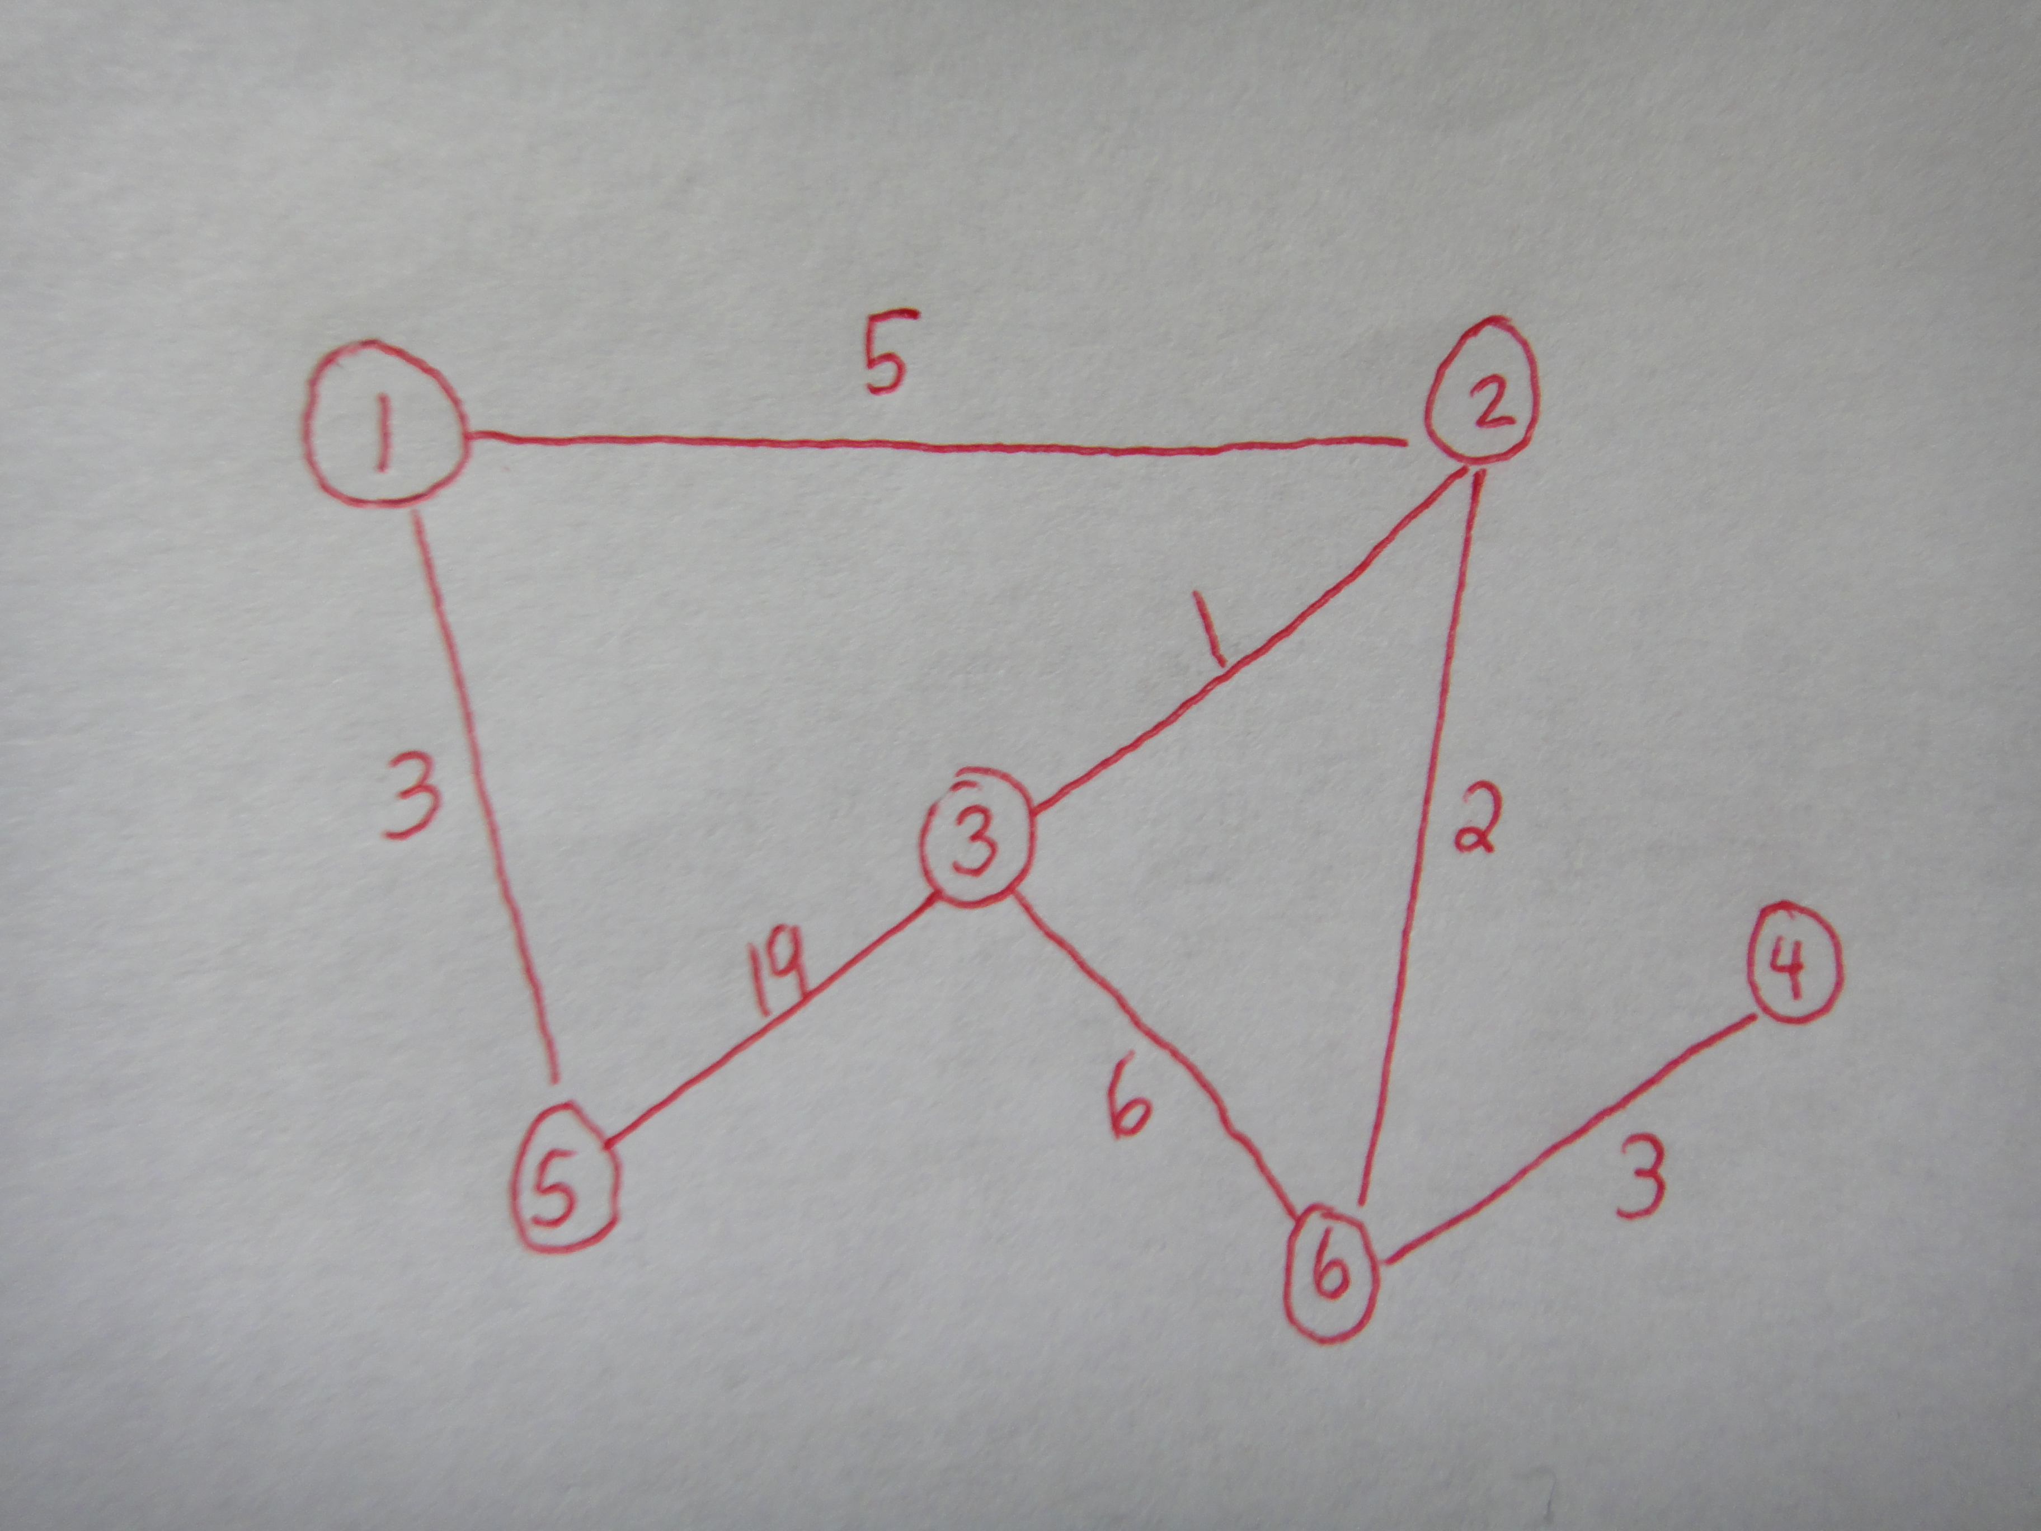
Adjacency List

Slide 8
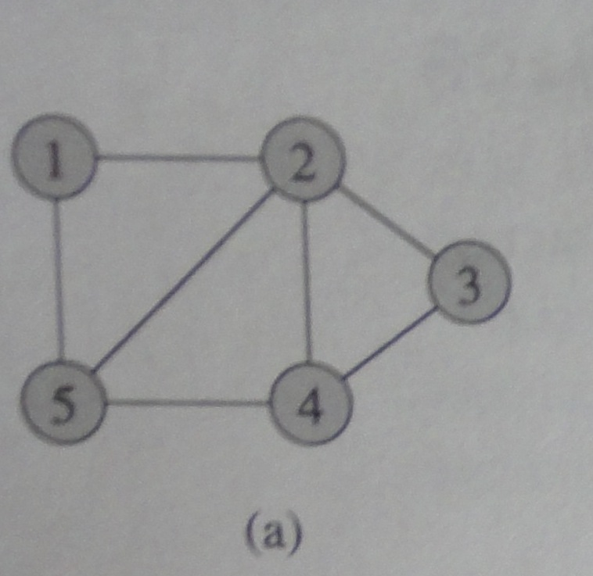
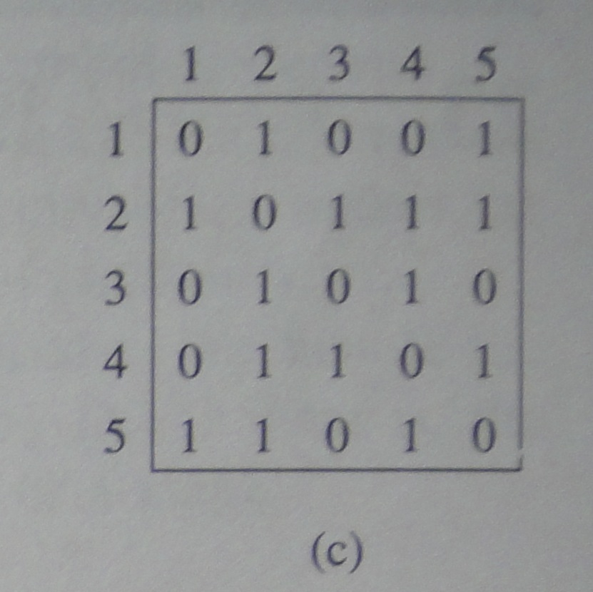
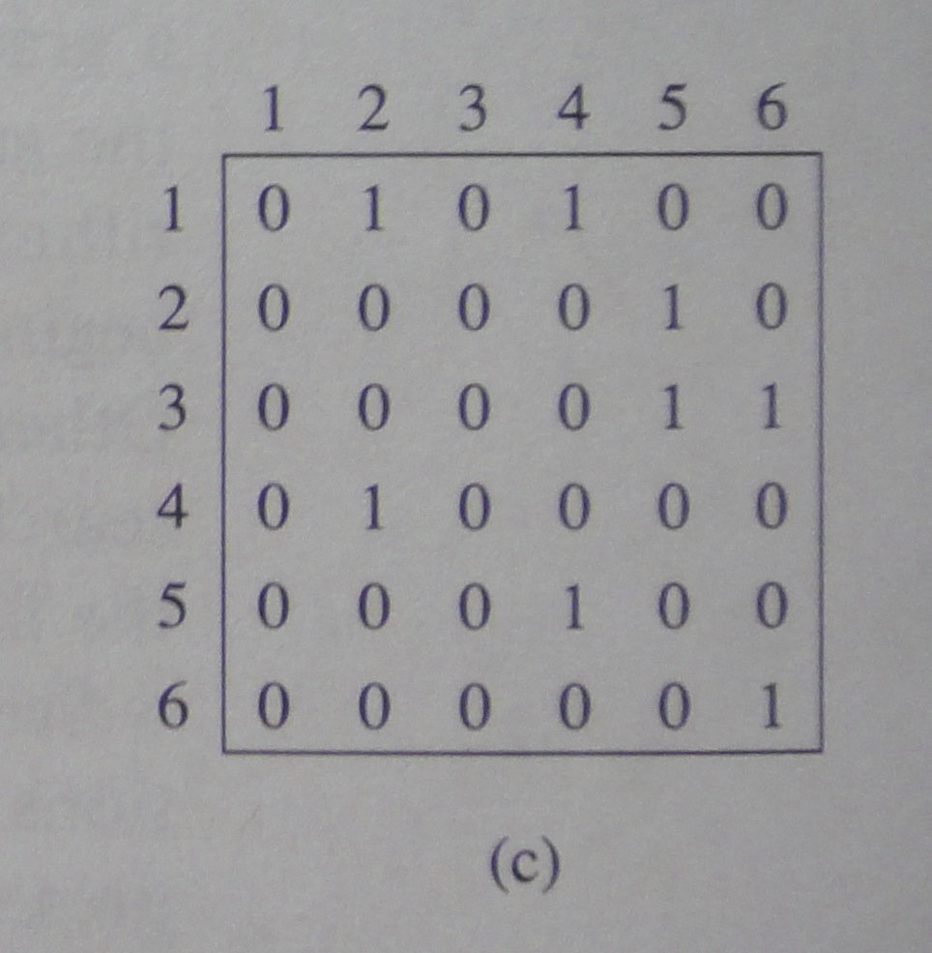
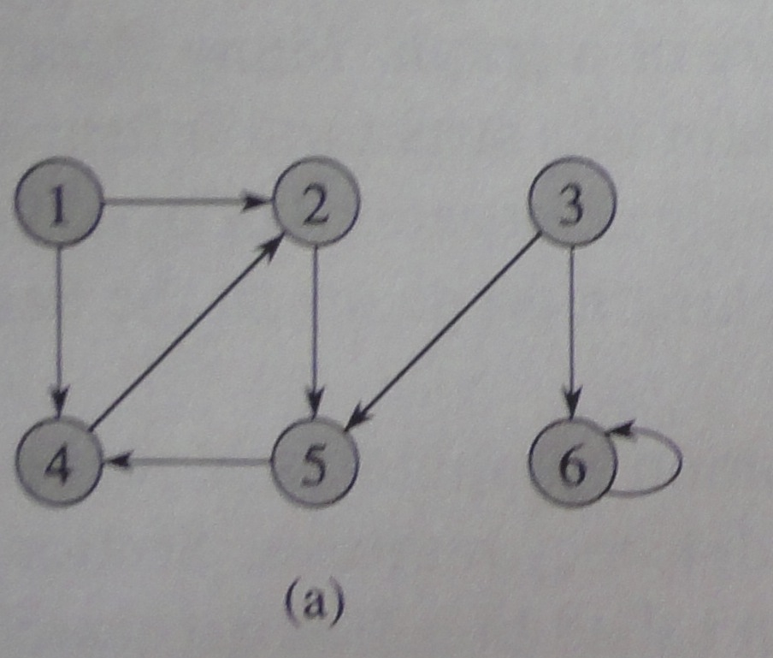
Adjacency matrix
Undirected
[i][j] = from I to j
Note the symmetry
Directed
Notes:
Undirected
Note the symmetry – there exists an edge from point A to point B and point B to point A
Directed
From I to J – one direction only
Alternate -
-this one only stores TRUE if there is an edge
-can also store the weight of an edge, set
non=edged to weight infinity (or -1 if no negative edges)
Problem – when there are a ton of vertices, but only 1 or two edges – wasted space

