Slide 1
Graphs pt2 – Traversal Algorithms

Slide 2
Overview
DFS – Depth First Search
BFS – Breadth First Search

Slide 3
Breadth First Search (BFS)
Searching through a tree level by level to find all vertices that can be reached by a certain node
Start → All nodes 1 edge away → All nodes 2 edges away...
Need to account for visited/unvisited nodes to avoid cycling in an infinite loop

Slide 4
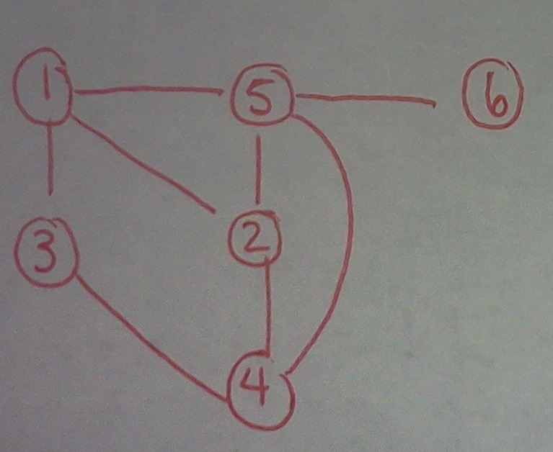
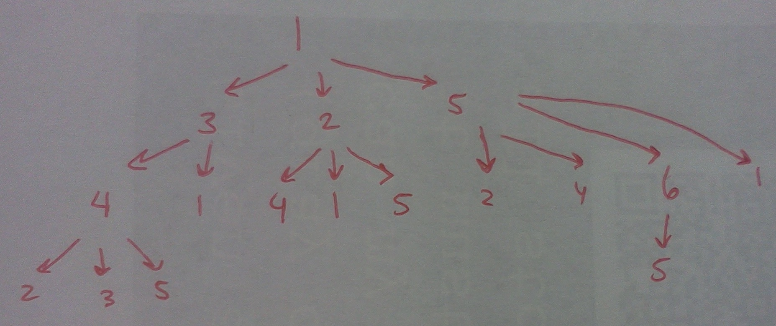
BFS Example

Slide 5
Breadth First Search Algorithm, for connected graph
--------------------------------
Nodes have three states:
WHITE: Undiscovered node.
GRAY: Discovered node, but not fully explored.
BLACK: Completely explored node.
graph gr //best as an adjacency list or incidence list
queue q //used in BFS
start s // starting node
for all v in gr: //init
color[v] = WHITE //mark as undiscovered
end for
enqueue(q, start) //this starts us off
while(q is not empty):
e <- dequeue q //this will be first elem in q
for each neighbor v of e:
if color[v] = WHITE: //if undiscovered
color[v] = GRAY //discover node
enqueue(v, q) //push this child onto queue
end for
color[e] = BLACK; //completely done with the node
end while
Modified from source: http://www.personal.kent.edu/~rmuhamma/Algorithms/MyAlgorithms/GraphAlgor/breadthSearch.htm

Slide 6
//Breadth First Search for a *connected* graph
queue <int> q;
set<int> visited;
int start = 1;
q.push(start);
vector<int > order; //What is the order we are traversing?
int i =1;
cout << "Breadth First Search of a Connected Graph" <<endl;
while(!q.empty()) {
int v = q.front();
q.pop();
order.push_back(v);
cout << "Moving to node " << v <<endl;
//For each neighbor of v
it = adjList.find(v);
cout << "Node " << v << " has the following neighbors: ";
for(neigh = it->second.begin(); neigh != it->second.end(); neigh++) {
//If the neighbor has been visited already, mark it
if(visited.find(*neigh) == visited.end()) {
q.push(*neigh);
visited.insert(*neigh);
}
}
visited.insert(v);
cout <<" -> Done visiting " <<v << ", ";
}

Slide 7
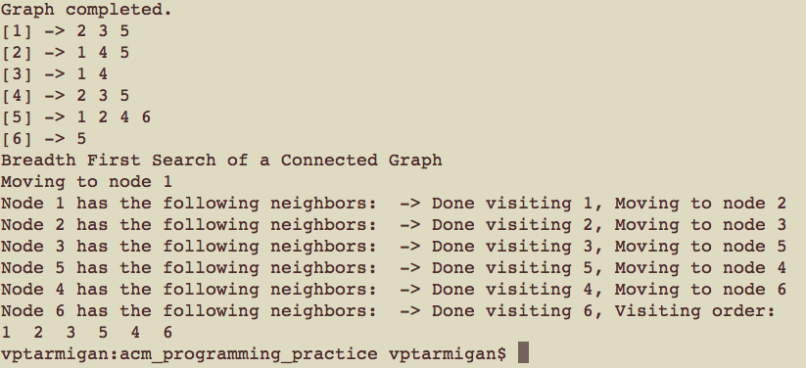

Slide 8
Depth First Search (DFS)
Starts at one node
Goes as far along as possible along a path until it reaches the end, then backtracks
Corn maze – always keeping one hand on the wall

Slide 9
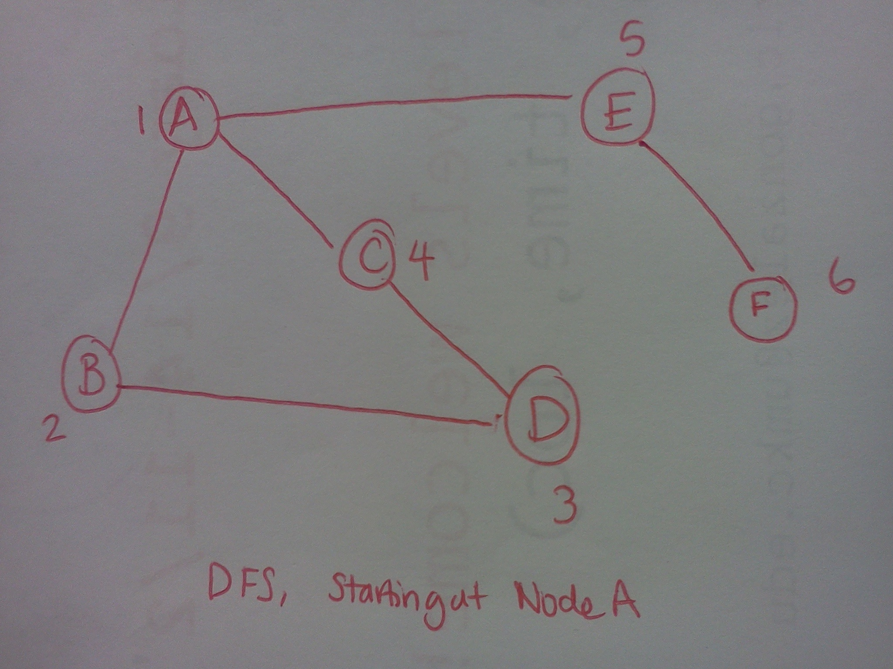

Slide 10
DFS Algorithm
---------------
Nodes have three states:
WHITE: Undiscovered node.
GRAY: Discovered node, but not fully explored.
BLACK: Completely explored node.
graph gr
stack stk
start s
for all v in gr:
color[v] = WHITE //init graph
end for
push s on stk //start!
while(stk is not empty):
e <- pop stk
for each neighbor v of e:
if color[v] = WHITE: //if undiscovered
color[v] = GRAY //mark as discovered
push v on stk //push onto stack
end if
end for
color[e] = BLACK //done with this node
end while

Slide 11
stack <int> stk;
set<int> visited;
int start = 1;
stk.push(start);
vector<int > order; //What is the order we are traversing?
int i =1;
while(!stk.empty()) {
int v = stk.top();
stk.pop();
order.push_back(v);
//For each neighbor of v
it = adjList.find(v);
for(neigh = it->second.begin(); neigh != it->second.end(); neigh++) {
//If the neighbor has been visited already, mark it
cout << *neigh << " is a neighbor of " << v << endl;
if(visited.find(*neigh) == visited.end()) {
cout << "Found a non visited node!" << endl;
stk.push(*neigh);
visited.insert(*neigh);
}
}
visited.insert(v);
}
//Printing out results of the traversal
vector<int>:: iterator vec;
cout << "Visiting order: " << endl;
for(vec = order.begin(); vec!= order.end(); vec++) {
cout << *vec << " ";
}
cout << endl;

Slide 12
