Slide 1
Files you need for a typical GacUI application
Vlpp
VlppOS
VlppRegex
VlppReflection
VlppParser (deprecating)
GacUIWindows
VlppParser2
GacUI
DarkSkin
VlppWorkflowLibrary
VlppWorkflowRuntime
VlppWorkflowCompiler
GacUIReflection
DarkSkinReflection
GacUICompiler

Slide 2
<Instance ref.CodeBehind="false" ref.Class="helloworld::MainWindow">
<Window Text="Hello, world!" ClientSize="x:480 y:320">
<att.BoundsComposition-set PreferredMinSize="x:480 y:320"/>
<Label Text="Welcome to GacUI Library!">
<att.Font>fontFamily:"Segoe UI" size:32 antialias:true</att.Font>
</Label>
</Window>
</Instance>

Slide 3
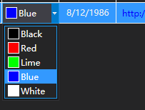
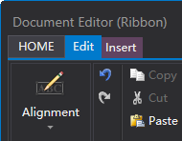

+
{ }
[1, 2, 3]
1
2
class C {
void F();
};
文
A
α
あ
ꀉ
1
A
#
numbers
\d+
{ }
{a:0}
.cpp
test()
#FFFFFF
return 0 ;
a.txt
class VM {
void Submit();
};
</>
class C {
void F();
};
R”str(...
{ }

Slide 4
DecoderStream
BomDecoder
RecorderStream
FileStream
StreamReader
BroadcastStream
EncoderStream
Utf8Decoder
FileStream
EncoderStream
Utf16Decoder
FileStream

Slide 5
Parent
Parent.InternalMargin.top
Parent.InternalMargin.left
AlignmentToParent.right
Parent.InternalMargin.right
AlignmentToParent.left
AlignmentToParent.top
Margin.top
Margin.left
Margin.right
this
composition
Margin.bottom
AlignmentToParent.bottom
Parent.InternalMargin.bottom

