Slide 1
Banking Dataset
Marketing Targets Prediction
Customer conversion prediction for term deposits
Group 8

Slide 2
Topic
Every business has a limited marketing budget. Therefore it's vital that each dollar is spent in the most efficient way possible.
Prediction based on existing customer base really helps in developing focussed marketing initiative and better customer upselling
Product: Term deposits are similar to GICs, where a client will give the bank money in exchange for the money plus interest after a fixed period of time. During this time, the client is unable to withdraw their money.
In a bank's case, it's necessary to determine which of their clients will be receptive to phone marketing campaigns regarding the bank's financial services, specifically term deposits.

Slide 3
Team Members
Andrew (ML Lead)
Vikas (PM / Deck / Git Hub Lead))
Shawn (DB Lead)
Joan (Data analysis / Dashboard Lead)
Zubair (Data Clean Up Lead)

Slide 4
Rationale
The motivation behind the topic is to determine if marketing campaigns through phone calls is an effective use of marketing spend by companies such as a bank or large institution.
This could also shed light on why so many people receive fraudulent phone calls of people claiming to be from IRS/CRA demanding money. If phone campaigns are truly effective, then one would expect to continue receiving fraudulent calls.

Slide 5
Data Source
Dataset source: Kaggle (https://www.kaggle.com/prakharrathi25/banking-dataset-marketing-targets)
The data was pulled from the UCI Machine learning repository. The data was gathered from marketing campaigns a Portuguese banking institution implemented through phone calls.
Source: [Moro et al., 2014] S. Moro, P. Cortez and P. Rita. A Data-Driven Approach to Predict the Success of Bank Telemarketing. Decision Support Systems, Elsevier, 62:22-31, June 2014

Slide 6
Objectives
(Questions to be answered)
Primary Goal:
To determine whether or not a bank client would be interested in a term deposit subscription based on their profile and past history with the bank. This will enable the bank to better target their phone based marketing efforts towards clients who would be open to a term deposit subscription.
Secondary Goal(s)
Determine if there is an upper limit on the amount of marketing campaigns a client can receive before terminating communication
Determine if a relationship between a client's profile and their usage of financial services exists

Slide 7
Communication Protocols
Group communication will be located on a Slack group that each member will join.
We also created whatsapp group for quick assembly / communication
Any updates or changes throughout the project will be posted in this group chat.
Additionally members will be able to direct message any other member of the group in order to ask them questions or make comments about the project, the data or the work.
Microsoft Teams is being used for weekly project update meetings

Slide 8
Technology stack
Database Storage
Postgres is the database we intend to use since the data for the topic is well structued with a specific schema. We will import and export data using SQL queries and the Python "Pandas" library.
Machine Learning
SciKitLearn is the ML library we'll be using to create, train, and test a model. The order of creating a model will be the following
Preprocessing data
Model selection
Model training
Model testing and results
Output metrics
Dashboard
In addition to using a Flask template, we will also integrate D3.js and Plotly for a fully functioning and interactive dashboard. It will be hosted on Github Pages.
Tableau

Slide 9
Data exploration
Extraction:
Data extracted from the CSV file using Pandas read me
Analysis of features to be used for analysis and machine learning model
Transformation
Removed null values
Checked the data types, converted string to boolean whenever needed for code
Analysis to check properties about the features such as
Distribution
missing values
extreme values

Slide 10
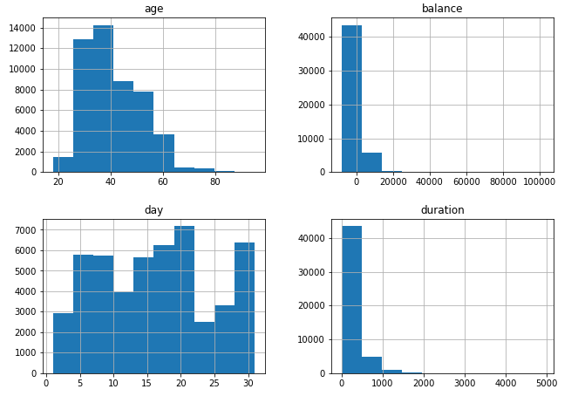
Analysis phase
Distribution of numerical values

Slide 11
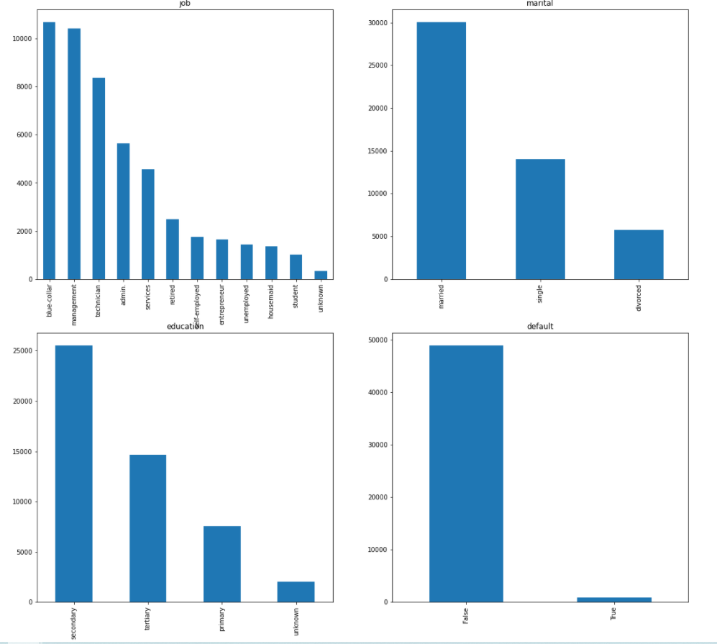
Analysis phase
Frequency of features

Slide 12
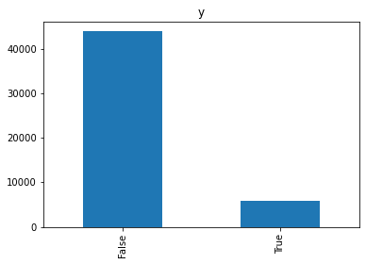
Analysis phase
Frequency of outcome

Slide 13
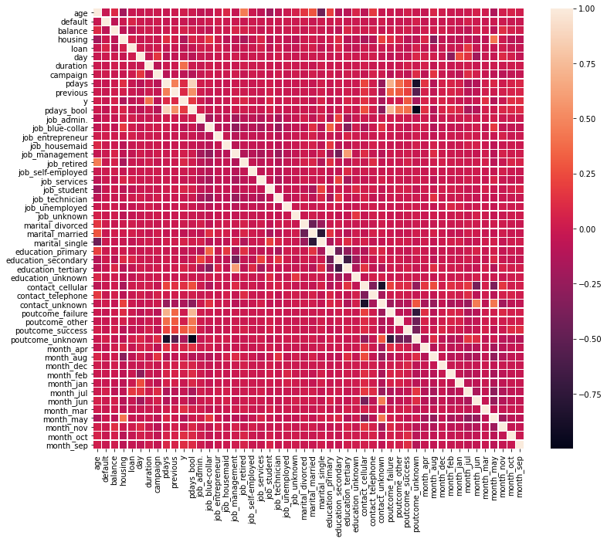
Analysis phase
Find one to one relationships between features and outcome

Slide 14

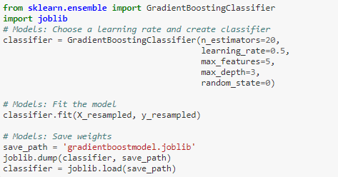
Machine learning
Preprocessing / Feature engineering:
Dropped features that were not relevant to the model
Converted category variables into multiple binary variables for modelling to work
Train/test set
Created data splits into a training and test set using stratification
Used sampling on the training set to accommodate the class imbalance of the outcome variable.
Models
Trained models using the preprocessed training set

Slide 15
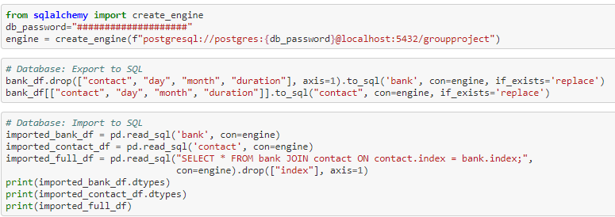
Database Integration
Used Sqlalchemy to connect to database
Data exported to excel for analysis
Tables created to hold required data
Join created to combine the data

