Slide 1
Morse Code Decoder Victor Dinh May 9th, 2016
Abstract: Receiving and decrypting Morse code messages can take several minutes and requires a well-trained human decoder. Luckily, with the help of computers, one can decrypt a 10 minute Morse message in 10 seconds or less. To do this, the computer smooths out a sound file by using a filter, identifies dashes and dots, recognizes patterns of words and spaces, and compares these dashes and dots with a Morse dictionary. This program makes it possible for an untrained person to read the message from a Morse code file.

Slide 2
Background
Decrypting Morse code has traditionally required experienced decoders
Training human decoders uses up a lot of time
Why not use a computer program instead?
Programs are faster at decrypting messages
Anyone could use this program

Slide 3
Technical Approach – 1
This project uses 7 customized functions
Most of these functions involve combing through arrays or cells of data and manipulating each of their elements
Some numerical methods:
Getting average value of multiple segments of data in an array
Determining Morse letters in a string of dots, dashes, and spaces

Slide 4
Technical Approach – 2
Basic steps:
Read in sound file, save data, and determine frequency of data
Square and smooth data so that noise doesn’t heavily affect calculation time
Get logical vector indicating sounds and silences
Determine whether there is a dot, dash, or silence

Slide 5
Technical Approach – 3
Determine combinations of dots, dashes, and silences that make up words, letters, or spaces
Convert Morse to alpha-numeric characters
Put these characters and spaces into a string
Save result
Done!

Slide 6
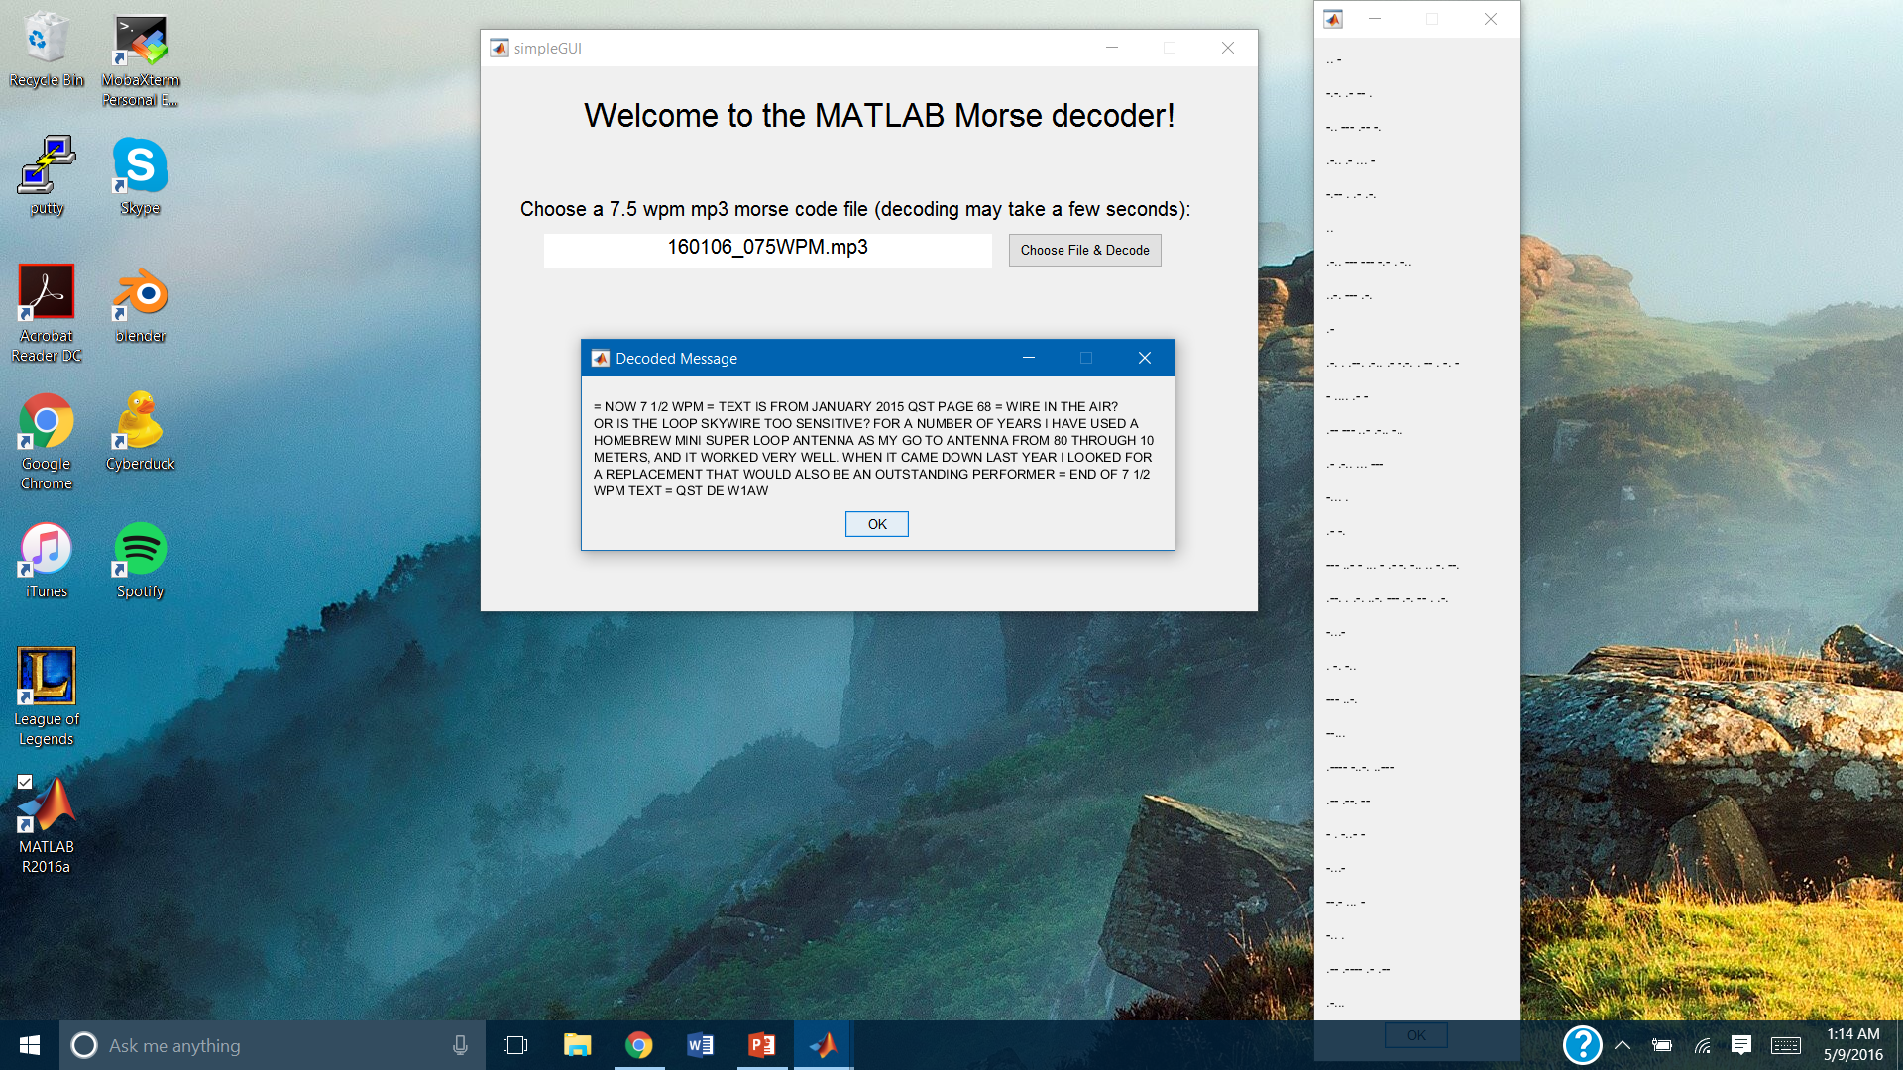
Results

Slide 7
Conclusions and Next Steps
The code works, but only for 7.5 wpm Morse messages with very little noise.
Improvements could enable the program to read any speed of Morse message.
Options to GUI could be added, such as:
Toggle switch for playing sound
Password to be able to decode messages
More user-friendly design to accommodate these options

Slide 8
References
MATLAB documentation
Project handout
TA
Classmates

