Slide 1
Math 411: Numerical Analysis
Chapter-1: Mathematical Preliminaries

Slide 2
Chapter Summary
1.1 Review of Calculus
1.2 Round-off Errors and Computer arithmetic
1.3 Algorithms and converges

Slide 3
1.1 Review of Calculus ----Limits and Continuity

Slide 4
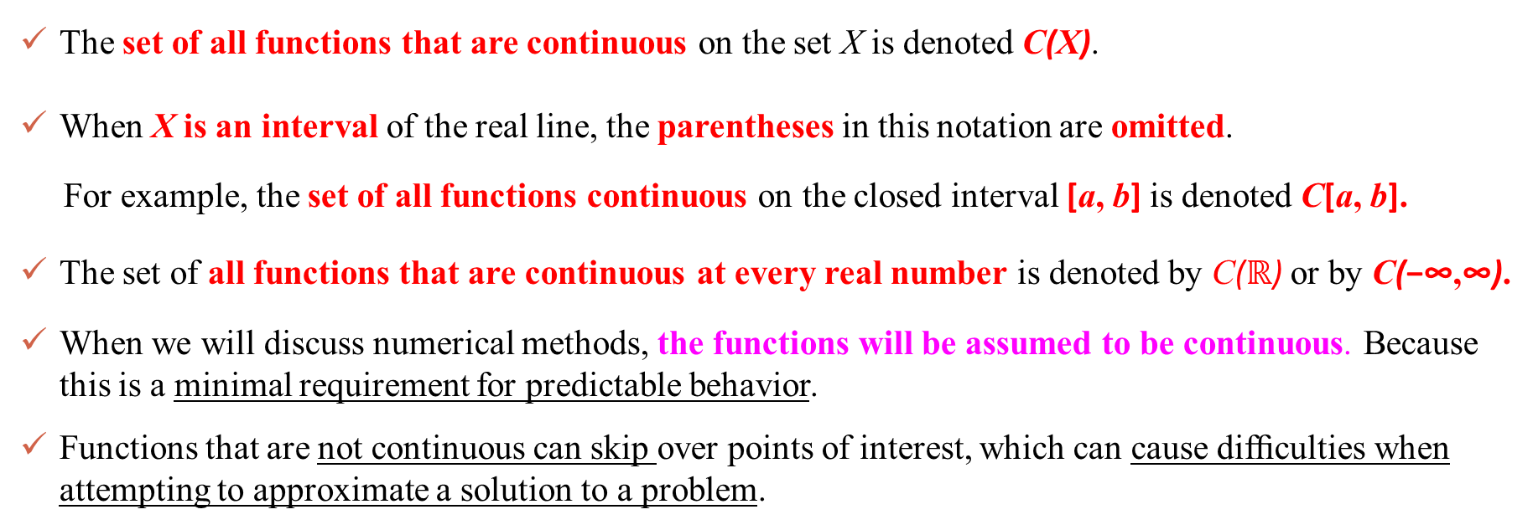
1.1 Review of Calculus ----Limits and Continuity
The set of all functions that are continuous on the set X is denoted C(X).
When X is an interval of the real line, the parentheses in this notation are omitted.
For example, the set of all functions continuous on the closed interval [a, b] is denoted C[a, b].
The set of all functions that are continuous at every real number is denoted by C($ℝ$) or by C(−∞,∞).
When we will discuss numerical methods, the functions will be assumed to be continuous. Because this is a minimal requirement for predictable behavior.
Functions that are not continuous can skip over points of interest, which can cause difﬁculties when attempting to approximate a solution to a problem.

Slide 5
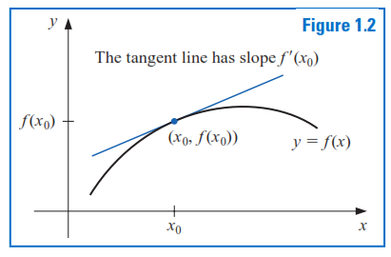
1.1 Review of Calculus ----Derivative
More sophisticated assumptions about a function generally lead to better approximation results.
For example, a function with a smooth graph will normally behave more predictably.
The smoothness condition relies on the concept of the derivative.
Note:
Theorem: If the function f is differentiable at $x_{0}$, then f is continuous at $x_{0}$.

Slide 6

1.1 Review of Calculus ----Derivative
Average rate of changes is zero
6
Rate of change is zero. Because things are reversed at this point. i.e., slope of horizontally oriented line is zero
Notes:
in other words, f(x) has a critical point in (a,b).
Rolle's theorem essentially states that any real-valued differentiable function that have equal values at two distinct end points must have at least one critical/stationary point somewhere between them—that is, a point where the first derivative is zero.

Slide 7
1.1 Review of Calculus ----Derivative

Slide 8
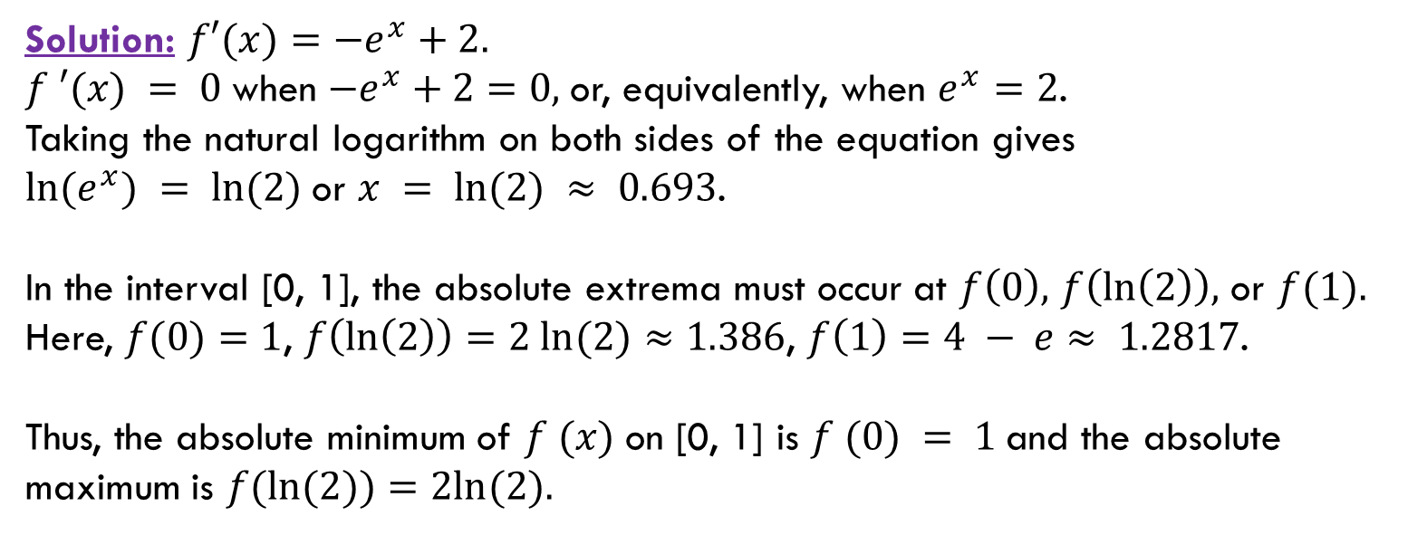

1.1 Review of Calculus ----Derivative
Example: Find the absolute minimum and absolute maximum values of
$f\left(x\right)=2−e^{x}+2x$ at [0,1]
Solution: $f′(x)=−e^{x}+2.$
$f ′(x) = 0$when $−e^{x}+2=0,$or, equivalently, when $e^{x}=2$.
Taking the natural logarithm on both sides of the equation gives
$ln⁡(e^{x}) = ln⁡(2)$or $x = ln⁡(2) ≈ 0.693$.
In the interval [0, 1], the absolute extrema must occur at $f\left(0\right),$ $f\left(\ln\left(2\right)\right),$ or $f(1).$
Here, $f(0)=1$, $f\left(\ln\left(2\right)\right)=2 ln⁡(2)≈1.386$, $f\left(1\right)=4 − e≈ 1.2817$.
Thus, the absolute minimum of $f (x)$on [0, 1] is $f (0) = 1$and the absolute
maximum is $f(ln⁡(2))=2ln⁡(2).$

Slide 9
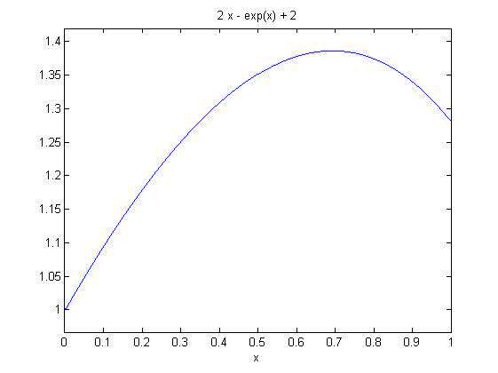
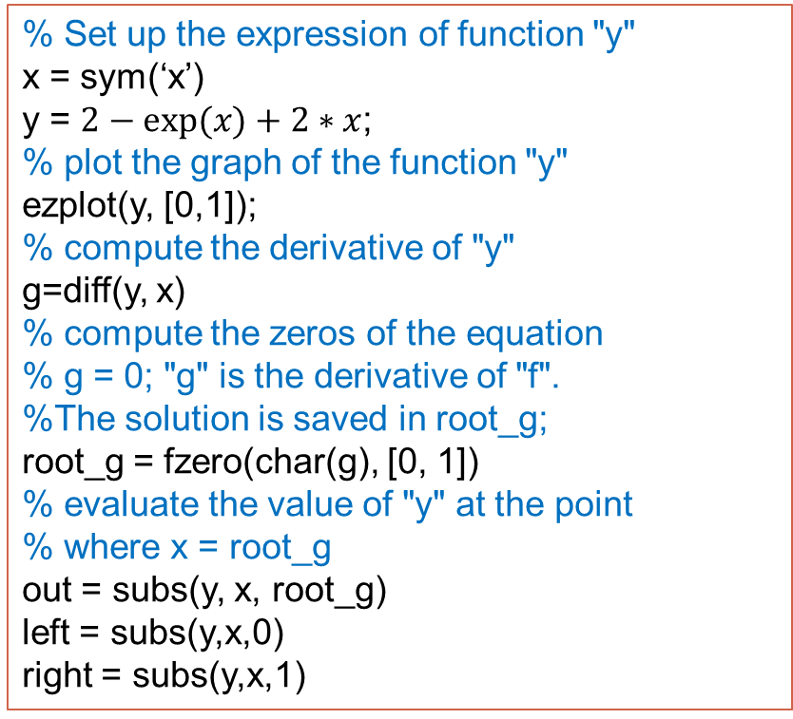
1.1 Review of Calculus ----Derivative
% Set up the expression of function "y"
x = sym(‘x’)
y = $2−exp⁡(x)+2∗x$;
% plot the graph of the function "y"
ezplot(y, [0,1]);
% compute the derivative of "y"
g=diff(y, x)
% compute the zeros of the equation
% g = 0; "g" is the derivative of "f".
%The solution is saved in root_g;
root_g = fzero(char(g), [0, 1])
% evaluate the value of "y" at the point
% where x = root_g
out = subs(y, x, root_g)
left = subs(y,x,0)
right = subs(y,x,1)
g = 2 - exp(x)
root_g = 0.6931
out = 1.3863
left = 1
right = 1.2817

Slide 10
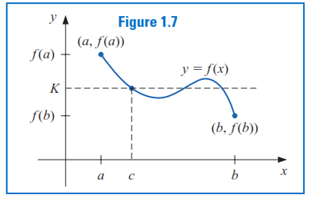
1.1 Review of Calculus ----IVT
Intermediate means anywhere between f(a) and f(b), i.e., it does not necessarily mean the mid-point.

Slide 11
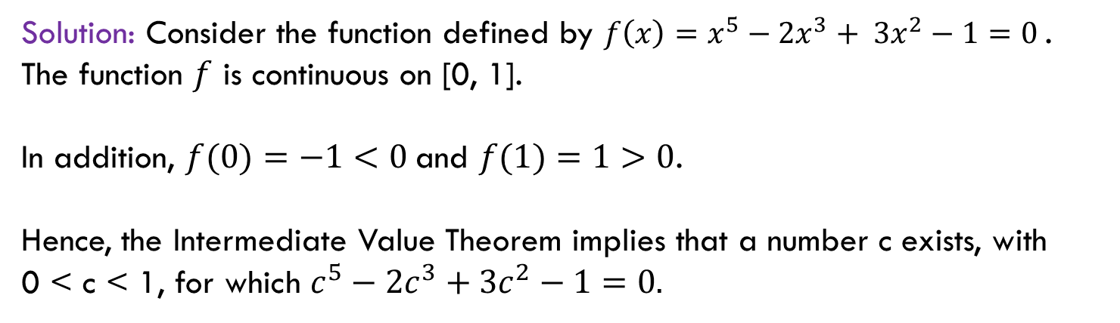
1.1 Review of Calculus ----IVT
Example: Show that $x^{5}−2x^{3}+ 3x^{2}−1=0$has a solution in the interval [0,1].
Solution: Consider the function defined by ${f\left(x\right)=x}^{5}−2x^{3}+ 3x^{2}−1=0$. The function $f$ is continuous on [0, 1].
In addition, $f(0)=−1<0$and $f(1)=1>0$.
Hence, the Intermediate Value Theorem implies that a number c exists, with
0 < c < 1, for which $c^{5}−2c^{3}+3c^{2}−1=0.$
As seen in this example, the Intermediate Value Theorem is used to determine when solutions to certain problems exist.

Slide 12
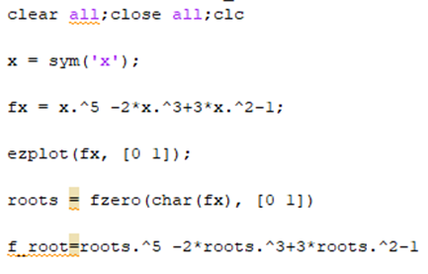
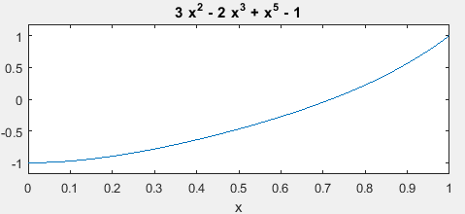
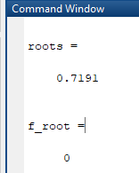
1.1 Review of Calculus ----IVT
12
Example2: Show that $x^{5}−2x^{3}+ 3x^{2}−1=0$has a solution in the interval [0,1].

Slide 13



1.1 Review of Calculus Taylor Polynomials and Series
Non-elementary functions such as trigonometric, exponential, and others are expressed in an approximate fashion using Taylor series when their values, derivatives, and integrals are computed.
Taylor’s theorem states that any smooth function can be approximated as a polynomial.
Taylor series ( center is a )
If the function f and its first n + 1 derivatives are continuous on an interval containing a and x,
there exists a point ξ between a and x such that the reminder, truncation error,
Maclaurin series ( center is 0 )
where with ξ between 0 and x

Slide 14
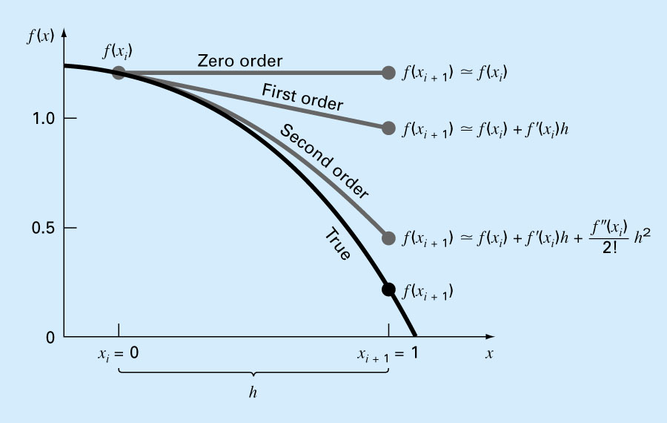
1.1 Review of Calculus Taylor Polynomials and Series
In general, the nth-order Taylor series expansion will be exact for an nth-order polynomial.
For other differentiable and continuous functions, such as exponentials and sinusoids, a finite number of terms will not yield an exact estimate.
Each additional term will contribute some improvement, however slight, to the approximation.

Slide 15
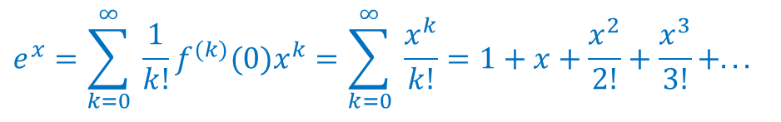
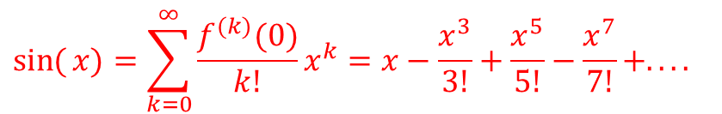
1.1 Review of Calculus Taylor Polynomials and Series
$$\text{Maclaurin} \text{series} \text{expansion} \text{of} f(x)=\sin{(}x)$$
$$e^{x}=\sum_{k=0}^{∞}{ \frac{1}{k!}f^{(k)}(0)x^{k}}=\sum_{k=0}^{∞}{ \frac{x^{k}}{k!}}=1+x+\frac{x^{2}}{2!}+\frac{x^{3}}{3!}+...$$
$$\sin{(}x)=\sum_{k=0}^{∞}{\frac{f^{(k)}(0)}{k!}x^{k}}=x−\frac{x^{3}}{3!}+\frac{x^{5}}{5!}−\frac{x^{7}}{7!}+....$$

Slide 16
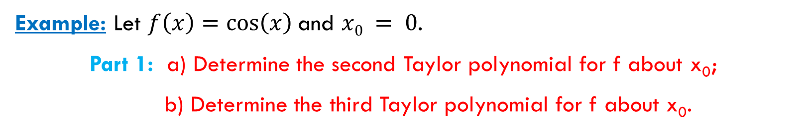
1.1 Review of Calculus Taylor Polynomials and Series
Example: Let $f\left(x\right)=\cos\left(x\right)$and $x0 = 0$.
Part 1: a) Determine the second Taylor polynomial for f about x₀;
b) Determine the third Taylor polynomial for f about x₀.
MatLab code for Taylor polynomial :
syms x
f=cos(x);
Taylor2 = taylor(f,‘ExpansionPoint’,0,‘order’,2)
Taylor3 = taylor(f,‘ExpansionPoint’,0,‘order’,3)
Taylor2 = 1
Taylor3 = 1 - x^2/2
“taylor” computes the Taylor series approximation with the order n – 1.

Slide 17
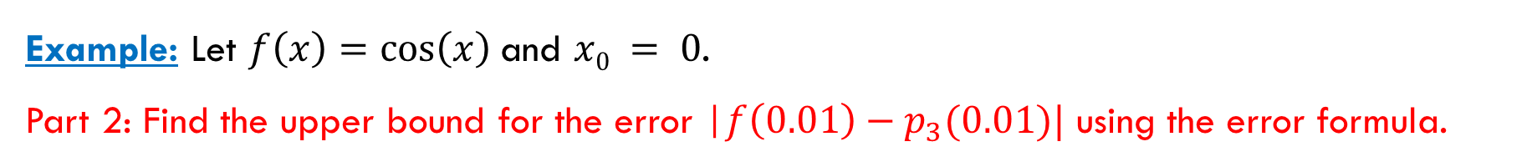
Example: Let $f\left(x\right)=\cos\left(x\right)$and $x0 = 0$.
Part 2: Find the upper bound for the error |$f\left(0.01\right)−p_{3}(0.01)|$ using the error formula.

Slide 18
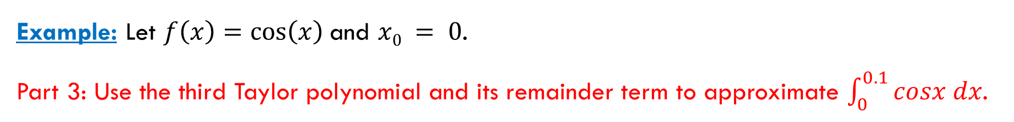
Example: Let $f\left(x\right)=\cos\left(x\right)$and $x0 = 0$.
Part 3: Use the third Taylor polynomial and its remainder term to approximate $\int_{0}^{0.1}{cosx dx}$.

Slide 19
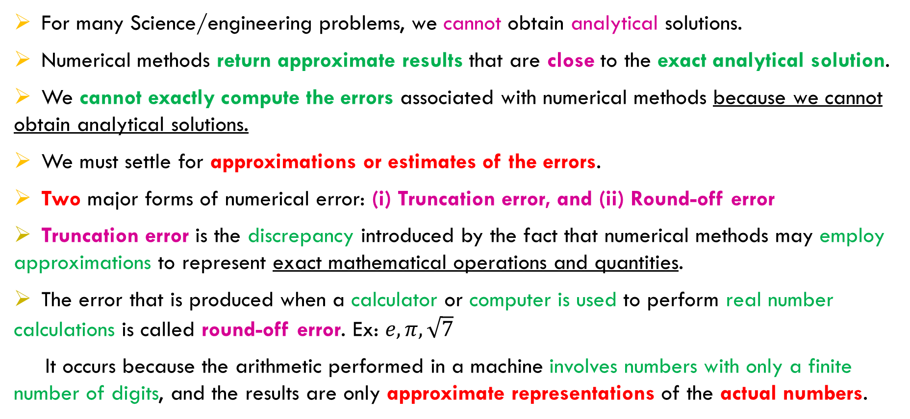
1.2 Round-off Errors and Computer arithmetic
For many Science/engineering problems, we cannot obtain analytical solutions.
Numerical methods return approximate results that are close to the exact analytical solution.
We cannot exactly compute the errors associated with numerical methods because we cannot obtain analytical solutions.
We must settle for approximations or estimates of the errors.
Two major forms of numerical error: (i) Truncation error, and (ii) Round-off error
Truncation error is the discrepancy introduced by the fact that numerical methods may employ approximations to represent exact mathematical operations and quantities.
The error that is produced when a calculator or computer is used to perform real number calculations is called round-off error. Ex: $e, π, \sqrt{7}$
It occurs because the arithmetic performed in a machine involves numbers with only a finite number of digits, and the results are only approximate representations of the actual numbers.

Slide 20
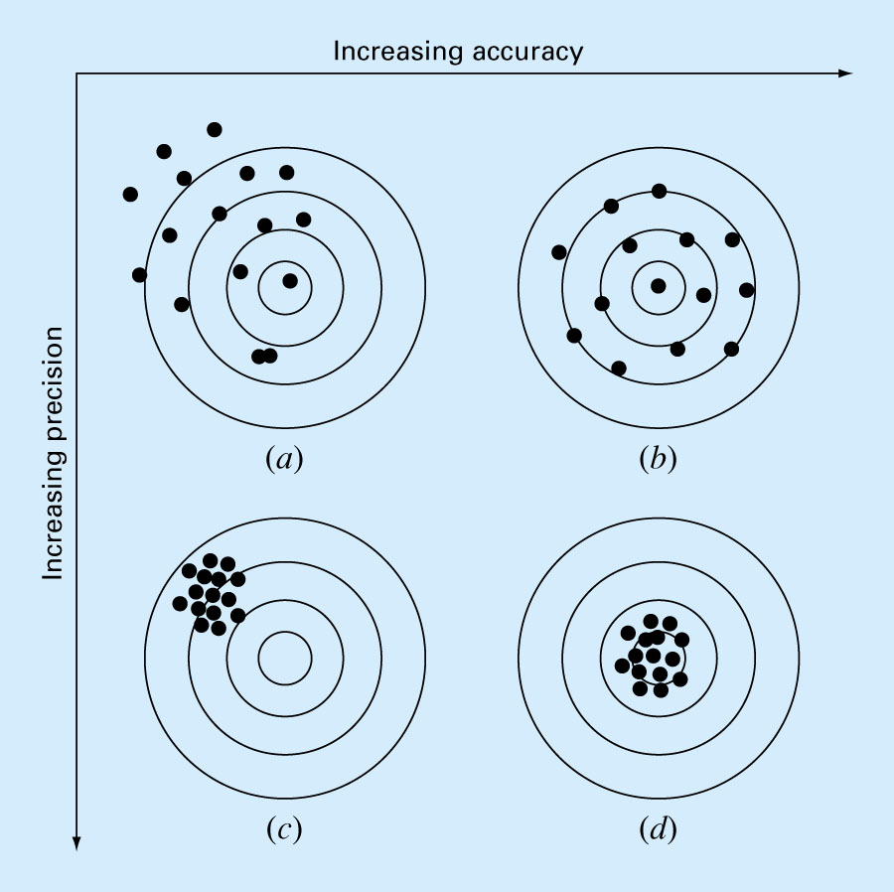
1.2 Round-off Errors and Computer arithmetic
How confident we are in our approximate result?
--The question is “how much error is present in our calculation and is it tolerable?”
Accuracy & Precision
Accuracy: How close is a computed or measured value to the true value.
Precision (or reproducibility): How close is a computed or measured value to previously computed or measured values.
Inaccuracy (or bias): A systematic deviation from the actual value.
Imprecision (or uncertainty): Magnitude of scatter.
Targets Illustrating Accuracy & Precision
inaccurate and imprecise;
accurate and imprecise;
inaccurate and precise;
accurate and precise.

Slide 21
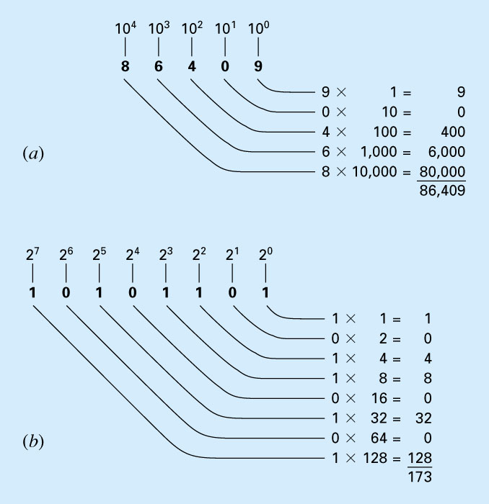
1.2 Round-off Errors and Computer arithmetic
Binary Machine Numbers:
Computer Representation of Numbers
Numerical round-off errors are directly related to the manner in which numbers are stored in a computer.
A number system is simply a convention for representing quantities.
decimal, or base-10, number system
binary, or base-2, system
(a) provides a visual representation of how the number 86,409 is formulated in the base-10 system.
In (b), the binary number 10101101 is equivalent to the decimal number 173.
Figure: How the (a) decimal (base-10) and the (b) binary (base-2) systems work.

Slide 22
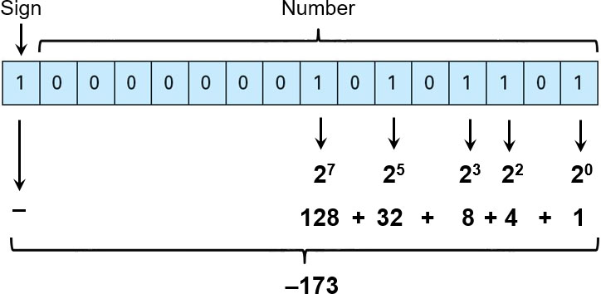
1.2 Round-off Errors and Computer arithmetic
Binary Machine Numbers:
Integer Representation.
Signed magnitude method: 16-bit is used to represent an integer:
the first bit to indicate the sign, with a 0 for positive and a 1 for negative,
the remaining bits are used to store the number.
For example, the integer value of −173 would be stored on a 16-bit computer as:

Slide 23
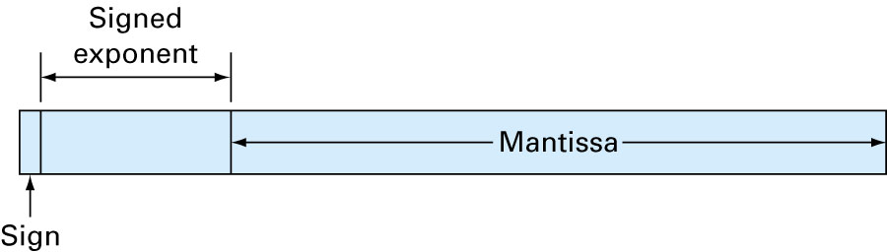
1.2 Round-off Errors and Computer arithmetic
Binary Machine Numbers:
IEEE published a report called Binary Floating Point Arithmetic Standard , provides standards for binary and decimal floating-point numbers.
64-bit is used for a real number. The first bit is a sign indicator, denoted s. This is followed by an 11-bit exponent, c, called the characteristic, and a 52-bit binary fraction, f , called the mantissa.
The base for the exponent is 2.
A floating-point number of the form: (−1)^{s}2^{c−1023}(1 + f ).
Here 1023 is called the exponent bias.

Slide 24
1.2 Round-off Errors and Computer arithmetic
Binary Machine Numbers:
A floating-point number of the form: (−1)^{s}2^{c−1023}(1 + f ).
Example: Consider the machine number
0 10000000011 1011100100010000000000000000000000000000000000000000.
Solution: The leftmost bit is s = 0, which indicates that the number is positive.
The next 11 bits, 10000000011, give the characteristic:
The final 52 bits specify that the mantissa:
As a consequence, this machine number precisely represents the decimal number

Slide 25
1.2 Round-off Errors and Computer arithmetic
Binary Machine Numbers:
A floating-point number of the form: (−1)^{s}2^{c−1023}(1 + f ).
Smallest normalized positive number on machine has 𝑠=0, 𝑐=1, 𝑓=0:
2⁻¹⁰²² ∙ (1 + 0) ≈ 0.22251 × 10⁻³⁰⁷
Largest normalized positive number on machine has 𝑠=0, 𝑐=2046, 𝑓=1−2⁻⁵²:
2¹⁰²³ ∙ (1 + 1 −2⁻⁵²) ≈ 0.17977 × 10³⁰⁹
Underflow: 𝑛𝑢𝑚𝑏𝑒𝑟𝑠 < 2⁻¹⁰²² ∙ (1 + 0), generally set to 0.
Overflow: 𝑛𝑢𝑚𝑏𝑒𝑟𝑠 > 2¹⁰²³ ∙ (2 − 2⁻⁵²), typically cause the computation to stop.
Machine epsilon (𝜖_{𝑚𝑎𝑐ℎ}) = 2⁻⁵²: this is the difference between 1 and the smallest machine floating point number greater than 1.

Slide 26
1.2 Round-off Errors and Computer arithmetic
Decimal Machine Numbers:
k-digit decimal machine numbers:
Any positive number within the numerical range of the machine can be written:
The floating-point form of y, denoted fl(y),
---- by terminating the mantissa of y at k decimal digits.
There are two common ways of performing this termination.
Chopping
Rounding

Slide 27
1.2 Round-off Errors and Computer arithmetic
Decimal Machine Numbers:
Chopping: simply chop off the digits d_{k+1}d_{k+2} . . . .
This produces the floating-point form
Rounding:
when d_{k+1} ≥ 5, we add 1 to d_{k} to obtain fl(y); i.e., we round up.
when d_{k+1} < 5, we simply chop off all but the first k digits; so we round down.
Example: Determine the five-digit (a) chopping and (b) rounding values of the irrational number π.
Solution: The number π has an infinite decimal expansion of the form
π = 3.14159265. . . .= 0.314159265 . . . × 10¹
(a) Using five-digit chopping, f l(π) = 0.31415 × 10¹ = 3.1415.
(b) Using five-digit rounding, f l(π) = (0.31415 + 0.00001) × 10¹ = 3.1416.

Slide 28
1.2 Round-off Errors and Computer arithmetic
Decimal Machine Numbers:
Example:

Slide 29
1.2 Round-off Errors and Computer arithmetic
Decimal Machine Numbers:
Example: Let p = 0.54617 and q = 0.54601. Use four-digit arithmetic to approximate p − q and determine the absolute and relative errors using (a) rounding and (b) chopping.
Solution: The exact value of r = p − q is r = 0.00016.
(a) Using four-digit rounding arithmetic: Rounding p and q to four digits gives p∗ = 0.5462 and q∗ = 0.5460, respectively, and r∗ = p∗ − q∗ = 0.0002 is the four-digit approximation to r. And
The result has only one significant digit, whereas p∗ and q∗ were accurate to four and five significant digits, respectively.

Slide 30
1.2 Round-off Errors and Computer arithmetic
Finite-digit arithmetic:
Assume that the floating-point representations f l(x) and f l(y) are given for the real numbers x and y and that the symbols represent machine addition, subtraction, multiplication, and division operations, respectively

Slide 31
1.2 Round-off Errors and Computer arithmetic
Finite-digit arithmetic:
Example:

Slide 32
1.2 Round-off Errors and Computer arithmetic
Finite-digit arithmetic:
Nested Arithmetic: Polynomials should always be expressed in nested form before performing an evaluation, because this form minimizes the number of arithmetic calculations.
Example: Evaluate $f\left(x\right)=x^{3}−6.1 x^{2}+3.2x+1.5$ at $x=4.71$using 3-digit rounding.

Slide 33


1.3 Algorithms and converges
Rates of Convergence
Rate of convergence for sequences:
Typically we use for some $p>0.$
We are generally interested in the largest value of p with
$$αn = α + O\left(\frac{1}{n^{p}}\right).$$

Slide 34

1.3 Algorithms and converges
Rates of Convergence
Rate of convergence for functions:
Typically we use $G(h) = hp$, for some $p>0.$
We are generally interested in the largest value of p with
$$F(h) = L + O(hp).$$

Slide 35

1.3 Algorithms and converges
Rates of Convergence
$\sin{x=x−\frac{x^{3}}{3!}+\frac{x^{5}}{5!}−\frac{x^{7}}{7!}+…….}$
$\cos{x}=1−\frac{x^{2}}{2!}+\frac{x^{4}}{4!}−\frac{x^{6}}{6!}+ ……$
$e^{x}=1+x+\frac{x^{2}}{2!}+\frac{x^{3}}{3!}+\frac{x^{4}}{4!}+…..$
$\ln\left(1+x\right)=x−\frac{x^{2}}{2}+\frac{x^{3}}{3}−\frac{x^{4}}{4}+……$
$\ln\left(1−x\right)=−x −\frac{x^{2}}{2}−\frac{x^{3}}{3}−\frac{x^{4}}{4}−…….$

Slide 36

Example
Find the rate of convergence of the following sequence as $n→∞$
$\lim_{n→∞}{\sin{\frac{1}{n}=0}}$

Slide 37
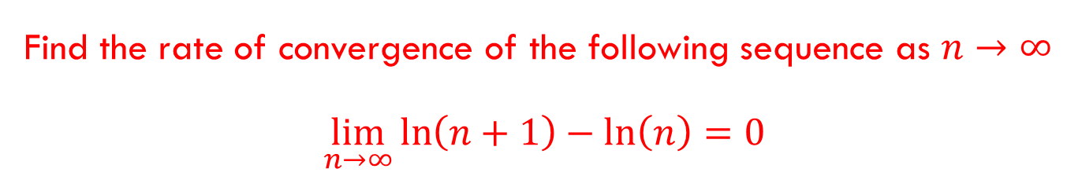
Example
Find the rate of convergence of the following sequence as $n→∞$
$\lim_{n→∞}{\ln\left(n+1\right)−\ln\left(n\right)=0}$

Slide 38
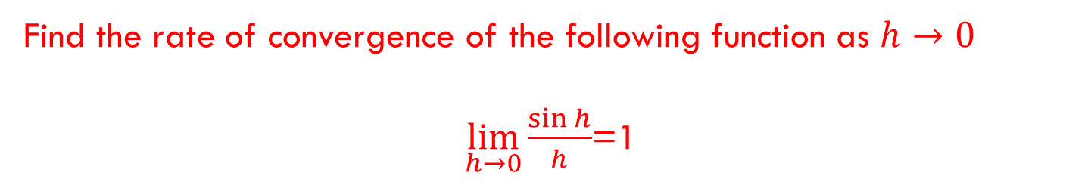
Example
Find the rate of convergence of the following function as $h→0$
$\lim_{h→0}{\frac{\sin{h}}{h}}$=1

Slide 39
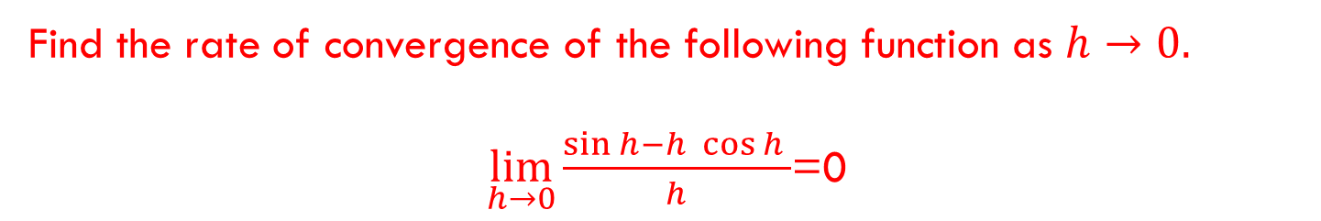
Example
Find the rate of convergence of the following function as $h→0.$
$\lim_{h→0}{\frac{\sin{h−h \cos{h} }}{h}}$=0

