Slide 1
Analysis overview
Vivek Das
11/24/2019
Data provided by Dr. Biswapriya B. Misra

Slide 2
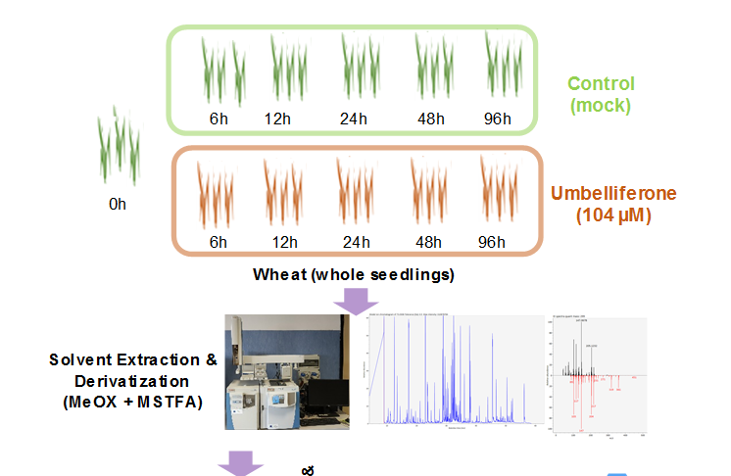
Experimental Design and Data structure
Phenotypic condition
 | Sample1 | Sample2 | … | Sample53
Metabol1
Metabol2
Metabol3
…
…
…
Metabol177
Temporal conditions

Slide 3
Analytics workflow
Phenotypic conditions
Exploratory Data Analysis
Sample-sample Distance Clustering
Temporal conditions
Normalized Data (n * p = 177 * 53)
Orthogonal Dimension Reduction via PCA

Slide 4
What does sample-sample clustering infer?
Two major clusters: Cluster 1 and Cluster 2 denoted by arrow and parenthesis via correlational measures
Cluster 2 is subdivided in 5 sub-clusters
Patterns are not very clear and distinctive
0H is all over the place
12H+U cluster together
Big red cluster has ~87% overall H+U (treated) samples. Total samples in big red cluster is 37(not considering small red sub-cluster). ~57% are H+U (treated)

Slide 5
What does overall PCA clustering infer?
Max variance is contained in PC1 vs PC2 (Dim1 vs Dim2) ~ 24.9 % vs 12.4%
Overall variance ~37%
Most samples or time specific groups are along the Dim 2 while Dim 1 has 3 samples belonging to24H + U(n=1) and from 48H (n=2)
These 3 are strong enough to drive variance along x-axis

Slide 6
What does 0h vs “control” group PCA clustering infer?
Max variance is contained in PC1 vs PC2 (Dim1 vs Dim2) ~ 29.3 % vs 13.4%
Overall control samples variance ~34%
Most samples or time specific groups are along the Dim 2 while Dim 1 has 2 samples belonging to 48H account to variances in Dim1 (can this be biological)
3 quadrants explain all the variances of the groups in most representative Dim1 and Dim2
Labels with no sample name in the image refer to overall contribution of that individual group in the 2D space in the respective quadrants.
6H,12H and 96H are in + ve Y-axis.
24H and 48H are in –ve Y-axis but they are also far apart
96H is closer to 0H than 6H and 12H controls

Slide 7
What does Oh vs “treated” group PCA clustering infer?
Max variance is contained in PC1 vs PC2 (Dim1 vs Dim2) ~ 25.2 % vs 15.2%
Overall treated samples variance ~40%
Most samples or time specific groups are along the Dim 2 while Dim 1 has 2 samples belonging to 24H account to variances in Dim1 (can this be biological)
3 quadrants explain all the variances of the groups in most representative Dim1 and Dim2
Labels with no sample name in the image refer to overall contribution of that individual group in the 2D space in the respective quadrants.
6H+U and 48H+U are in +ve Y-axis but they are and closer 0H
12H+U, 24H+U and 96H+U are in -ve Y-axis.
24H+U is in the treated is mostly along varying from 12H and 96H along X-axis

