Slide 1

World of Handwriting
Simpler the Better
By Graphologist Mukesh Shukla
GraphoMind Services

Slide 2
Why Handwriting
Dear Parents,
For centuries, handwriting (or drawing structures) has been essential for expression, creativity, thoughtful required for powerful communication and messaging. Irrespective of digital media advancement, we still remains as we were centuries old modern humans, who needs to behave even today as body required
When we forgo writing, we are doing away with mental exercise (2 way)
No writing - no time concentrating your mind and generate thoughts for the given purpose
Engage your brain, else it won’t develop. Like body, Brain too has got muscles, it needs to be exercised and trained everyday. New neuron must develop regulalry to reduce brain aging later in the year
Now a days, journaling is being promoted to solve many mental and emotional problems:
Write down your problems so that your mind no more holds the baggage of negative thoughts
Writing down is mental exercise relaxing brain and building new neuron (muscle memory)
Graphologist Mukesh Shukla: Whatsapp: +91 7016567143

Slide 3
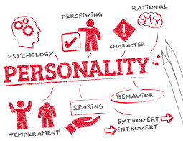

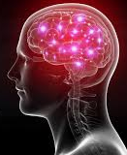

What is Handwriting
Hand (Brain) writing to reflect your personality which is nothing but Reflection of Parenting, Upbringing and Self Initiatives
Brain Sending Impulse to Fingers
Handwriting is nothing but Graphs being drawn on the paper having various formations inline with person’s thoughts process
Graphologist Mukesh Shukla: Whatsapp: +91 7016567143

Slide 4
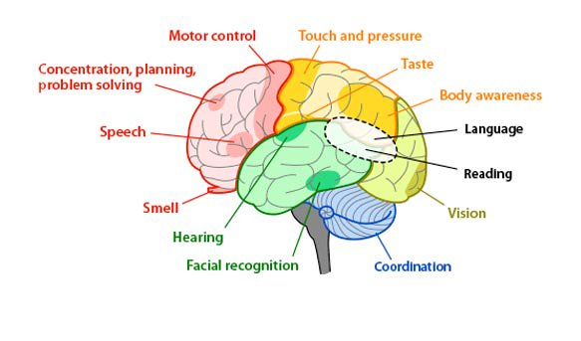
How Brain Works when You Write
Graphologist Mukesh Shukla: Whatsapp: +91 7016567143

Slide 5
Why no two Handwriting is same
 | More than 500 variables and their combination controls the handwriting | Just like fingerprints, It’s very unlikely that any 2 people would have exactly same variable values
But only 2 Major Variables Impacts the Child,
like brain programming
Mother
Father
Environment
1111111111111
0000000
Child
Emotional Energy
Emotional Expression
Intra and Interpersonal Relation
Character Building
Personality Type
Graphologist Mukesh Shukla: Whatsapp: +91 7016567143

Slide 6
What is Graphology and Handwriting Analysis
Graphology is an evidence based tool in the your hands to read an individual’s mind and thoughts
A Science
It is a science of understanding pattern of human behavior and the cause of the same to be observed through a person’s handwriting
An Art
Graphology is an art of analyzing handwriting to understand the behavioral pattern of the writer
Graphologist has to develop this capability through practice and experience to analyze handwriting of the writer accurately and appropriately
 | Language | Script
 | Hindi | Devnagri
 | English | Roman
 | Punjabi | Gurumukhi
What’sapp Writing | Hindi | Roman
Graphologist Mukesh Shukla: Whatsapp: +91 7016567143

Slide 7
Why Graphology
Dear Parents,
Through handwriting of your children, as they are growing up, you can get to know following attributes of their Intellectual and Emotional development through their handwriting and take corrective action:
How are they building up:
Level of Emotional Energy: High, Medium, Low: Higher the better
Balance of Emotional expression: Introvert, extrovert and other shades of expressions: Subtle, intense, responsible, irresponsible
Their ability to build Intra and Inter-personal relationship
Balance of thoughts: Spiritual, Intellectual, Entertainment, Physical and Sports activities
Exclusive impact of Father’s input and Mother’s input, as they distinctly seen in the handwriting
Emotional Patterns being built and how to understand them
Graphologist Mukesh Shukla: Whatsapp: +91 7016567143

Slide 8
Grapho-Therapy
You will see the difference in your mindset and thought process. Your life will improve over the years
Keep practicing it for (3-5) years till the time, form and structure becomes normal (natural writing)
Start writing Consciously the write structure and form. Same applies to Signature as well
Know the right structure and form. May be seeking underlying reasoning as well
Simpler the Better
Graphologist Mukesh Shukla: Whatsapp: +91 7016567143

Slide 9
Graphologist Mukesh Shukla
01
Post my BE in 2002, I took up Graphology as Hobby
Continue to learn and Completed Level 4 Graphology till 2010
Learn Drawing Analysis in 2006
Have learned from 2002 to 2010
Have Learned Graphology since 2002 till 2010
02
Along with learning, analysed thousands of live handwriting analysis and Signatures
As a volunteer attended various events and managed Graphology Stalls for handwriting analysis
Have been Practicing since 2002
03
Have been teaching and guiding people, friends
Especially interested in Parenting and Relationship Counselling and Self-help
Graphology finds its use in Criminology, Recruitment, Employee Assessment and Evaluation for the high profile job
Have been Teaching and Guiding
Graphologist Mukesh Shukla: Whatsapp: +91 7016567143

Slide 10
GRAPHOLOGY – WHAT WOULD YOU LEARN
Definition of the page
Margins
Baselines
Letter Size
Spacing – Letter and word spacing
Slants
Pressure
Zones
Connections
Letter shapes (a to z)
Signature - Basic
Resource Utilization
Perspective of time
Focus of life
Big picture and An eye for detail
Time allocations for self and others
Emotional Expressions
Emotions and Emotional Energy
Balance of Expression and Emotions
Ability to connect with People and thoughts
Behavioral pattern
Alter ego – the other I – the self
Graphologist Mukesh Shukla: Whatsapp: +91 7016567143

