Slide 1

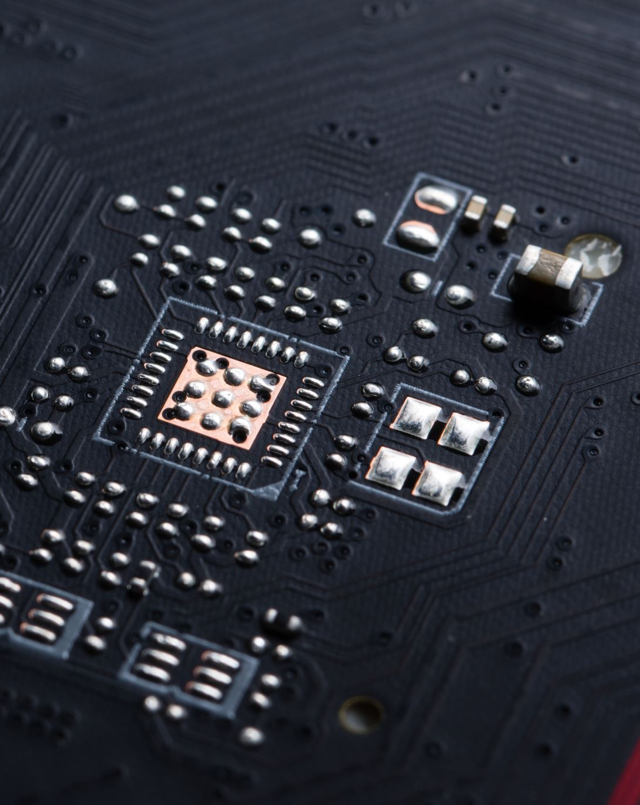
Simulated IoT Processing with Pentaho and Kafka
IoT Smart House Temperature Sensors

Slide 2
Agenda
Assignment of choice
Goal
How the program works
Graphs
Struggles and learnings

