Slide 1
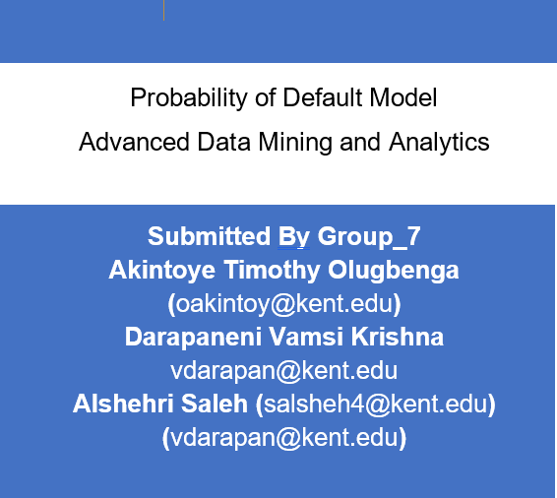

Slide 2
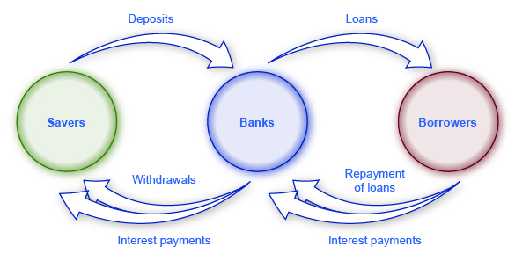


Probability of Default Model Advanced Data Mining and Analytics
The reason to build any model is to be able to use it! The expectation of the future projection is profit, in Money Creation Interest Rate have to Predict, ROI (Constructed Model for ROI ) Return on Investment

Slide 3




Way to the future- R codes and script
Prediction of Potential Loss
What else can a statistical analysis Package do?
Calculate interest %
Rate ROI
Prediction of possibility
of pattern for Robbery
Prediction on Probability
Of Loss
model to predict the loss for a list of customers Robbers without weapon who will approach the bank to borrow but 99% no intention to pay back money. The module in other word provide a kind of security to know the risk of losing their investment.
The risk analysis have provided based on the lending institution the test dataset. We are to prorogate three scenarios, to be submitted.
Predict who to trust or not to trust

Slide 4


Way to the future- R codes and script
What else can a statistical analysis
Package Can Forecast Profit
Calculate interest %
Rate ROI
Nice Guy Pays back
Prediction on Probability
Of Loss
model to predict the loss for a list of customers Robbers without weapon who will approach the bank to borrow but 99% no intention to pay back money. The module in other word provide a kind of security to know the risk of losing their investment.
The risk analysis have provided based on the lending institution the test dataset. We are to prorogate three scenarios, to be submitted.
Predict who to trust or not to trust

Slide 5

R codes and script
What else can a statistical analysis Package do? i)Predictive-ii)Descriptive-iii)Prescriptive-iv)Forecast
GX_S1.csv: binary approve/disapprove for each applicant for scenario 1
GX_S2.csv: binary approve/disapprove for each applicant for scenario 2
GX_S3.csv: binary approve/disapprove for each applicant for scenario 3
Yes will pay back (Approve) Possibly risk > 0 He/She will not pay back (disapprove),
Positive ++ Possibly risk < 0 (Approve) Poor homeless and No Job (disapprove), Negative + Negative

Slide 6
Conclusion:
A Bank is in the business of making money, Loan others from other people’s money to make money = Profit (savings)
Leaned to other people other people money to make money (Loan)

Slide 7
References
Bank is in the business of making money - Google Search. 2020. Bank is in the business of making money - Google Search. [ONLINE] Available at: https://www.google.com/search?q=Bank+is+in+the+business+of+making+money&oq=Bank+is+in+the+business+of+making+money&aqs=chrome..69i57.46442j0j7&sourceid=chrome&ie=UTF-8. [Accessed 03 May 2020].
https://www.northwest.bank/business/borrow/commercial-loans?gclid=Cj0KCQjwtLT1BRD9ARIsAMH3BtWxXmOnNYOaWu2vEFs1YUbdDGytZWB0w7BFEvRWKPTMmdzGbMdM9uQaAhhZEALw_wcB. [Accessed 03 May 2020].

