Slide 1
Image gallery
Chuong Vu

Slide 2
Why I do this?
I’m a photographer. I have been taking a lot of picture over the years and I want to share it to everyone.
I know there are many Image Gallery website on the internet, but they are limited feature and you have to pay.
I want to create a free Image Gallery website.
Simple, easy to use.
Release source code for free.

Slide 3
Idea Development
Automatic create thumbnails
Auto resize images (I will make the max size is 1024x768 due to storage space)
Upload image via web interface
Upload images or zip file
Option Watermark for each photo
Each photo will display all information about a picture based on their detail’s property.
Folder tree on website for each album

Slide 4
Scripting language & database
PHP
- Free, open source
- Works great with MyQSL database
- Dynamic Webpages
- Version 5.6
MySQL
- Relational Database management system

Slide 5
JavaScript + HTML + CSS
JavaScript
- Drag & Drop (DropzonJS)
- Slide Show gallery (Light Gallery jQuery)
- Font/Icons (Font Awesome)
HTML + CSS
- Website display and style

Slide 6
Website Features
User control gallery panel
Admin and member
Multi files upload with drag & drop
Login – Logout – Register – Change password
Slide Show

Slide 7
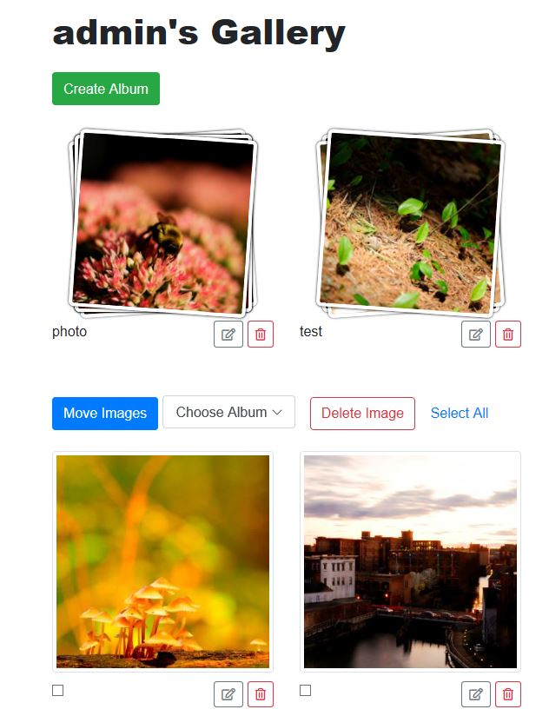
User Control panel
Using Bootstrap to display images
Create/Delete Albums
Move images to albums
Delete Photos
Verify admin and user

Slide 8
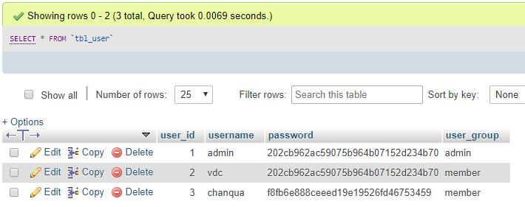
Admin and member
Member
- Allow to view other gallery
- Only allow to modified it’s own gallery (rename/delete)
Admin
- Full access.
- Can rename/delete any pictures from all user.
- Can create album in member gallery.

Slide 9

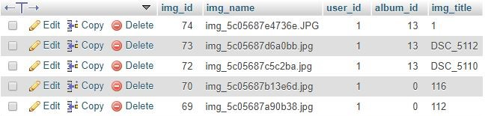
User control panel Database
User albums is saved in database
Photos information in each album is also saved in database

Slide 10
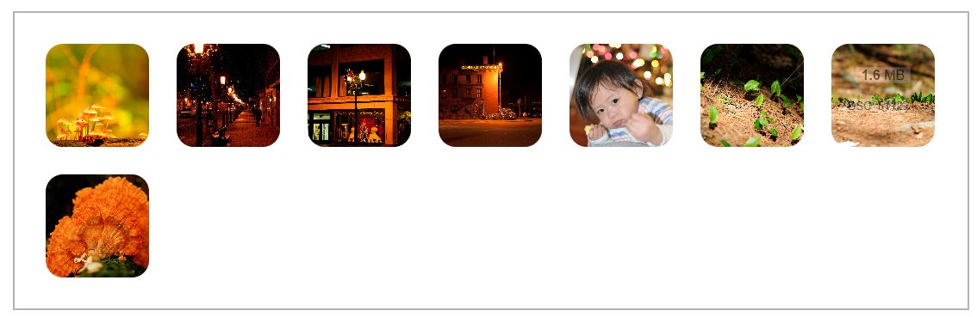
Drag & Drop multi files upload
Auto resize
- Auto resize the image to width 1024 to save the space on server.
Use DropzoneJS library
- Allow to drap’n’drop file uploads with image previews.

Slide 11
Login – Logout – Register Change password
PHP functions
Get data from MySQL. Check username/password.
Password is in MD5 form.
Usergroup is also verified after login.
isadmin = true/false

Slide 12
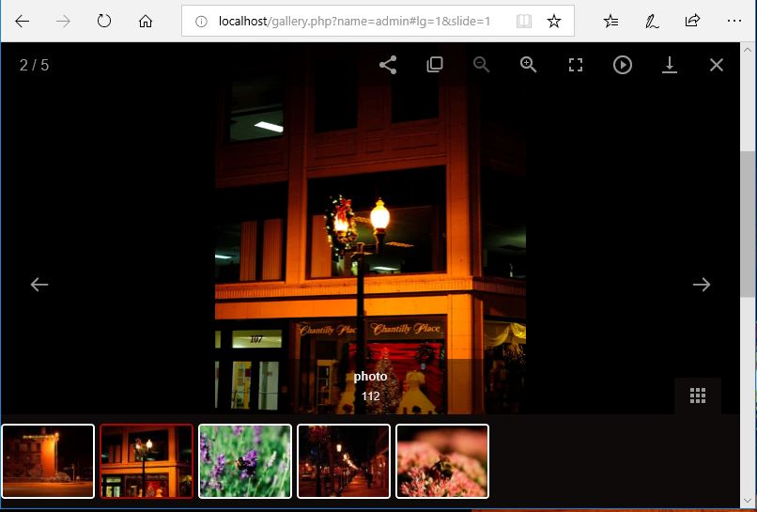
Slide Show
Use lightgallery.js
Allow to download
Auto-play
Print

Slide 13
DEMO
http://weblab.cs.uml.edu/~cvu/COMP5130/Week-12/root/

Slide 14
Summary and future Update
What I have learned
PHP, MySQL Server.
Need to know how to configure the server-side.
Set access permission (chmod) to allow files is saved to directory on server.
Future Update
Add email when register.
Forgot password with email confirmation.

Slide 15
Question?

