Slide 1
Image gallery
Chuong Vu

Slide 2
Why I do this?
I’m a photographer. I have been taking a lot of picture over the years and I want to share it to everyone.
I know there are many Image Gallery website on the internet, but they are limited feature and you have to for it.
I want to create a free Image Gallery website.
Release source code for free.

Slide 3
Idea Development
Automatic create thumbnails
Auto resize images (I will make the max size is 1024x768 due to storage space)
Upload image via FTP or web interface
Upload image, folder or zip file
Option Watermark for each photo
Each photo will display all information about a picture based on their detail’s property.
Folder tree on website for each album

Slide 4
Scripting language & database
PHP
- Free, open source and se
- Works great with MyQSL
- Dynamic Webpages
- Version 5.6
MySQL
- Relational Database management system

Slide 5
JavaScript + HTML + CSS
JavaScript
- Drag & Drop (DropzonJS)
- Slide Show gallery (Light Gallery jQuery)
- Font/Icons (Font Awesome)
HTML + CSS
- Website display and style

Slide 6
Website Features
Admin and member
Drag & Drop multi files upload
User control gallery panel
Login – Logout – Register – Change password
Slide Show

Slide 7
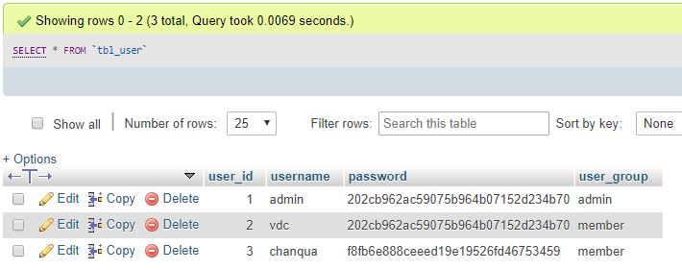
Admin and member
Member
- Allow to view other gallery
- Only allow to modified it’s own gallery
Admin
- Full access. Can create/edit/delete any pictures from all user.

Slide 8
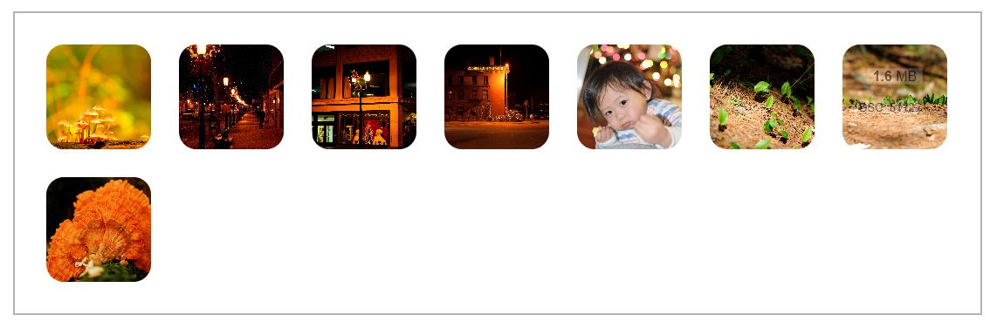
Drag & Drop multi files upload
Auto resize
- Auto resize the image to width 1024 to save the space on server.
Use DropzoneJS library
- Allow to drap’n’drop file uploads with image previews.

Slide 9

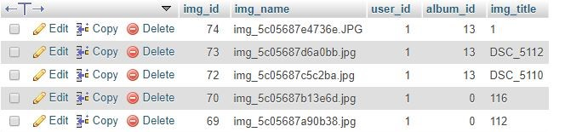
User control gallery panel
Rename the photo
Create/rename Albums
Delete photos/Albums
User albums is saved in database
Photos information in each album is also saved in databasw

Slide 10
Login – Logout – Register Change password
PHP functions
Get data from MySQL. Check username/password.
Usergroup is also verified after login.
isadmin = true/false

Slide 11
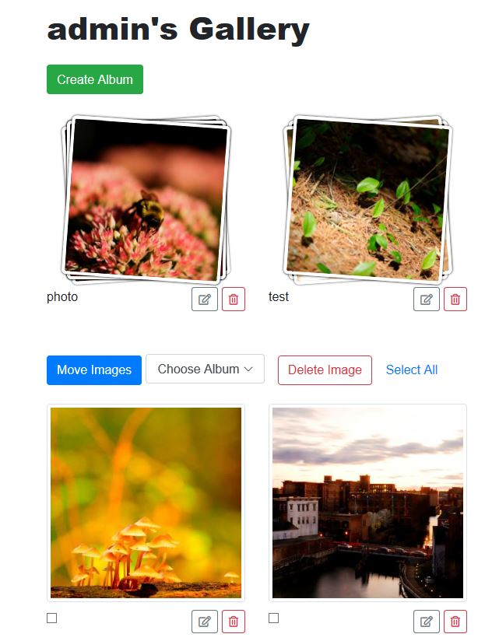
User Control panel
Using Bootstrap to display images
Create/Delete Albums
Move images to albums
Delete Photos
Verify admin and user

Slide 12
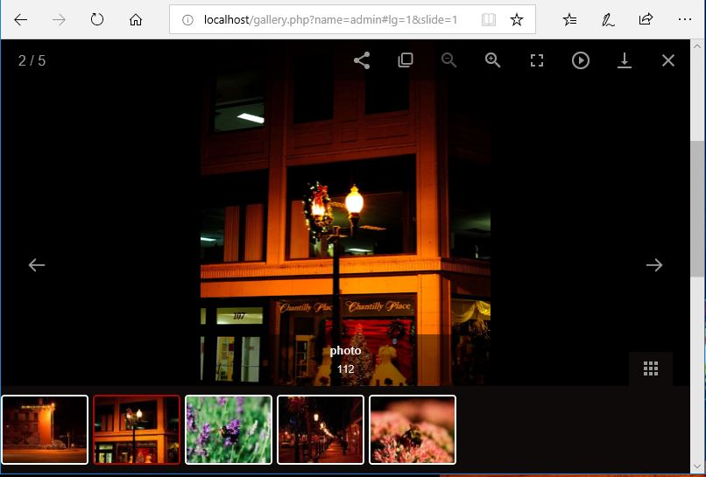
Slide Show
Use lightgallery.js
Allow to download
Auto-play
Print

Slide 13
Summary and future Update
What I have learned
PHP, MySQL server
Need to know how to configure the server-side
Weblab is limited for web designer. (.htaccess is not allow to run on weblab.cs.uml.edu)
Future Update
Forgot password have not added
Minor bug for delete albums
Admin user can’t create albums in member control panel

Slide 14
Question?

