Slide 1
Image classification Model
Vashcar Nath

Slide 2
Introduction
Basis
Project sees the development of 3 different image classification models
First two written using only NumPy and third with Keras API (From TensorFlow)
Used the load_digits dataset from Sklearn
Questions
Is it possible to develop an image classification model using only NumPy?
How does the NumPy model compare to the Keras model?
What is the reason for making the NumPy model?

Slide 3
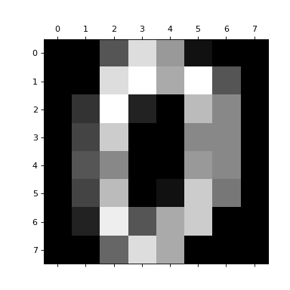
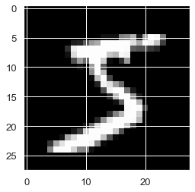
Background (Image Data)
Each image from the data can be represented as a 2x2 matrix
The value for each entry in the matrix is a pixel color value
Can perform mathematical operations on the matrix values
Using different operations/mixing up the order can lead to different results

Slide 4
Background (Image Data)

