Slide 1
Image classification Model
Vashcar Nath

Slide 2
Introduction
Basis
Project sees the development of 3 different image classification models
First two written using only NumPy and third with Keras API (From TensorFlow)
Used the load_digits dataset from Sklearn and train_test_split function
Questions
What is the reason for making the NumPy model?
Is it possible to develop an image classification model using only NumPy?
How does the NumPy model compare to the Keras model?

Slide 3
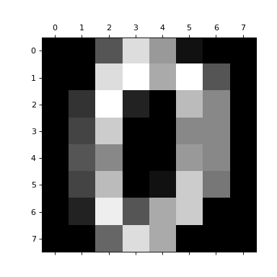
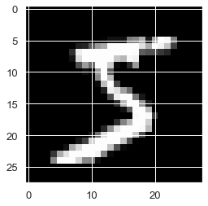
Background (Image Data)
Each image from the data can be represented as a 2x2 matrix
The value for each entry in the matrix is a pixel color value
Can perform mathematical operations on the matrix values
Using different operations/mixing up the order can lead to different results

Slide 4
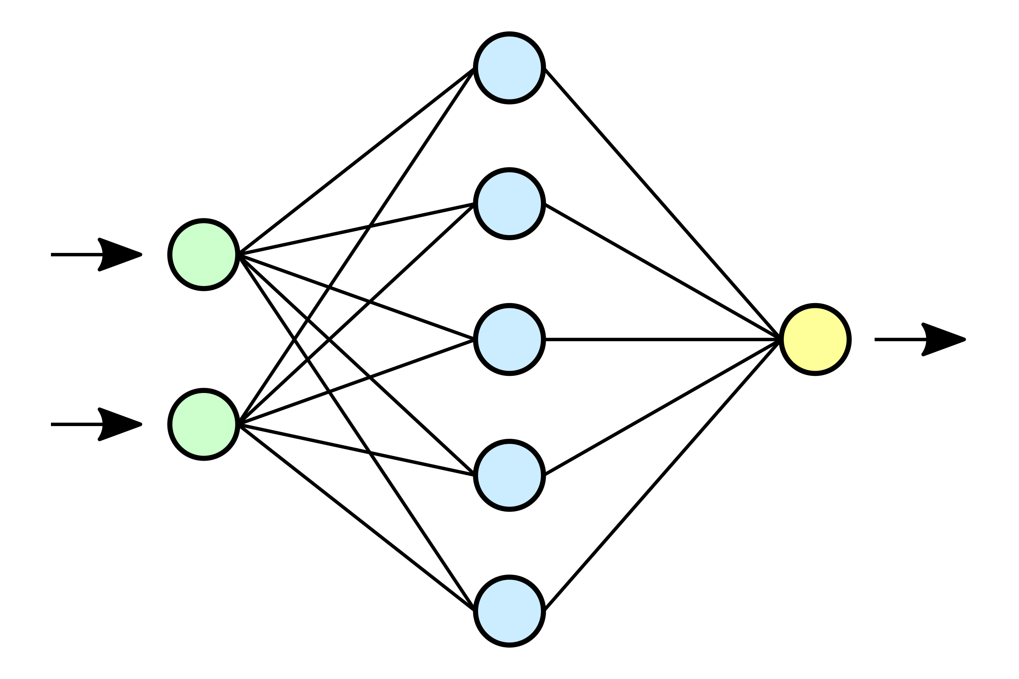
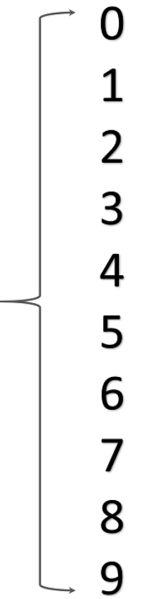
Background (Neural Networks)
Definition: Neural Networks (NNs) are AI models that receive input data, perform operations on that data, and process the outputs
NNs consists of an input layer, one or more hidden layers, and an output layer
Each of the models made can be labeled as a Multi Layer Perceptron (MLP)
Input Layer: Receives data and passes to hidden layer(s) for processing
Hidden Layer: Input data undergoes operations (ran through activation function)
Output Layer: Produces a classification for an image and is tested using a validation set

Slide 5
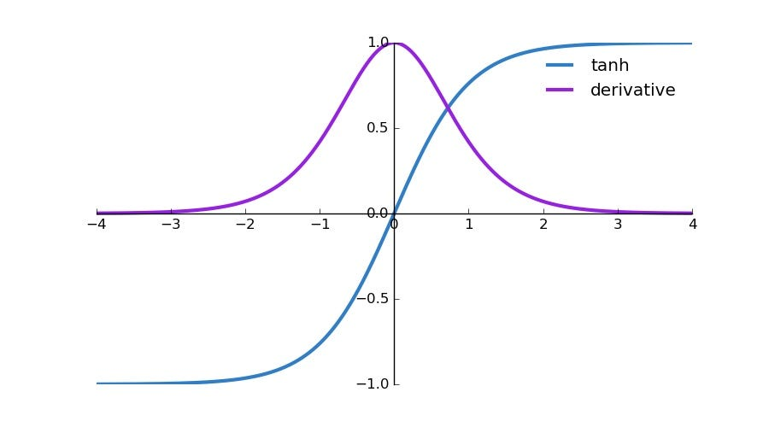
Model 1
Implemented using 1 hidden & 1 output layer
Hidden Layer: tanh()
Output layer: derivative of tanh()
1000 epochs
0.1 learning rate
Plots for activation functions
Tanh and its derivative used due following:
Non-linearity
Centered around 0
Smooth curves
All reasons make it easier for the NN to learn

Slide 6
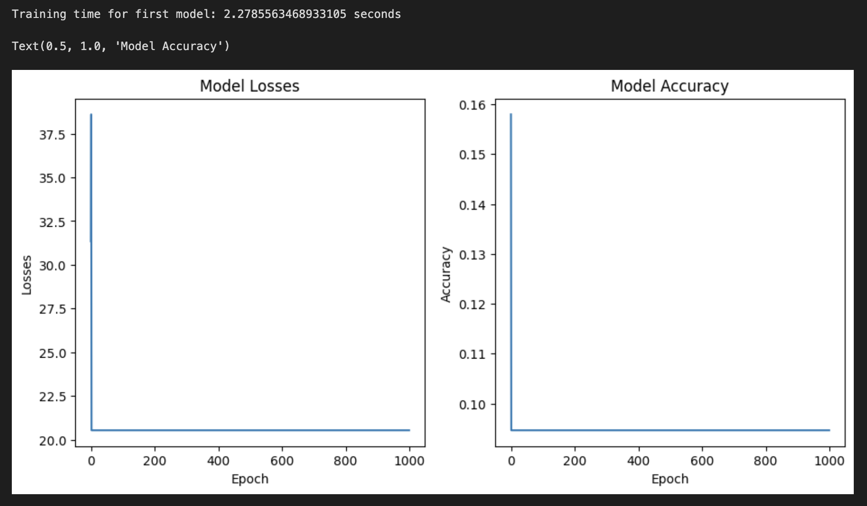
Model 1 (Runtime & Plots)
Time taken to train the model as well as accuracy and loss plots shown

Slide 7
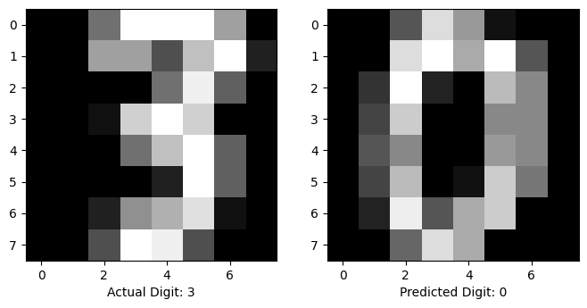
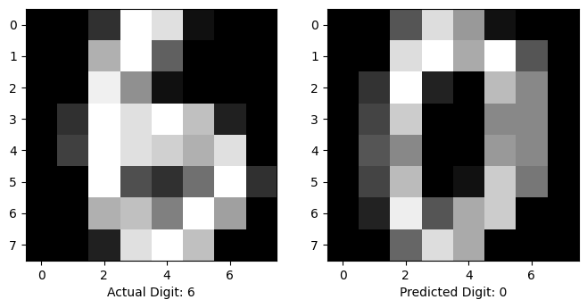
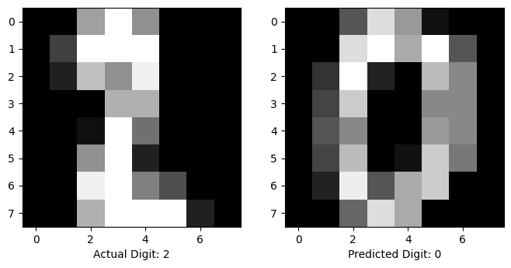
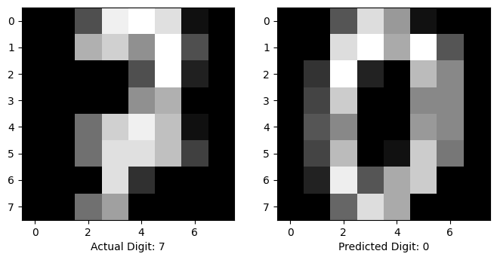
Model 1 (Results)
Results of the model given random input images shown

Slide 8
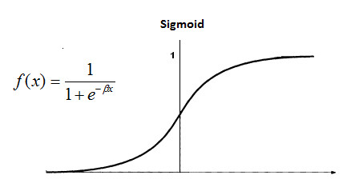
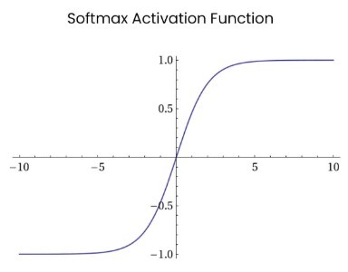
Model 2
Implemented using 2 hidden layers & 1 output layer
1st Hidden Layer: tanh()
2nd Hidden Layer: sigmoid()
Output layer: SoftMax()
1000 epochs
0.1 learning rate

Slide 9
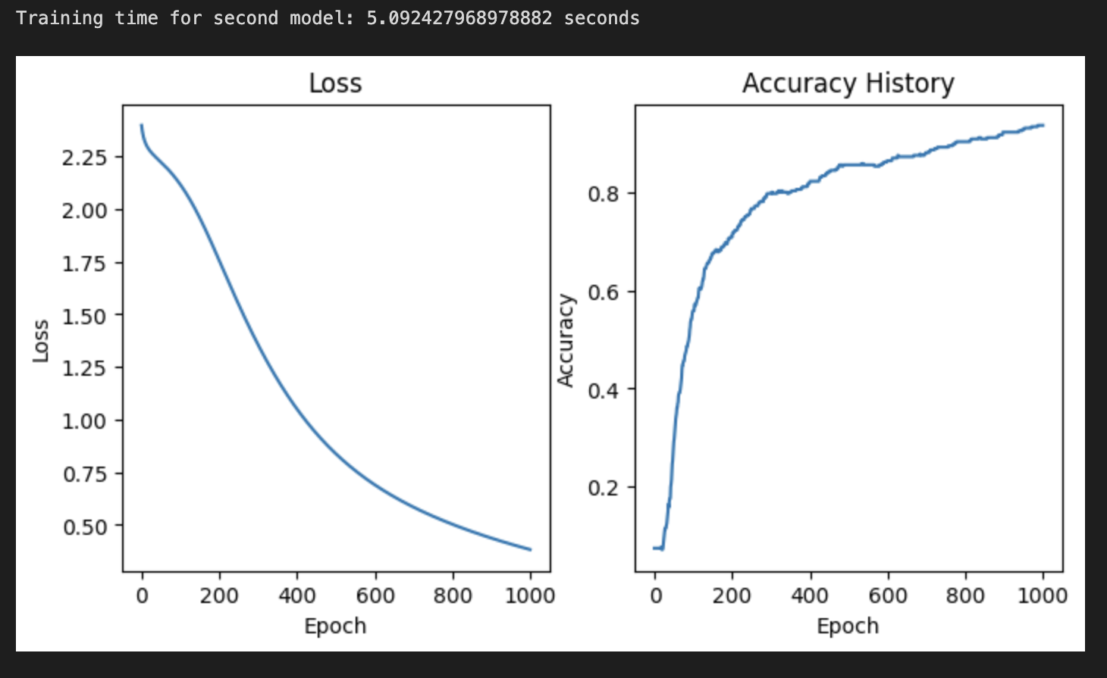
Model 2 (Runtime & Plots)
Time taken to train the model as well as accuracy and loss plots shown

Slide 10
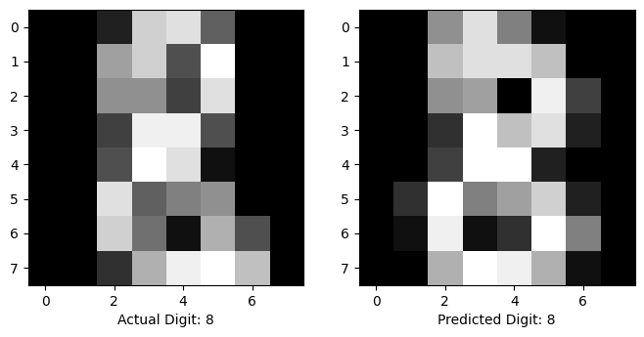
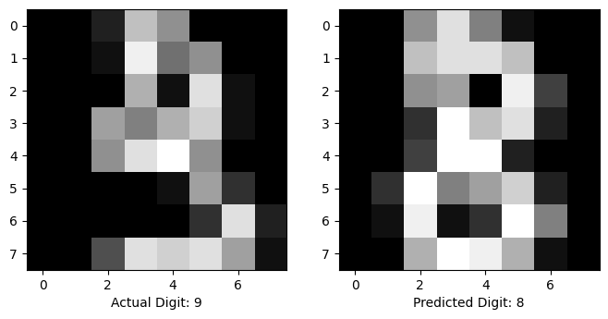
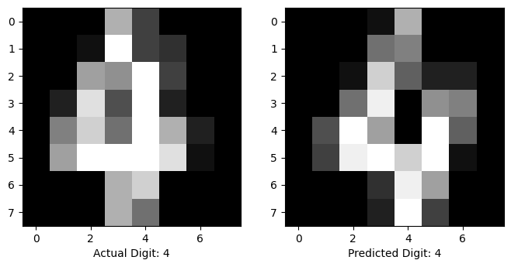
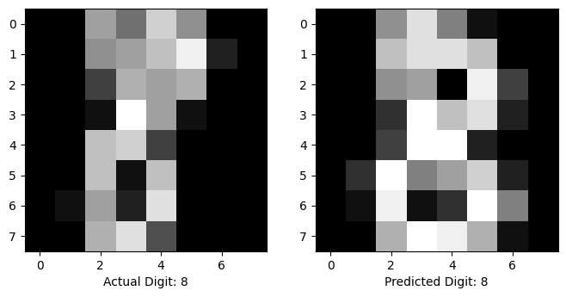
Model 2 (Results)
Results of the model given random input images shown

Slide 11
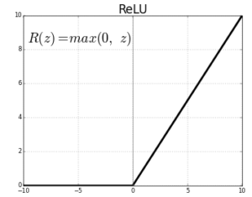
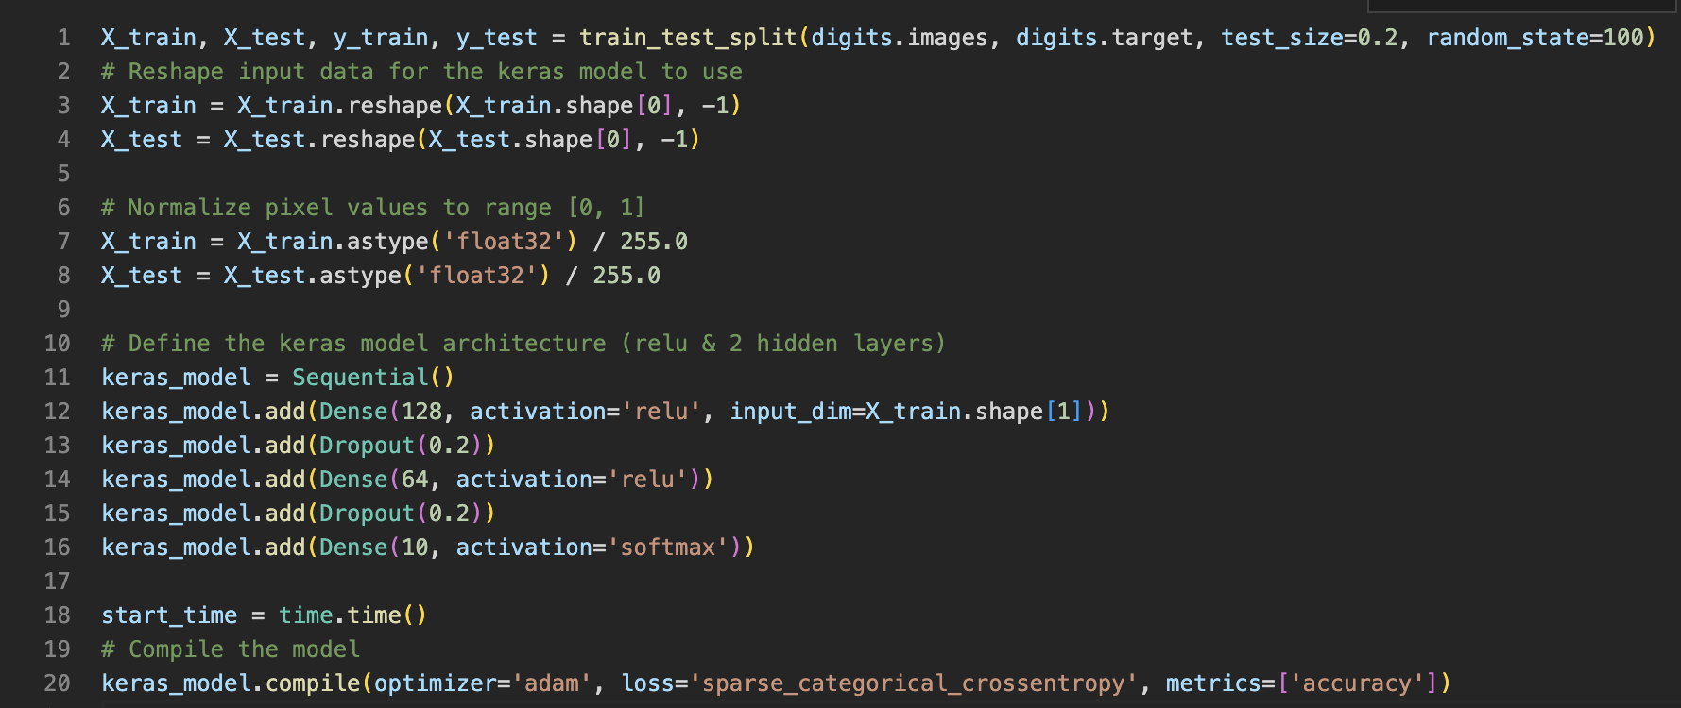
Model 3
Implemented using Keras Sequential Model
2 hidden layers (both relu) & output layer SoftMax()
Optimizer: Adam
Loss Tracker: sparse_categorical_crossentropy
Metrics: Accuracy
Epochs: 20

Slide 12
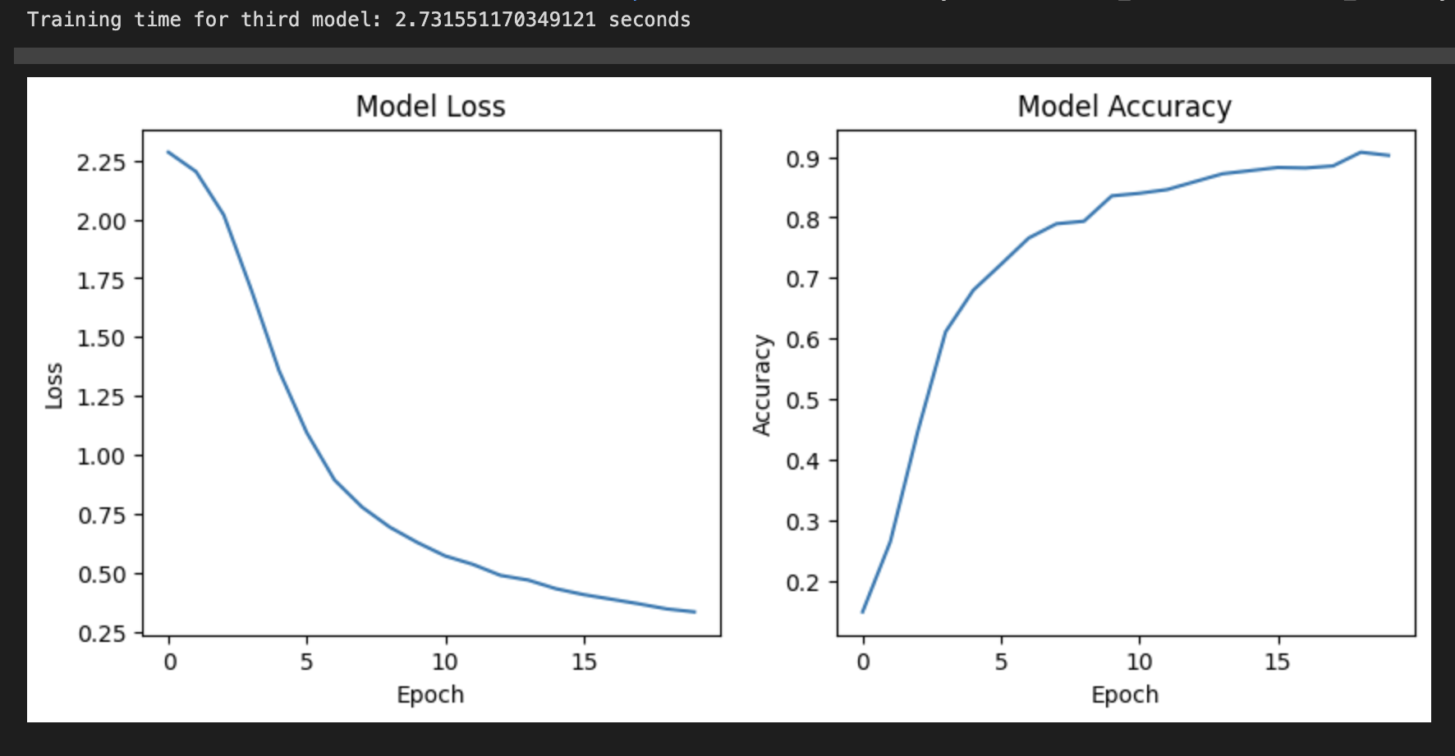
Model 3 (Runtime & Plots)
Time taken to train the model as well as accuracy and loss plots shown

Slide 13
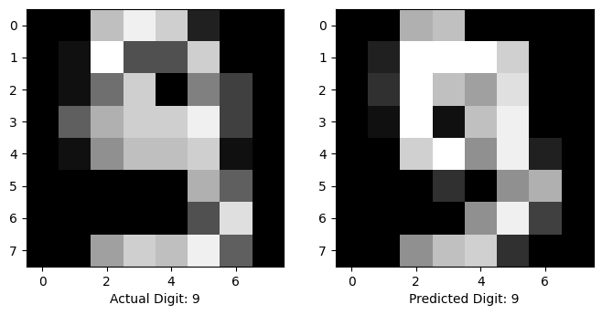
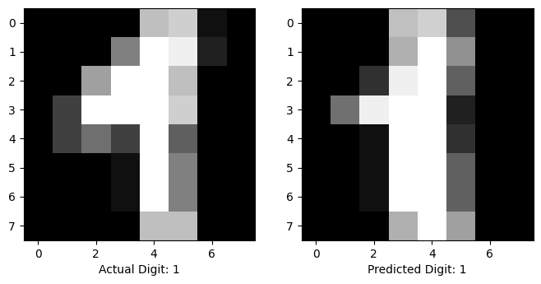
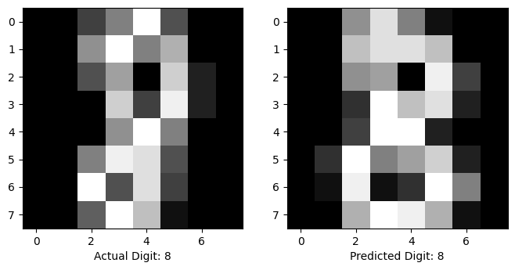
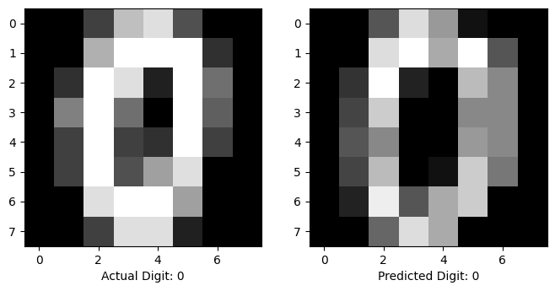
Model 3 (Results)
Results of the model given random input images shown

Slide 14
Conclusions & Limitations
Conclusions
Main reason is to understand basics of NNs
Allows better understanding of more complex models
It is possible to create an image classification model solely using NumPy
NumPy model isn’t as good as Keras, but good enough for this problem
Limitations
Could have tested with more images
Could have used different activation functions
Could have used another library and compared results
Images used don’t have 3 channel RGB

Slide 15
THANK YOU

