Slide 1

Authenticate your users
using Auth0 in an angular web app
connected to a .Net Core API
Damien Vande Kerckhove
Architect .Net
Damien.vandekerckhove@gmail.com

Slide 2


About me
Damien Vande Kerckhove
.Net Architect consultant
Over 10 years of experience
Developer since the year of 14
Facebook : damien.vandekerckhove
Twitter : @vdekercd
LinkedIn : Damien Vande Kerckhove
Github : https://github.com/vdekercd/

Slide 3


Auth0 : Never Compromise on Identity

Slide 4


Auth0 : Never Compromise on Identity
Universal authentication
& authorization platform
Support a lof of
technologies
</>
Native app
  Android
  IOS Objective-C
  Cordova
  React native
  …
SPA
  Angular
  ….
Regular web app
  Asp.Net
  PHP
  ….
Machine to Machine
Database
Google
Microsoft
Facebook
LinkedIn
Paypal
Amazon
Twitter
Active Directory / LDAP
Passwordless (SMS/Mail)
….

Slide 5
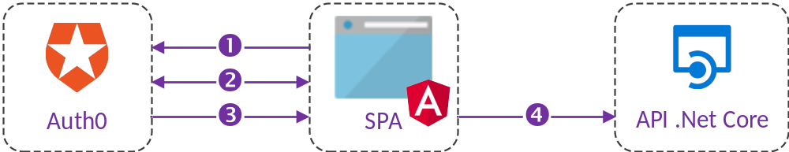
Auth0 : Never Compromise on Identity
◆
Web app asks for authentication
Auth0 authenticates the user
❖
⬥
Auth0 redirects the user to the app with an Access Token

The app can use the Access Token to call the API on behalf of the user.

Slide 6

Part 1 : API .Net Core

Slide 7
Json Web Tokens (JWT)
JSON Web Tokens are an open, industry standard RFC 7519 method for representing claims securely between two parties.
JWTs can be signed using a secret (with the HMAC algorithm) or a public/private key pair using RSA or ECDSA.
JSON Web Tokens consist of three parts separated by dots (.)
Header.Payload.Signature

Slide 8
Json Web Tokens (JWT) : Header
{
"alg": "RS256",
"typ": "JWT"
}
alg : The signing algorithm
typ : Type of the token

Slide 9
Json Web Tokens (JWT) : Payload
{
"iss": "https://ysor.eu.auth0.com/",
"sub": "123456789",
"aud": "http://127.0.0.1/",
"iat": "1551891518",
"exp": "1551977918",
"azp": "2Rm4Wn8g051TWpGELGuNEk31VcwXbh6y",
}
iss : Issuer who created and signed the token
sub : Subject (Whom the token refers to)
aud : Audience (Who or what the token is intended for)
iat : Issued at (Seconds since Unix epoch)
exp : Expiration Time (Seconds since Unix epoch)
azp : Authoriezd party (The party to which this token was issued)

Slide 10
Json Web Tokens (JWT) : Signature
RSASHA256(
base64UrlEncode(header) + "." +
base64UrlEncode(payload),
secret
)

Slide 11
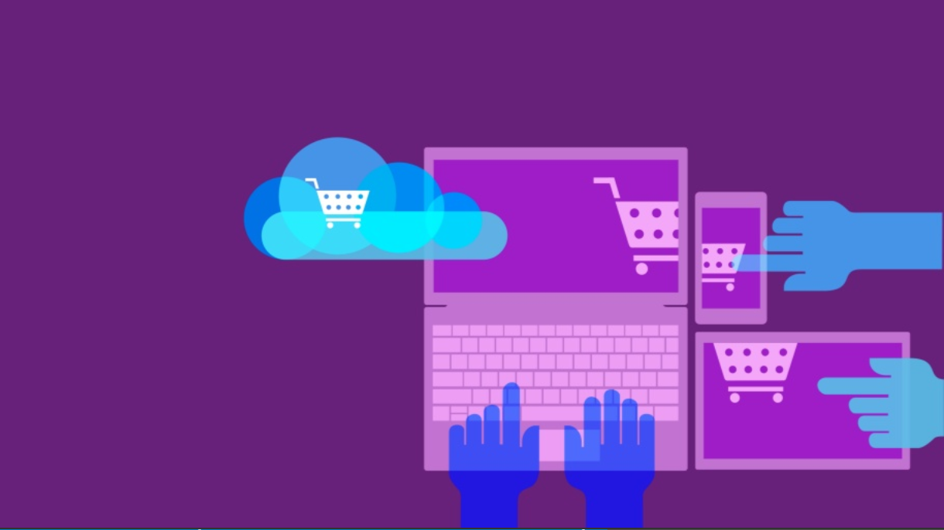
Part 2 : Angular SPA

Slide 12
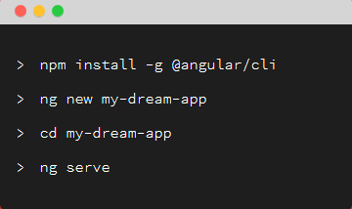
Angular-Cli
A command line interface for angular
https://cli.angular.io/

Slide 13

Angular : Routing
Decide which component to display based on the URL
Declared in the app.module.ts

Slide 14
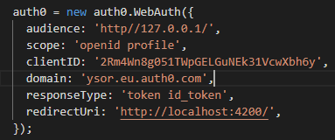

WebAuth
Configure
Then ask Auth0 to authenticate users

Slide 15
Cross Origin Resource Sharing (CORS)
Same Origin
http://127.0.0.1/index.html
http://127.0.0.1/faq.html
Cross Origin
http://127.0.0.1/index.html
http://127.0.0.1:8080/index.html
http://127.0.0.2/index.html

Slide 16

if ( Questions.Any() )
{
AskQuestions();
}
else
{
}

