Slide 1


Introduction
PWF Summer school on Theoretical and Computational Biophysics
University of Colombo
Day 1/5
Dr. Vittorio Del Tatto

Slide 2
In this summer school:
Program overview:
Day 1: introduction to the field (integrating Hamilton equations, sampling statistical ensembles)
Day 2: force fields, solvent, running simulations and analyzing trajectories
Day 3: free energy methods (how to sample rare events)
Day 4: ab-initio molecular dynamics
Day 5: machine-learning integration with MD
Structure of the days: theory (morning) + hands-on (afternoon)
…ask questions!!

Slide 3
What do we mean by computational science?
The scientific method in a nutshell:
validation / new theory
Experiments
(truth)
Theory
(model)
Two kinds of predictions:
analytical (simple models)
numerical (complicated models)
prediction
(analytical or numerical)
Computational science sits in the middle: when the model is too complex to be solved analytically, numerical predictions (or computational experiments) are still possible
  e.g. a protein in a water environment
Important disclaimer: computational experiments approximate the model, not the real world!

Slide 4
Biophysics in a nutshell
Very interdisciplinary field; studies the behaviour and features of biological molecules using tools from Physics
Experimental
Structure:
X-ray crystallography (~ 1–2 Å)
CryoEM
…
Dynamics:
Ultrafast pump-probe experiments (~ 5–10 fs)
Fluorescence spectroscopy
Optical tweezers
…
Theoretical and computational
Numerical methods for simulations: classical molecular dynamics (MD), quantum (ab-initio MD)
Force fields
Machine learning (ML) techniques
Coarse-graining
Out-of-equilibrium dynamics (e.g. active matter)
Polymer physics
…
If the model is a good approximation of reality: simulation as computational microscope, time and space resolutions of the most advanced experimental techniques at a fraction of the effort

Slide 5
The problem of scales
The “theory” employed depends on the time scales of interest and the size of the system
Theory | Quantum mechanics | Classical mechanics
Simulation methods | Ab-initio MD, QM/MM | All-atom MD | Coarse-grained MD
Processes resolved | Covalent bond breaking, electron transfers, transitions to excited states | Atomic vibrations, H-bonds formation / breaking, side-chain rotations | Soft collective modes (e.g. bending of a membrane)
Time resolution | ~ 0.1–0.5 fs | ~ 1-2 fs | ~ 20-40 fs
Total time reachable (routine) | ~ 10–100 ps | ~ 1 µs | ~ 10 µs –1 ms
Typical system size | 10²–10³ atoms | 10⁴–10⁶ atoms | 10⁵–10⁷ beads (10⁶–10⁸ atoms)

Slide 6
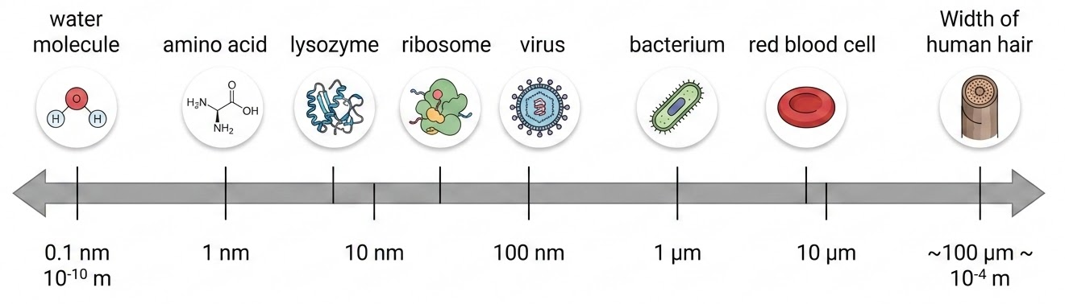
Length scales in biology
Coarse-grained MD
All-atom MD
Ab-initio MD

Slide 7
Classical vs ab-initio MD – key differences
In a nutshell: classical MD treats atoms classically and neglects electrons (e–); ab-initio MD treats nuclei classically and electrons as quantum objects
 | Classical MD | Ab-initio MD
State of the system | positions and momenta (6N numbers if N atoms) | positions and momenta of nuclei, wave function of e–
Law of motion | Newton’s equation | Schrodinger’s equation for e–; Newton’s equation for nuclei
Interaction (potential) | “force-field” | “electronic Hamiltonian” for e–, its ground-state energy for nuclei
Numerical integration | Verlet integrator | Self-consistent energy calculation for electrons, Verlet integrator for nuclei

Slide 8
Other (common) elements
Simulation parameters: time step of integrator, trajectory length (simulated time), …
Specification of the statistical ensemble:
  microcanonical (NVE): only Newton’s equations; total energy is conserved
  canonical (NVT): Newton + thermostat
  isobaric (NPT): Newton + thermostat + barostat
Approximations for long-range interactions

Slide 9
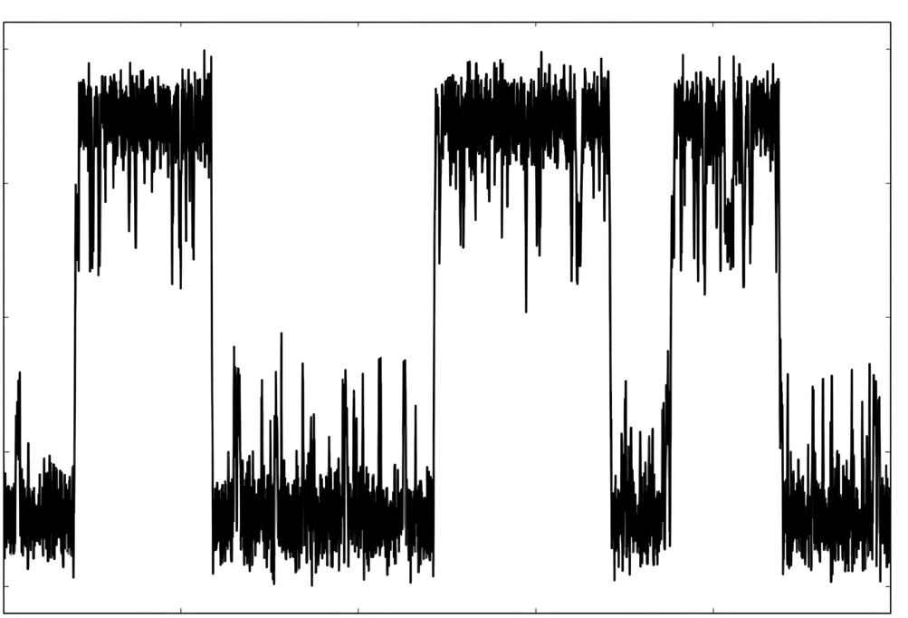
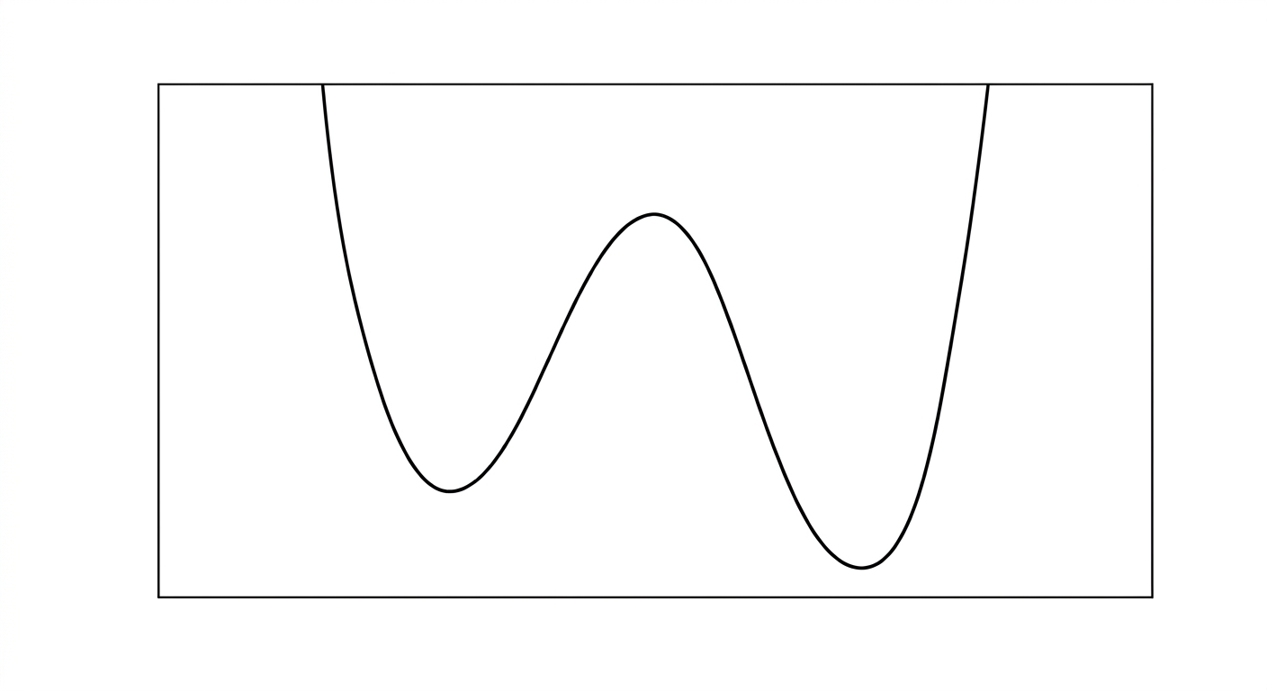
Metastability and rare events
Typical trajectory showing metastability and rare transitions:
reaction coordinate
free energy
simulated time
reaction coordinate
Three relevant time scales:
  “relaxation” time within a minimum, 𝝉_{relaxation}
  “residence” time between two transitions, 𝝉_{residence}
  “echange” time required to perform the transition, 𝝉_{exchange}
Metastability: 𝝉_{relaxation} << 𝝉_{residence}; rare event: 𝝉_{exchange} << 𝝉_{residence}

Slide 10
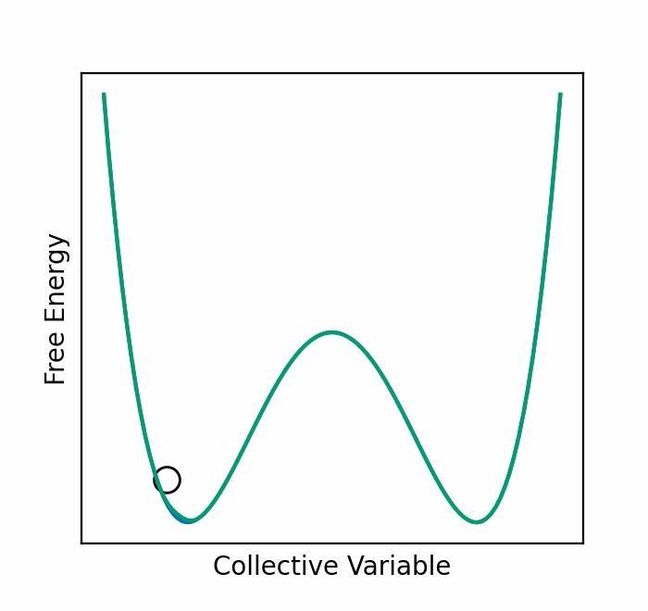
Enhanced sampling
Problem of rare events: require long trajectories to be observed (often too long than what achievable with all-atoms MD)
Solution: enhanced sampling (or free energy methods)
  make rare events frequent in the simulation
  e.g. umbrella sampling, metadynamics, replica-exchange, transition path sampling, …
e.g.
Taken from: B. Hishberg, “Stochastic Resetting for Enhanced Sampling”
https://hirshblab.sites.tau.ac.il/post/stochastic-resetting-for-enhanced-sampling

Slide 11
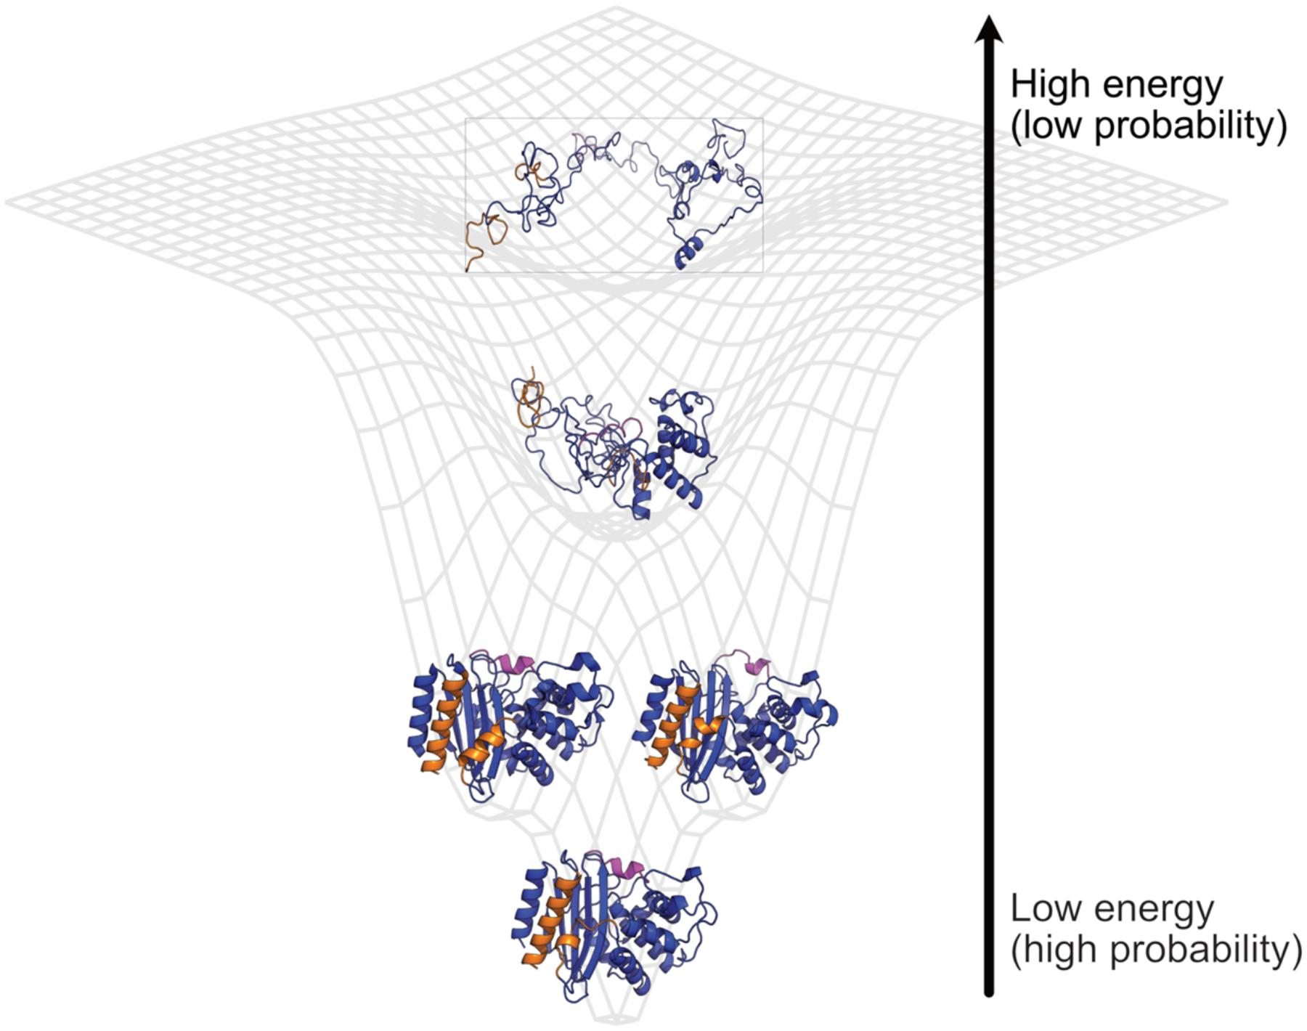
A challenging example of metastability: protein folding
Example: protein folding
𝝉_{echange == folding}~ 10-100 ns
𝝉_{residence} ~ 1 ms
only one supercomputer in the world (ANTON) can simulate trajectories with this length!
Taken from: Bowman GR, Annu Rev Biomed Data Sci. (2024)
N.B. AlphaFold (2024 Nobel Prize in Chemistry) “solved” the problem of protein structure prediction, not the full protein folding problem (no kinetic information!)
Why the problem is still unsolved?
  Enhanced sampling usually requires good reaction coordinates, unknown a priori
  Errors in the force field can significantly increase the escape time (height of barriers)

