Slide 1


Beyond Newton’s equations: sampling statistical ensembles
PWF Summer school on Theoretical and Computational Biophysics
University of Colombo
Day 1/5
Dr. Vittorio Del Tatto

Slide 2
Statistical mechanics in a nutshell
Classical mechanics: with N particles, the state of the system is defined by 6N numbers
However in the real world, only few macroscopic variables can be typically observed
If we measure a set of macroscopic variables, can we still say something about the state of the underlying microscopic variables?
Statistical mechanics studies the relationship between macroscopic quantities (e.g. temperature, pressure, specific heat, energy fluctuation) and the microscopic degrees of freedom
N.B. involve ensemble averages of the microscopic variables

Slide 3
Macroscopic and microscopic states
Macroscopic state: identified by the state of one or more macroscopic variables
  e.g. (N = 100, V = 10 nm³, T = 273.15 K)
Microscopic state: identified by the state of all the underlying (unknown) microscopic variables (3N positions, 3N momenta)
  e.g.
A large (often infinite) number of microscopic states can represent the same macroscopic state!
Statistical ensemble:
  the set of microscopic states compatible with a given macroscopic state, {𝛤 }
  the probability of finding the system in each microscopic state, p(𝛤)

Slide 4
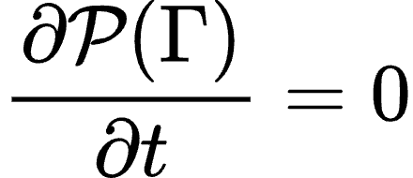


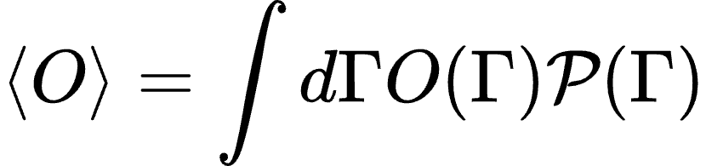
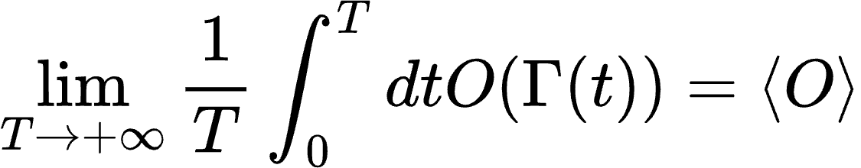
Properties of statistical ensembles
Equilibrium:
  probability does not depend on time:
  probability is invariant under time-reversal symmetry:
where
Ensemble averages: given microscopic observable O(𝛤), its expected value is
Ergodicity: if 𝛤(t) denotes a single trajectory starting from 𝛤(0),
If the system is ergodic, ensemble averages (across different realizations) are equivalent to time averages (on a single realization)!

Slide 5
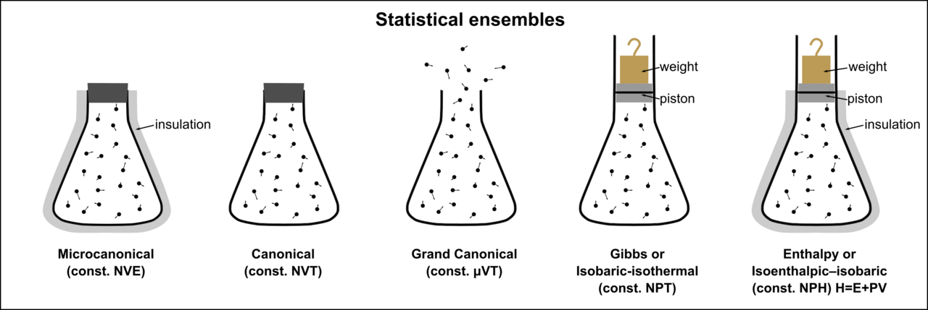
Statistical ensembles
*
closed,
isolated,
rigid walls
closed,
not isolated,
rigid walls
closed,
not isolated,
movable walls
* Taken from: http://en.wikipedia.org/wiki/Ensemble_(mathematical_physics)

Slide 6
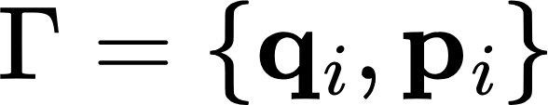
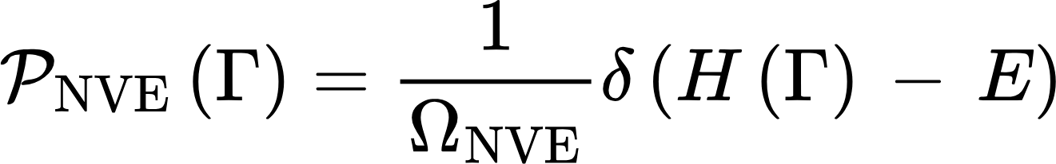
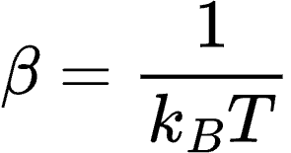
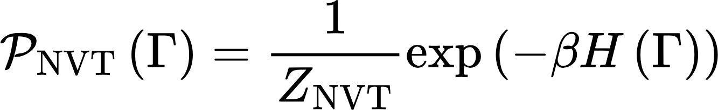
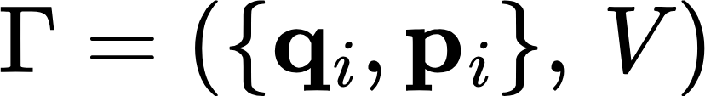
Statistical ensembles
from principle of “equal a priori probability”
Boltzmann distribution
Isothermal-isobaric distribution

Slide 7
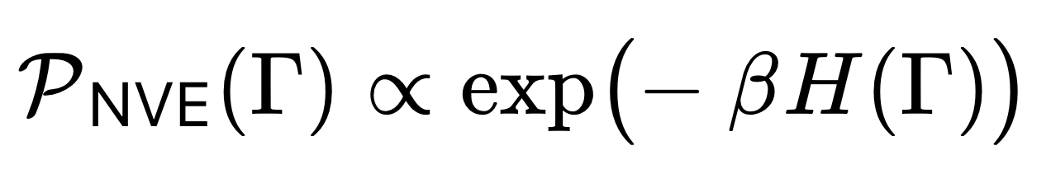




Canonical ensemble (NVT)
Distribution we want to sample:
Problem: direct sampling is not possible! (≠ simple low-dimensional distribution)
Solution: complex probability distribution can be still sampled using Markov chains!
A Markov-chain sampler of a distribution is an update rule which should satisfy the following properties:
Stationarity of the target distribution: applied to , it returns
Ergodicity: no “unexplored” regions in the - space after a finite number of updates
[optional] Fast decorrelation of samples: sampled with shorter trajectories!
N.B. the update rule can be deterministic or stochastic (involving the extraction of random numbers)
Notes:
The message: in the canonical ensemble the kinetic energy is a random variable with a known distribution, and its fluctuations are as much a part of the ensemble as its average. The relative width goes as one over the square root of Nf, so for large systems the distribution is narrow but never a delta.

Slide 8
Canonical ensemble (NVT)
Candidate Markov chain samplers:
Markov chain Monte-Carlo (not in this school): update in two steps,
  deterministic trial move
  random acceptance rule (Metropolis-Hastings)
Limitation: designing trial moves which give large acceptance is hard! (property 3 not satisfied)
Velocity Verlet? Is it a good sampler of ?
  deterministic update:
  Property 1 (stationarity) satisfied (can be shown)
  Property 2 (ergodicity) not satisfied: dynamics stuck to subregion of phase space with
Notes:
The message: in the canonical ensemble the kinetic energy is a random variable with a known distribution, and its fluctuations are as much a part of the ensemble as its average. The relative width goes as one over the square root of Nf, so for large systems the distribution is narrow but never a delta.

Slide 9
Canonical ensemble (NVT)
Can we couple Velocity Verlet to an update rule that modifies energy according to the NVT distribution, achieving ergodicity?
Velocity Verlet
Update energy
Velocity Verlet
Update energy
…
…
If we could find an energy update rule which is stationary wrt NVT distribution, we would achieve ergodicity will preserving stationarity!
In other words, we would have a sampler of the canonical distribution!
Notes:
The message: in the canonical ensemble the kinetic energy is a random variable with a known distribution, and its fluctuations are as much a part of the ensemble as its average. The relative width goes as one over the square root of Nf, so for large systems the distribution is narrow but never a delta.

Slide 10
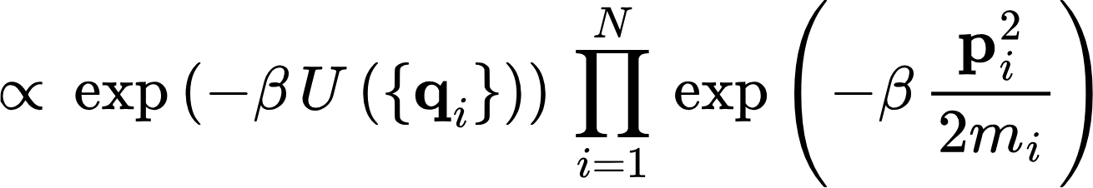
Canonical ensemble (NVT)
It turns out that a simple way to do this is updating only the kinetic energy part
How? Distribution is separable in positions and momenta: since
difficult to sample
easy to sample
(just a product of Gaussians!)
A sampling algorithm for the kinetic energy of the NVT distribution is called thermostat
Hamilton’s eqs. integrator (e.g. Velocity Verlet) + thermostat = sampler of canonical ensemble
Notes:
The message: in the canonical ensemble the kinetic energy is a random variable with a known distribution, and its fluctuations are as much a part of the ensemble as its average. The relative width goes as one over the square root of Nf, so for large systems the distribution is narrow but never a delta.

Slide 11
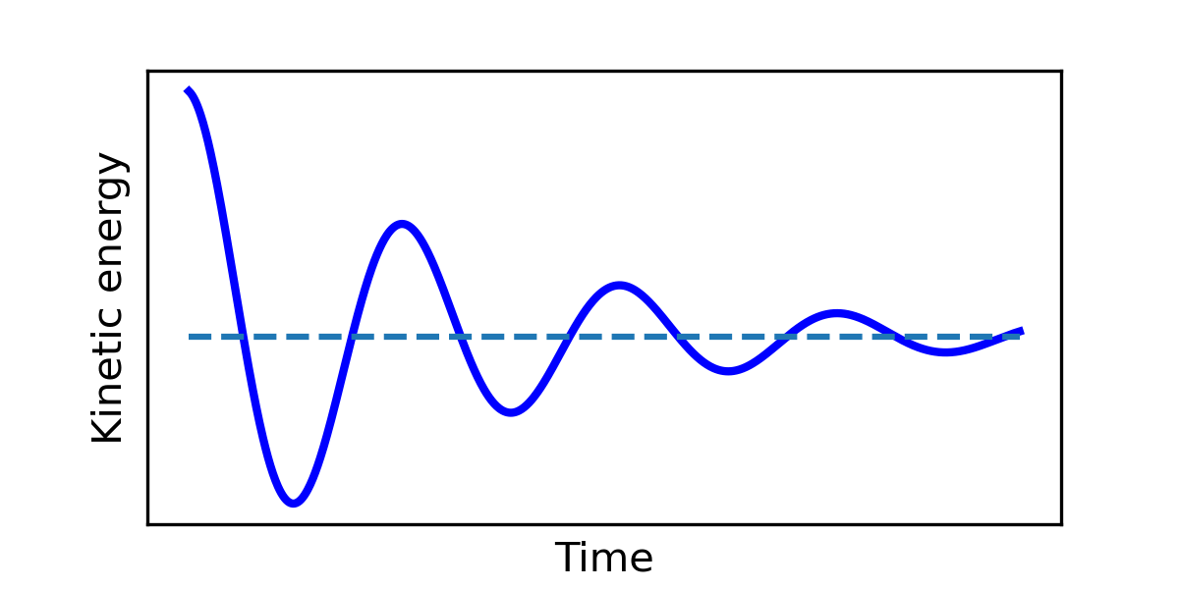

Thermostats
Properties:
Deterministic vs stochastic thermostats
Typically equilibrate faster (no slow dumped oscillations), exception: Berendsen
Local vs global thermostats
update momenta one by one,
with a different rule per particle
update momenta globally,
with the same rule
requires extracting 3N random numbers
requires extracting a single random number (faster!)
Notes:
The message: in the canonical ensemble the kinetic energy is a random variable with a known distribution, and its fluctuations are as much a part of the ensemble as its average. The relative width goes as one over the square root of Nf, so for large systems the distribution is narrow but never a delta.

Slide 12
Thermostats
A list of thermostats:
Berendsen thermostat: deterministic, global (but technically wrong! It samples correctly the mean kinetic energy, not the full distribution)
use it for equilibration, not for production
Andersen thermostat: stochastic, local
…More at the hands-on session of this afternoon!
Langevin thermostat: stochastic, local
Nosé-Hoover: deterministic, local
Stochastic velocity rescaling (v-rescale): stochastic, global
Notes:
The message: in the canonical ensemble the kinetic energy is a random variable with a known distribution, and its fluctuations are as much a part of the ensemble as its average. The relative width goes as one over the square root of Nf, so for large systems the distribution is narrow but never a delta.

Slide 13
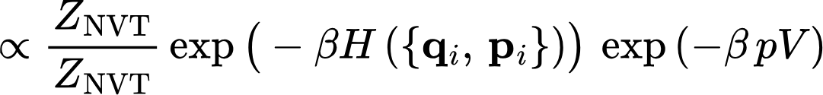
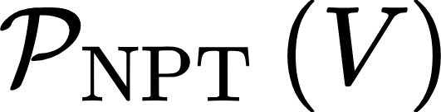
Isothermal – isobaric ensemble (NPT)
Target distribution:
now we know
how to sample it
what we need to sample!
(velocity Verlet + thermostat)
N.B. and V are separated in the last expression, so:
  a sampler of the NVT distribution is stationary wrt NPT distribution…
  …but not ergodic (volume fixed)!
does it ring a bell?
Notes:
The message: in the canonical ensemble the kinetic energy is a random variable with a known distribution, and its fluctuations are as much a part of the ensemble as its average. The relative width goes as one over the square root of Nf, so for large systems the distribution is narrow but never a delta.

Slide 14
Isothermal – isobaric ensemble (NPT)
Update
(kinetic) energy
Update
(kinetic) energy
Velocity Verlet
Update volume
Velocity Verlet
…
…
by sampling it from
A sampling algorithm for the volume of the NPT distribution is called barostat
Hamilton’s eqs. integrator + thermostat + barostat = sampler of NPT ensemble
Notes:
The message: in the canonical ensemble the kinetic energy is a random variable with a known distribution, and its fluctuations are as much a part of the ensemble as its average. The relative width goes as one over the square root of Nf, so for large systems the distribution is narrow but never a delta.

Slide 15
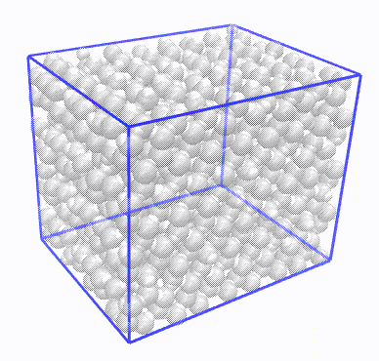
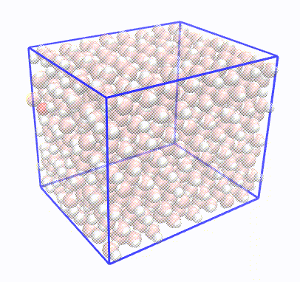
Barostats
Properties:
Deterministic vs stochastic thermostats
Local vs global?
Isotropic vs anisotropic (vs semi-isotropic)

Slide 16
Barostats
A list of barostats:
Berendsen: deterministic
Parrinello-Rahman: deterministic
Martyna-Tuckerman-Tobias-Klein (MTTK): deterministic
Stochastic cell rescaling (c-rescale): stochastic

Slide 17
Backup slides

Slide 18
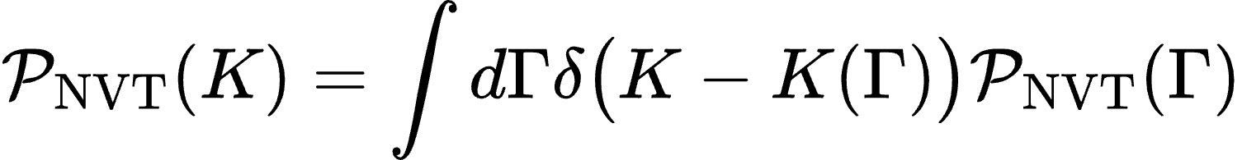
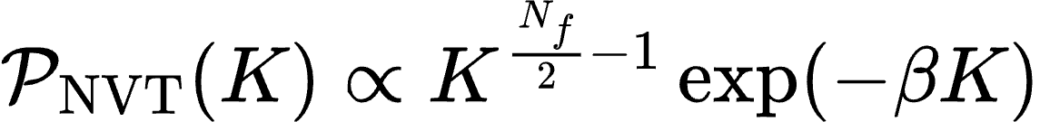

Canonical ensemble (NVT)
Distribution is separable in positions and momenta: since
Canonical distribution as a function of the kinetic energy only?
Change of variable:
[...]
“Gamma distribution”
where
number of momentum degrees of freedom
momentum components
number of constraints (e.g. rigid bonds, fixed angles)
number of conservation rules (if no external field)
Notes:
The message: in the canonical ensemble the kinetic energy is a random variable with a known distribution, and its fluctuations are as much a part of the ensemble as its average. The relative width goes as one over the square root of Nf, so for large systems the distribution is narrow but never a delta.

Slide 19

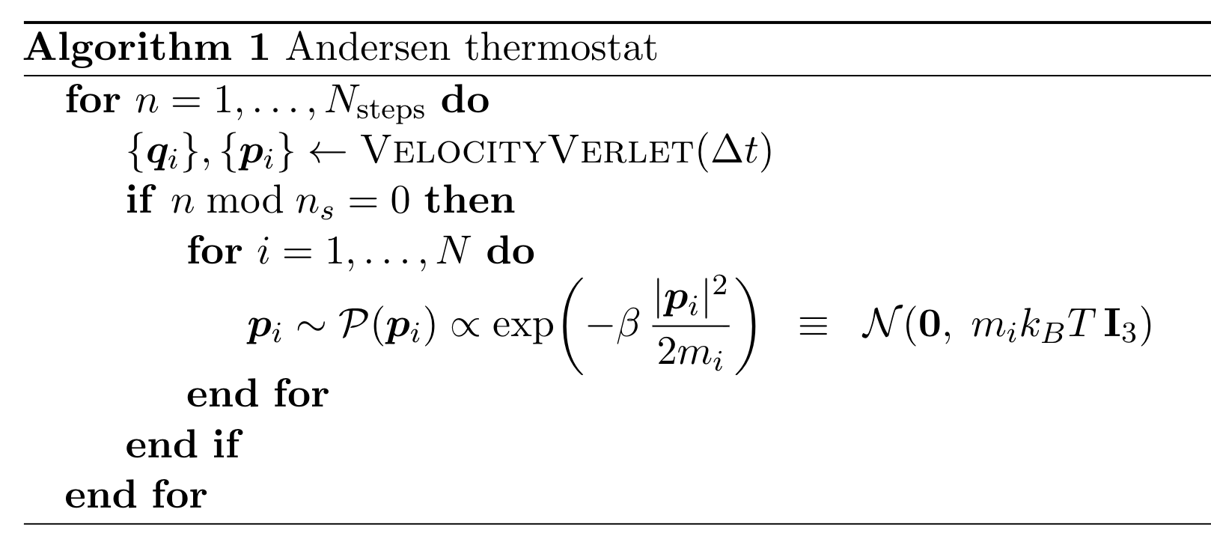

Andersen thermostat
Idea: re-sample momenta from scratch every few steps (using a stride )
samples the canonical distribution
equilibration of momenta is instantaneous, equilibration of positions can be slow
Notes:
The message: in the canonical ensemble the kinetic energy is a random variable with a known distribution, and its fluctuations are as much a part of the ensemble as its average. The relative width goes as one over the square root of Nf, so for large systems the distribution is narrow but never a delta.

Slide 20
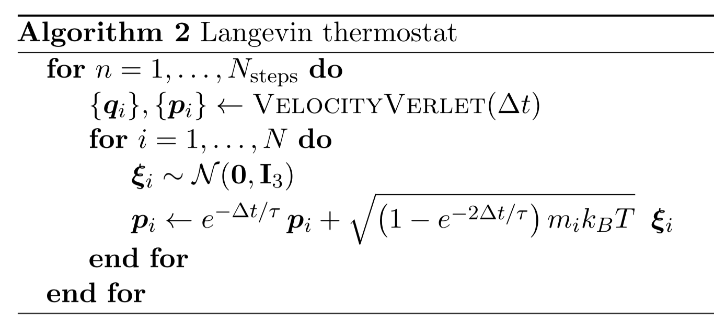
Langevin thermostat
can be seen as a “softer” version of the Langevin thermostat
samples the canonical distribution
equilibration of momenta is instantaneous, equilibration of positions can be slow
Notes:
The message: in the canonical ensemble the kinetic energy is a random variable with a known distribution, and its fluctuations are as much a part of the ensemble as its average. The relative width goes as one over the square root of Nf, so for large systems the distribution is narrow but never a delta.

Slide 21
Berendsen thermostat
can be seen as a “softer” version of the Langevin thermostat
samples the canonical distribution
equilibration of momenta is instantaneous, equilibration of positions can be slow
Notes:
The message: in the canonical ensemble the kinetic energy is a random variable with a known distribution, and its fluctuations are as much a part of the ensemble as its average. The relative width goes as one over the square root of Nf, so for large systems the distribution is narrow but never a delta.

Slide 22
Canonical ensemble (NVT)
Distribution is separable in positions and momenta: since
Canonical distribution as a function of the kinetic energy only?
Change of variable:
[...]
“Gamma distribution”
where
number of momentum degrees of freedom
momentum components
number of constraints (e.g. rigid bonds, fixed angles)
number of conservation rules (if no external field)
Notes:
The message: in the canonical ensemble the kinetic energy is a random variable with a known distribution, and its fluctuations are as much a part of the ensemble as its average. The relative width goes as one over the square root of Nf, so for large systems the distribution is narrow but never a delta.

Slide 23
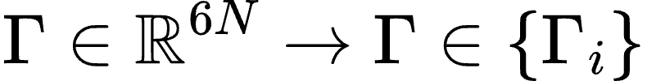

Deriving the Boltzmann distribution
How to derive it?
From microcanonical ensemble, splitting a single NVE system in two NVT systems (reservoir + system)
From an information-theoretic principle: Maximum Entropy (MaxEnt)
For simplicity we will write it for a discrete distribution:
error of the approximation can be made arbitrarily small by taking a grid which is “fine enough”
[Just a matter of convenience: same results can be obtained in the continuous case]

Slide 24
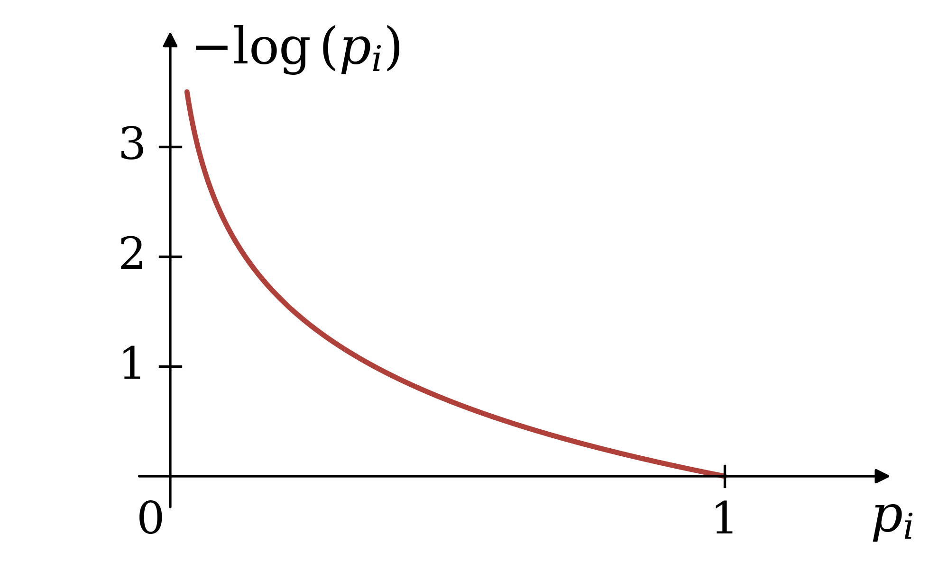

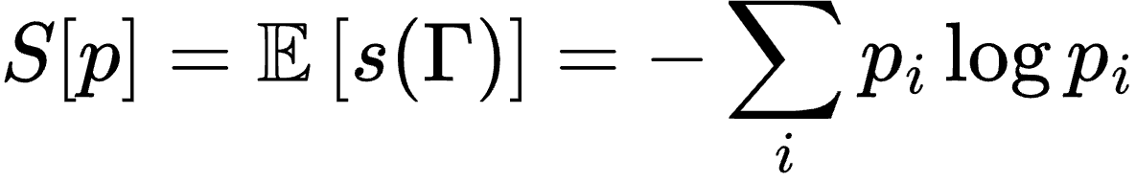
Deriving the Boltzmann distribution
Definitions (from Information Theory)
Surprisal (of an event): “How unlikely is the configuration ?”
Shannon entropy (of the distribution): “How unlikely is a generic configuration ?

