Slide 1


Molecular Dynamics:
Interactions and Force Fields
PWF Summer school on Theoretical and Computational Biophysics
University of Colombo
Day 2/5
Dr. Marta Monti

Slide 2
Overview
In a molecular dynamics (MD) simulation, we integrate the equation of motions to follow the temporal evolution of a set of N interacting particles:
Initial positions
Compute forces (F_{i})
Time integration of trajectory
Measure quantity
Initial velocities
No
Converged?
Yes
Finish
Notes:
Before looking at the different types of interactions, let’s first recall what actually happens in a molecular dynamics simulation.
We start from an initial configuration of the system: the positions of all atoms and their initial velocities. From these coordinates, we calculate the forces acting on each particle as a consequence of the interactions with the other particles in the system.
Once we know the forces, we can use Newton’s equations of motion to propagate the system forward by a very small time step. This gives us new positions and velocities. We then calculate the forces again, propagate another step, and repeat this procedure many times.
In this way we generate a trajectory, which describes how the system evolves with time. From this trajectory we can then calculate the quantities we are interested in — structural properties, energies, diffusion, conformational changes, and so on.
If the simulation is not yet long enough to sample the behaviour we are interested in, we simply continue the cycle.

Slide 3
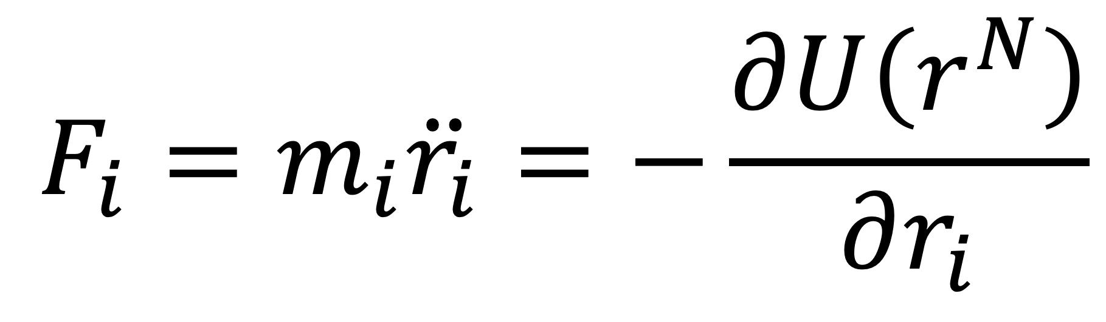
Overview
In a molecular dynamics (MD) simulation, we integrate the equation of motions to follow the temporal evolution of a set of N interacting particles:
Initial positions
Compute forces (F_{i})
Time integration of trajectory
Measure quantity
Initial velocities
No
Converged?
Yes
Finish
Notes:
So the key ingredient in this whole workflow is really the calculation of the forces: to run an MD simulation, we need a model that tells us how the particles interact with each other.

Slide 4
Interatomic interactions
Force acting on the i particle due to its interaction with other particles
We derive the forces from the potential energy
The potential energy function can be split into three components: bonded term, non-bonded term, and the term due to the presence of an external field:

Slide 5
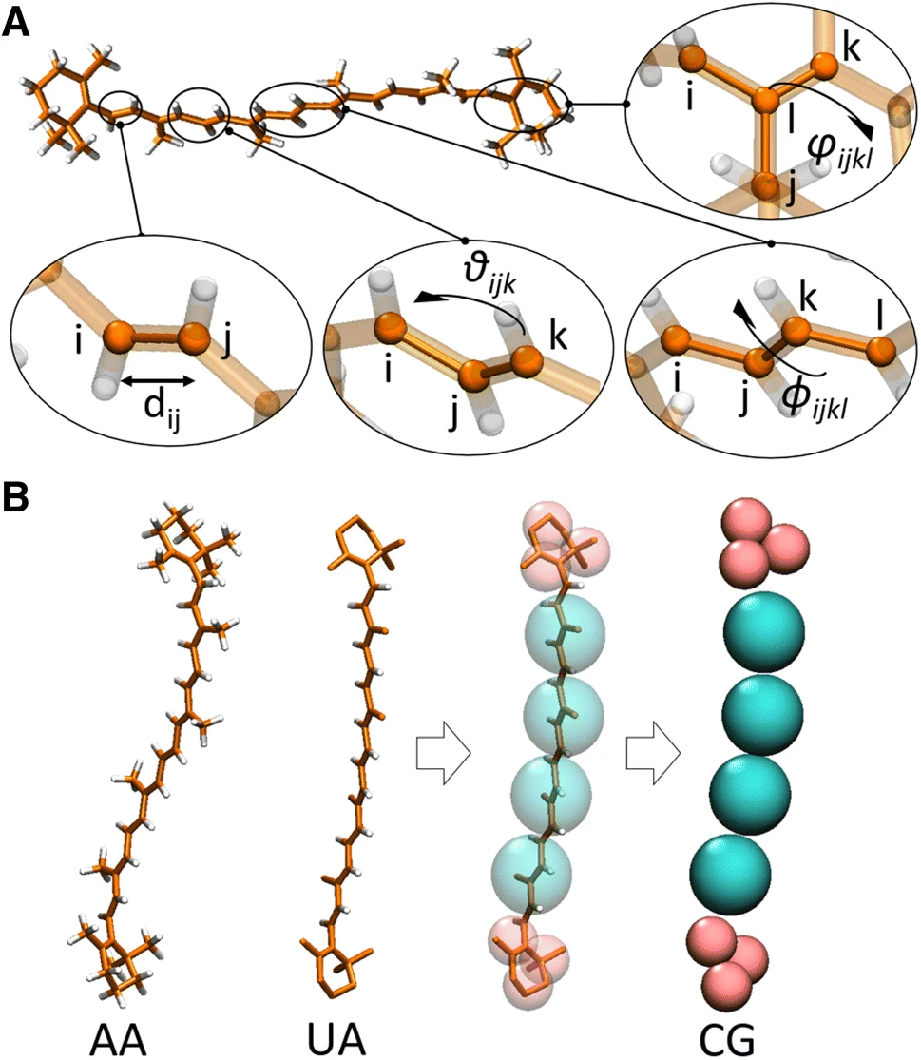
Bonded term
The bonded term includes the 2-, 3-, and 4-body interactions between atoms that are bonded covalently.
bonds
angles
dihedrals
proper dihedral
improper dihedral

Slide 6
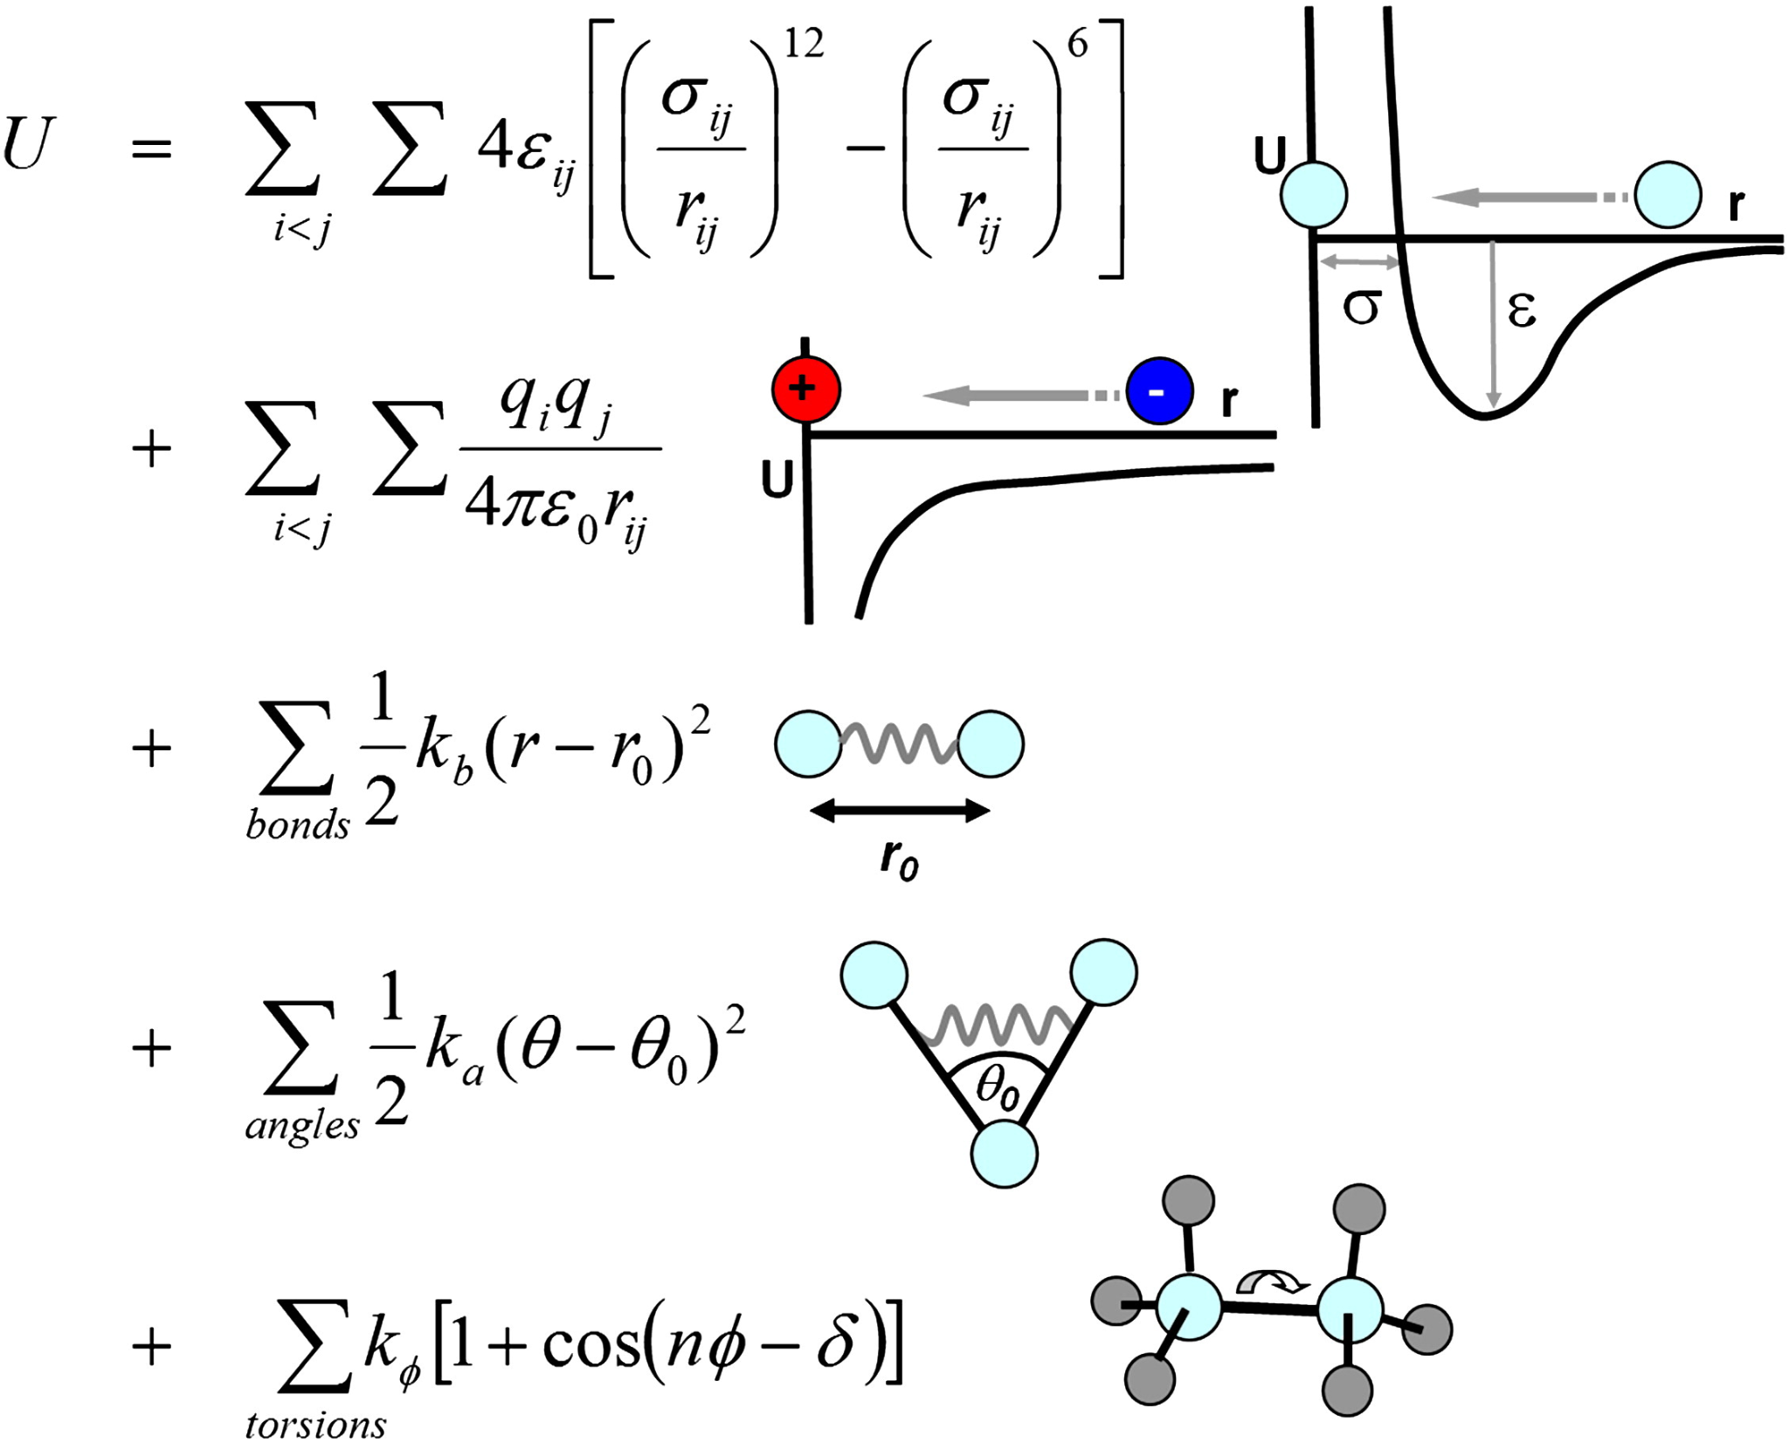
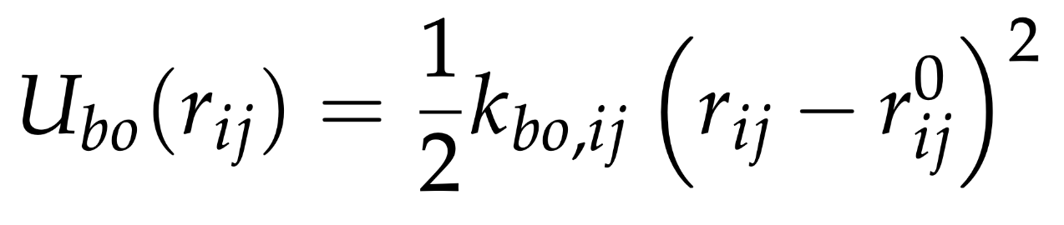
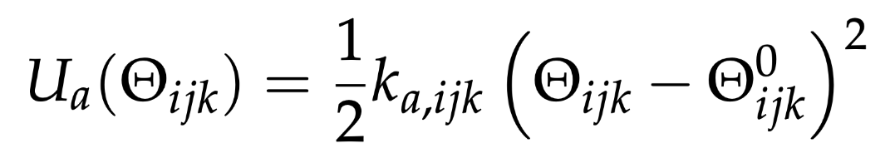
Bonded term
The bond stretching between two atoms, i and j, is usually described with a harmonic potential
The angle bending between a triplet of i-j-k atoms is also described with a harmonic potential

Slide 7
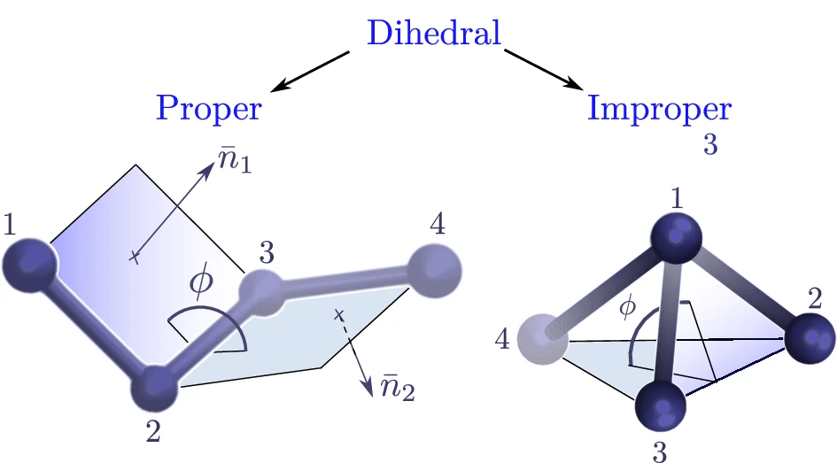
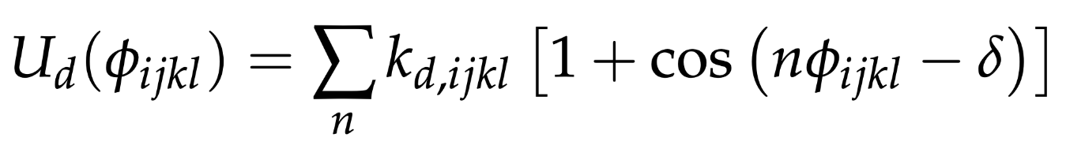
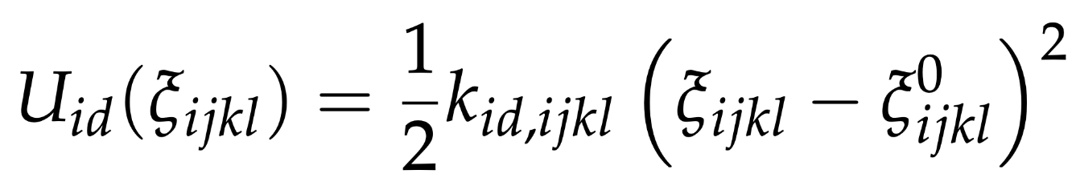
Bonded term
Proper dihedrals can be described by a sum of cosine functions:
Improper dihedrals are described by means of harmonic potential functions:

Slide 8
Non-bonded term
The non-bonded term should consider all the potential terms between non-bonded atoms.
We approximate it considering only the interaction between pair of particles → pairwise potential
van der Waals
term
electrostatic
term

Slide 9
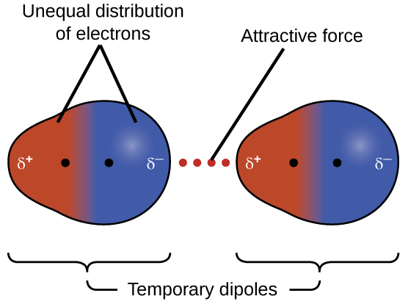
van der Waals
In classical MD, the van der Waals term groups the non-bonded, non-electrostatic interactions between atoms: London dispersion attraction and short-range Pauli repulsion.
London dispersion: temporary electron-density fluctuations create instantaneous dipoles that induce dipoles in nearby atoms, leading to attraction.
Short-range repulsion: when atoms get too close, their electron clouds overlap, leading to strong Pauli repulsion.
Both contributions depend strongly on the distance between atoms.
Notes:
London dispersion attraction: even an atom with no permanent dipole has electrons that are constantly moving. At any instant, the electron cloud can become slightly asymmetric, creating a temporary dipole. This can induce a dipole in a neighbouring atom, and the two become weakly attracted. That is the origin of London dispersion.
Let’s now look at the van der Waals contribution to the force field. This term acts between atoms that are not directly bonded to each other and contains two competing effects: an attractive interaction at intermediate distances and a very strong repulsion when atoms get too close.
The attractive part is mainly due to London dispersion. Electrons are constantly moving, so even in an atom or molecule with no permanent dipole, the electron density can become temporarily asymmetric. This creates an instantaneous dipole, which can induce another dipole in a neighbouring atom. The interaction between these temporary dipoles produces a weak attraction.
On the other hand, if two atoms approach each other too closely, their electron clouds start to overlap. Because of the Pauli exclusion principle, this becomes energetically very unfavorable and produces a strong short-range repulsion.
Both effects depend very strongly on the distance between the atoms, which is why we need a distance-dependent potential to describe them

Slide 10
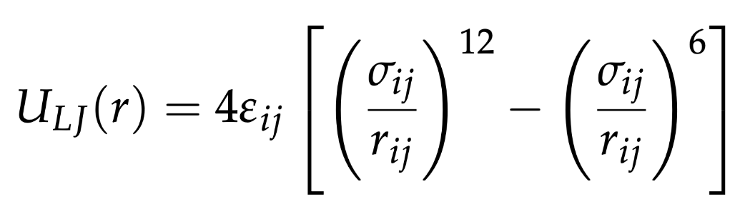
van der Waals
The van der Waals terms of the i, j atomic pairs can be modeled by the Lennard-Jones potential:
Repulsion:
Pauli repulsion due to electron-cloud overlap
Attraction:
London dispersion forces
Notes:
In most classical biomolecular force fields, these two effects are represented using the Lennard–Jones potential.
The Lennard–Jones potential combines these two physical effects in a very simple mathematical form.
The first term varies as 1/r121/r^{12} and represents the strong short-range repulsion. Notice how rapidly this term increases when rr becomes small: this effectively prevents two atoms from occupying the same region of space.
The second term varies as 1/r61/r^6 and represents the attractive London dispersion interaction.
The balance between these two terms gives the characteristic shape shown here. At very short distances the energy becomes very large and positive, so the interaction is strongly repulsive. At somewhat larger distances the attractive contribution dominates and the energy becomes negative. And when the atoms are very far apart, both contributions go to zero, so the van der Waals interaction disappears.
The r−6r^{-6} dependence has a physical basis in London dispersion theory, whereas the r−12r^{-12} repulsive term is mainly a convenient empirical approximation because it is computationally simple

Slide 11
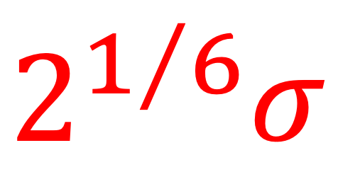
van der Waals
The van der Waals terms of the i, j atomic pairs can be modeled by the Lennard-Jones potential:
ε_{ij} = depth of the potential well → it controls the strength of the interaction
σ_{ij} = distance at which the LJ potential is zero (if r = σ → U_{LJ}=0)
r = 2^{1/6}σ → U_{min} = -ε
Notes:
The shape of the Lennard–Jones potential is controlled by two parameters, σ\sigma and ε\varepsilon, and these parameters depend on the atom types involved.
ε\varepsilon is the depth of the potential-energy well. So it tells us how favorable the attractive interaction is: a larger ε\varepsilon means a deeper well and therefore a stronger attraction.
σ\sigma is related to the effective size of the atoms. More precisely, it is the distance at which the Lennard–Jones energy becomes zero. So σ\sigma is not the equilibrium distance
The most favorable distance corresponds to the minimum of the potential, which occurs at r=21/6σr=2^{1/6}\sigma. At this distance the energy is exactly −ε-\varepsilon. Here the attractive and repulsive contributions balance each other.
So, in very simple terms, σ\sigma controls how close the atoms can comfortably approach, while ε\varepsilon controls how strongly they attract each other.

Slide 12
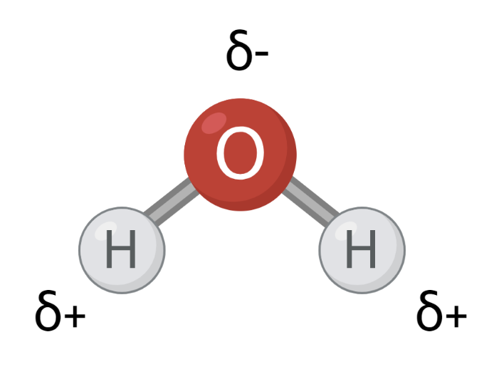
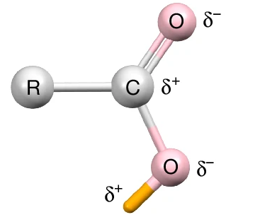
Electrostatics
Atoms in molecules can carry partial positive or negative charges due to an uneven distribution of electrons.
Electrostatic interactions arise between electrically charged or partially charged atoms
Their strength depends on the magnitude of the charges and the distance between them
In classical MD, atoms are treated as point charges carrying partial charges

Slide 13
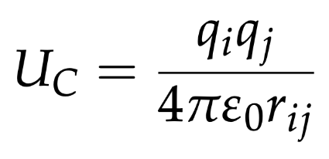
Electrostatics
The electrostatic interactions can be modeled by the Coulomb potential:
qi, qj → atomic partial charges
rij → distance between atoms
q_{i}q_{j} < 0 → attraction (U < 0); q_{i}q_{j} > 0 → repulsion (U > 0)
magnitude decreases as 1/r → unlike van der Waals interactions, electrostatics are long-ranged

Slide 14
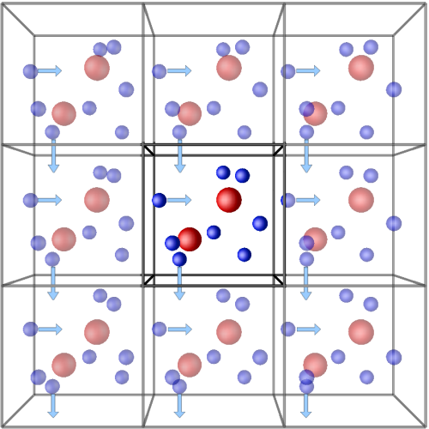
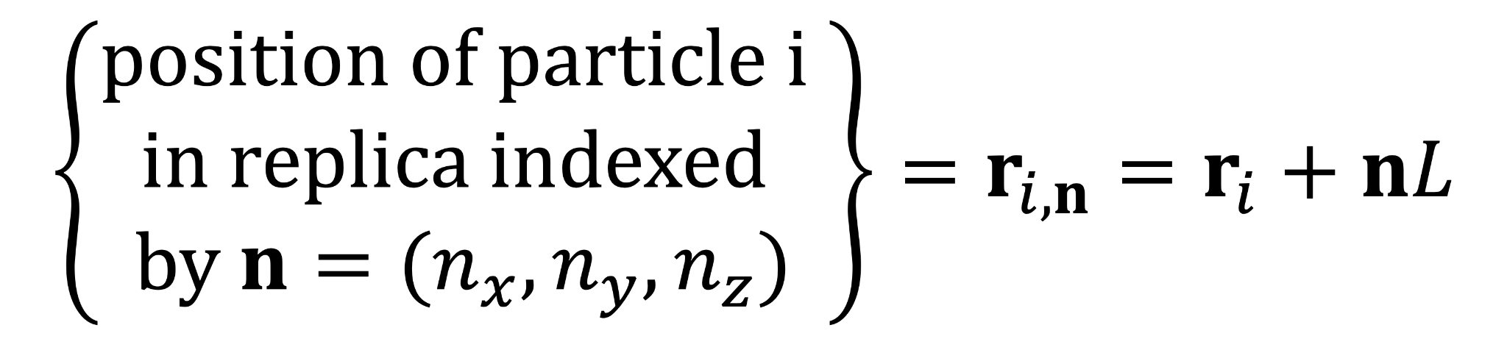
What happens under periodic boundary conditions?
The simulation box is replicated infinitely in all directions to mimic a bulk system
Each atom interacts not only with atoms in the original box, but also with their periodic images
In a cubic simulation cell of volume L³:
Periodic cells
position of i in primary cell
n = (0,0,0)
primary cell
Simulation cell
Notes:
talk about simulation vs periodic cells: the simulation box is treated as surrounded by infinite replica over the three dimensions of the space. This is simply accomplished by considering that if a particle moves out of the box, an image particle moves in to replace it
interaction between particles in the simulation cell and the periodic ones: how do we treat them?

Slide 15
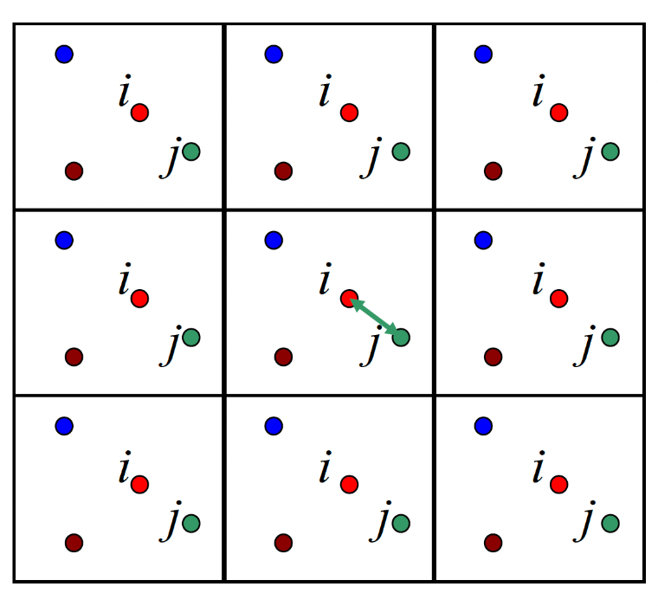
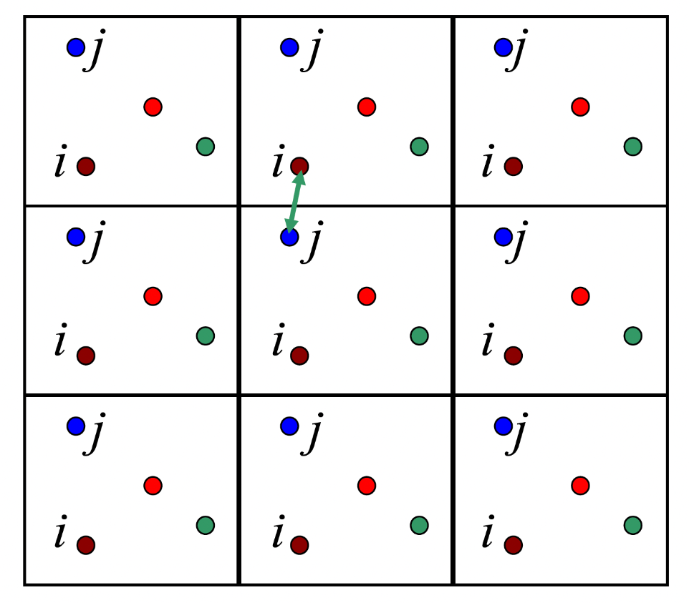
Minimum image convention
When potential decays rapidly with distance (= short-range interactions):
we neglect all n except the one for which |r_{i} - r_{j} + nL| is the smallest
Notes:
Because the box is repeated infinitely, atom i has many periodic copies of atom j around it. We do not want to count all of these copies as separate nearby neighbours. Instead, for short-range pair interactions, we use the minimum image convention: we take the shortest distance between i and any periodic image of j (= a particle interacts only with the nearest image of all the other particles)

Slide 16
Minimum image convention
When potential decays rapidly with distance…
Lennard-Jones potential
Short-range forces using the minimum image convention and PBC require the calculation of N(N-1)/2 distances and pair interactions for each type of potential → huge number
Usually short-range potentials can be safely cut off at a distance shorter than L/2.
Notes:
In principle, the computation of non-bonded interactions within the PBC and minimum image convention requires a huge number of pairwise calculations. Indeed, for each atom i, we should loop over all the j-atoms to find the minimum image distance, rij. A first assumption can be made imposing that the potential is equal to zero when rij > rcut, thus the distance between two atoms is bigger than the potential cutoff.

Slide 17
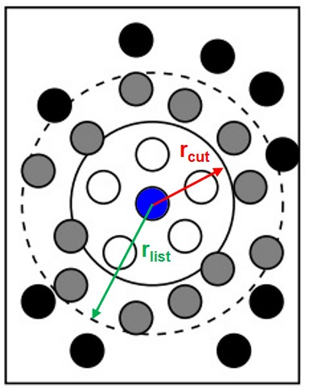
Verlet neighbor lists
Calculation of N(N-1)/2 distances can be avoided at most simulation steps using neighbor list
Verlet scheme: build a neighbor list containing all atoms within r_{list}
If r_{ij} < r_{cut} → compute the interaction
The neighbor list is updated periodically as atoms move
r_{list} > r_{cut} provides a buffer so no interaction is missed between updates
j
i

Slide 18
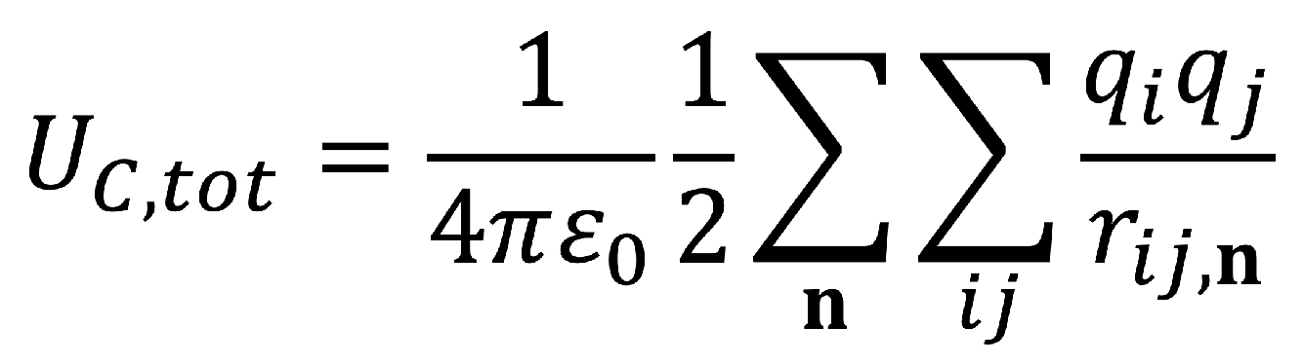
Long-range interactions
These approximations don’t work for long-range interactions (Coulomb potential)
Interactions between the particle and its images in the periodic cells should be explicitly included in the potential calculation
Full sum is slowly (and conditionally) convergent → too computationally expensive
First solution: Ewald method (scales as N²); current solution: Particle-mesh Ewald (PME) method (scales as Nlog(N))

Slide 19
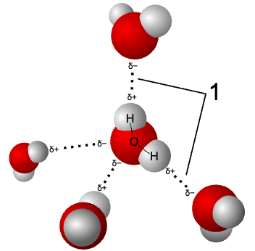
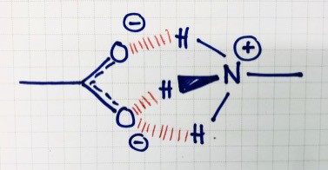
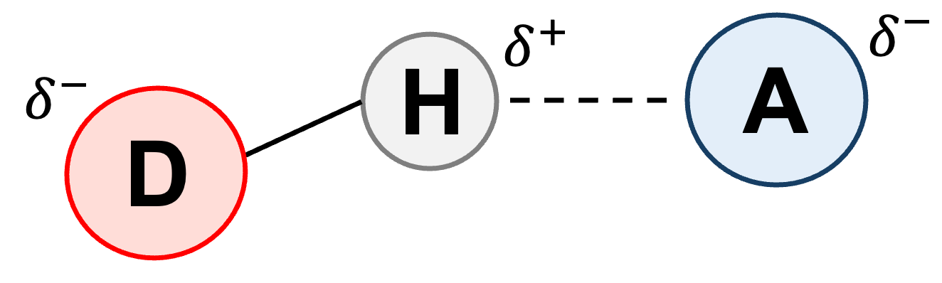
Hydrogen bonds
Molecular interaction where an H atom bonded to a highly electronegative atom (= donor) is attracted to another electronegative atom (= acceptor) bearing a lone pair of electrons
H-bonds play a fundamental role in biology and chemistry: they are responsabile for the anomalously high boiling point of water and the stabilization of proteins
d(D- - -A) ≲ 3.0 Å
a(D-H- - -A) ≳ 150°

Slide 20
Hydrogen bonds
They are not represented by an explicit H-bond potential
            H-bonds emerge from the combination of: a) electrostatic interactions between partial charges and b) van der Waals interactions between donor and acceptor atoms
                Their strength depends on the partial charges and LJ parameters
d(D- - -A) ≲ 3.0 Å
a(D-H- - -A) ≳ 150°

Slide 21

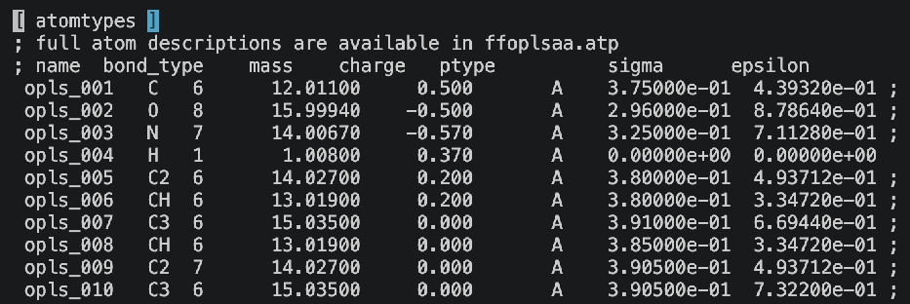
Force Field
All these potential terms are collected together in the force field (FF) that we provide in our MD simulation.
Practical example of an FF in GROMACS (OPLS-AA):
ffbonded.itp
ffnonbonded.itp
(bonds, angles, and dihedrals)
(partial charges, LJ parameters)
b0 = equilibrium bond distance
kb = spring constant → stiffness of the bond
Notes:
We will see in the next lessons the connection between these parameters and the topology we provide as input

Slide 22
Force Field
Parameters of the FFs are usually obtained by combining quantum mechanical calculations, experimental data, and fitting procedures.
The quality of an FF is usually assessed by its ability to reproduce thermodynamic properties of bulk solutions
Typical FFs for biomolecules are: AMBER, CHARMM, and OPLS-AA
We can distinguish all-atom and united-atom FFs
Interatomic potential parameters are defined for each atom type
Atoms of the same chemical group (e.g. H and C atoms of CH₃) are treated as one interaction center.

Slide 23
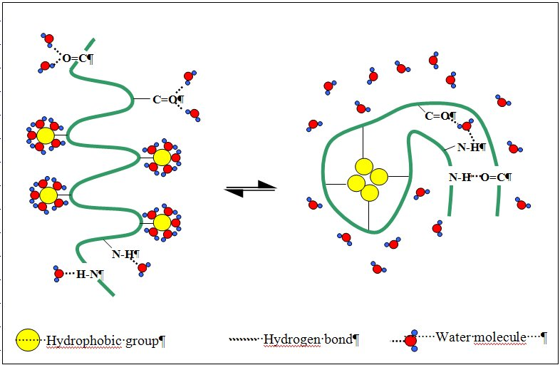
Force Field
What about the parameters for H₂O?

