Slide 1


Molecular Dynamics:
Simulations for hydrated biomolecules
PWF Summer school on Theoretical and Computational Biophysics
University of Colombo
Day 2/5
Dr. Marta Monti

Slide 2
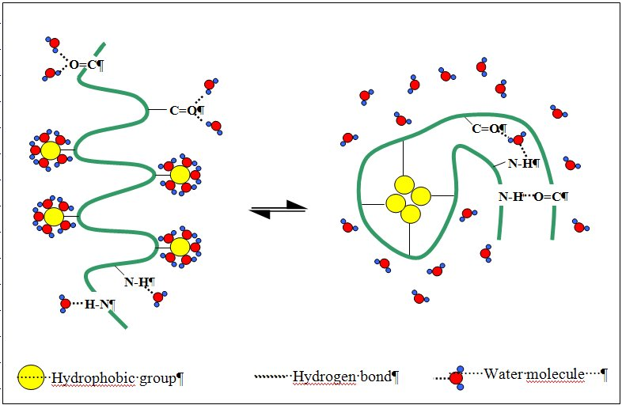
Force Field
What about the parameters for H₂O?

Slide 3
H₂O models
Models for H₂O can be distinguished by:
Number of sites (interaction points)
Rigidity
Inclusion of polarization effects

Slide 4
H₂O models
Models for H₂O can be distinguished by:
Number of sites (interaction points)
Rigidity
Inclusion of polarization effects
SPC and TIP3P
Three-site approach: 3 interaction points corresponding to the 3 atoms of the molecule
Each site has a point charge; LJ parameters for the O atom
Rigid geometry fixed according to the model; TIP3P uses a geometry close to the experimental gas-phase structure, while SPC uses the ideal tetrahedral HOH angle.

Slide 5
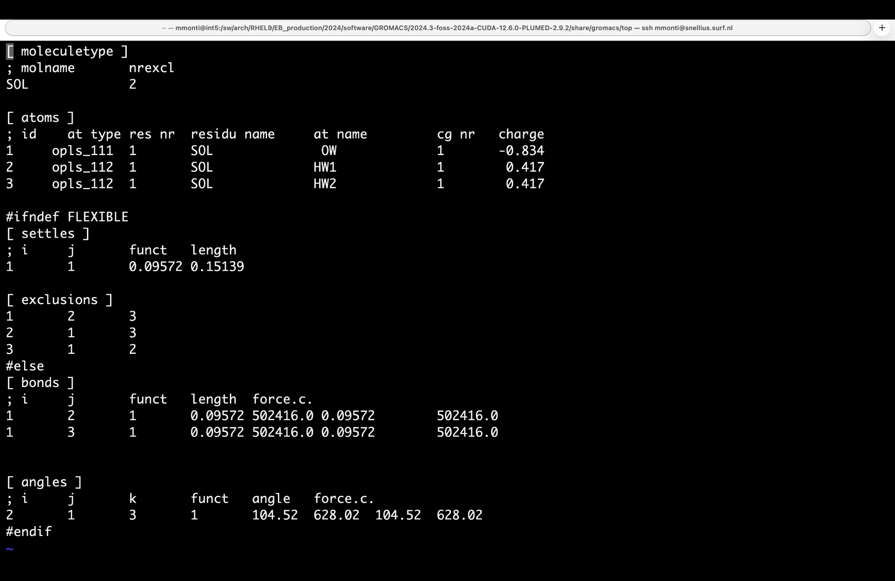
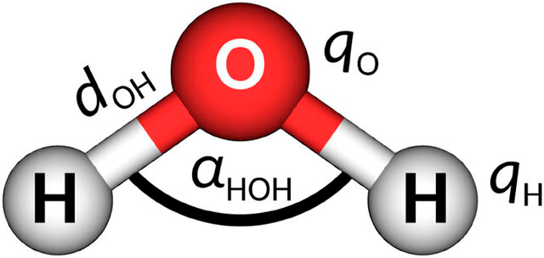
H₂O models - TIP3P
TIP3P
Widely used and computationally efficient, but it overestimates water mobility
Notes:
Explanation of the parameters.
Conclusion: this is probably the most standard model for biomolecular simulations because it provides a good compromise between cost and accuracy: TIP3P famously overestimates water mobility (diffusion coefficient is too high), which speeds up sampling but deviates from real-world dynamics.

Slide 6
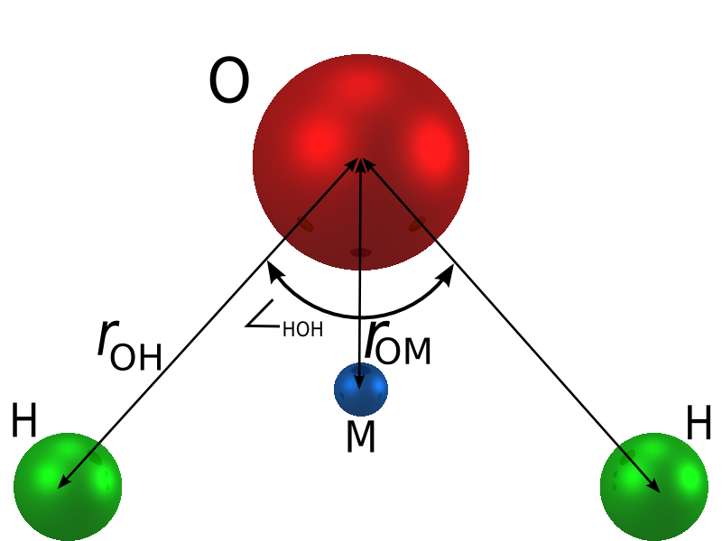
H₂O models
SPC/E, SPC/F, and TIP4P
SPC/E model adds an average polarization correction and improves properties such as density and diffusion relative to SPC.
SPC/F is a flexible variant that provides improved diffusion and dielectric properties compared with rigid SPC.
TIP4P introduces a 4th interaction site carrying the negative charge along the HOH bisector, providing a more realistic electrostatic representation.
Different models reproduce different properties — there is no universally “best” water model.
Notes:
There are more accurate models (but they may be more expensive) that provide higher accuracy for physical properties like density, diffusion, and electrostatic behavior.
TIP4P improves the representation of water electrostatics by placing the negative charge on a virtual site rather than directly on the oxygen atom.
The water model should also be chosen together with the biomolecular force field, since their parameters are designed and validated as a combination.

Slide 7
Why simulate biomolecules in water?
Biomolecules do not function in isolation: their native environment is aqueous.
Water plays an essential role in the structure, stability and flexibility of biomolecules
It forms hydrogen-bond networks with biomolecules
It screens electrostatic interactions
It contributes to hydrophobic effects
It can participate directly in binding, catalysis and conformational changes
Notes:
Water is not just a background solvent. It is part of the molecular environment that determines how biomolecules behave.

Slide 8
What can we learn from hydrated MD simulations?
MD connects molecular structure, dynamics and hydration at atomic resolution.
Structural properties
Solvation properties
Thermodynamic and kinetic properties
RMSD/RMSF
Radius of gyration
Secondary structure
Hydrogen shell (RDF)
Hydrogen bonds
Water residence time
Conformational populations
Binding affinities
Folding rates
We will see most of these quantities in detail in the next lecture
and in practice in the afternoon exercise!
Notes:
Secondary structure = Ramachandran plots for example

Slide 9
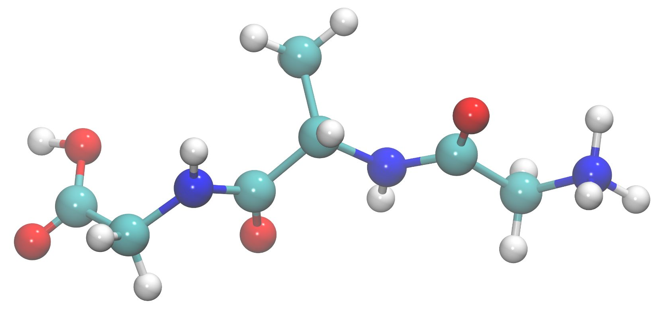
What can we learn from hydrated MD simulations?
Example: MD simulations of small solvated peptides (GAG⁺)
Gly
(C-protonated)
Ala
Gly
(N-protonated)
How many stable conformational states can such a small peptide have?
Notes:
Secondary structure = Ramachandran plots for example

Slide 10
What can we learn from hydrated MD simulations?
Example: MD simulations of small solvated peptides (GAG⁺)
Gly
(C-protonated)
Ala
Gly
(N-protonated)
Even a peptide this small has multiple stable conformational states
Conformational landscape is affected by factors as hydration and temperature

Slide 11
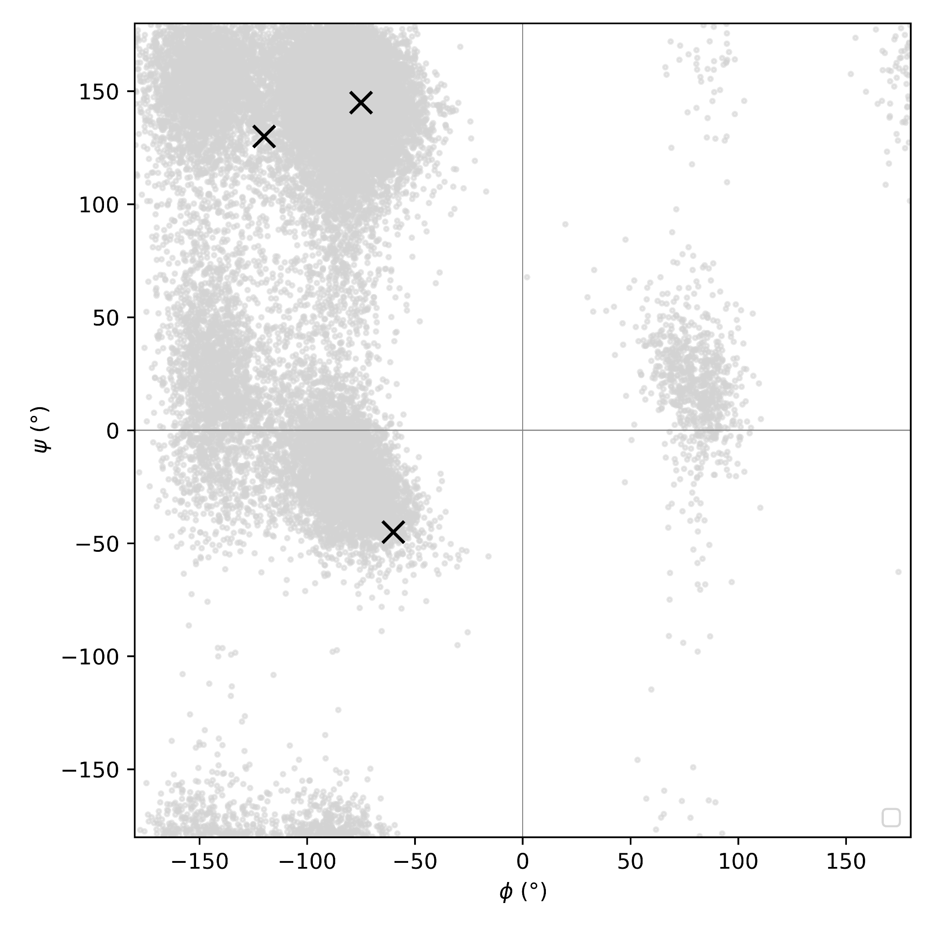
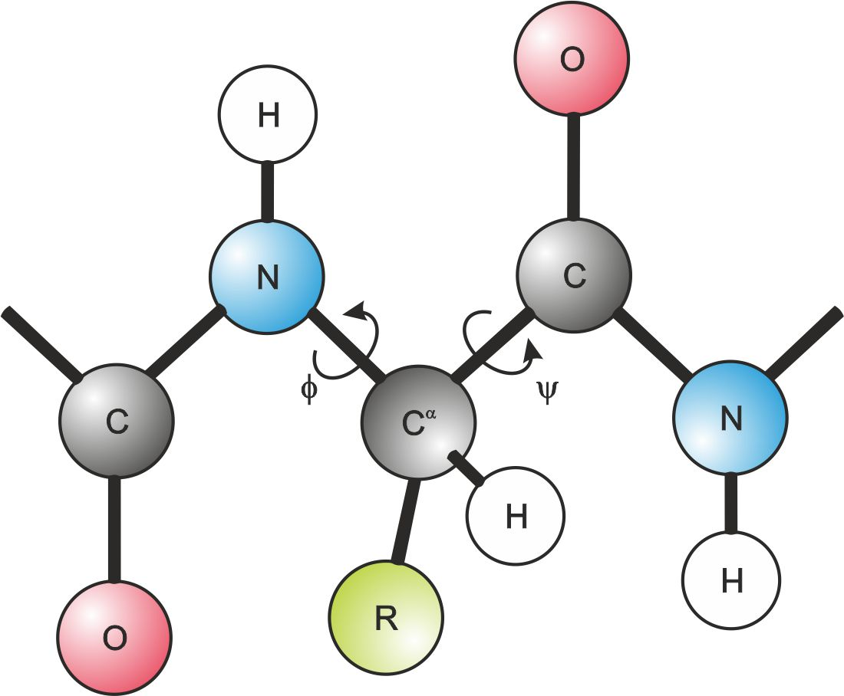
GAG⁺ in aqueous environment
Two main populations of GAG⁺: pPII- and β-like conformations
pPII
β-sheet
RH ɑ-helix
Ramachandran plot visualizes the backbone dihedral angles for amino acid residues.
backbone angles ↔ secondary structure
Notes:
Secondary structure = Ramachandran plots for example

Slide 12
GAG⁺ in aqueous environment
Two main populations of GAG⁺: pPII- and β-like conformations
pPII
pPII-like conformers are favoured at lower T,
while β-like conformers at higher T
β-sheet
How did we understand that?
RH ɑ-helix
Starting with MD simulations!

Slide 13
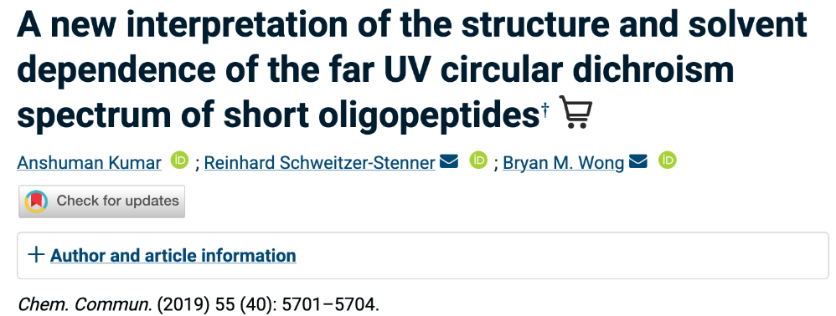
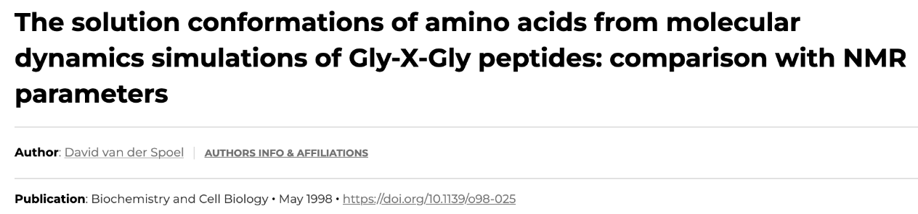
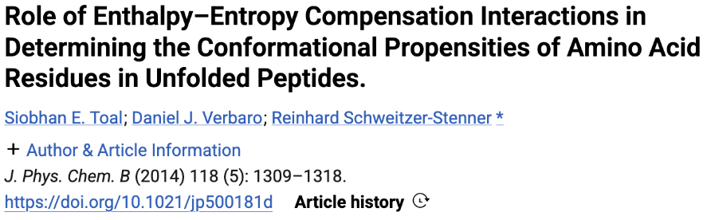
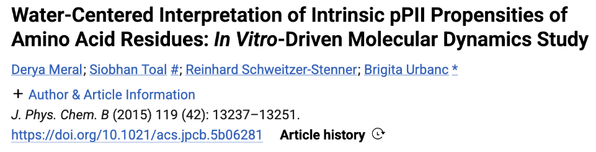
GAG⁺ in aqueous environment
There have been a few studies on G-x-G tripeptides
and many more that can’t fit the slide!

Slide 14
GAG⁺ in aqueous environment
Why study the conformational landscape of these peptides?
Small GxG peptides allow us to probe the intrinsic conformational preference of a residue with minimal influence from tertiary structure.
These intrinsic preferences help us understand the starting ensemble for protein folding and the behavior of intrinsically disordered regions.
Their conformational populations are strongly influenced by hydration, temperature and side-chain chemistry.
Experimental measurements usually provide ensemble-averaged observables; MD helps resolve the individual conformational states underlying those averages.
Because extensive spectroscopic data exist, GxG peptides are also excellent benchmarks for force fields and water models.
Notes:
Random coil does not actually mean random. Even very short unfolded peptides have preferred regions of conformational space, and understanding these intrinsic preferences helps us understand what conformations are available before a protein folds

Slide 15
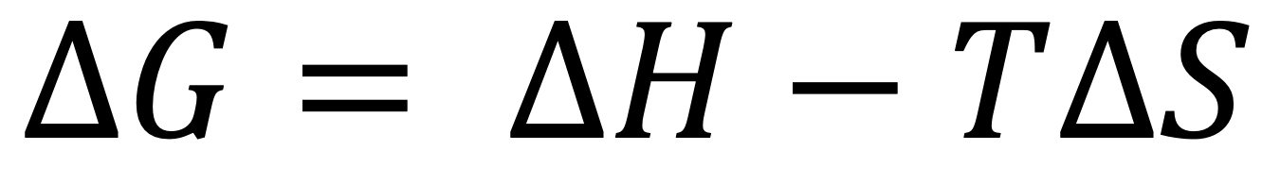
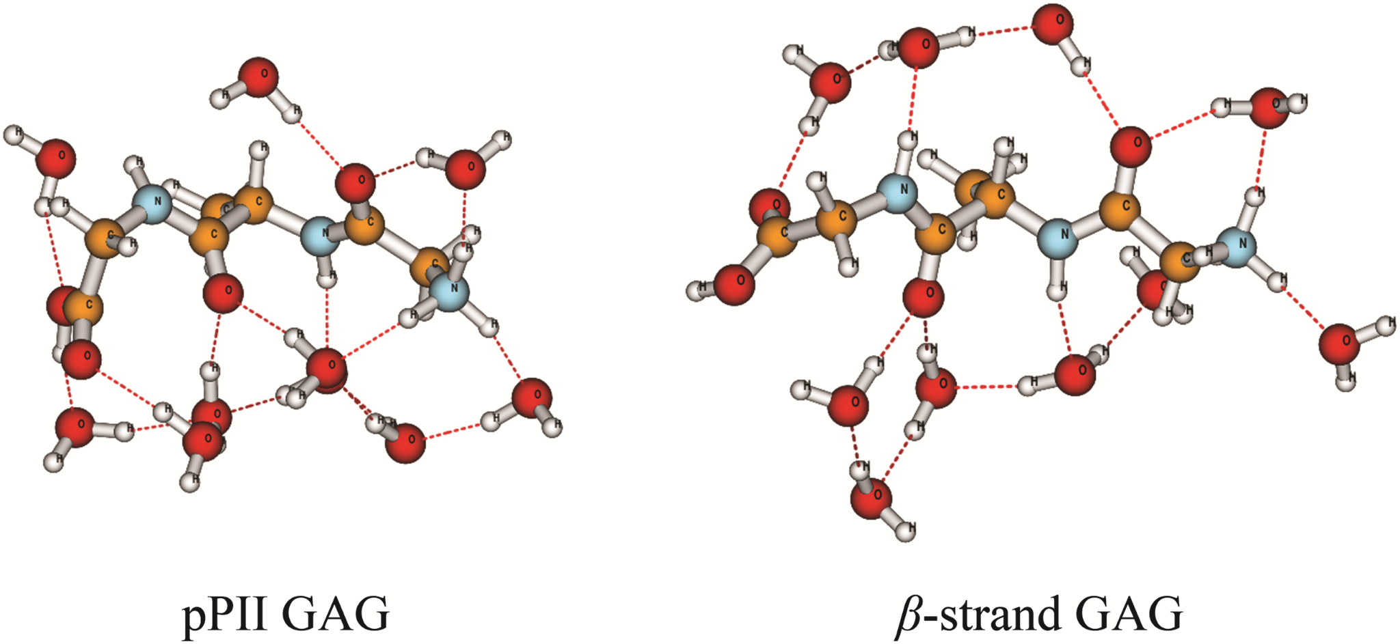
GAG⁺ in aqueous environment
Why pPII at low T and β at high T?
pPII is enthalpically favored: favorable peptide–water interactions stabilize this conformation (“clathrate-like” hydration structure)
β-strand is entropically favored: more heterogeneous hydration environment
Low T: smaller TΔS → enthalpic stabilization dominates → pPII favored
High T: larger TΔS → β population increases

Slide 16
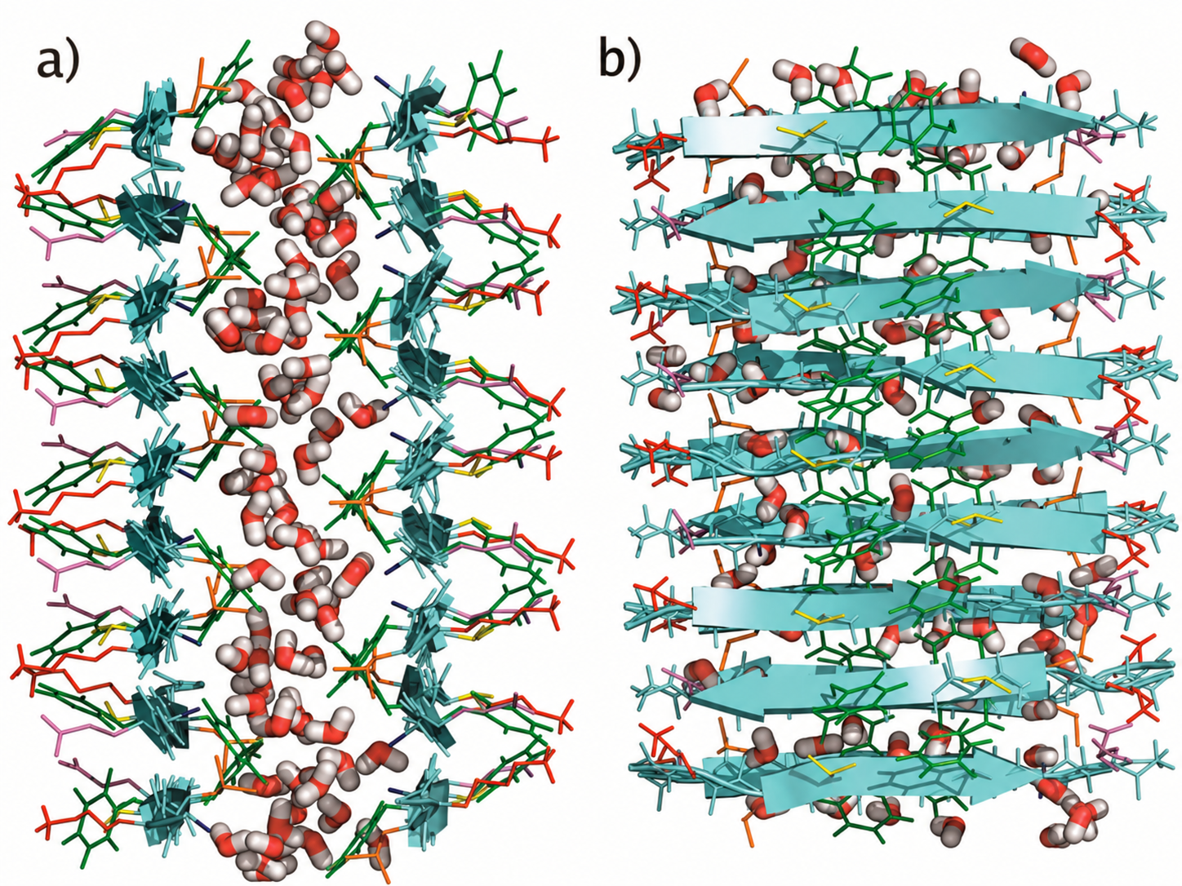
From small peptides to large biomolecular assemblies
Modern MD can treat large solvated biomolecular assemblies containing many peptide/protein chains and thousands of water molecules.
We can investigate processes such as aggregation, self-assembly and hydration of interfaces.
The system size should follow the scientific question: sometimes the full assembly is needed, while in other cases a smaller region or sequence is sufficient.
Amyloid-β 16-22 peptides
Notes:
So far, we have focused on GAG⁺, which is deliberately a very small system. But of course molecular dynamics is not limited to systems of this size.
With modern GPUs and high-performance computing resources, we can now simulate much larger solvated systems, from complete proteins and membrane proteins to large biomolecular assemblies, and follow their dynamics for hundreds of nanoseconds or even microseconds.
One example is shown here. These structures are assemblies formed by the short amyloid-β 16–22 peptide. Even though the individual peptide is very small, many copies can self-assemble into much larger β-sheet-rich structures. Molecular dynamics can then be used to investigate how these structures assemble, how stable they are, and importantly for this lecture, how water behaves at and between the peptide interfaces.
But larger is not always better. The size of the model should depend on the scientific question we want to answer. If we want to understand the global dynamics of a protein or an entire assembly, then we need to simulate the complete system. If instead we are interested in a very local phenomenon, sometimes we can focus on a particular domain, peptide sequence, or region of interest and reduce the computational cost — provided that the environment we remove is not essential for the process we want to study.
So the general message is that the same principles we have discussed for our small hydrated peptide extend to much more complex biomolecular systems: we choose an appropriate molecular model, include the relevant aqueous environment, run the dynamics, and use the trajectory to answer a specific biological or chemical question.
This afternoon, we will start from the simplest end of this spectrum and work with GAG⁺ ourselves, going through the complete workflow from setting up the hydrated system to extracting its conformational landscape. -> next lecture will be focused on learning the full MD workflow + analyses

