Slide 1


Molecular Dynamics:
Workflow for MD Simulations
PWF Summer school on Theoretical and Computational Biophysics
University of Colombo
Day 2/5
Dr. Marta Monti

Slide 2

Full MD pipeline
Step 1
System (and box) preparation
Step 2
Energy minimization
Step 3
Equilibration
Step 4
Production
Step 5
Analyses
There are many softwares to run classical MD simulations (e.g., AMBER, LAMMPS, CP2K, etc…).
Among them, one of the most used is GROMACS

Slide 3
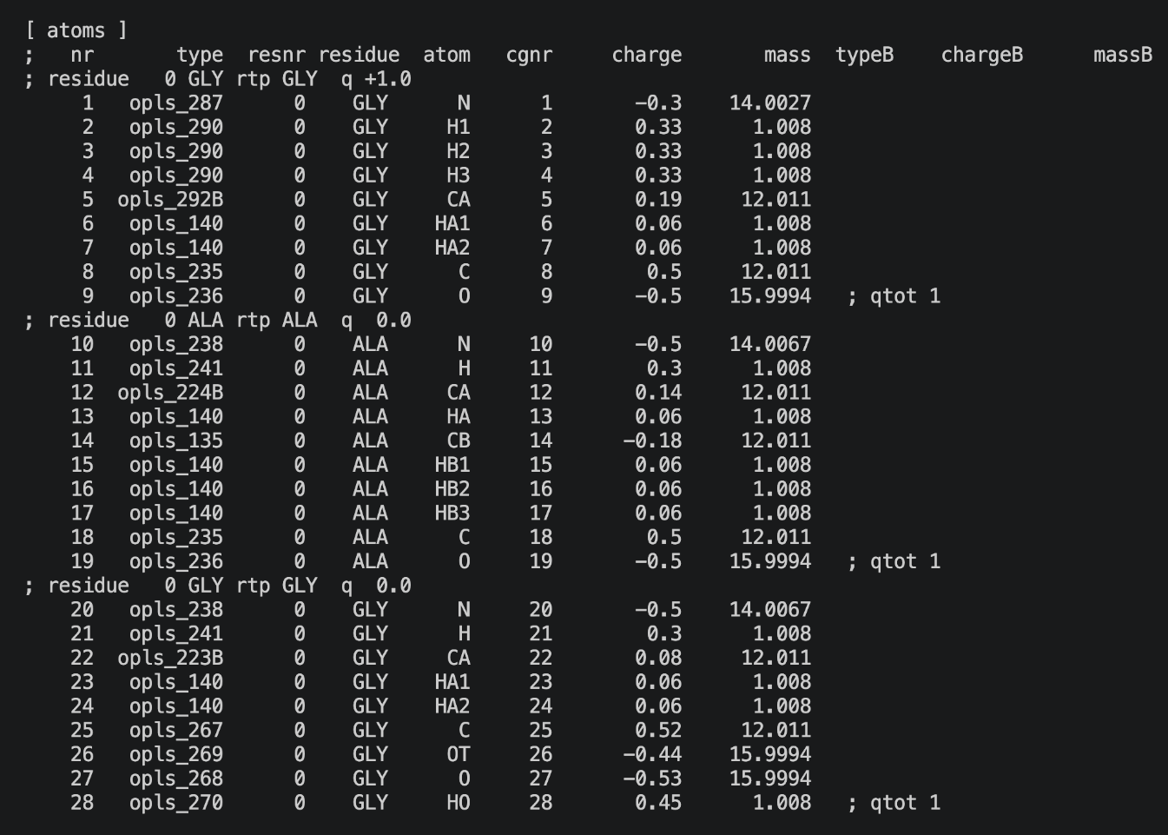
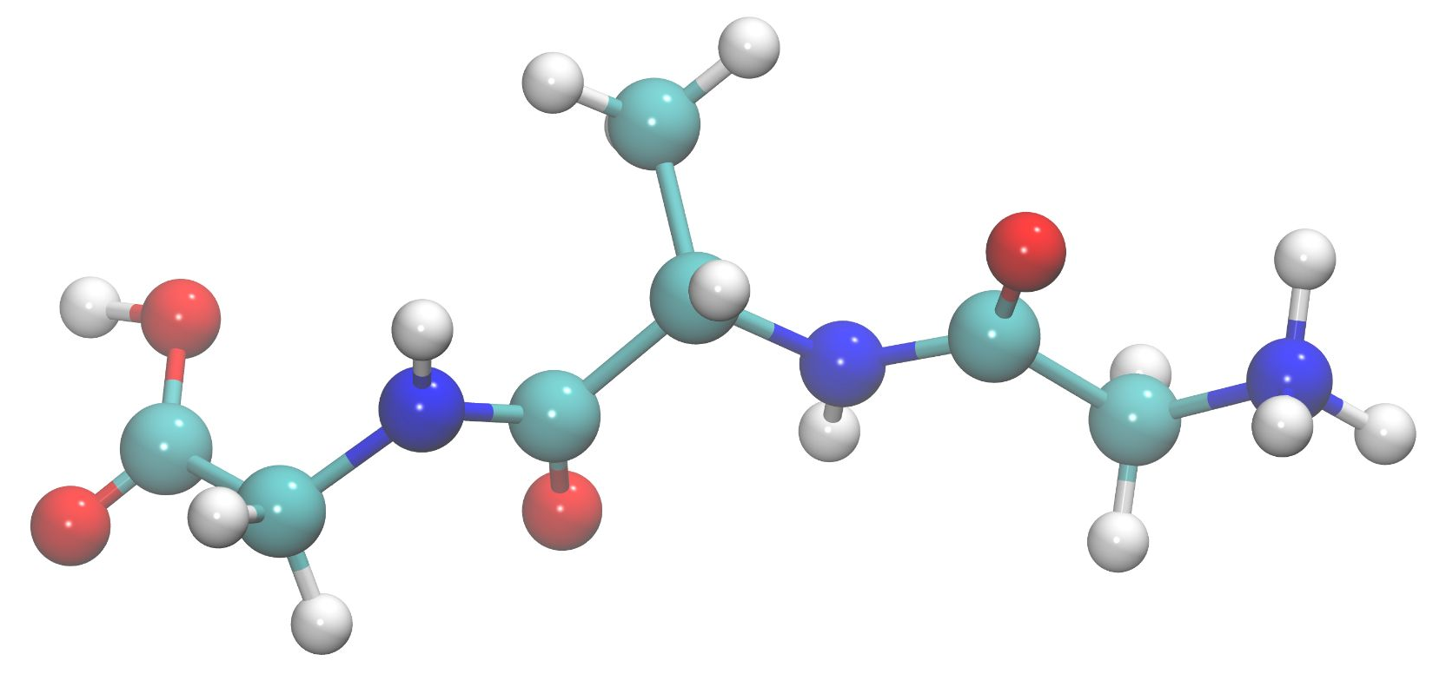
Step 1: System and box preparation
The first thing we need to do is prepare a solvated simulation box containing our biomolecule
Structure
Topology
Assign atom types, bonds, charges and force-field parameters to the biomolecule.
CB
HB
HO
H
HA
OT
C
CA
N
O

Slide 4
Step 1: System and box preparation
The first thing we need to do is prepare a solvated simulation box containing our biomolecule
Structure
Topology
Simulation box
Solvation (H₂O + Ions)
Assign atom types, bonds, charges and force-field parameters to the biomolecule.
Place the biomolecule at the center of a box large enough to avoid interactions with its periodic images.
Fill the box with water and ions to obtain an electrically neutral box.
CB
HB
HO
H
HA
OT
C
All these steps can be performed with GROMACS commands that we’ll use this afternoon
CA
N
O

Slide 5
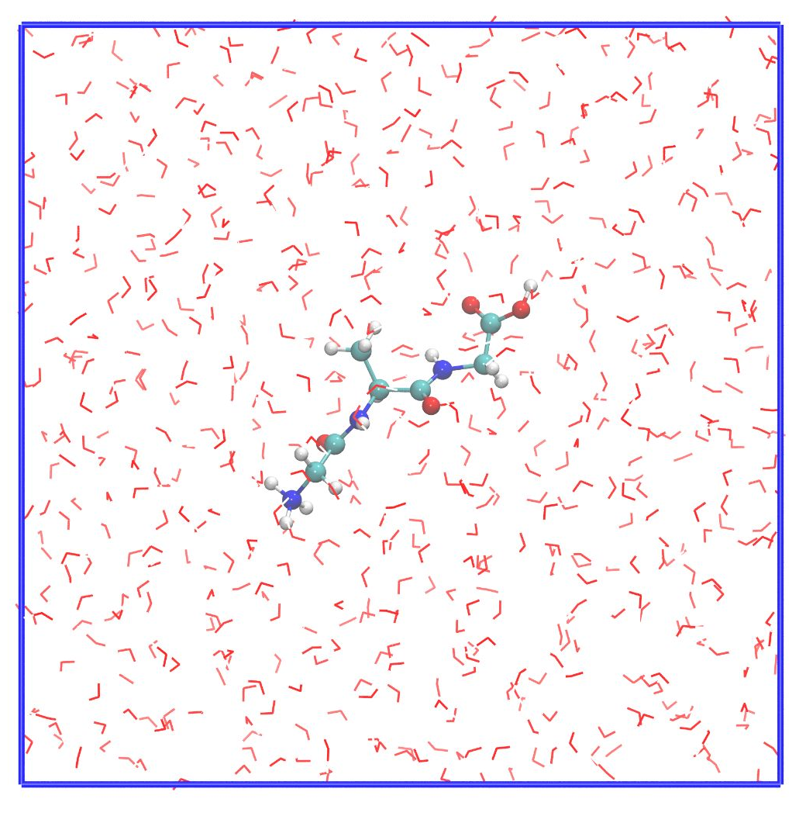
Step 1: System and box preparation
The first thing we need to do is prepare a solvated simulation box containing our biomolecule
Structure
Topology
Simulation box
Solvation (H₂O + Ions)

Slide 6
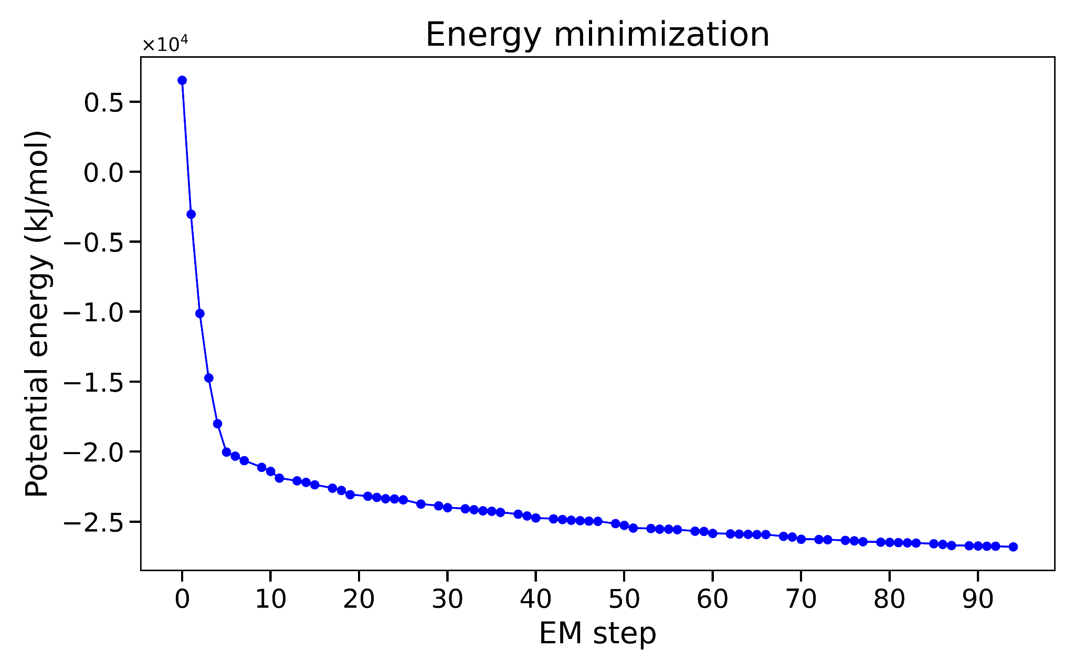
Step 2: Energy minimization
Before starting the dynamics, we relax the system through a process called energy minimization
Why: remove steric clashes and locally unfavorable geometries introduced during system preparation.
How: atoms are moved iteratively toward lower potential energy, following the forces acting on them.
When do we stop: when the maximum force falls below a chosen threshold.

Slide 7
Step 3: Equilibration
After energy minimization, the structure is locally relaxed, but the system is not yet at the desired thermodynamic conditions.
Why do we need to equilibrate?
Bring the system to the target temperature
Allow the solvent and ions to reorganize around the peptide
Adjust the pressure and density
Avoid starting production MD from an artificial, non-equilibrated state
Energy-minimized system
NVT
NPT
Equilibrated system

Slide 8
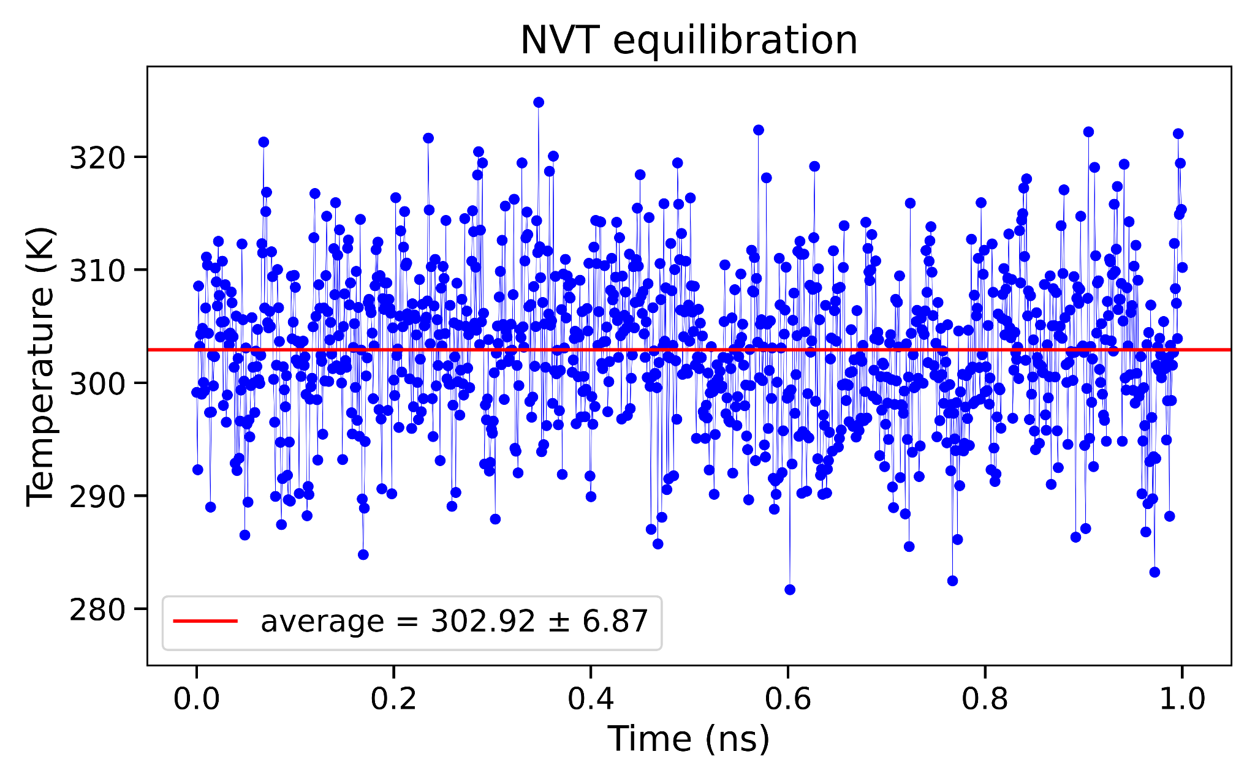
Step 3: NVT equilibration
Goal: bring the system to the target temperature and allow the solvent to reorganize around the peptide
NVT
Number of particles, Volume, and Temperature are kept constant
T is controlled with a thermostat
(stochastic velocity-rescaling)
T usually equilibrates quickly
T should fluctuate around the target value with no drift

Slide 9
Step 3: NPT equilibration
Goal: allow the simulation box to adjust until the system reaches the appropriate pressure and density
NPT
Number of particles, Pressure, and Temperature are kept constant
P is controlled with a barostat
(stochastic cell rescaling)
T is controlled with a thermostat
(stochastic velocity-rescaling)

Slide 10
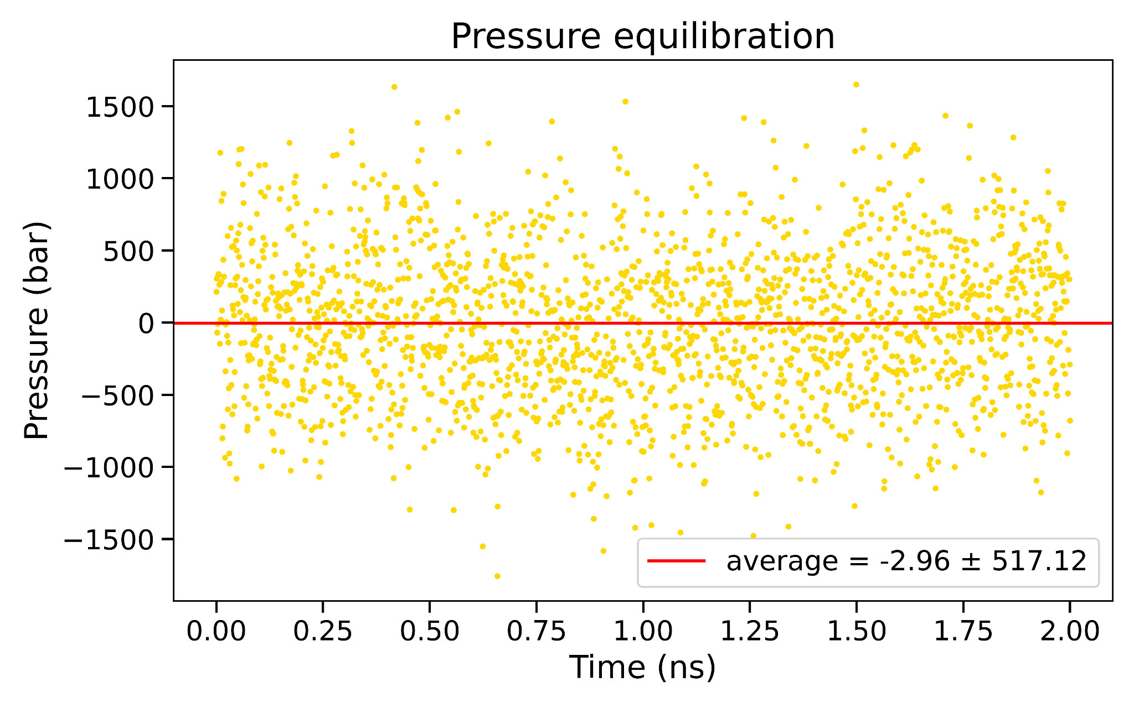
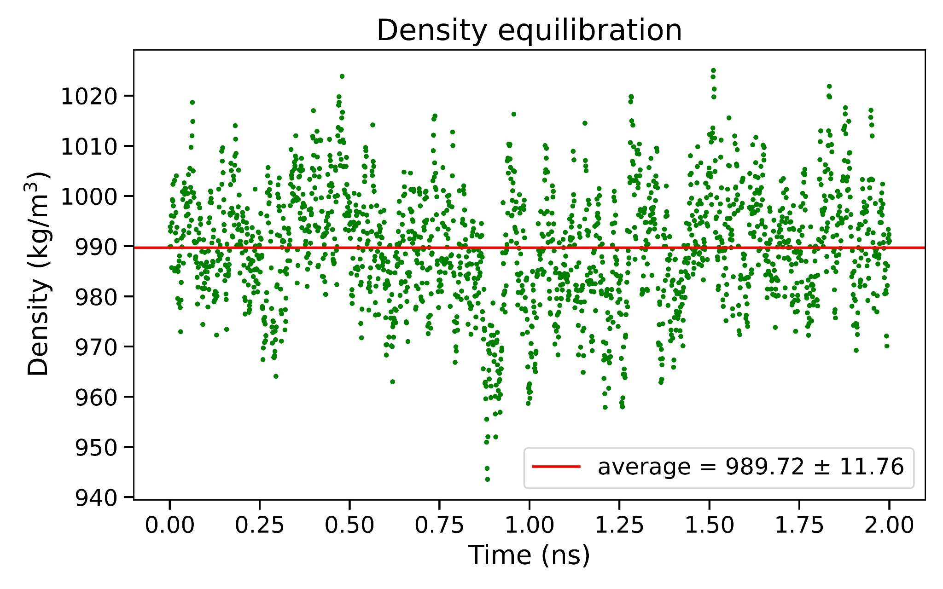
Step 3: NPT equilibration
Instantaneous P fluctuates strongly — this is expected for small MD systems
Density does not need to match pure water: we are simulating a peptide solution
We look for a stable average and no systematic drift
Notes:
(i) Notice how density is much less noisy than pressure. That’s why density is often easier to use visually when checking NPT equilibration.
(ii) Pressure fluctuates much more than temperature or density because it is directly related to the instantaneous forces and collisions in the system. So fluctuations of hundreds of bar are completely normal in a small simulation box; we care about the average over time, not the value of individual points.

Slide 11

Step 4: Production
Once the system is well equilibrated, we can start the production simulation used for data collection.
Simulation length depends on the process of interest (conformational changes, folding/unfolding, ligand binding, etc..)
Typical atomistic MD scales: ns-μs
GPU acceleration now makes longer scales much more accessible
Coordinates are saved at regular intervals to generate the trajectory used for analysis

Slide 12
Step 5: Analyses
We can perform a variety of analyses on the resulting MD trajectory either using GROMACS itself or python packages such as MDAnalysis.
Structural analysis of the solute
Solute-solvent analysis
How does the biomolecule itself behave?
Root mean square deviation (RMSD)
Root mean square fluctuation (RMSF)
Radius of gyration (Rg)
How does the biomolecule interact with its environment?
Radial distribution function (RDF)
Hydrogen bonds
Solvent accessible surface area (SASA)

Slide 13
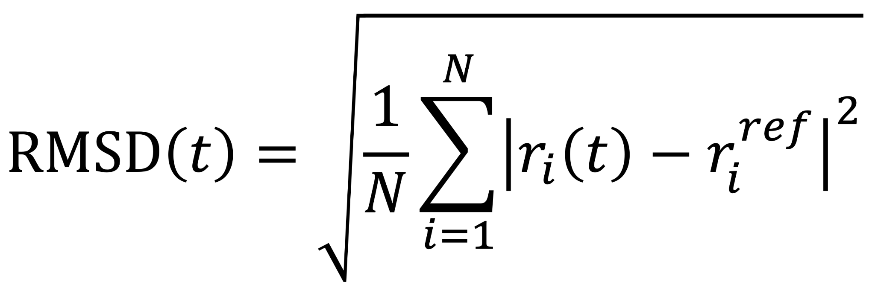
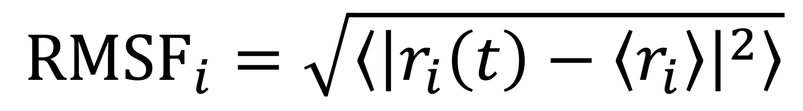
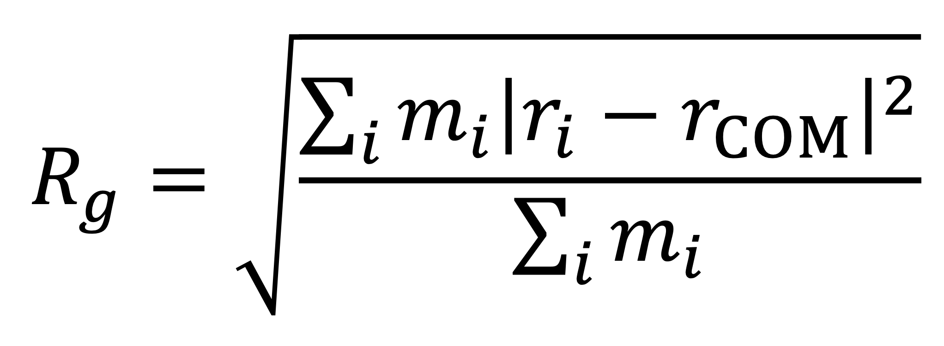
Step 5: Solute analysis
Root mean square deviation:
Measures how much the structure at time t differs from a reference structure.
Root mean square fluctuation:
Measures how much each atom i (or residue) fluctuates around its average position.
Radius of gyration:
Measures how compact (small Rg) or extended (large Rg) the molecule is.
Notes:
Structures are aligned first to remove overall translation and rotation
RMSF tells us which parts of the molecule are most flexible: it tells us how much each atom fluctuates around its own average position during the simulation.
Rg is a mass-weighted measure of how far the atoms are spread out around the molecule’s center of mass.

Slide 14
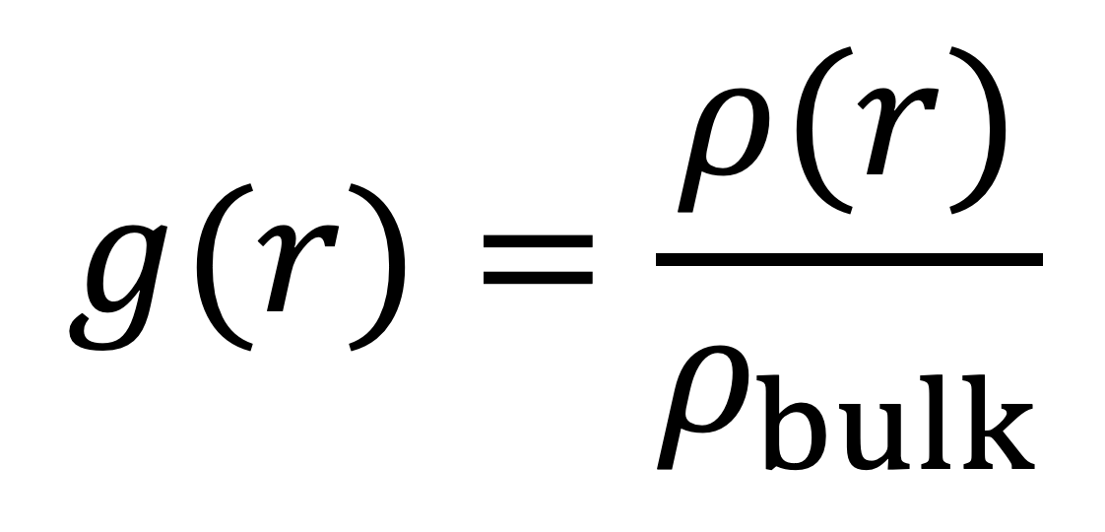
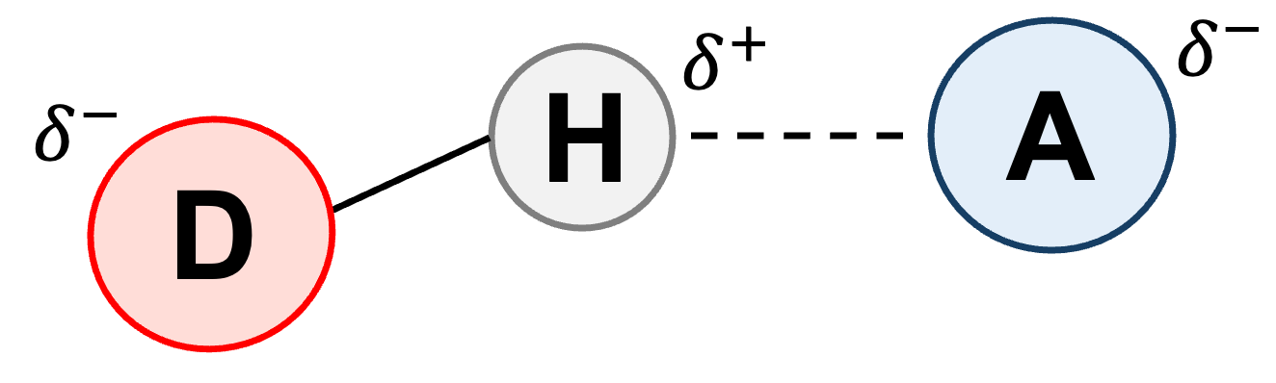
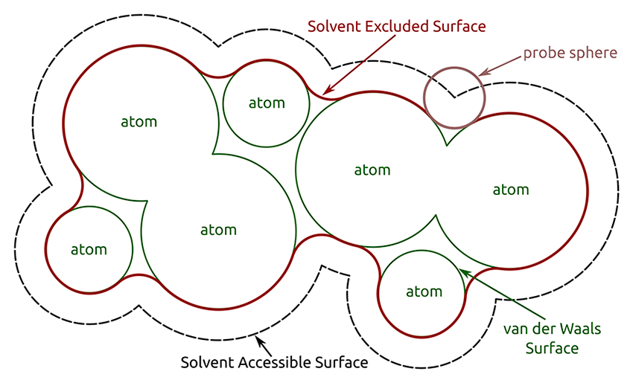
Step 5: Solute-solvent analysis
Radial distribution function:
Describes how the local density varies as a function of distance (r) from a reference particle.
Hydrogen bonds:
Describe specific directional interactions between the solute and surrounding water molecules
Solvent accessible surface area:
Describes the surface area of the solute that is accessible to a solvent
D = donor; A = acceptor
d(D- - -A) ≲ 3.0 Å and a(D-H- - -A) ≳ 150°
Notes:
The radial distribution function tells us how the density of solvent particles changes as a function of distance from a reference particle in the solute. In practice, we divide the local density at a given distance by the bulk density. So if g(r)=1g(r)=1, the solvent distribution is bulk-like. Values larger than 1 mean that solvent particles are preferentially found at that distance, while values below 1 mean they are depleted. Peaks in the RDF therefore identify preferred solvation distances or hydration shells
Hydrogen bonds are directional non-covalent interactions between a donor and an acceptor. In MD we usually identify them using simple geometric criteria. In our analysis, the donor–acceptor distance has to be shorter than about 3 Å and the D–H···A angle has to be larger than 150 degrees. We can then count how many hydrogen bonds form between the solute and the surrounding water and how this changes during the trajectory.
SASA tells us how much of the solute surface is exposed to the solvent. Conceptually, we imagine rolling a spherical probe, representing a solvent molecule, over the molecular surface. A larger SASA means that more of the molecule is accessible to the solvent, while a smaller SASA usually indicates a more buried or compact structure.

Slide 15
Step 5: Essential dynamics analysis
A trajectory contains thousands of structures — how do we identify the important conformational states?
We need to reduce the dimensionality of this conformational space
Essential dynamics (ED)
ED applies principal component analysis (PCA) to an MD trajectory to reduce its dimensionality and reveal the main conformational motions.

Slide 16
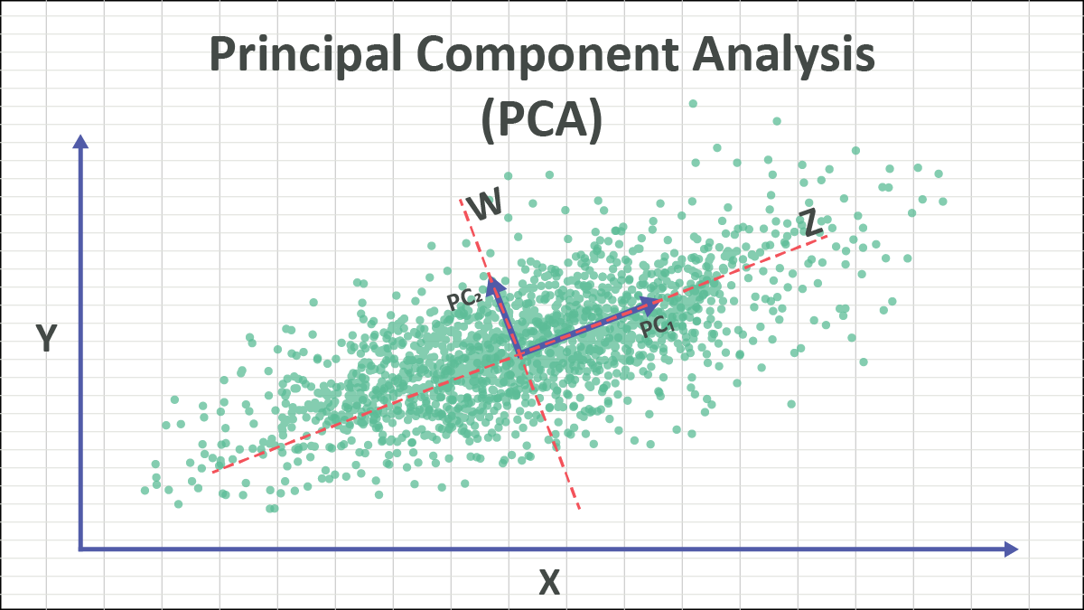
Step 5: Principal component analysis
What is principal component analysis?
PCA is a powerful mathematical technique used in data science, machine learning, and statistics. It transforms high-dimensional data into a lower-dimensional space while preserving as much of the variance (spread) as possible.
Notes:
Description of the figure:
We can see the points don't really fill the whole 3D space but they roughly lie on a plane. What PCA does is find that plane: it identifies two orthogonal directions, PC1 along the largest spread of the data, and PC2 along the largest spread perpendicular to it. Then we project the points onto those two directions: we now have the same data but described in just two dimensions instead of three.

Slide 17
Step 5: Principal component analysis
Set of original variables
Set of uncorrelated variables (PCs)
PCs are linear combinations of the original variables.
PCs are ordered by the amount of variance they explain
By keeping only the first few PCs, we reduce the dimensionality of our data while retaining most of its variance.
Dimensionality reduction

Slide 18
Step 5: Principal component analysis
Advantages
Limitations
Useful with high-dimensional data
It can help filter out noise
It makes complex data visualizable
It helps identify the directions along which the data varies most
PCs can be difficult to interpret
It only captures linear relationships
Some information is inevitably lost when reducing dimensions
What does applying PCA to our MD simulation mean?
Notes:
when to use PCA:
PCA is particularly useful in the following scenarios:
High-Dimensional Data: When dealing with datasets with many features that might lead to overfitting.
Visualization: To visualize high-dimensional data in 2D or 3D.
Noise Reduction: To filter out noise in the data by focusing on components with higher variance.
Feature Extraction: To extract meaningful features from complex data.
Multicollinearity: When dealing with highly correlated features in regression models.

Slide 19
Step 5: Essential dynamics analysis
An MD trajectory of N atoms contains 3N Cartesian coordinates per frame (x₁, y₁, z₁,..., x_{N}, y_{N}, z_{N})
Over thousands of frames, this create a very high-dimensional dataset
Atomic motions are often correlated: groups of atoms move together rather than independently
We apply PCA to the atomic fluctuations of our system to identify the collective motions that dominate its dynamics
Goal: describe the trajectory using only a few dominant collective motions instead of all 3N coordinates.

Slide 20
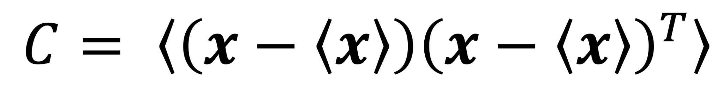
Step 5: Essential dynamics analysis
MD production
1) We remove the overall rotation and translation to look at the internal motion only (= least square fitting to a ref. structure)
2) We construct the covariance matrix of the positional fluctuations:
C is a symmetric 3N x 3N matrix, which can be diagonalized with an orthonormal transformation matrix R:

Slide 21
Step 5: Essential dynamics analysis
Eigenvectors: columns of R
directions along which the internal motion takes place; also called principal/essential modes.
Eigenvalues:
mean square fluctuations of the principal components
The first few principal modes often describe the relevant motion of the system (not a rule)
The trajectory can be projected on the principal modes to give the principal components (p_{i}(t))

Slide 22
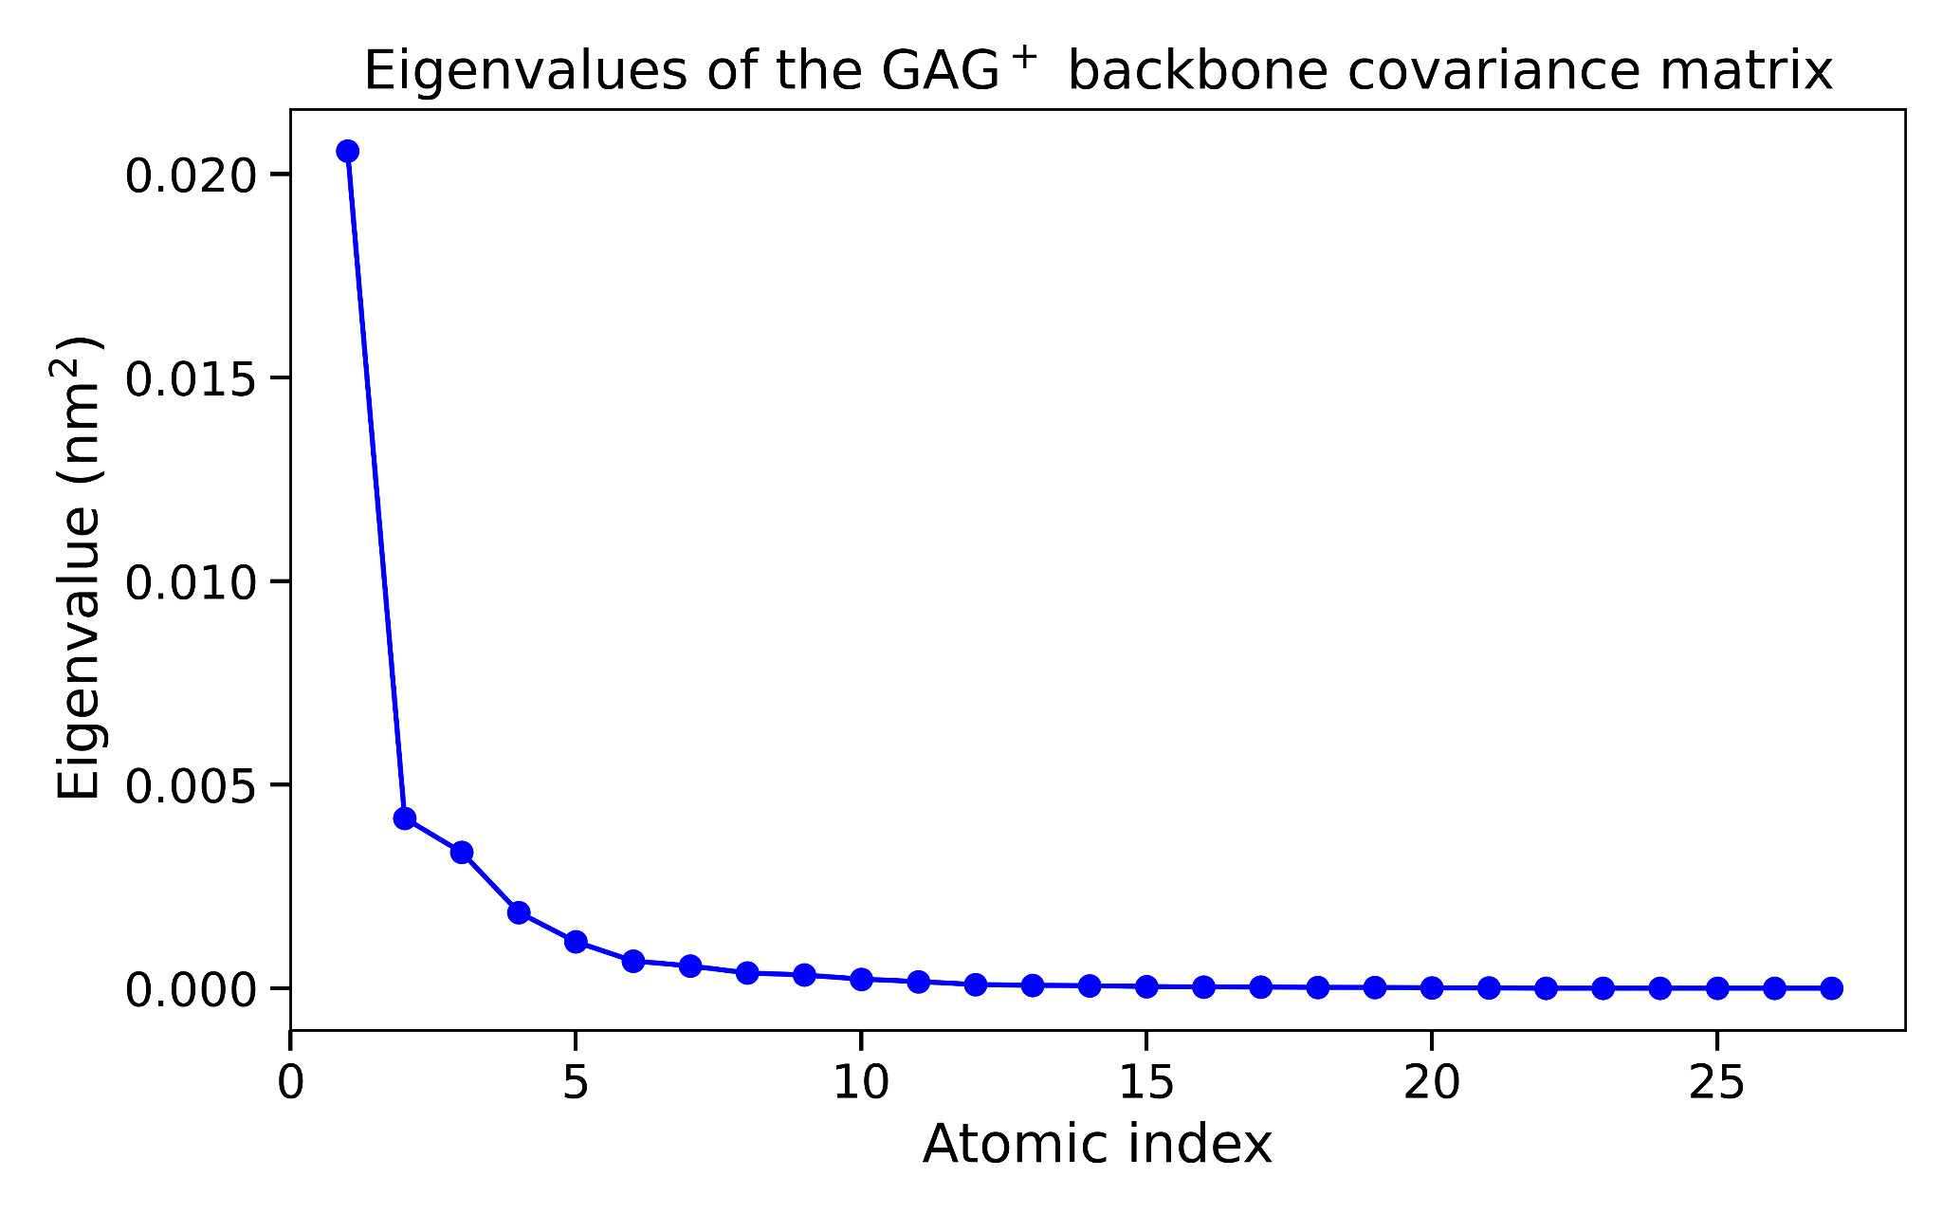
Step 5: Essential dynamics analysis
The first few principal modes often describe the relevant motion of the system
Exercise of this afternoon:
Exploring the conformational landscape of GAG⁺ in H₂O at T = 30 °C
We focus on the backbone for the ED analysis since it defines the secondary structure (= conformations)

Slide 23
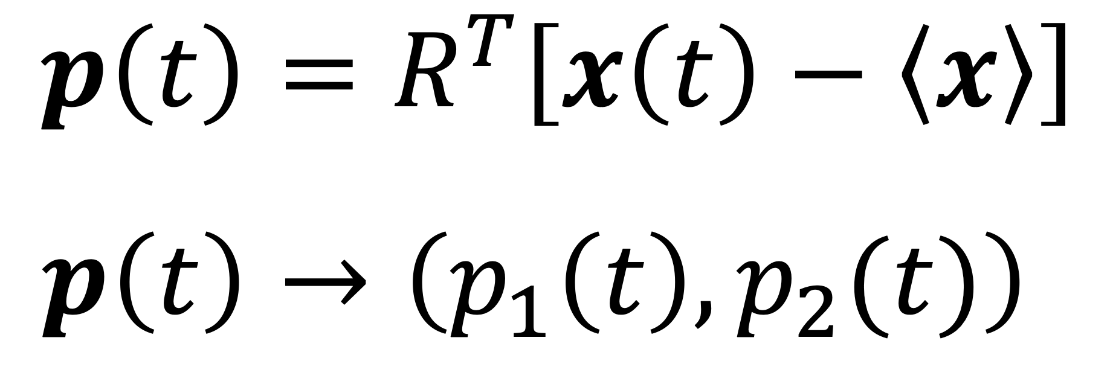
Step 5: Essential dynamics analysis
The trajectory can be projected on the principal modes to give the principal components
Since the first two principal components capture most of the variance, we retain only PC1 and PC2:
Each MD frame is therefore represented by one point in a 2D conformational space: 3N → 2

Slide 24
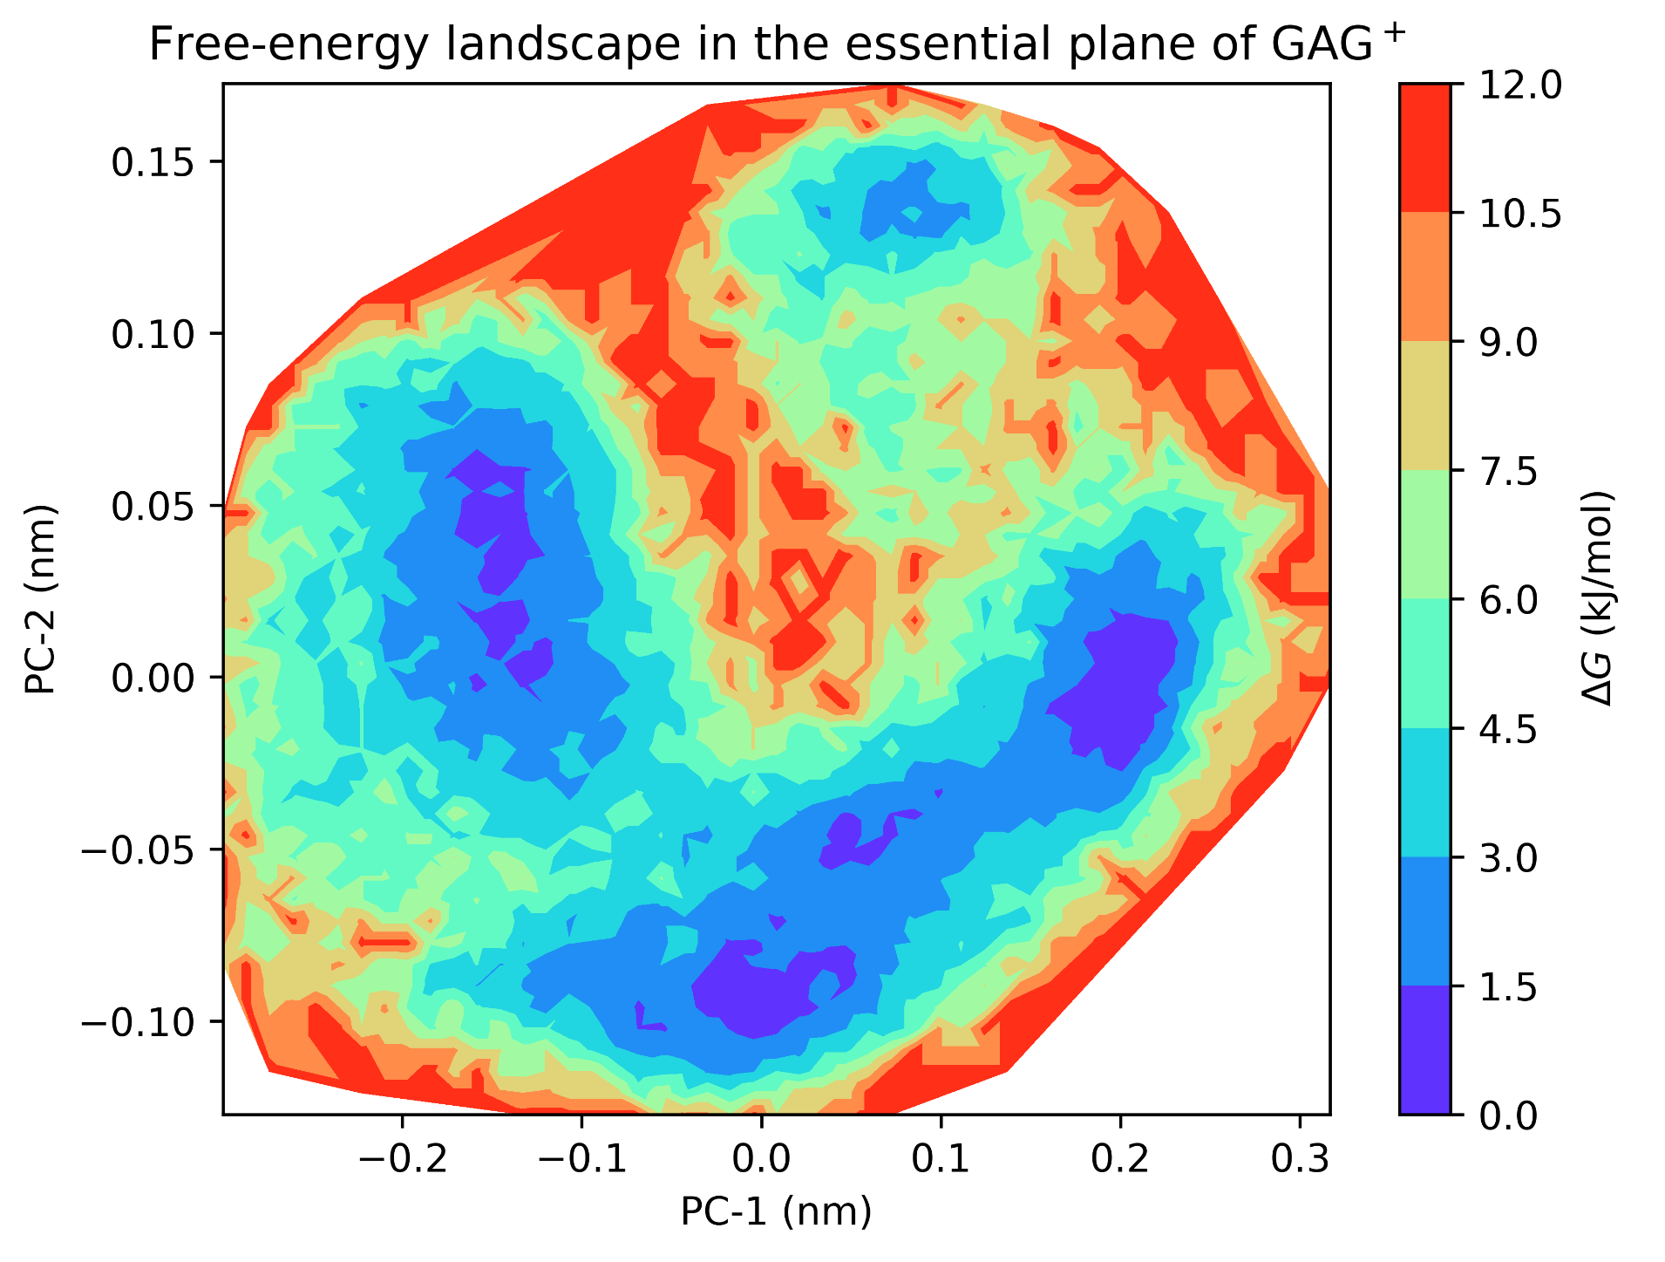
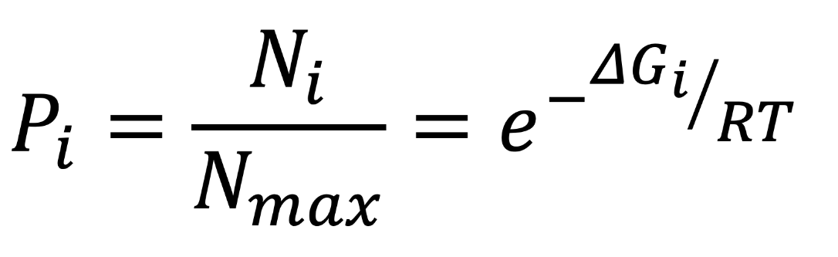
Step 5: Essential dynamics analysis
We build a 2D histogram from the pairs of PC1 and PC2 values sampled along the trajectory.
For each square/bin i, we count how many PC pairs fall inside it → N_{i}
The most populated regions correspond to free-energy minima and identify the preferred conformational states of the system.

Slide 25
Conclusions
Classical MD provides an atomistic picture of molecular motion over time
A reliable simulation requires careful system preparation, energy minimization and equilibration
The production trajectory can be analyzed to characterize structure, flexibility and solute–solvent interactions
Essential Dynamics (PCA) reduces the dimensionality of the trajectory and identifies the dominant collective motions
These approaches work when the relevant states and transitions are sufficiently sampled during the MD simulation
But what if the transition between two states occurs on a timescale much longer than our MD simulation?

