Slide 1


Enhanced sampling techniques
PWF Summer school on Theoretical and Computational Biophysics
University of Colombo
Day 3/5
Dr. Vittorio Del Tatto

Slide 2
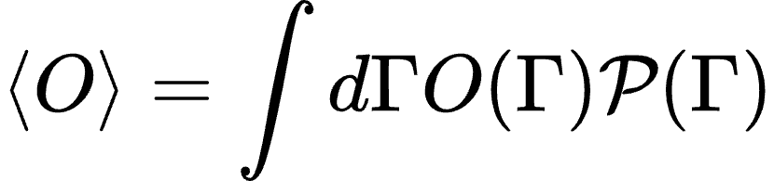
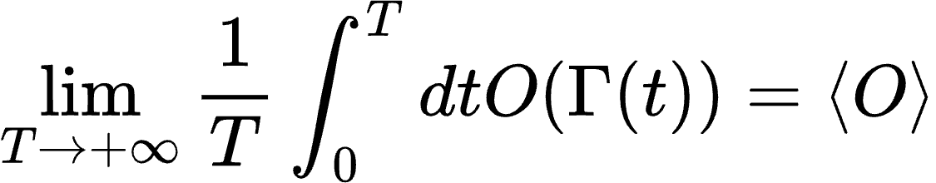
Ensemble averages
Ensemble averages: given microscopic observable O(𝛤), its expected value is
Ergodicity: if 𝛤(t) denotes a single trajectory starting from 𝛤(0),
If the system is ergodic, ensemble averages (across different realizations) are equivalent to time averages (on a single realization)!

Slide 3
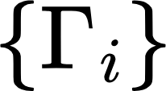
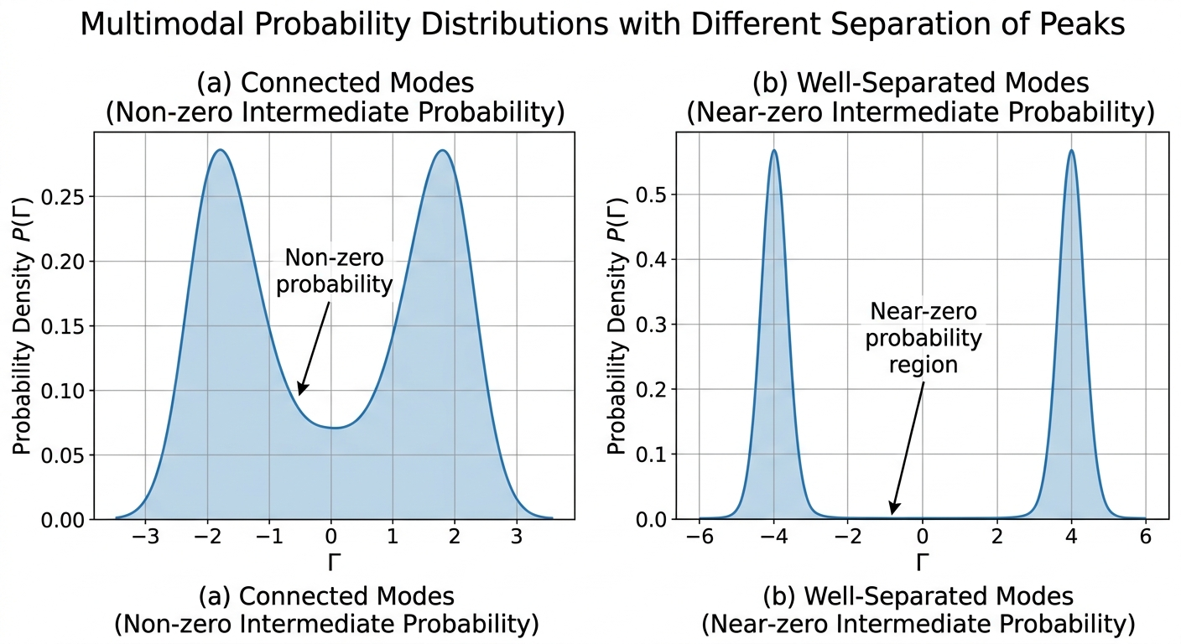

Ensemble averages
In practice, when can we reliably estimate averages from a finite trajectory?
when the samples (i = 1,..,N) faithfully represent the distribution
This typically occurs when the distribution is “simple” enough

Slide 4
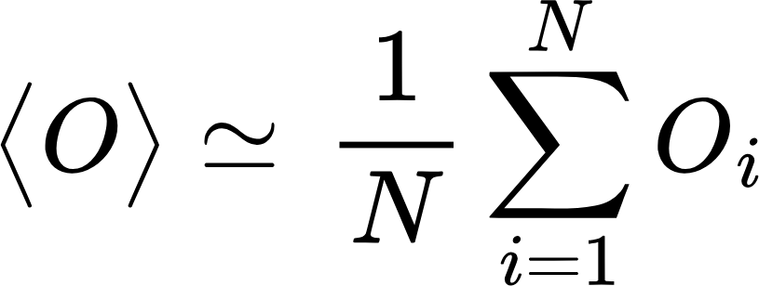
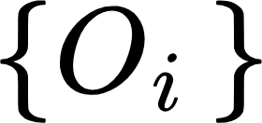
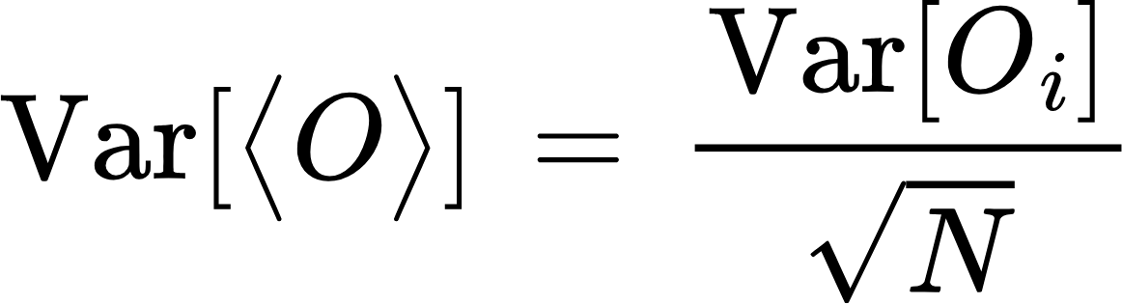
Ensemble averages
Let’s suppose that is “simple enough” (or that the trajectory is “long enough” to explore all modes)
can be simply estimated from an average along the trajectory:
Total number of steps in the trajectory
Value of the microscopic observable at the i-th step
Step index
(spread of )
What is the error associated to ?
applying the central limit theorem:
What’s wrong with this relationship?

Slide 5
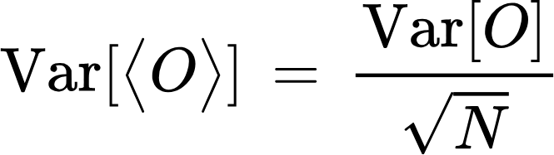

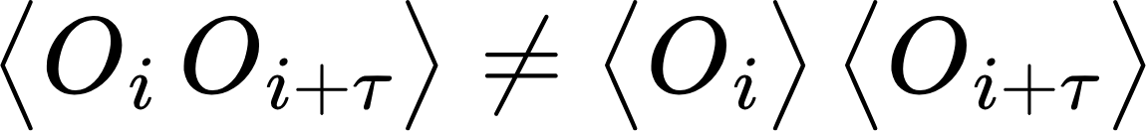
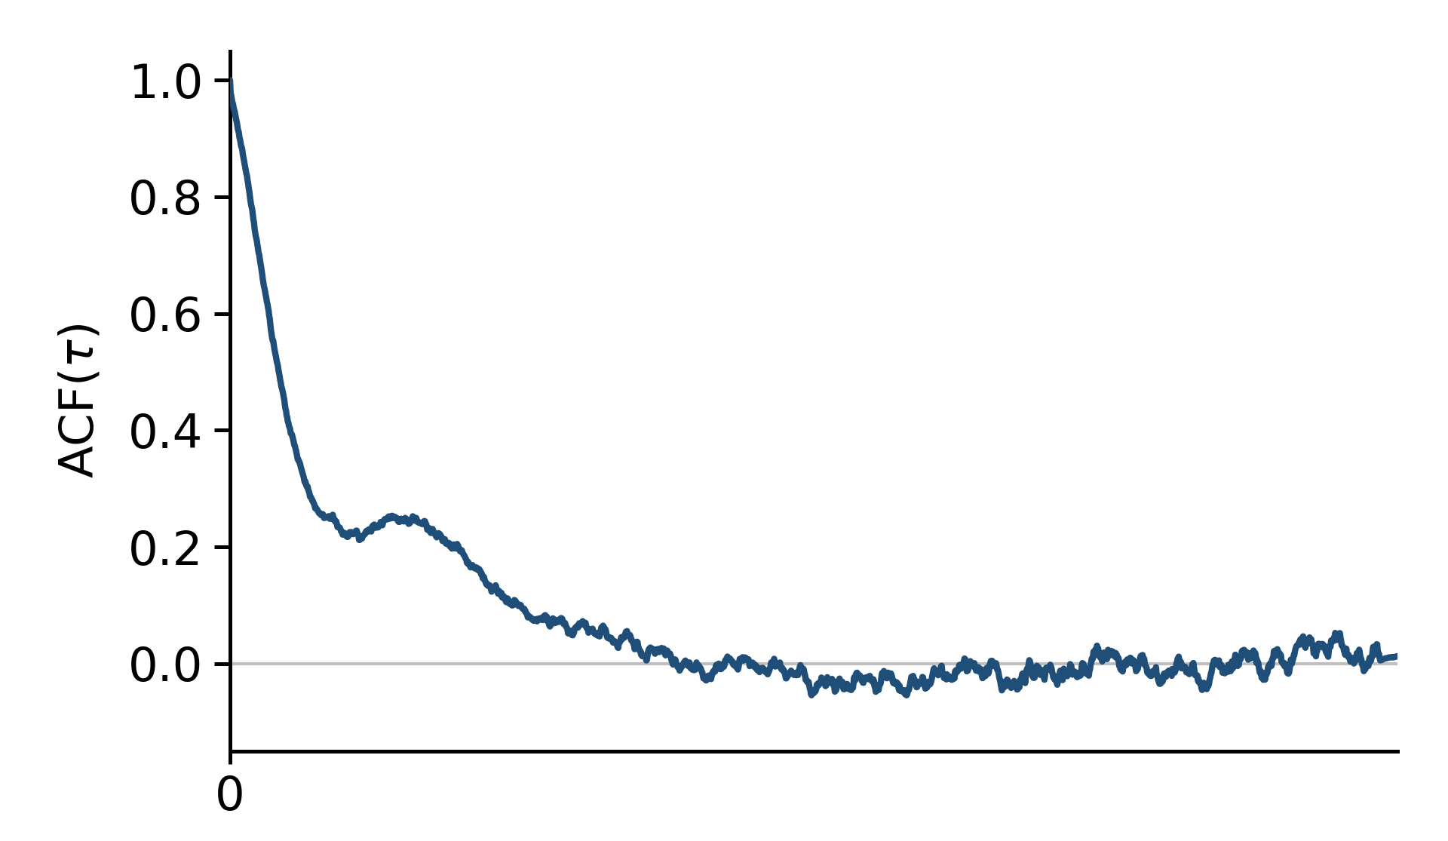
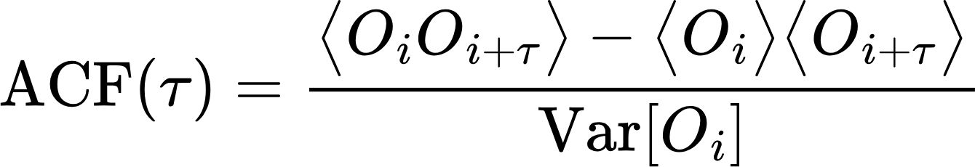

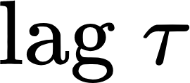
Errors of time averages
N.B. the relationship holds if the samples are independent!
By construction, points in a time series are correlated through time: for a generic lag ,
Degree of correlation though time quantified by the autocorrelation function:
for
for a stationary dynamics (as in equilibrium MD) it’s only a function of
(autocorrelation time)

Slide 6
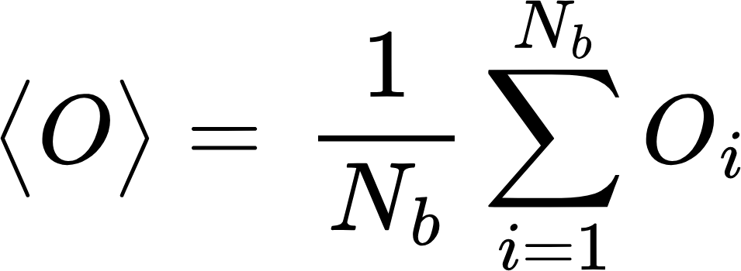
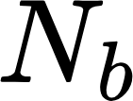
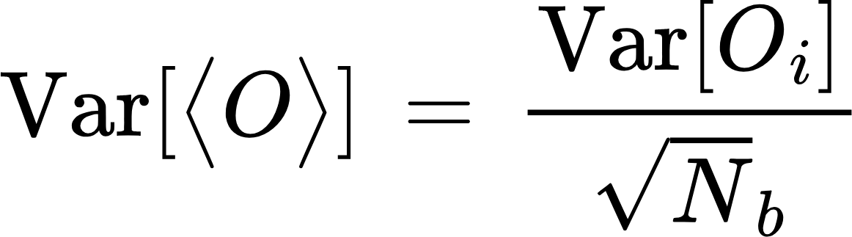
Errors of time averages
Two possibilities:
Subsample the time series with a stride equal (or larger) than the autocorrelation time
time
non-overlapping “blocks”
Now this formula is correct, because samples are independent!
Note that the autocorrelation time might be different for different observables!
Can we do better?

Slide 7



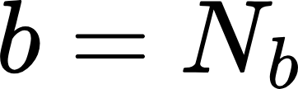
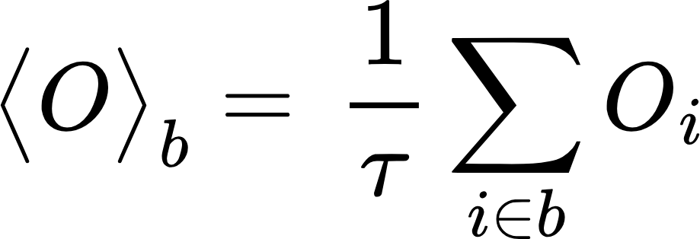
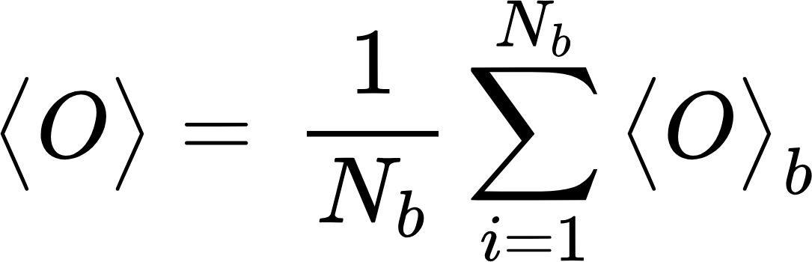
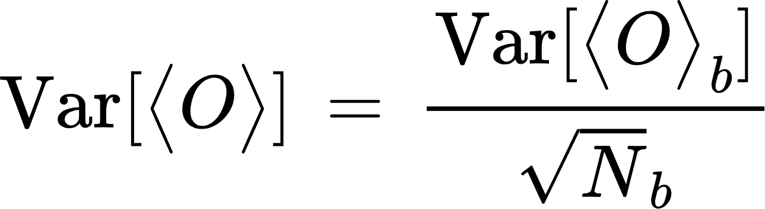
Errors of time averages
2. Block analysis
time
non-overlapping “blocks”
Compute average over each block:
Treat these block-averages as our independent samples:
this is significantly smaller than the variance of a single sample! :)
Problem: block-averages have longer time-correlation time than single samples…

Slide 8
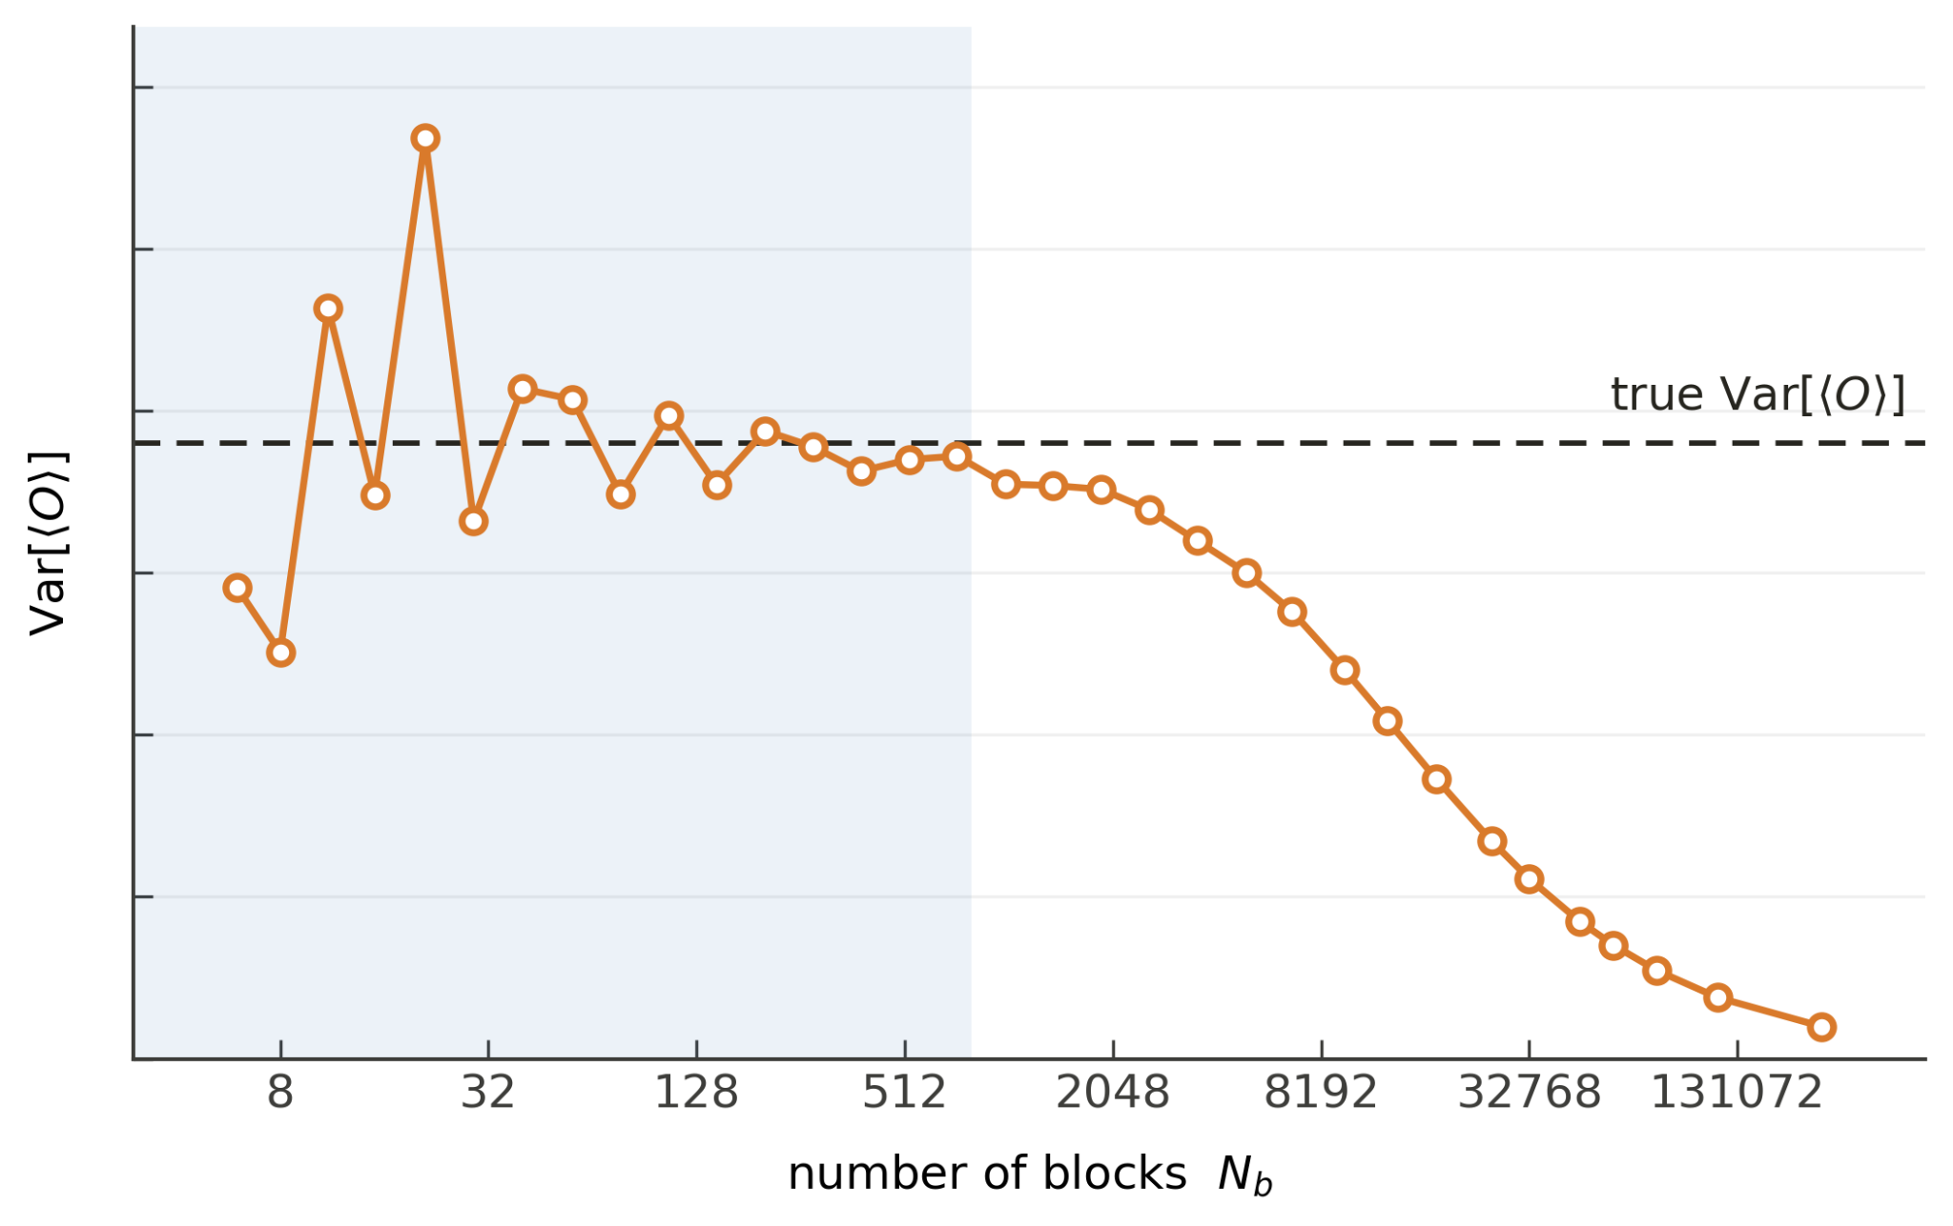
Errors of time averages
2. Block analysis
How can we identify correct block size to make the block averages independen?
where we should stop: beginning of the plateau
blocks are too small:
block averages are correlated
error is underestimated
too few blocks: the estimate is noisy

Slide 9
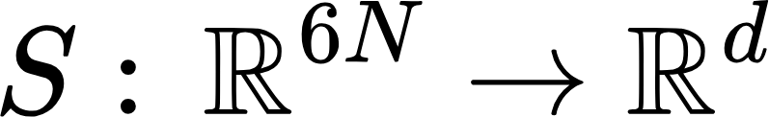

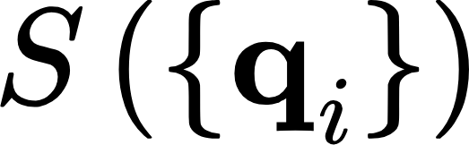
Collective variables
A collective variable is a low-dimensional (1D, 2D, …) representation of the high-dimensional state of the system:
Most CVs actually depend on the positions only:
Examples:
Interatomic distance between two atoms
Bond or dihedral angle
Coordination number of an atom
Radius of gyration
Complex function of learnt through dimensionality reduction
…

Slide 10
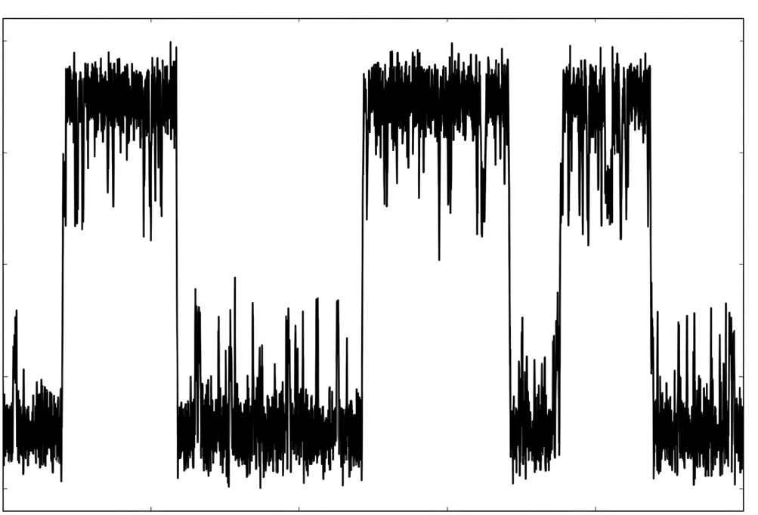
Collective variables
Let’s go back to the case of a multimodal probability distribution
A CV behaves as a reaction coordinate if it allows distinguishing “well” the two states (modes):
typical trajectory
reaction coordinate
NB: not all CVs are good reaction coordinates!
time

Slide 11
Metastability and rare events
reaction coordinate
time
Three relevant time scales:
  “relaxation” time within a minimum (=metastable state) , 𝝉_{relaxation}
  “residence” time between two transitions, 𝝉_{residence}
  “echange” time required to perform the transition, 𝝉_{exchange}
Metastability: 𝝉_{relaxation} << 𝝉_{residence}
Rare events: 𝝉_{exchange} << 𝝉_{residence}
actually one implies the other, because 𝝉_{relaxation} ~ 𝝉_{exchange}

Slide 12
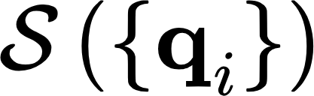
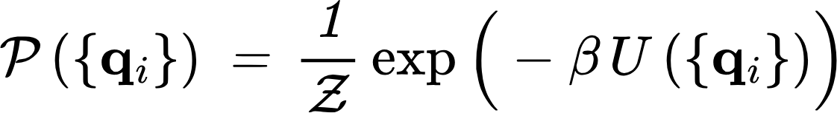
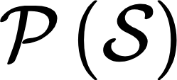
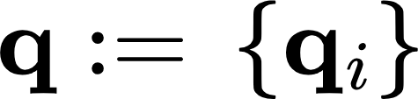
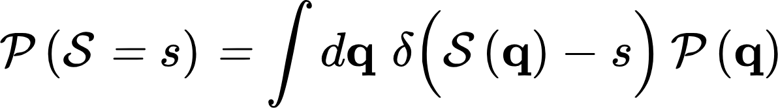
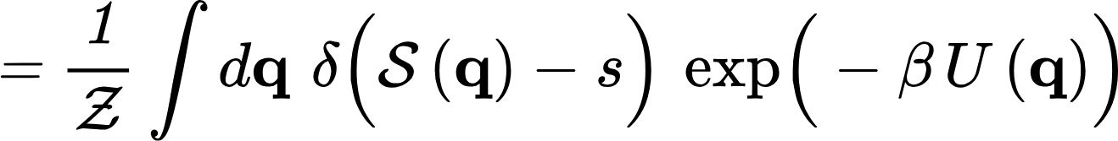
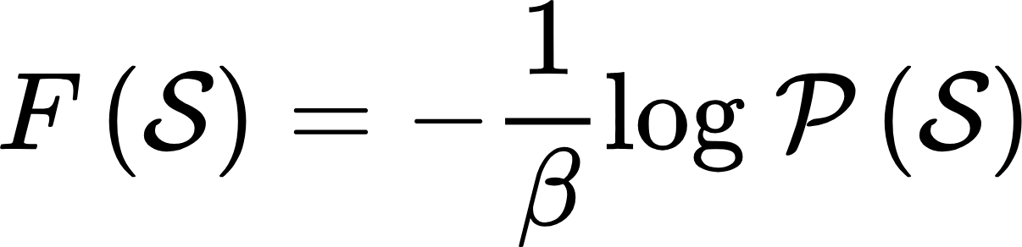
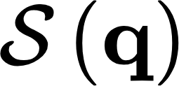
Free energies
First: can we write the probability of finding the system in a given value of the CV ?
?
Simper notation from now on:
Using the delta-function:
The free energy as a function of the CV is defined as

Slide 13
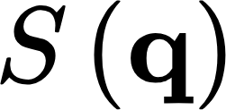
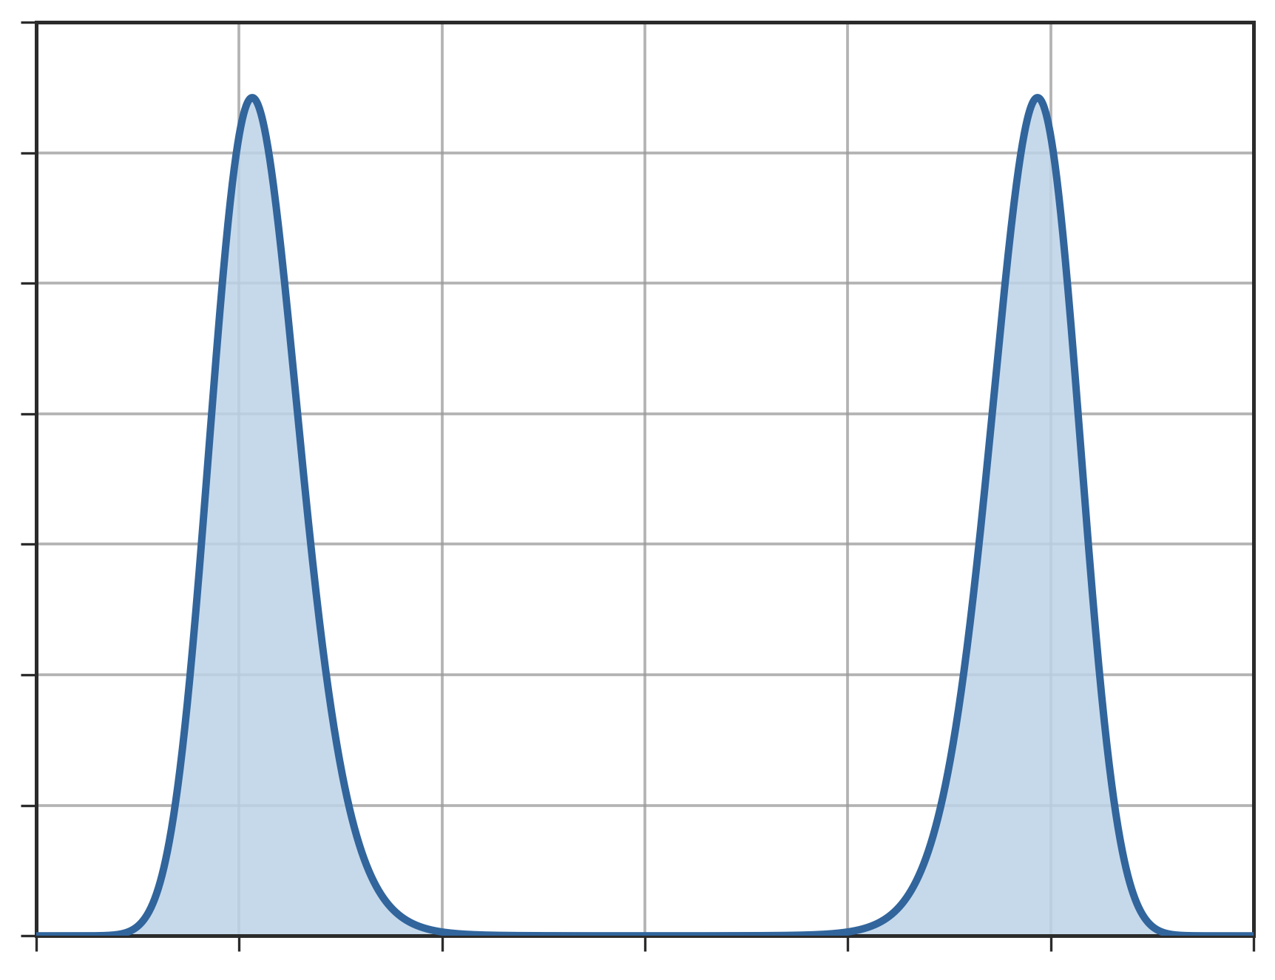
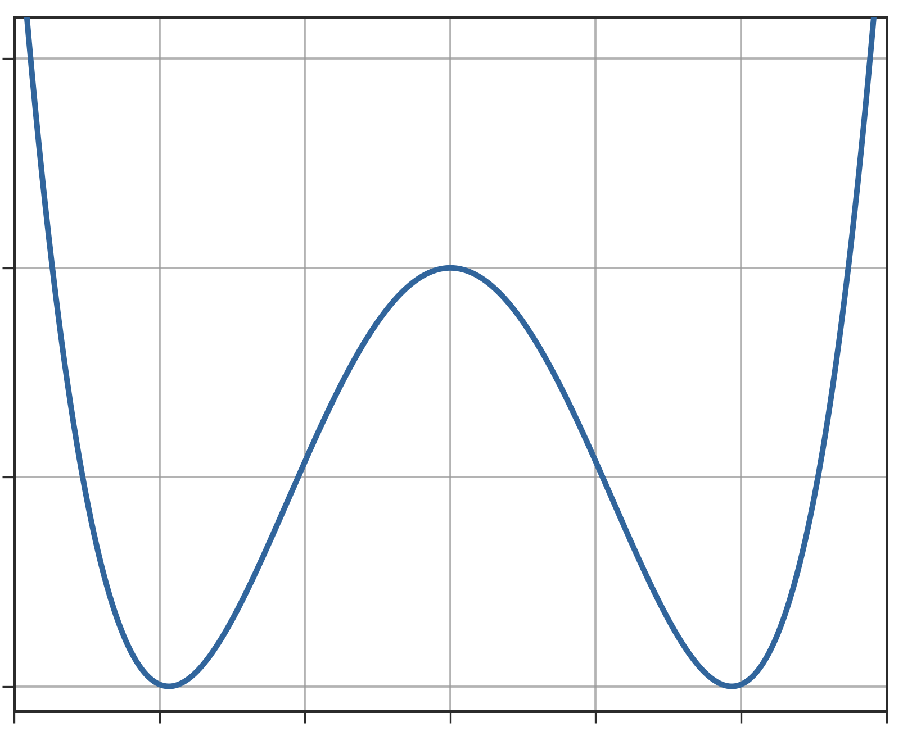
Free energies
The free energy as a function of the CV is defined as
~ 5 orders of magnitude
~ 5
Modes of are local minima of
Low-probability regions between modes become barriers

Slide 14
Sum up so far
We want to sample a complex, high-dimensional target distribution (e.g. Boltzmann)
In many cases, is multimodal and the modes are separated by low-probability regions: sampling it through a dynamics takes long simulation times
Why do we want to explore all the modes of ?
To compute ensemble averages through time averages
To study the transition mechanism itself! (e.g. how does a protein fold?)
We suppose to now a “good” CV that behaves as a reaction coordinate (a variable that characterizes transitions between metastable states)
Assumption: the CV is able to capture in a high-dimensional space (e.g. 1D) the transition between two high-dimensional modes of

Slide 15
Enhanced sampling
Can we use our CV to speed up the exploration of ?
Enhanced sampling techniques aim at accelerating the “ergodic sampling” of
by simulating rare transitions more frequently
We will focus on two CV-based enhanced sampling methods:
  Adaptive umbrella sampling
  Metadynamics
…but the class of methods is much larger:
  Steered MD
  Replica-Exchange
  Weighted-histogram analysis method (WHAM)
  Transition path sampling
  ….

Slide 16
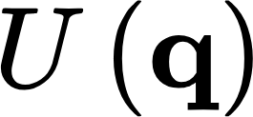
Umbrella sampling
First, let’s show the “re-weigthing trick” applied to probability distribution / free energy of the CV:
Idea: simulate the system in a biased potential in which the barrier is lower (=more frequent transitions), then reweight the sampled distribution to get the unbiased distribution
Key assumption: add to the potential energy a biased potential that depends on the state of the system through the CV :
As a consequence the sampled distribution changes as well:

Slide 17
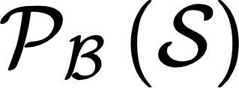
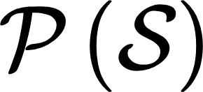
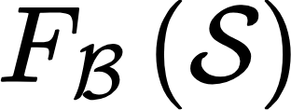
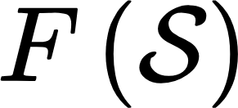
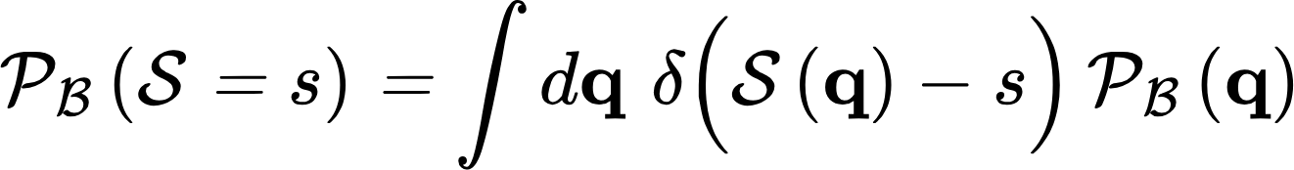
Umbrella sampling
First, let’s show the “re-weighting trick” of umbrella sampling applied to the probability distribution / free energy of the CV:
Goal:
from biased simulation
unbiased quantities
Definition of :
Similarly, for :
Let’s try to connect the two!

Slide 18
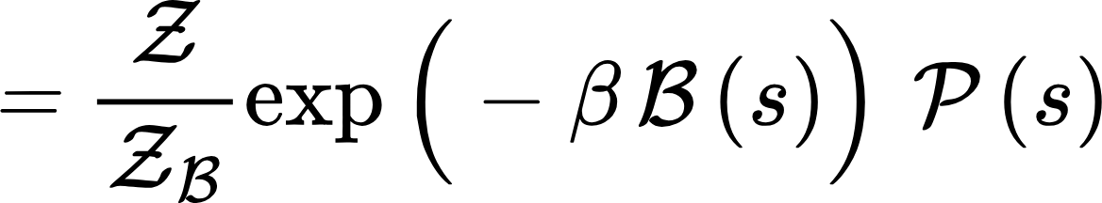
Umbrella sampling

Slide 19
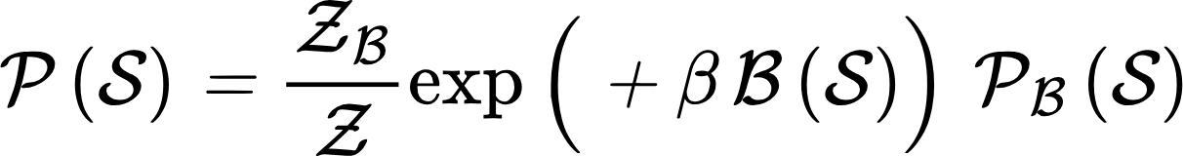
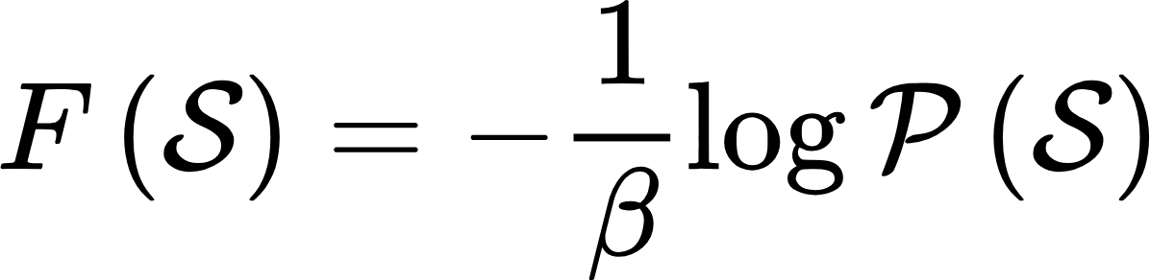
Umbrella sampling
What about the unbiased free energy? Substituting in :

