Slide 1


Density Functional Theory:
Treatment of the Electronic Structure
PWF Summer school on Theoretical and Computational Biophysics
University of Colombo
Day 4/5
Dr. Marta Monti

Slide 2

What is DFT?
Density functional theory (DFT) is a quantum-mechanical method used to describe the (ground-state) electronic structure of many-body systems as atoms, molecules, or solids.
The central quantity in DFT is the electron density ρ(r)
From the electronic structure we can determine the energy of the system and many other properties.

Slide 3

What can we learn from DFT?
DFT is widely used in chemistry, biophysics, materials science, and machine learning.
A DFT calculation can provide us with:
Optimized molecular structures
Total energies
Forces on the nuclei
Reaction energies and activation barriers
Electron density and charge distribution
Electronic structure (orbitals, energy levels)
Vibrational properties and spectra

Slide 4

The quantum-mechanical problem
In principle, by solving the Schrödinger equation we can obtain the energy and wavefunction of a quantum system:
Hamiltonian operator, containing the different energy contributions
Wavefunction of the system
Total energy
For an N-electron system, however, solving the Schrödinger equation exactly becomes extremely difficult

Slide 5
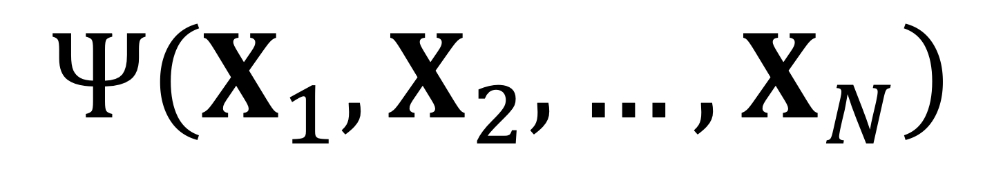
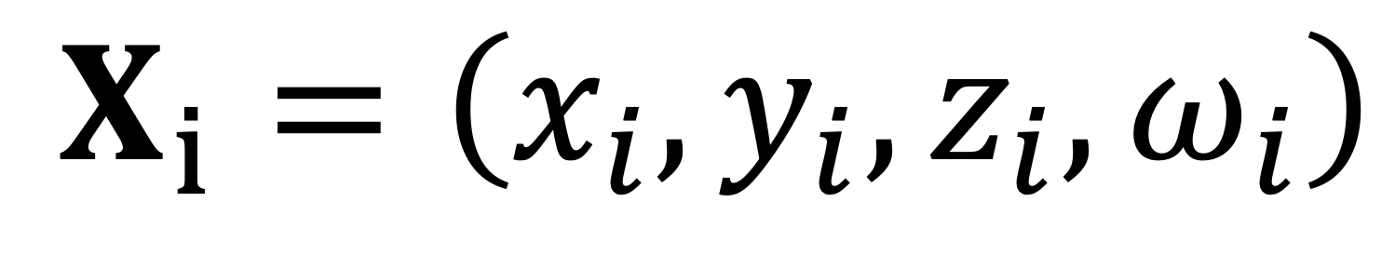
The quantum-mechanical problem
The N-electron system is described by the wavefunction:
Cartesian coordinates
Spin coord.
The many-electron wavefunction depends on the spatial and spin coordinates of N electrons
Problem with 3N spatial variables + N spin variables

Slide 6
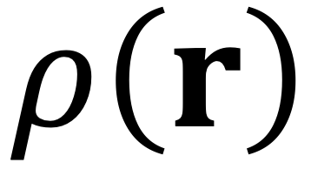

From the wavefunction to the electron density
In DFT, the N-electron system is described by the electron density:
which depends only on the three spatial coordinates
From 3N spatial variables
To 3 spatial variables

Slide 7

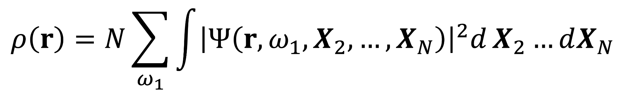
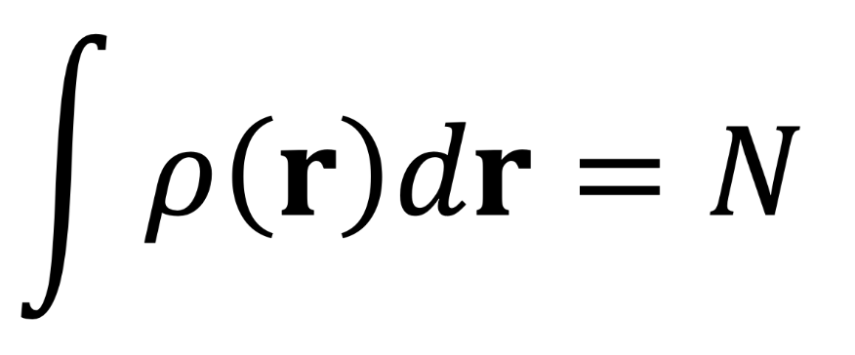
What is the electron density?
The electron density describes the probability of finding electrons in an infinitesimal region of space around a given point r:
electrons are indistinguishable:
N accounts for the possibility of finding any electron at r
integration over the spatial coordinates and summation over the spin coordinates of the remaining N-1 electrons
By integrating the density over all space, we obtain the total number of electrons:
Notes:
Imagine that we pick one point in space, r, somewhere around a molecule. We then ask: how much electronic charge is present in a very small region around that point?
The electron density ρ(r) gives us exactly that information. If we multiply it by a tiny volume element dV, we obtain the average number of electrons that we expect to find in that small region of space.
Now, where does this density come from? The full wavefunction depends on the coordinates of all the electrons at the same time. To obtain the density at our chosen point r, we fix one electron at that position and then integrate over all possible positions and spin states of the remaining electrons.
Because electrons are indistinguishable, it does not matter which electron we label as ‘electron 1’. Any of the N electrons could be the one found at r, and that is why the expression contains the factor N.
So after integrating out all the other electronic coordinates, what remains is a much simpler quantity: a function that depends only on position in ordinary three-dimensional space.
And if we repeat this idea at every point in space around the atoms of a molecule, we build up the full electron-density distribution. Regions close to nuclei usually have high electron density, while other regions have lower density.
Finally, if we integrate the density over all space, we recover the total number of electrons, N.
So the electron density is much simpler than the many-electron wavefunction, but still contains a physically meaningful picture of how the electrons are distributed around the nuclei.

Slide 8
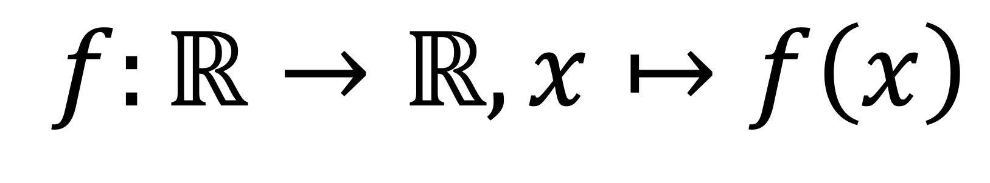
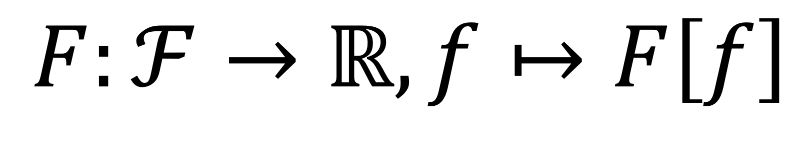

What is a functional?
Fundamental object of DFT → functional, F.
A functional is a mathematical object that takes a function as input and returns a scalar:
function
functional
In DFT, the relevant function is the electron density and the total energy is the functional:
Notes:
We just saw one of the most important quantities in DFT, the electron density. Let's now look at the second important object: the functional.
A functional is a mathematical object that takes a function as input and returns a real number.
Just to distinguish the two: a function takes a scalar as input and returns a scalar — so x, a scalar, maps into f(x). A functional instead takes a function and returns a number — here f (function) maps into F[f] (number). We write ℝ as the codomain because in DFT the functionals we care about — the energy and its pieces — are all real-valued.
In DFT, our function of interest is the electron density ρ(r), and the total energy is the functional. So E[ρ] (E evaluated at ρ) takes the density as input and returns the total energy, a number.
But first of all: how do we know that the ground-state energy is determined by the density alone? This is what the Hohenberg–Kohn theorems answer.

Slide 9

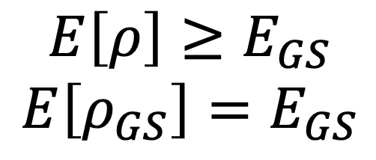
Hohenberg-Kohn theorems
A bit of historical context:
DFT is based on the two theorems proposed by Hohenberg and Kohn (HK) in 1964 (Phys. Rev., 136, 1964)
Some of the limitations of the HK theorems were overcome by the constrained-search formulation introduced by Levy and Lieb (PNAS, 76, 1979; Int. J. Quantum. Chem., 24, 1983)
First HK theorem → it proves that there is a one-to-one correspondence between the ground-state (GS) density and the external potential:
Second HK theorem → it establishes that the GS energy can be written as a universal functional of the density, obeying a variational principle:
Notes:
HK theorems limitations: they work only with non-degenerate ground-states and V-representable densities.
HK theo_1: “given V_ext you get a unique ρ_GS, and given ρ_GS you can recover V_ext uniquely." The forward direction is trivial (solve the Schrödinger equation, take the density); the non-trivial part that HK-I actually proves is the inverse.
--------------------------------------------------------------------------------
Before saying a few words on these theorems, a bit of historical context.
Hohenberg and Kohn presented their two theorems, which are the foundation of DFT, in 1964. Kohn later won the Nobel prize in chemistry — in 1998, shared with John Pople — for the development of density functional theory. Some important additional work was done more than a decade later by Levy and Lieb, who introduced the constrained-search formulation of DFT. This put the theory on firmer mathematical ground and extended it beyond some of the assumptions of the original HK theorems.
I won't go into the proofs, but I want to give you a few essential points.
The first HK theorem proves the one-to-one correspondence between the ground-state density and the external potential. In other words, if you know the ground-state density everywhere, you can in principle recover the external potential that produced it. And since the external potential determines the full Hamiltonian, and the Hamiltonian determines everything about the system, this means that the ground-state density alone determines all the ground-state properties — including the total energy. This is the theorem that tells us we're allowed to use the density as our fundamental variable.
The second HK theorem establishes that the GS energy can be written as a universal energy functional of the density — universal meaning it doesn't depend on the specific system — and that this functional obeys a variational principle. This means that the energy functional evaluated at any trial density is greater than or equal to the true ground-state energy, and that the energy functional evaluated at the ground-state density is exactly equal to the ground-state energy.
So in principle, we can find the ground state by minimizing E[ρ] over all admissible densities: the density that minimizes the functional is the true ground-state density, and the value of the functional at that minimum is the true ground-state energy.

Slide 10
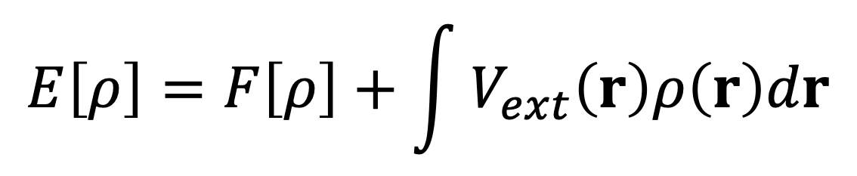
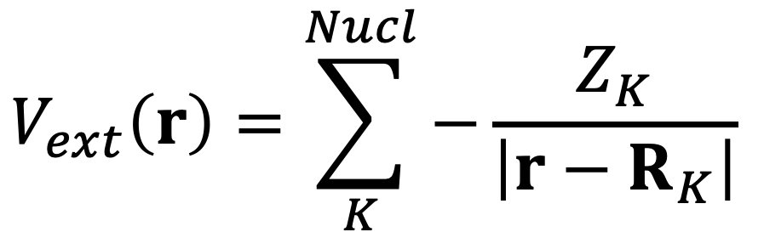
The energy functional
The energy functional contains two main quantities:
In principle: V_{ext} can include any external potential acting on the electrons
In practice: the nuclear attraction dominates and V_{ext} takes the following form:
Coulomb attraction
Once we have ρ, V_{ext} is straightforward to compute (we know Z_{K} and R_{K})
Notes:
Now let's look at what the energy functional actually contains. It splits into two pieces: F[ρ], which we'll come to on the next slide, and the integral of V_ext times ρ, which describes the interaction of the electrons with the external potential.
This second piece is the system-dependent part of the energy: it's what tells us we're looking at hydrogen versus benzene versus bulk silicon. In principle, V_ext can be any external potential the electrons feel — an applied electric field, for instance. In practice, though, for molecules and materials the dominant contribution comes from the attraction between the electrons and the nuclei — the nuclei being treated as external classical charges thanks to the Born–Oppenheimer approximation you saw in the previous lecture. So V_ext takes the familiar Coulomb form: a sum over nuclei K, each with charge Z_K located at position R_K.
The nice thing about this term is that we know it completely. We know where the nuclei are, we know their charges, so once we have the density, this integral is straightforward to compute. All the difficulty of DFT sits in the other term, F[ρ] — which is what we'll look at next.

Slide 11
The energy functional
The energy functional contains two main quantities:
In principle: V_{ext} can include any external potential acting on the electrons
In practice: the nuclear attraction dominates and V_{ext} takes the following form:
Coulomb attraction
Once we have ρ, V_{ext} is straightforward to compute (we know Z_{K} and R_{K})
Notes:
Now let's look at what the energy functional actually contains. It splits into two pieces: F[ρ], which we'll come to on the next slide, and the integral of V_ext times ρ, which describes the interaction of the electrons with the external potential.
This second piece is the system-dependent part of the energy: it's what tells us we're looking at hydrogen versus benzene versus bulk silicon. In principle, V_ext can be any external potential the electrons feel — an applied electric field, for instance. In practice, though, for molecules and materials the dominant contribution comes from the attraction between the electrons and the nuclei — the nuclei being treated as external classical charges thanks to the Born–Oppenheimer approximation you saw in the previous lecture. So V_ext takes the familiar Coulomb form: a sum over nuclei K, each with charge Z_K located at position R_K.
The nice thing about this term is that we know it completely. We know where the nuclei are, we know their charges, so once we have the density, this integral is straightforward to compute. All the difficulty of DFT sits in the other term, F[ρ] — which is what we'll look at next.

Slide 12
The Kohn-Sham approach

Slide 13
The exchange-correlation functional

Slide 14
Practical implementation (SCF)

