Slide 1
Annalect Problem Set
Vivienne

Slide 2
Allocation of 200 New Age Care Units
Assumptions
Each Age Care Unit has a capacity of 90
Goal
At least 20 in 1000 Australian residents, ages 50 and above should have access to an ACU in their state

Slide 3
Proposal 1: Allocation of 200 New Aged Care Units
State | Current State X in 1000 has access to ACU | # of Proposed ACUs to Build | Proposed State At least 20 in 1000 has access to ACU
NSW | 27.55796693 | 0 | 27.55796693
VIC | 27.87932377 | 0 | 27.87932377
QLD | 25.5714345 | 0 | 25.5714345
WA | 22.85825867 | 0 | 22.85825867
SA | 30.16553166 | 0 | 30.16553166
TAS | 25.46664464 | 0 | 25.46664464
ACT | 22.03430501 | 0 | 22.03430501
NT | 18.0401528 | 176 | 21
Assumption: Each Age Care Unit has a capacity of 90
Goal: At least 20 in 1K, ages 50 and above should have access to an ACU in their state
Current Total: 176 (for leeway and Other Territories)

Slide 4
Allocation of 200 New Age Care Units
Assumptions
Each Age Care Unit has a capacity of 90
Goal
Introduce improvements to population and age care units ratio to all states

Slide 5
Proposal 2: Allocation of 200 New Aged Care Units
State | Current State X in 1000 has access to ACU | # of Proposed ACUs to Build | Proposed State X in 1000 has access to ACU | Proposed % Improvement from Current State
NSW | 27.55796693 | 25 | 27.5669669 | 0.009
VIC | 27.87932377 | 19 | 27.8883238 | 0.009
QLD | 25.5714345 | 15 | 25.5804345 | 0.009
WA | 22.85825867 | 55 | 22.9232587 | 0.065
SA | 30.16553166 | 6 | 30.1745317 | 0.009
TAS | 25.46664464 | 16 | 25.5416446 | 0.075
ACT | 22.03430501 | 2 | 22.044305 | 0.01
NT | 18.0401528 | 58 | 19 | 0.95
Assumption: Each Age Care Unit has a capacity of 90
Goal: Introduce improvements to population and age care units ratio to all states
Current Total: 196 (for leeway and Other Territories)

Slide 6
Hypothesis
The ratio of old-age population distribution, and available Age Care Units (ACU) across states (or better yet, suburbs) should be as close as possible.
If NSW contains 15% of the old-age population, then about 15% of the ACUs should be in NSW.
The ratio of old-age population and the availability of ACUs should be same across all states
If 1 in 35 NSW residents has access to ACU, then this ratio should also hold true for all other Australian states.
The scenarios above are too ideal for the real world, so introduce socialised improvements population-ACU ratio across all states

Slide 7
Methodology
Gather data on population arranged by age and location
Gather data regarding the location, and capacity of existing aged care units
Merge the two data sources and decide the best possible location for the 200 new aged care units
Rank states depending on which ones needs the most number of new ACUs
Provide visualisation to effectively report findings

Slide 8
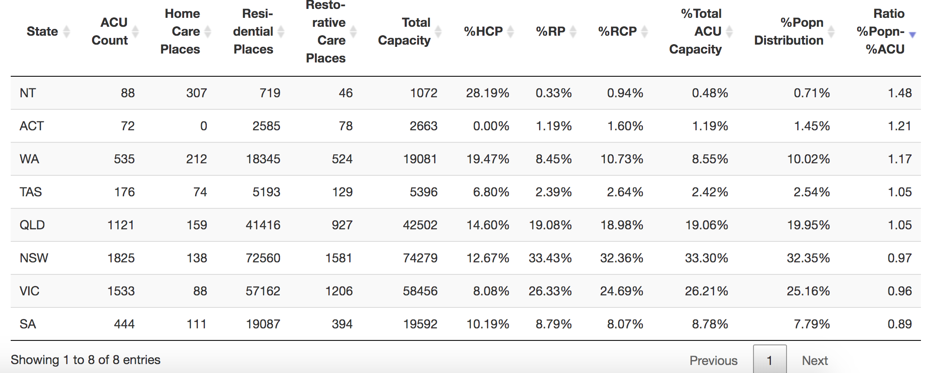
Focus on States with the Highest Ratio %Popn-%ACU

Slide 9
Technical Methodology
Visualise the problem using RShiny
Mark the physical location of aged care units in the Australian map. Use leaflet library, and Local Government Area (LGA) shape data
Color the LGAs depending on the old-age population density.
R, RShiny, Leaflet, GeoJSON, Mac terminal for processing shapefile data
Merge population data with aged care units data
The tricky part is getting data with matching location granularity (smallest possible)
R, dplyr, tidyr

Slide 10
Technical Methodology
Decide on a metric to allocate prioritization of new ACUs w/n states
Ratio of (% Old-age population distribution across states) and (% ACU capacity distribution across states)
If Ratio > 1 then there are more old-age people than ACUs in a state
If Ratio < 1 then there are more ACUs than old-age people in a state
Priority for building ACUs will go to states with higher metric value
Decide on a performance metric that will make all states content with the decision (fair or just)
% improvement with the ACU-Population ratio
Git and GitHub for versioning
Code is available upon request

Slide 11
Focus on States with the Highest Ratio %Popn-%ACU

Slide 12
Formula Used
(PROPOSED_ACU_CAPACITY + CURRENT_ACU_CAPACITY)/POPULATION = NUM_IN_1K / 1K
PROPOSED_ACU_CAPACITY = (NUM_IN_1K * POPULATION) - (1K * ACU)/1K

Slide 13
Proposal 1: Allocation of 200 New Aged Care Units
State | Current State X in 1000 has access to ACU | # of Proposed ACUs to Build | Proposed State At least 20 in 1000 has access to ACU
NSW | 27.55796693 | 0 | 27.55796693
VIC | 27.87932377 | 0 | 27.87932377
QLD | 25.5714345 | 0 | 25.5714345
WA | 22.85825867 | 0 | 22.85825867
SA | 30.16553166 | 0 | 30.16553166
TAS | 25.46664464 | 0 | 25.46664464
ACT | 22.03430501 | 0 | 22.03430501
NT | 18.0401528 | 176 | 21
Assumption: Each Age Care Unit has a capacity of 90
Goal: At least 20 in 1K, ages 50 and above should have access to an ACU in their state
Current Total: 176 (for leeway and Other Territories)

Slide 14
Issues
No population data gathered for Other Territories (misrepresentation)

Slide 15
Allocation of 200 New Aged Care Units
State | ACU Distribution by Capacity | Population Distribution | Ratio of ACU Distrib and Population Distrib | Population
NT | 0.48% | 0.71% | 1.48 | 59,423
ACT | 1.19% | 1.45% | 1.21 | 120,857
WA | 8.55% | 10.02% | 1.17 | 834,753
TAS | 2.42% | 2.54% | 1.05 | 211,885
QLD | 19.06% | 19.95% | 1.05 | 166,2089
NSW | 33.30% | 32.35% | 0.97 | 2,695,373
VIC | 26.21% | 25.16% | 0.96 | 2,096,751
SA | 8.78% | 7.79% | 0.89 | 649,483

Slide 16
Sources
Recent version of the 2016 aged care units data (link) - now in 2019
Population by Age and Sex (link)
Creation of GeoJSON file for Australian postcodes (link)
Postcode lat/lon (link)
LGA (link)

