Slide 1
Findings

Slide 2
Hypothesis
The ratio of old-age population distribution, and available Aged Care Units (ACU) across states (or better yet, suburbs) should be as close as possible.
If NSW contains 15% of the old-age population, then about 15% of the ACUs should be in NSW.

Slide 3
Methodology
Gather data on population arranged by age and location
Gather data regarding the location, and capacity of existing aged care units
Merge the two data sources and decide the best possible location for the 200 new aged care units
Provide visualisation to effectively report findings

Slide 4
Technical Methodology
Visualise the problem using RShiny
Mark the physical location of aged care units in the Australian map. Use leaflet library, and Local Government Area (LGA) shape data
Color the LGAs depending on the old-age population density.
R, RShiny, Leaflet, GeoJSON, Mac terminal for processing shapefile data
Merge population data with aged care units data
The tricky part is getting data with matching location granularity (smallest possible)
R, dplyr, tidyr

Slide 5
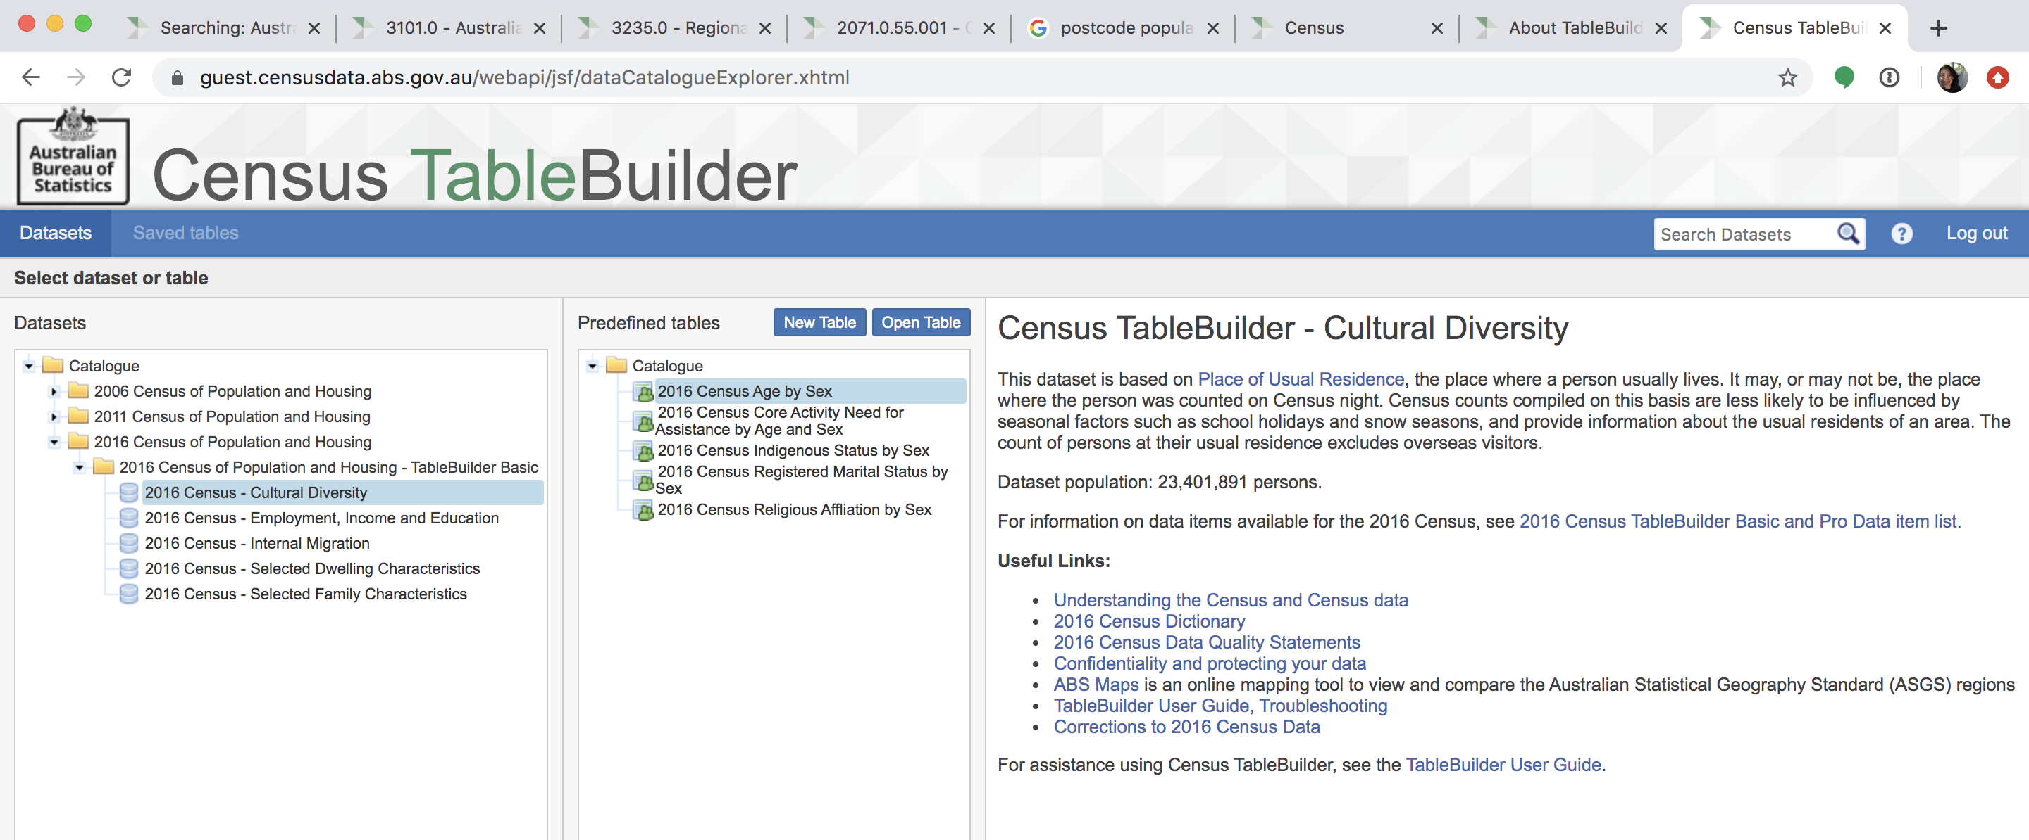

Slide 6
Sources
Recent version of the 2016 aged care units data (link) - now in 2019
Population by Age and Sex (link)
Creation of GeoJSON file for Australian postcodes (link)
Postcode lat/lon (link)
LGA (link)

