Slide 1
TechWise Team 4 Project 1
August 22, 2022
Notes:
Jackson

Slide 2
Project Team Members
Dennis Bowen – Frontend/Backend
Viktoriia Denys - Backend
James Rodgers- Backend
Alan Snyder – Frontend/Backend
Jackson Trainer – Frontend/Backend
Notes:
Jackson

Slide 3
Project Overview
Implement a digital version of the classic Scrabble board game
Minimum viable product
Notes:
Jackson

Slide 4
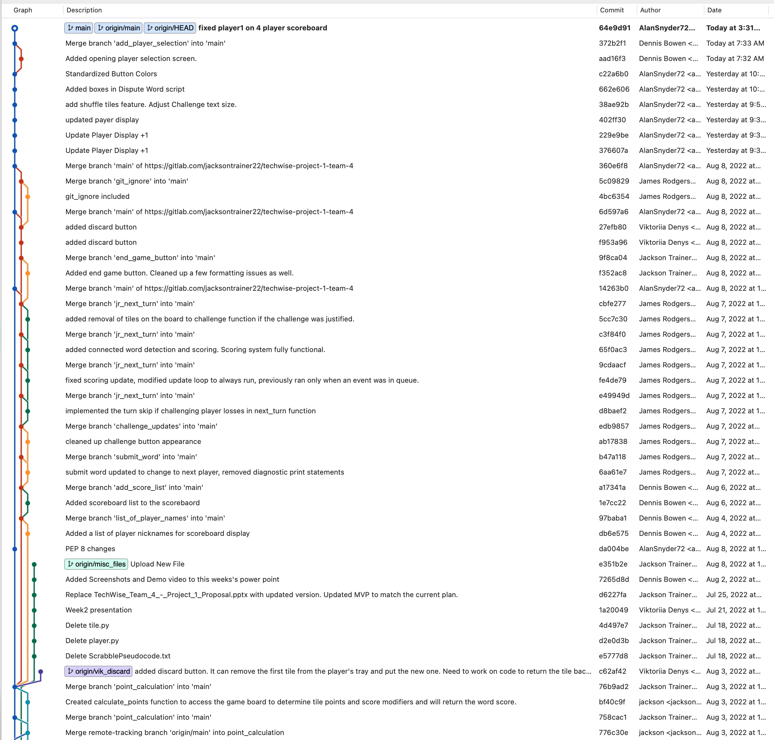
Git Commit 8/3 to 8/10

Slide 5

Demo
Notes:
Alan

Slide 6
Challenges
Dynamically creating player objects based on user input
Working with multiple classes to interact correctly
Making the font move with the tile image on the board
Infinite player loop
Working with a grid system and the math needed when using the mouse
Tile alignment to the space on the board
Rate of bug creation vs bug squashing
Tile refill refreshes entire tray with new tiles
Accounting for different word and letter modifier combinations in scoring
Complexity of designing objects
Translating requirements into pseudocode
Keeping the scope reasonable for the time constraints
Notes:
James

Slide 7
Lessons Learned
Creating title screens and buttons in PyGame
When to take a break when troubleshooting
Continuing to learn PyGame and how to render text and rectangle objects
Using objects in Python and how to pass objects
Working with mouse events in PyGame
Game loops with multiple loops
Continuing to learn PyGame and how to render text and rectangle objects
Create wireframes before starting work on GUI
Git and merge conflicts
Start with the program logic and focus GUI in the beginning.
Make sure naming convention is clear
Constant communication with team
Notes:
Dennis

Slide 8
Project Timeline
Project Kickoff
Week 1- 7/6
Completed initial pseudocode
Game board designed with basic features
Week 3 – 7/20
Display tiles on the game board
Multiple functions related to tile placement and interaction
Week 4 – 7/27
Basic scoring logic
Discard tiles
Improve on-screen buttons (submit, pass, discard)
Finish discard tiles
Dynamic to the game board
Reorder tiles in the tray
Discard tiles,
Remove tiles from the board
Number of player setup,
End game button
Continue to improve GUI
Application testing
Bug fixes
Build Freeze – 8/18
Presentation 8/22
Week 6 - 8/10
Created Player, Tile, Tile Bag, Controller objects
Week 5 - 8/3
Notes:
Viktoriia

Slide 9
Future Development Opportunities
Legal word checking
Custom legal word checking dictionaries
Acronyms
Foreign language
Slang
Display word definitions
Realtime word validation
Game modifiers
Tile/word limits
Turn time limit
Character selection for blank tiles
Notes:
Viktoriia

Slide 10
Questions?

