Slide 1
TechWise Team 4 Project 1 – Scrabble
August 22, 2022
Notes:
Jackson

Slide 2

Project Team Members
Dennis Bowen – Frontend/Backend
Viktoriia Denys - Backend
James Rodgers- Backend
Alan Snyder – Frontend/Backend
Jackson Trainer – Frontend/Backend
Notes:
Jackson

Slide 3
Project Overview
Implement a digital version of the classic board game Scrabble
Minimum viable product
Allows 2 - 4 players
Basic score keeping
User Interface
Game setup window
Display the game board
Place tiles on game board
Submit word for scoring
Notes:
Jackson
Scrabble is a word game in which two to four players score points by placing tiles, each bearing a single letter, onto a game board divided into a 15×15 grid of squares. The tiles must form words that, in crossword fashion, read left to right in rows or downward in columns and are included in a standard dictionary or lexicon.

Slide 4
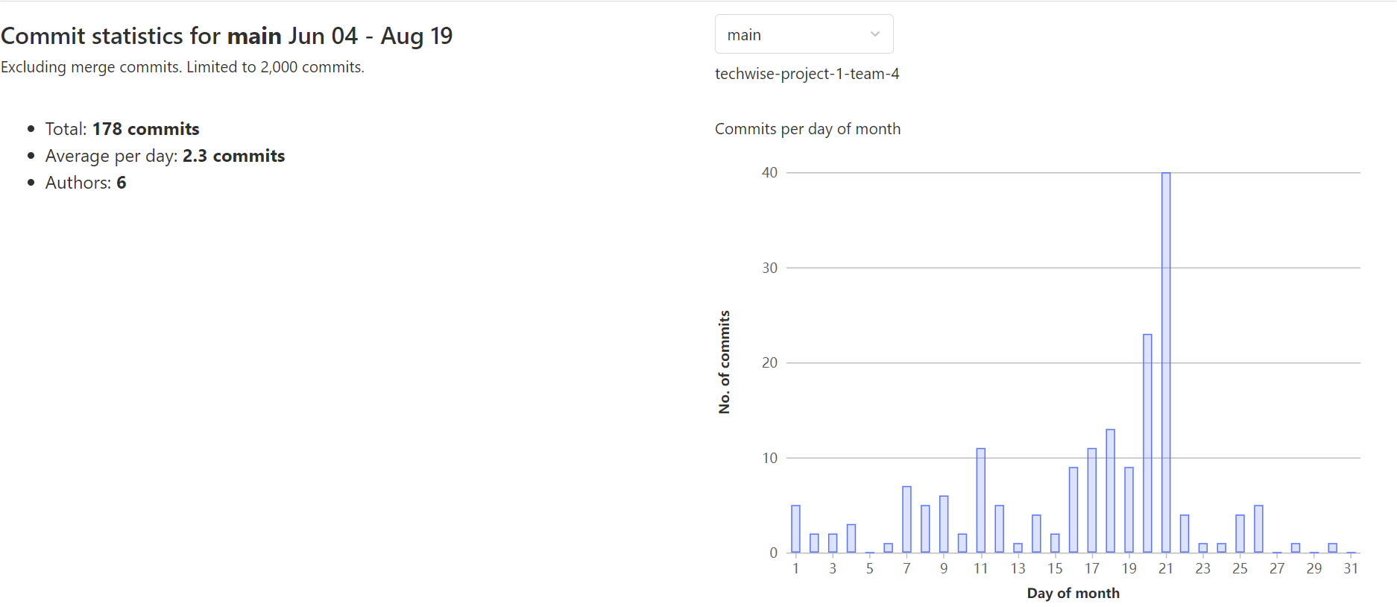
Git Commits
Notes:
Jackson

Slide 5
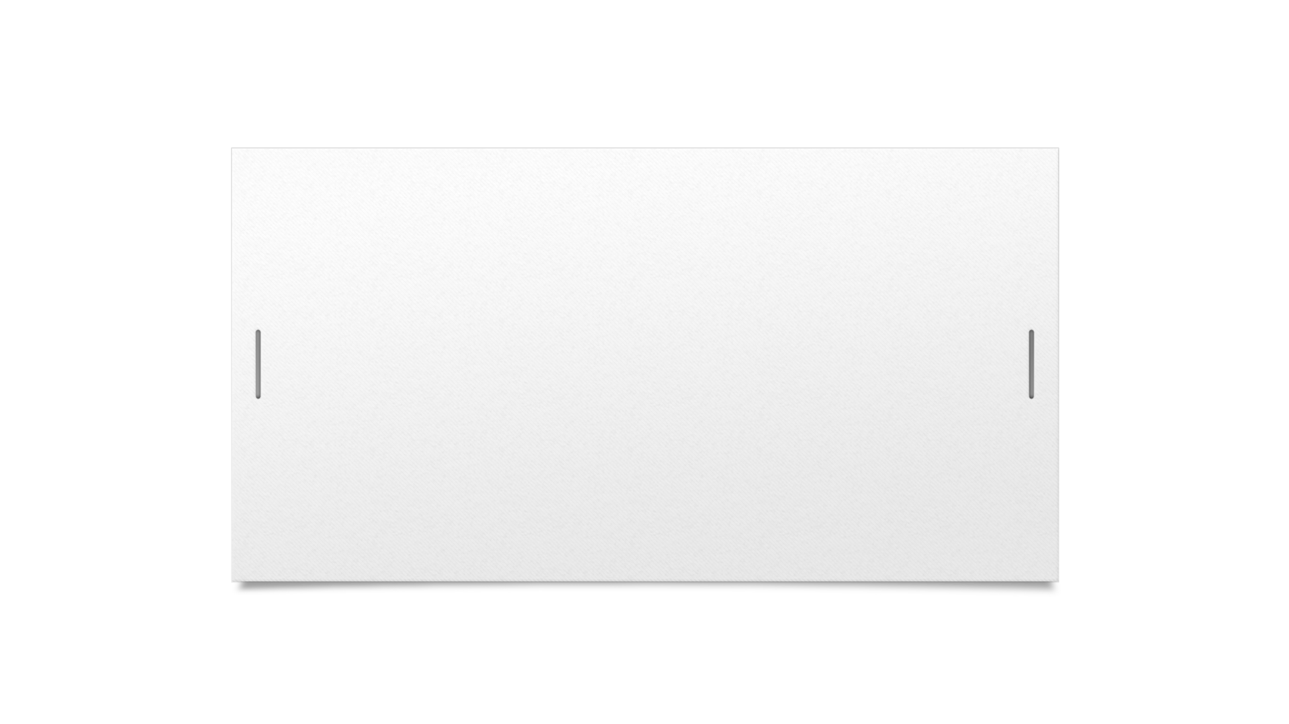




Demo
Notes:
Alan

Slide 6
Challenges
Project Scope
Design and Outline
Team Understanding of Core Components
Complex Program Complex Bugs
Notes:
James

Slide 7
Lessons Learned
Creating title screens and buttons in PyGame
When to take a break when troubleshooting
Continuing to learn PyGame and how to render text and rectangle objects
Using objects in Python and how to pass objects
Working with mouse events in PyGame
Game loops with multiple loops
Continuing to learn PyGame and how to render text and rectangle objects
Create wireframes before starting work on GUI
Git and merge conflicts
Start with the program logic and focus GUI in the beginning.
Make sure naming convention is clear
Constant communication with team
Notes:
Dennis

Slide 8
Project Timeline
Project Kickoff
Week 1 – 2
Week 3 – 4
Display tiles on game board
Multiple functions for core functions
Dynamic scoreboard
Discard tiles, remove tiles from the board
Number of player setup
End game button
Build Freeze – 8/19
Presentation – 8/22
Week 5 – 6
Initial pseudocode
Created foundational objects
Game board designed with basic features
Discard tiles
Improve on-screen elements
Application testing
Bug fixes
Basic scoring logic
Notes:
Viktoriia

Slide 9
Future Development Opportunities
Legal word checking
Custom legal word checking dictionaries
Acronyms
Foreign language
Slang
Display word definitions
Realtime word validation
Game modifiers
Tile/word limits
Turn time limit
Character selection for blank tiles
Notes:
Viktoriia

Slide 10
Questions?

