Slide 1
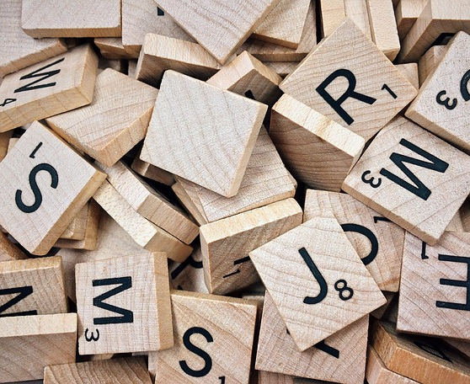
TechWise - Scrabble
Team 4

Slide 2
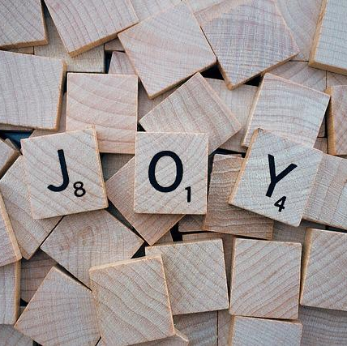
Project participants
Alan Snyder – FrontEnd /BackEnd
Dennis Bowen - FrontEnd /BackEnd
Jackson Trainer – FrontEnd/BackEnd
James Rogers - BackEnd
Viktoriia Denys - BackEnd

Slide 3
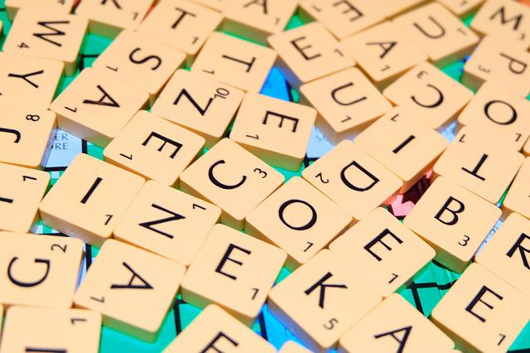
Project Status
Created Player, Tile, TileBag, Controller objects
Game board designed with basic features

Slide 4
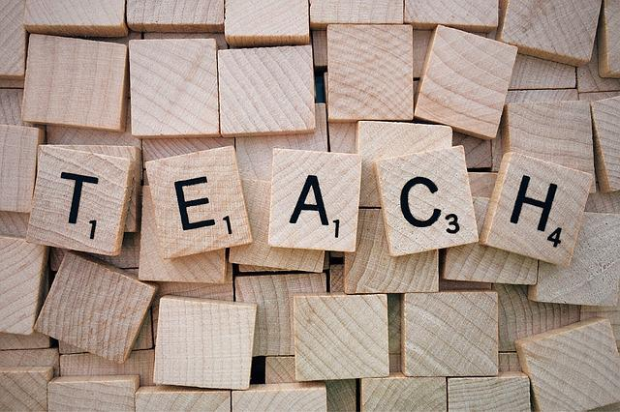
Learnings
PyGame basics
Game Board learning mechanics
Creating objects in Python

Slide 5
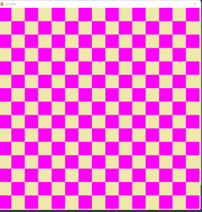
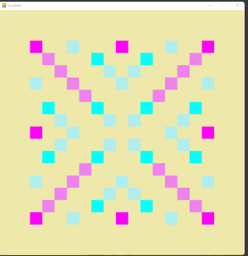
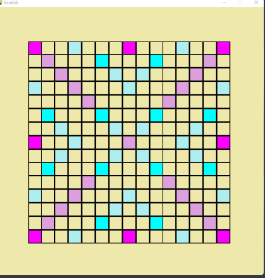
Demo
1st version
2nd version
Current version

Slide 6
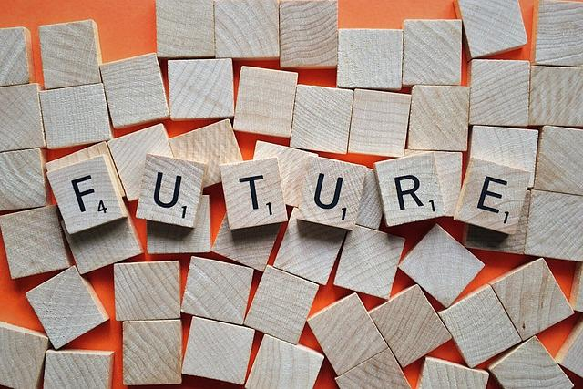
Future Steps
Tile placement
Calculating scores
Upgrading game board
Displaying tiles on the board

