Slide 1
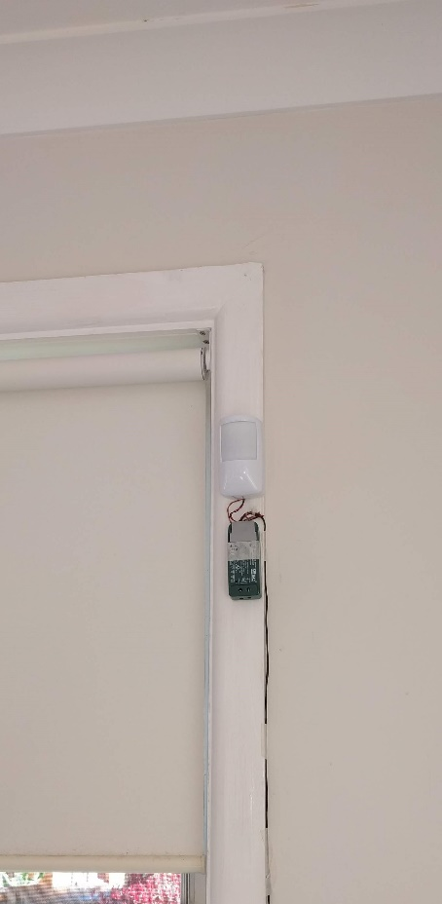
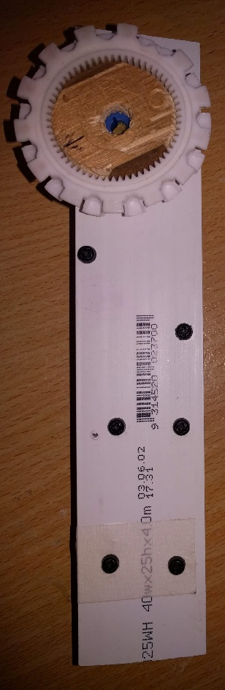
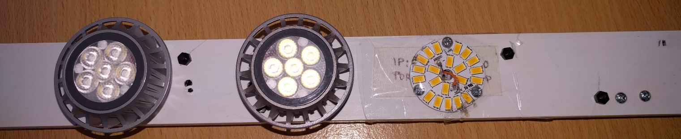
Passive Motion IR Sensor
With Wireless Interface
Wireless Interface
12V Power
Curtain Control
Dimmer Lights
Room lights
Night Light

