Slide 1
Detection of Diseases Using Medical Images
Vijay Karthik Deverkonda
University at Albany
December 2024

Slide 2
Presentation Flow:
1. Title Slide: Introduction to the project.
2. Introduction: Purpose and significance of the study.
3. Research Objectives: Goals of the research.
4. Literature Review: Existing methods and research gap.
5. Methodology: Approach, data collection, and preprocessing.
6. Results: Model performance and analysis.
7. Conclusion: Key findings and implications.
8. Recommendations: Future work and improvements.
9. References and Acknowledgments.

Slide 3
Introduction
Significance of Pneumonia Detection
- Pneumonia is a leading cause of morbidity and mortality worldwide.
- Diagnosis relies heavily on chest X-ray imaging, which is time-consuming and subject to human error.
Role of Artificial Intelligence
- AI and deep learning have revolutionized medical imaging and diagnostics.
- Automated solutions can enhance accuracy and efficiency in pneumonia detection.

Slide 4
Introduction
Purpose of the Study
- Develop a comprehensive approach using deep learning models to detect pneumonia from chest X-ray images.
- Leverage pre-trained models and ensemble techniques to improve diagnostic accuracy and robustness.

Slide 5
Research Objectives
Primary Goals
- Enhance the accuracy of pneumonia detection using deep learning models.
- Improve model robustness to address challenges like data scarcity and diagnostic variability.
- Validate the model across multiple datasets for generalizability in different clinical environments.

Slide 6
Literature Review
Advancements in Pneumonia Detection
- Sirazitdinov et al.: Used ensemble models combining RetinaNet and Mask R-CNN.
- Cheplygina et al.: Highlighted limitations of semi-supervised learning.
- Zhang et al.: Applied transfer learning with pre-trained CNN models.
- Dalhoumi et al.: Employed adaptive weighting in ensemble learning.
Research Gap
- Need for models that combine efficiency, accuracy, and generalizability.

Slide 7
Methodology
Model Architecture
- Utilized MobileNetV2 as the backbone for its balance of efficiency and performance.
- Added fully connected layers with L2 regularization and dropout to prevent overfitting.
- Implemented a sigmoid output layer for binary classification (pneumonia-positive or negative).
Data Augmentation
- Applied techniques like rotations, zooms, and flips to increase data diversity.

Slide 8
Data Collection and Preprocessing
Dataset Details
- Large dataset of chest X-ray images.
- Divided into training, validation, and test sets.
.- Training: 70% of the dataset, Validation: 15%, Testing: 15%.
- Data normalization ensures consistent brightness and contrast.
- Augmentation mimics real-world conditions, improving model adaptability
Preprocessing Steps
- Resized images to 224 × 224 pixels.
- Normalized pixel values for consistency.
- Employed data augmentation to mimic real-world variability.

Slide 9
Ensemble Learning Approach
Ensemble Model Components
- Combined MobileNetV2, DenseNet121, and Vision Transformer.
- Each model captures different aspects of the data.
Ensemble Strategy
- Weighted outputs based on validation accuracy.
- Aimed to leverage strengths of individual models for improved performance.

Slide 10
Results
Model Performance
- Test Accuracy: Achieved an accuracy of 93.9%.
- Precision, Recall, F1-Score: High metrics indicating reliable predictions.
• Accuracy: Overall 93% on the test set.
• Precision: 92% for pneumonia detection.
• Recall: 89%, highlighting sensitivity to true positive cases.
• F1-Score: 90%, balancing precision and recall effectively.
- Low false negatives are critical, as missing pneumonia cases can lead to severe outcomes.
- High F1-Score ensures the model balances precision and recall effectively
Confusion Matrix Analysis
- Demonstrated effective differentiation between pneumonia and non-pneumonia cases.
- Minimal false negatives, crucial for medical diagnostics.

Slide 11
Model Accuracy and Loss
Training Progress
- Monitored accuracy and loss over epochs.
- Training and validation accuracy increased over time.
- Training and validation loss decreased, indicating learning.

Slide 12
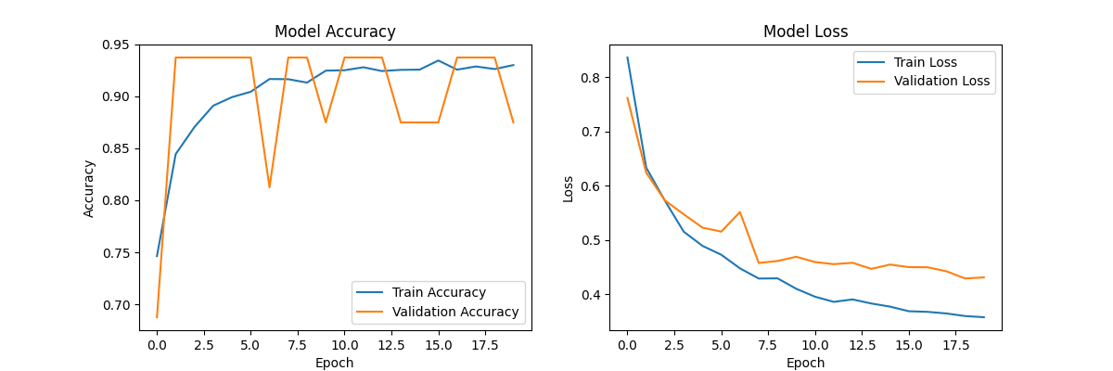
Model Accuracy and Loss
• Decreasing training loss: Indicates that the model is minimizing its error on the training data.
• Validation loss: Represents how well the model performs on unseen data. It should decrease in tandem with training loss.
• Overfitting detection: If validation loss starts to increase while training loss decreases, it suggests overfitting, meaning the model is learning noise or specific details of the training data that do not generalize.

Slide 13
Random X-ray Predictions
Model Predictions
- Displayed samples of correctly and incorrectly classified images.
- Correct Predictions: Model’s prediction matches the true label.
- Incorrect Predictions: Instances for further analysis and improvement.

Slide 14
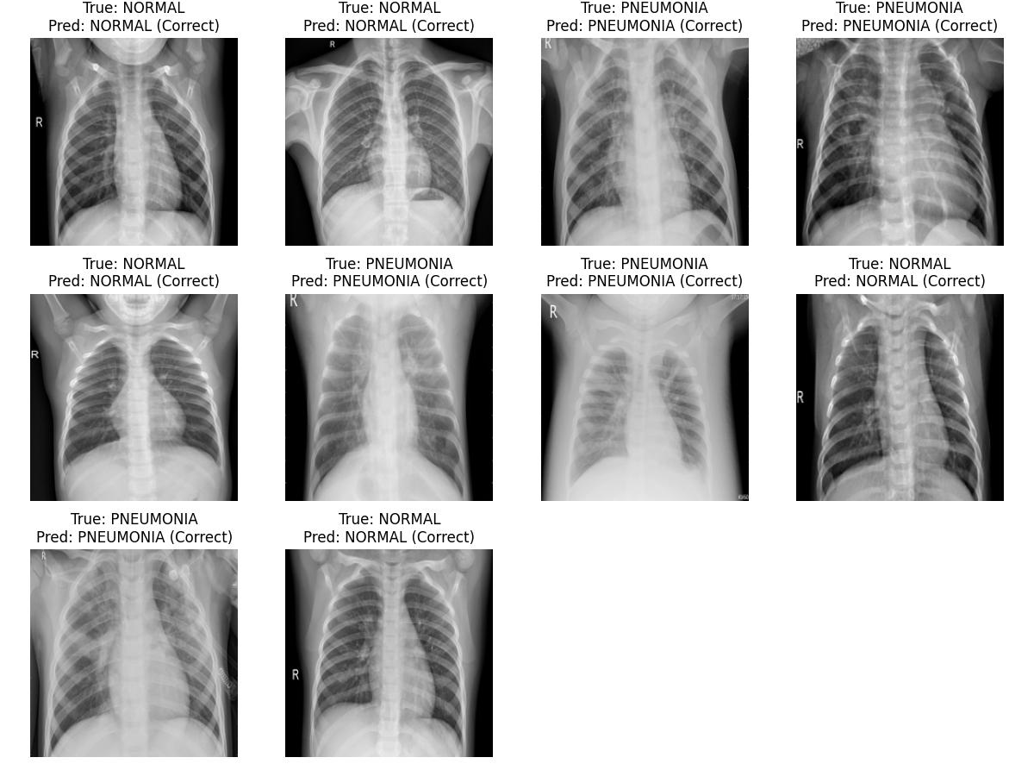
Random X-ray Predictions

Slide 15
Conclusion
Key Findings
- The ensemble deep learning model effectively detects pneumonia from chest X-ray images.
- Combining MobileNetV2, DenseNet121, and Vision Transformer enhances diagnostic reliability.
Implications
- Provides a balanced and efficient diagnostic aid for healthcare professionals.
- Potential to reduce radiologists’ workload and expedite patient care.

Slide 16
Recommendations
Future Work
- Incorporate external datasets to further validate model generalization.
- Optimize ensemble weighting techniques for enhanced performance.
- Explore real-time deployment in clinical settings.

Slide 17
References (Part 1)
1. Sirazitdinov et al. 'Deep neural network ensemble for pneumonia localization.'
2. Cheplygina et al. 'Not-so-supervised: semi-supervised learning in medical imaging.'
3. Zhang et al. 'Automated methods for pneumonia detection.'
4. Dalhoumi et al. 'Adaptive accuracy-weighted ensemble for classification.'
5. Franquet, T. 'Imaging of community-acquired pneumonia.'

Slide 18
References (Part 2)
6. Shao, Y. et al. 'Hierarchical lung field segmentation.'
7. Ibragimov, B. et al. 'Game-theoretic framework for image segmentation.'
8. Wang, X. et al. 'ChestX-Ray8: chest X-Ray database.'
9. Rajpurkar, P. et al. 'ChexNet: pneumonia detection with deep learning.'
10. Abiyev, R.H. 'Deep convolutional neural networks for chest diseases.'

Slide 19
Acknowledgments
Thank you for your attention!
Questions and Discussion

