Slide 1
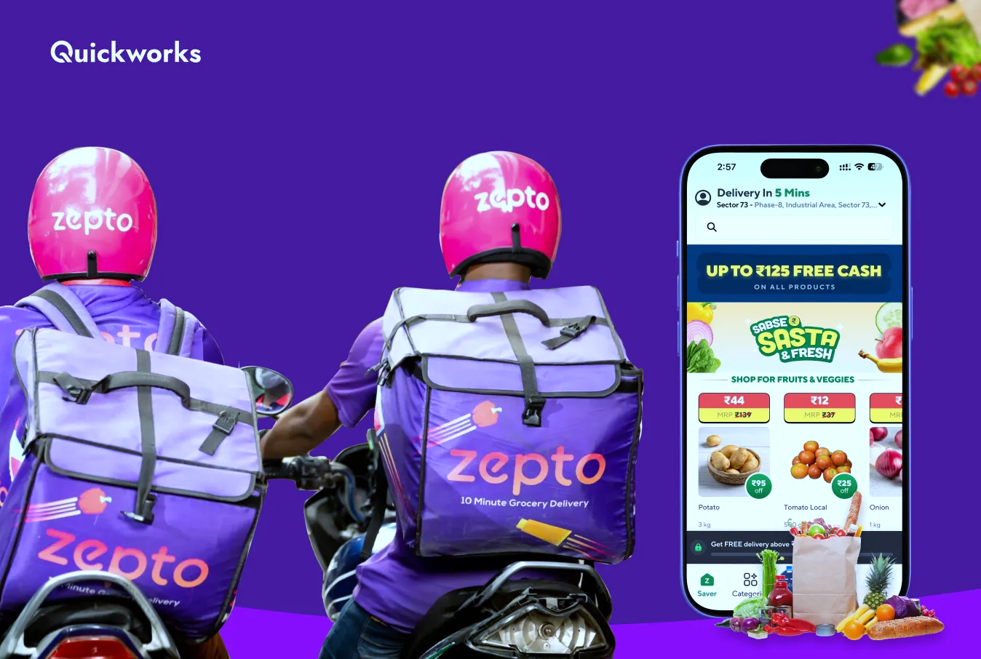
ZEPTO – Business Strategy Report
(Qualitative & Quantitative Analysis)
Zepto: The 10 - minute magic.

Slide 2
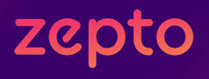



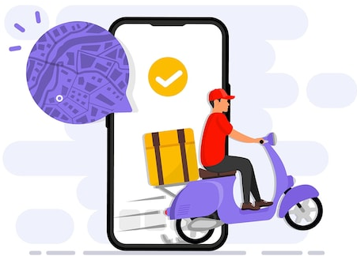

Company Introduction
zeptonow.com
zeptonow.com
Founded in 2021 by Aadit Palicha &
Kaivalya Vohra
Bengaluru, India
Grocery, essentials, FMCG via app
Quick Commerce (10-minute grocery delivery)
Urban millennials, working professionals, families
Revenue : ₹4,454 crore Net Income - ₹−1,248 crore Website : Zeptonow.com

Slide 3
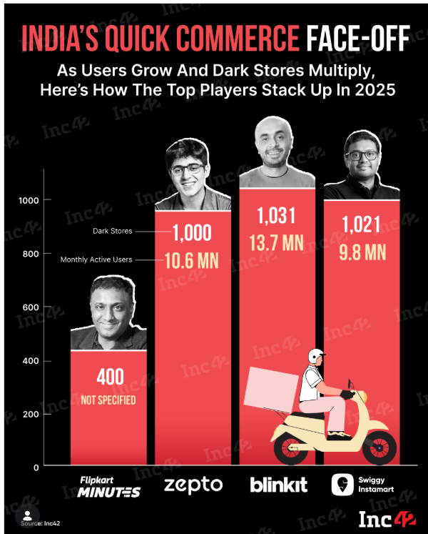
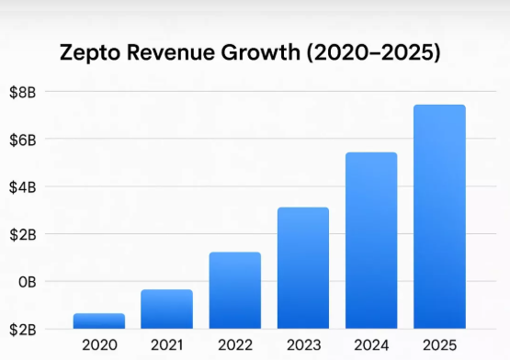

Slide 4


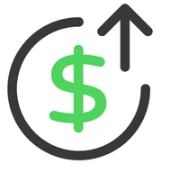
Business Model Analysis
Revenue:
  Product margins
  Delivery fees
  Subscriptions
  Brand ads
Value Delivery:
  Ultra-fast delivery,
  Convenience
  wide assortment
Major Costs:
  Dark stores
  Delivery partners,
  Technology
  Marketing

Slide 5
Cost Structure Breakdown of E-commerce Industry

Slide 6
Unique Selling Proposition (USP)
Key Differentiators
10‑minute delivery
Dark store network
AI‑driven logistics
Reliable stock Availability.
Customer Attraction
Speed
Convenience
Wide product range
Competitive pricing
Consistent service.
USP = Speed + Reliability
Branding & Experience
Youthful image
Modern app design
Customer‑centric Messaging
Loyalty programs.

Slide 7
Market Gap & Customer Needs
Market Pain Points (Before Zepto): Slow grocery deliveries, unreliable stock, and lack of convenience for busy urban lifestyles.
Problem Solved: Zepto introduced 10‑minute delivery with dark stores and tech‑driven logistics, ensuring speed and reliability.
Customer Benefits: Saves time, offers convenience, ensures product availability, and supports fast‑paced urban living.

Slide 8
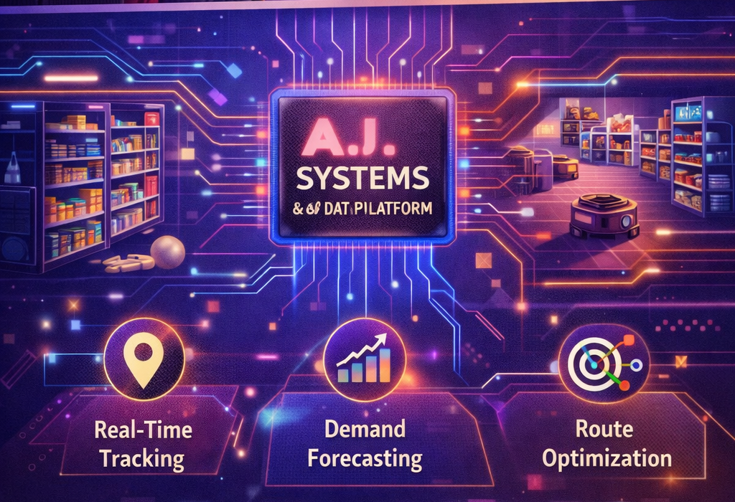
Technology & Innovation
Inventory AI
Geospatial Tracking
Proprietary Algorithms for Logistics
Innovation: Zepto Cafe
Zepto launched subscription-based AI tool 'Atom' to enhance brand insights and performance.

Slide 9
Customer Review & Sentiment Analysis
Speed, convenience, app usability, and competitive pricing.
Hidden fees, inflated MRPs, and slow customer support
Discounts tied to expiry dates, mixed perceptions of value.

Slide 10
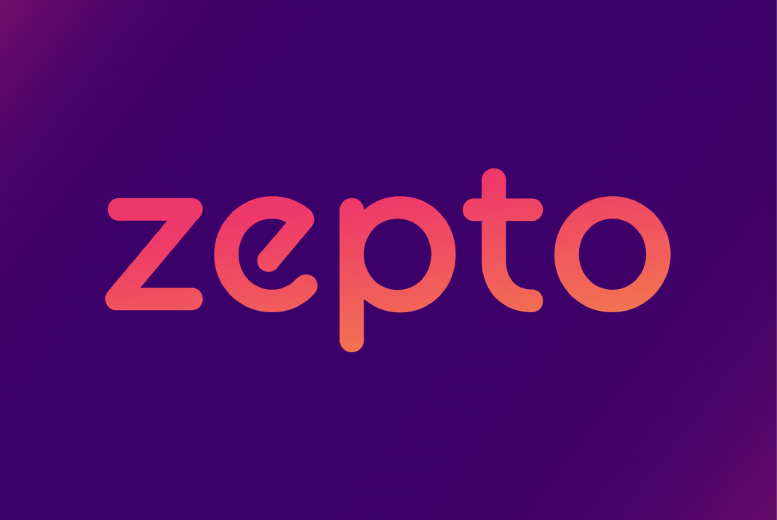

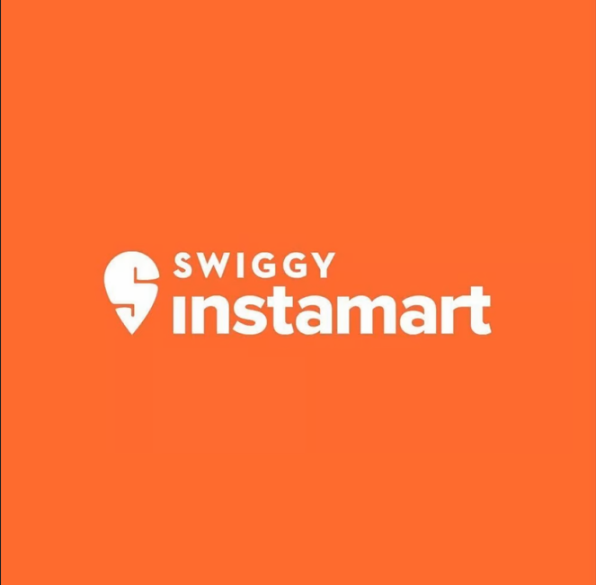

Competitor Benchmarking
Feature
Speed | ⚡ 10-12m | 12-15m | 15-25m | 15-30m
Variety | Grocery-Heavy | Electronics+ | General | Fresh/Bulk
Pricing | Zepto Pass | Dynamic | Swiggy One | BB Star
UX | Minimalist | Visual | Cluttered | Functional
Customer Satisfaction | High in metros | Fast but service issues | Generally positive | Mixed, Service Gaps

Slide 11
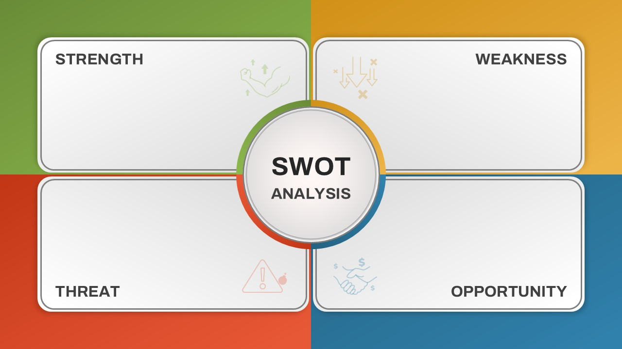
SWOT Analysis
Speed
Brand recall
Tech-driven ops
High burn rate
Limited geography
Thin margin
Low AOV
Intense competition
Regulatory pressure
Rising delivery cost
Customer fatigue
Tier-1 & Tier-2 expansion
Private label development
Strategic Partnership

Slide 12



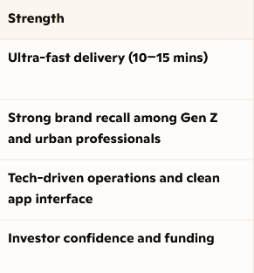
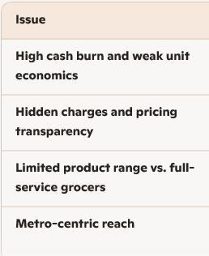
Key Insights & Findings
📊 Review Patterns & Performance Data
• Praise : Speed , app and delivery
• Complaints : Pricing, hidden fees and service gaps in non metros
• Average rating: 2.5–3.5 stars across platforms
• 19% 1-star reviews cite service gaps & fees

Slide 13
Strategic Recommendations
Recommendations | Short-Term (0–12 months) | Long-Term (1–3 years)
Customer Satisfaction | Fix hidden charges improve support launch loyalty rewards | Build private labels expand into Tier 2/3 cities
Operational Efficiency | AI-driven inventory micro-warehousing better delivery partner training | Invest in automation adopt EV fleets & eco-packaging
Competitive Edge | FMCG tie-ups expand essentials/ready-to-eat targeted Gen Z marketing | Diversify into lifestyle categories launch subscription model enhance AI personalization
Tagline: “Zepto: Fast today, sustainable tomorrow”

Slide 14
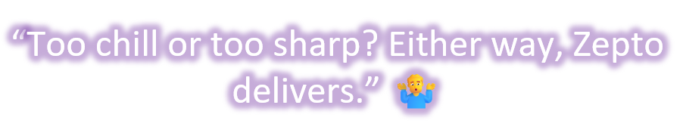

Slide 15
Thank you

