Slide 1
Project at a Glance
GDPR Data Anonymization Analysis
~5,000
8
11
Customer Records Processed
PII Fields Anonymized
Anonymization Techniques
E-commerce Customer Data Pipeline Privacy-First Cloud Analytics
269
6
100%
Free-text Notes Processed by Local AI
European Countries
GDPR Compliance
Victor Toret Marin Data Analyst
linkedin.com/in/victor-toret-marin-458674321 github.com/vdevictor123
https://vdevictor123.github.io/portfolio/
April 2026
NovaShop · Privacy by Design · GDPR Article 25

Slide 2
Executive Summary
01
Scale & Scope
02
Techniques Applied
03
Value Preserved
~5,000 synthetic e-commerce records from 6 EU countries were processed through a full GDPR-compliant anonymization pipeline — from raw PII to cloud-ready, anonymized datasets.
11 anonymization techniques were combined: SHA-256 hashing, email & phone masking, date generalization, postal truncation, IP truncation, noise injection, field removal, and local AI (Ollama) for free-text notes.
Despite full anonymization, 100% of analytical value is retained: country, age range, product categories, customer segments, and behavioral patterns remain available for cloud analytics — with zero PII exposure.
Victor Toret Marin · April 2026

Slide 3
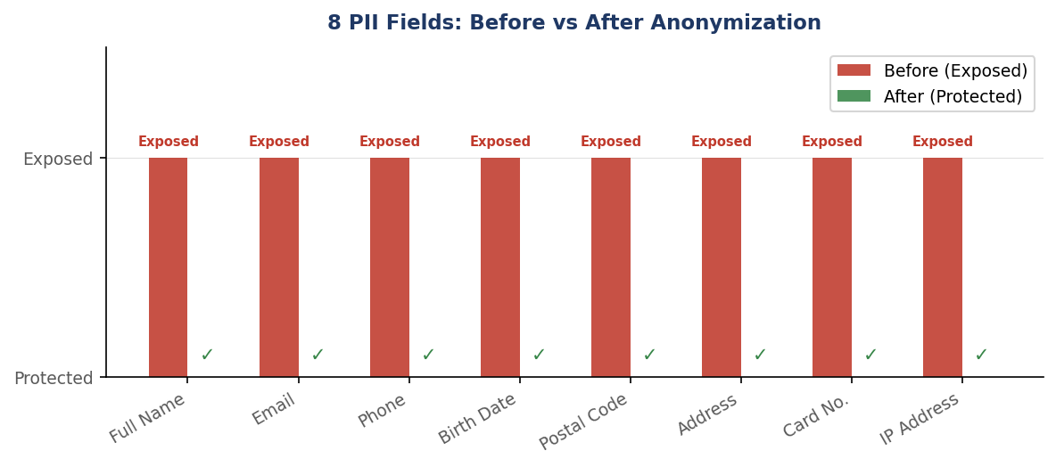
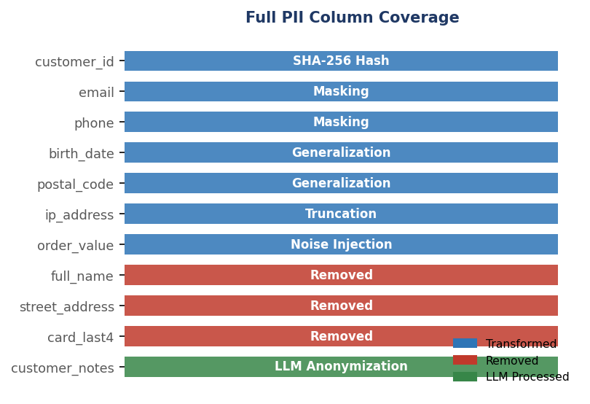
Anonymization Findings
8 PII fields
3 fields
269 notes
100%
fully anonymized
permanently removed
processed by local AI
analytical value retained
Before → After
Field
Before
After
customer_id
CUST-000764
919ed75…
email
user@email.com
us***@email.com
phone
0174-164776
***** 4776
birth_date
1963-02-13
60-69
postal_code
N27 7NYE
N2******
ip_address
161.198.44.35
161.198.0.0
order_value
44.48 €
43.40 € ±noise
full_name
Lotte Blaak
⛔ Removed
street_address
Briandreef 461
⛔ Removed
Free-text notes (269 records) processed with Ollama llama3.2:3b running locally — no customer data ever left the premises during AI processing.
Victor Toret Marin · April 2026

Slide 4
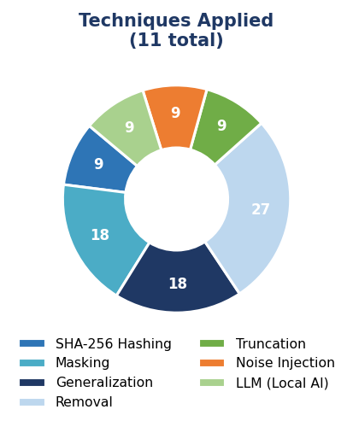
Anonymization Strategy Applied
11 Techniques · 3 Categories · 1 Pipeline
Technique
Column
Method
Result
🔐
Transformed
SHA-256 Hashing
customer_id
Irreversible pseudonymization
✉️
Transformed
Email Masking
email
Partial character replacement
📱
Phone Masking
phone
Show last 4 digits only
Transformed
📅
Transformed
Date Generalization
birth_date
Exact date → 10-year age range
📍
Postal Generalization
postal_code
Full code → first 2 chars + ******
Transformed
🌐
IP Truncation
ip_address
Last 2 octets zeroed out
Transformed
💶
Transformed
Noise Injection
order_value
Random ±offset added to EUR value
🗑️
Field Removal
full_name
Deleted — no analytical value
Removed
🗑️
Field Removal
street_address
Deleted — no analytical value
Removed
🗑️
Removed
Field Removal
card_last4
Deleted — no analytical value
🤖
LLM Anonymization
customer_notes
Ollama llama3.2:3b (local) → PII → [REDACTED]
AI
Pipeline order: Data Generation → MySQL Import → 8 SQL Anonymization Steps → k-Anonymity Validation → Analytical Views → LLM Text Anonymization → Cloud Export
Victor Toret Marin · April 2026

Slide 5
Conclusions & Recommendations
Privacy by Design Works
Local AI Is the Right Choice for Free Text
✅
By applying 11 anonymization techniques at source, the NovaShop pipeline proves that GDPR compliance and cloud analytics are not mutually exclusive — you can have both without compromise.
✅
Processing 269 customer notes with a local LLM (Ollama) eliminated cloud PII exposure entirely. No sensitive data left the local environment — this approach should be standard for unstructured data.
k-Anonymity Validation Closes the Loop
Analytical Value Is Fully Preserved
✅
The pipeline validates k-anonymity after each transformation, ensuring no combination of quasi-identifiers can re-identify an individual. This is the difference between 'anonymous-looking' and 'legally anonymous'.
✅
Country, age range, product categories, device type, and customer segments all survive anonymization intact — enabling full BI and ML workloads on cloud platforms with zero compliance risk.
Next steps: Extend to real datasets · Add differential privacy · Schedule automated re-validation · Publish pipeline as open-source template
Victor Toret Marin · April 2026

Slide 6
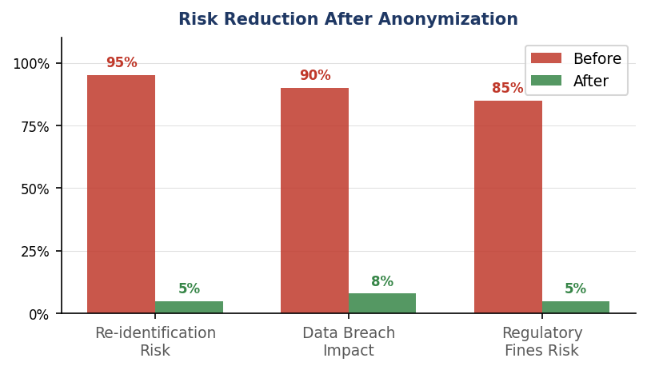
GDPR & Security Benefits
GDPR Articles Addressed
Art. 5
Data Minimisation
Only data necessary for analytics is retained.
Art. 17
Right to Erasure
PII fields removed; individuals cannot be identified.
Art. 25
Privacy by Design
Anonymization applied at the source, not as an afterthought.
Art. 32
Security of Processing
SHA-256, masking, and local AI prevent data exposure.
Art. 89
Scientific Research
Anonymized data can be freely used for analytics & ML.
"Anonymize locally. Analyse globally."
Victor Toret Marin · April 2026

Slide 7
Conclusions Anonymization
8 PII fields
3 fields
269 notes
100%
fully anonymized
permanently removed
processed by local AI
analytical value retained
Before → After
90%+ risk reduction across all 3 GDPR metrics
Field
Before
After
Re-identification risk, data breach impact, and regulatory fines exposure — all reduced by over 90% after anonymization.
Zero PII ever reaches the cloud
customer_id
CUST-000764
919ed75…
~5,000 records fully anonymized on-premises. Names, emails, addresses, IDs — none leave the local environment.
email
user@email.com
us***@email.com
100% analytical value preserved
Country, age range, segments, categories & device type survive intact for full BI and ML. workloads
phone
0174-164776
***** 4776
birth_date
1963-02-13
60-69
postal_code
N27 7NYE
N2******
ip_address
161.198.44.35
161.198.0.0
order_value
44.48 €
43.40 € ±noise
full_name
Lotte Blaak
⛔ Removed
street_address
Briandreef 461
⛔ Removed
Free-text notes (269 records) processed with Ollama llama3.2:3b running locally — no customer data ever left the premises during AI processing.
Victor Toret Marin · April 2026

