Slide 1

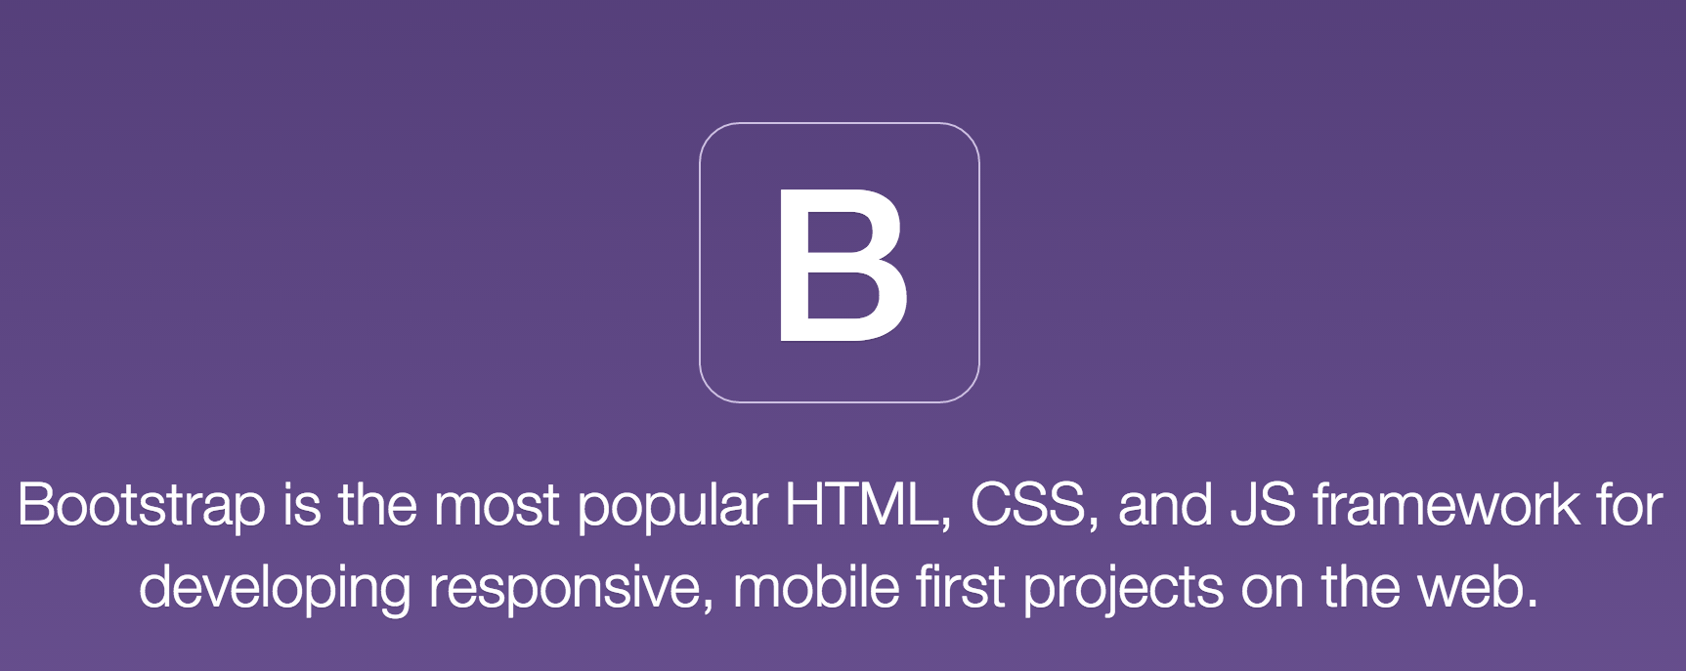
Bootstrap
by:-
Vignesh Dhamodaran

Slide 2
What is Bootstrap?
Originally created by a designer and a developer at Twitter. So initial name is Twitter Bootstrap.
Bootstrap has become one of the most popular front-end frameworks and open source projects in the world.
Front end Design framework.
Free and Open Source
The bootstrap framework aims to ease web development.

Slide 3
Why Bootstrap?
Easy to use: Anybody with just basic knowledge of HTML and CSS can start using Bootstrap
Responsive features: Bootstrap's responsive CSS adjusts to phones, tablets, and desktops.
Mobile-first approach: In Bootstrap 3, mobile-first styles are part of the core framework.
Browser compatibility: Bootstrap is compatible with all modern browsers.
It assumes you have no designing knowledge and all you want to do is write some HTML as per the Bootstrap specifications.

Slide 4
Getting Started
Make Sure it uses HTML5 doctype
Include:
bootstrap.min.css
bootstrap.min.js
jquery.min.js
We can either download these files locally or use CDN Network.

Slide 5
Bootstrap Grid
It allows Maximum of 12 Grids
The grid system has 4 Classes
xs for phones.
sm for tablets.
md for desktops.
lg for large desktops.
We can have
Equal columns, Unequal columns and Nested columns.

Slide 6
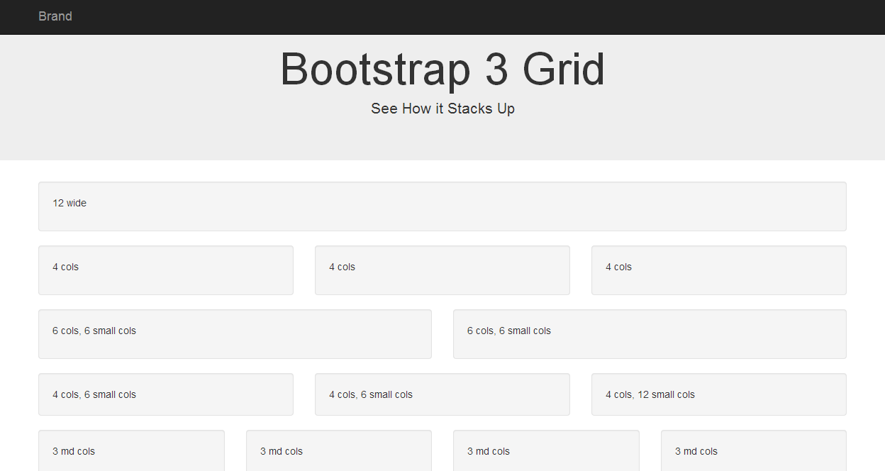

Slide 7
Bootstrap Typography
Default font size is 14px and line-height is 1.428 which is applied to <body>.
Specific classes for
Alignment and
Casing
Color of text
Phone
Email
address.

Slide 8
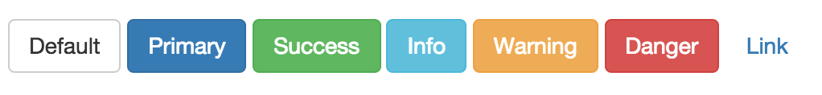
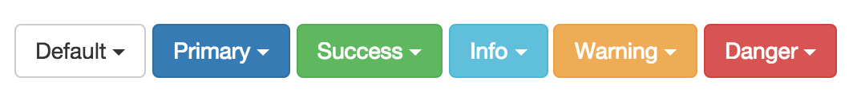
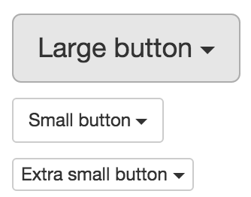
Bootstrap Button Style
Default Button Styles:
Dropdown Button Groups:
Size

Slide 9
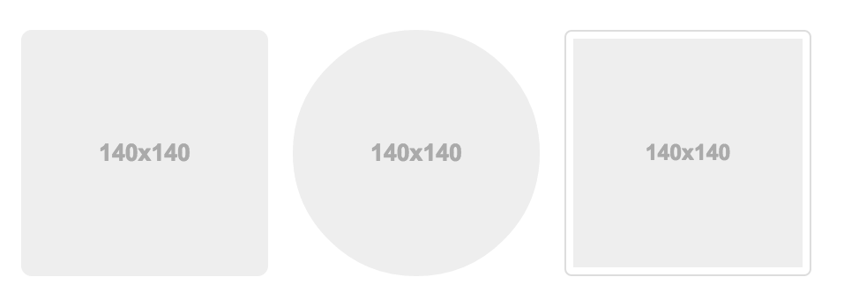
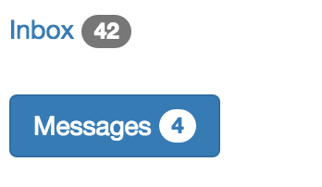
Bootstrap Images
3 types of image classes
Badges

Slide 10
Bootstrap Navs and Navbars
Tabs
Pills
Navbar

Slide 11
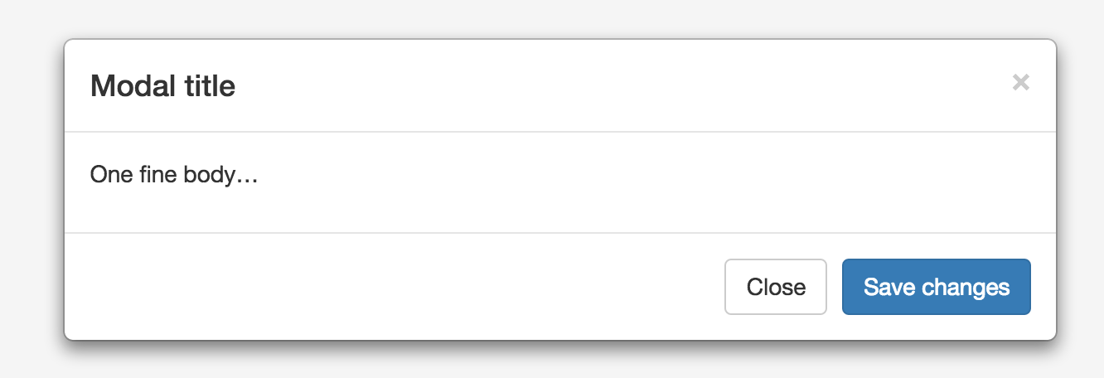
Bootstrap Modal
Modal is a plugin.
Flexible prompts used for some functionality.

Slide 12
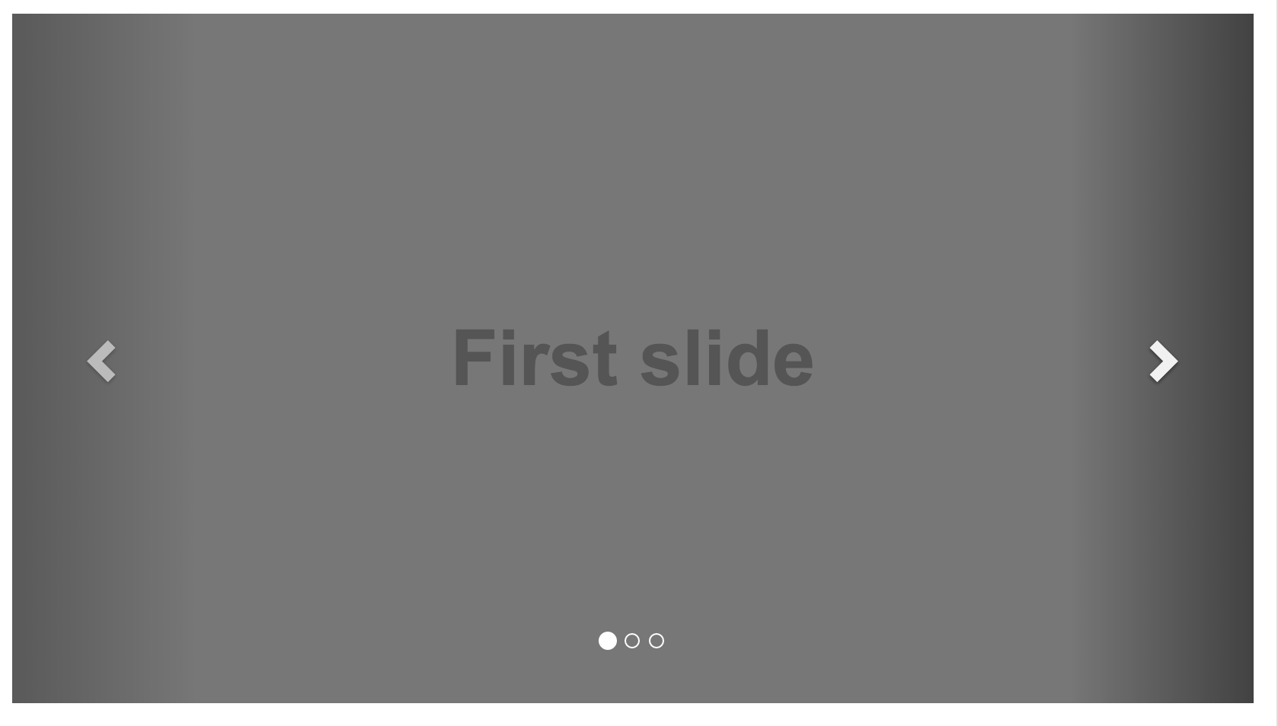
Bootstrap Carousel
Image slideshow plugin

Slide 13
Links
http://getbootstrap.com/examples/theme/
http://getbootstrap.com/examples/grid/
http://vignesh24.github.io/U-Integrate/

Slide 14
References
http://getbootstrap.com/

