Slide 1
FINAL PROJECT-2 Forward and Inverse kinematics of the 5 DOF- Robotic Arm
Illuri Satyajith reddy
Dhushetty Venkat Sai

Slide 2
Contents:
Problem statement
Approach
Forward kinematics
Inverse kinematics
Results
Discussion
Conclusion
Descriptions on code
Contribution of team member

Slide 3
Problem statement
In robots, the forward kinematics and inverse kinematics are important in determining the position and orientation of the end-effector to perform multi-tasks.
This paper presented the inverse kinematics analysis for a 5 DOF robotic arm using the robotics toolbox of MATLAB and the Denavit-Hartenberg (D-H) parameters were used to represent the links and joints of the robotic arm.
A geometric approach was used in the inverse kinematics solution to determine the joint angle parameters of the robotic arm and the path of the robotic arm was divided into successive lines to accomplish the required tasks of the robotic arm. Therefore, this method can be adopted for engineering applications.
MATLAB (Graphical User Interface) program was used to simulate the movement of the robotic arm in 3D. This gives the position of End-effector for different positions.

Slide 4
Approach
MATLAB Graphical User Interface (GUI) and peter corke robotics toolbox was used in this project to perform simulation of 5-dof robotic arm.
It illustrates the inputs to the program was the position of the end-effector of the robotic arm while the outputs were the joints angles of the robotic arm. Also, a 3D simulation of the robotic arm movement was presented in GUI as an output.
3D simulation to the movement of the robotic arm was applied using the Robotics toolbox in MATLAB depending on the DH parameters.
The program was performed as in the following steps:
Firstly, we have to design the forward and inverse program for the 5 degrees of freedom robotic arm in GUI section.
Then, we need to implement code for the forward and inverse kinematics and call back the functions from the GUI section.

Slide 5
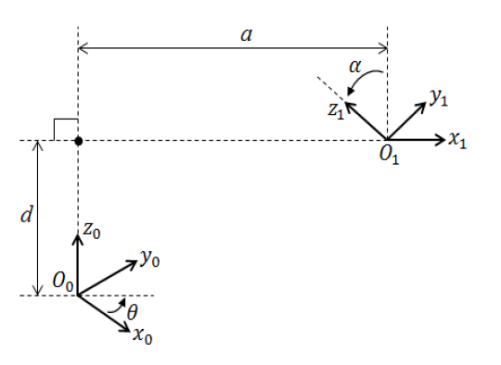
Forward kinematics
Forward kinematics is used to determine the position and orientation of the end-effector of the robotic arm from the specified joints angles.
DH method is one of the most methods used in forward kinematics which represents the relationship of the joint coordinate between two links.
ai: Link length.
αi: Link twist.
di: Link offset.
θi: Joint angle.
DH frame

Slide 6
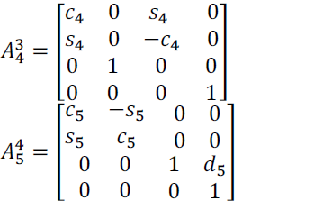
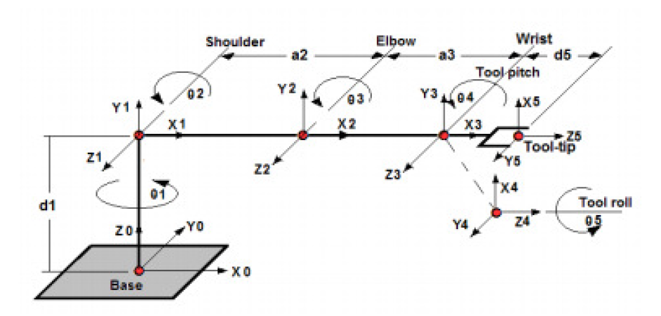
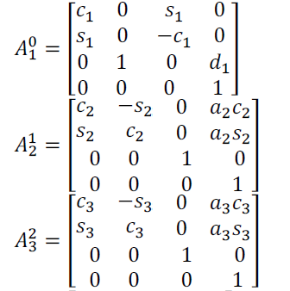
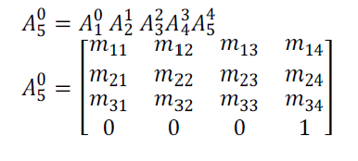
The coordinate frame of the robotic arm.
Above fig shows the end effector position Of 5-DOF manipulator.
In order to calculate the end effector position, we should calculate Transformation matrix for each of the joint
Finally , We should multiply every matrix in order to get the position of origin of the end effector.
By applying forward kinematics , We can estimate the workspace of manipulator. Therefore, for designing a manipulator for a specific task , It is crucial to do forward kinematic analysis.

Slide 7
Inverse kinematics
Inverse Kinematics (IK) is used to determine the required joints angles of the robotic arm to achieve the specified position and orientation of the end-effector of the robotic arm.
In general, the inverse kinematics problem can be solved either by an algebraic, an iterative, or geometric approach. The closed form solution is very difficult and suffers from the fact that the solution does not give a clear indication on how to select the correct solution from several possible solutions for a particular arm configuration. The iteration solution of ten equations requires more computation, and it does not guarantee convergence to the correct solution, especially in the singular and degenerate cases.
The geometric approach presents a better approach when the manipulator is simple, but it is not suitable for computer served robots. The closed form solutions are preferable for two reasons.

Slide 8
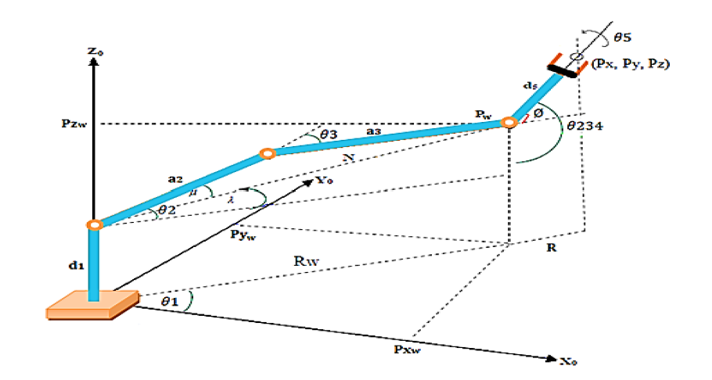
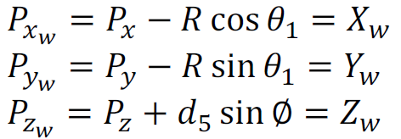
First, the forward kinematics equations must be solved at a rapid rate and second, inverse kinematics equations in general have multiple solutions.

Slide 9
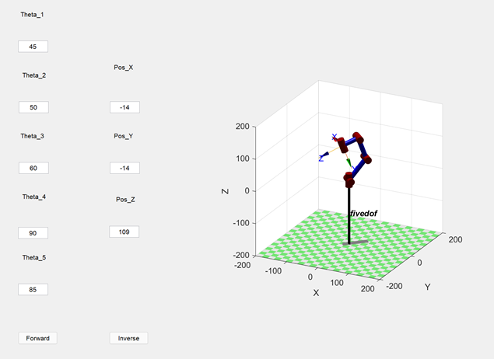
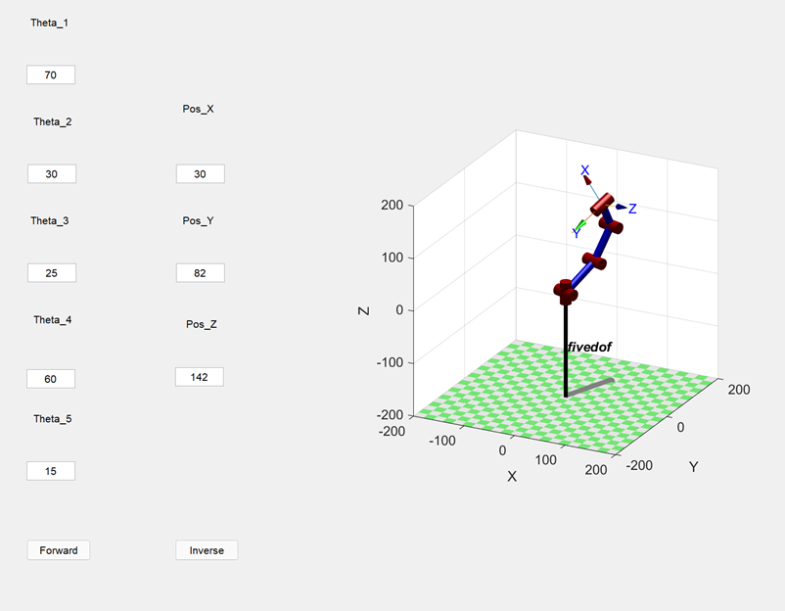
Results
https://drive.google.com/file/d/1lZgnZMxhtYr8nWk2pI0GH8F5i_zQXcOv/view?usp=sharing
Forward kinematics result 1
Forward kinematics result 2

Slide 10
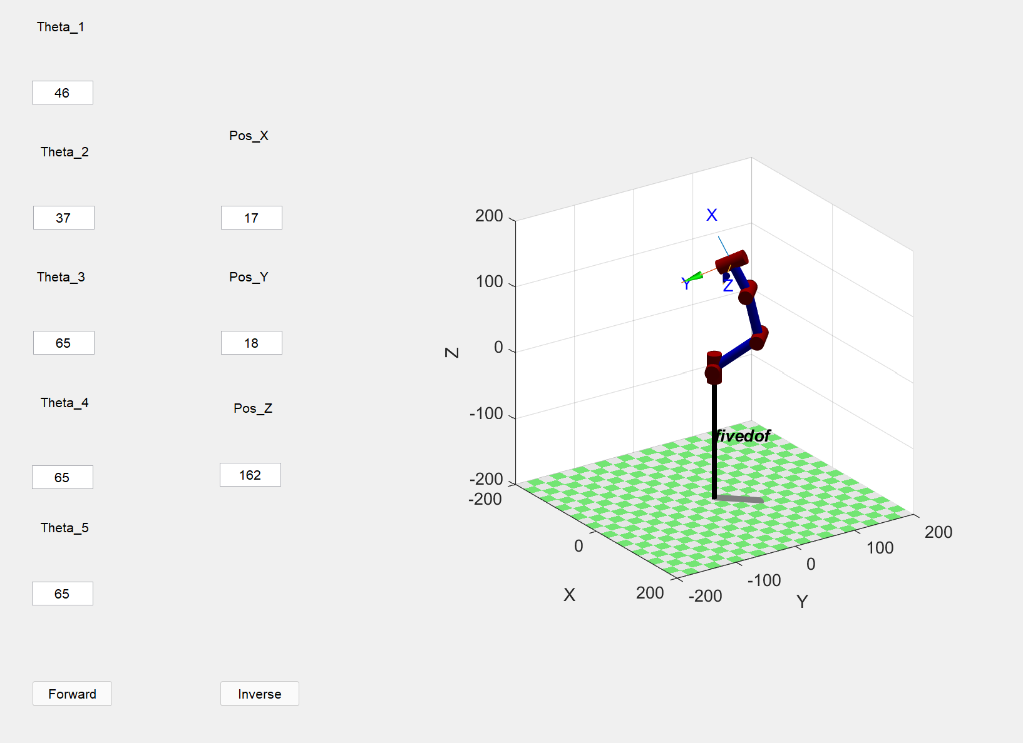
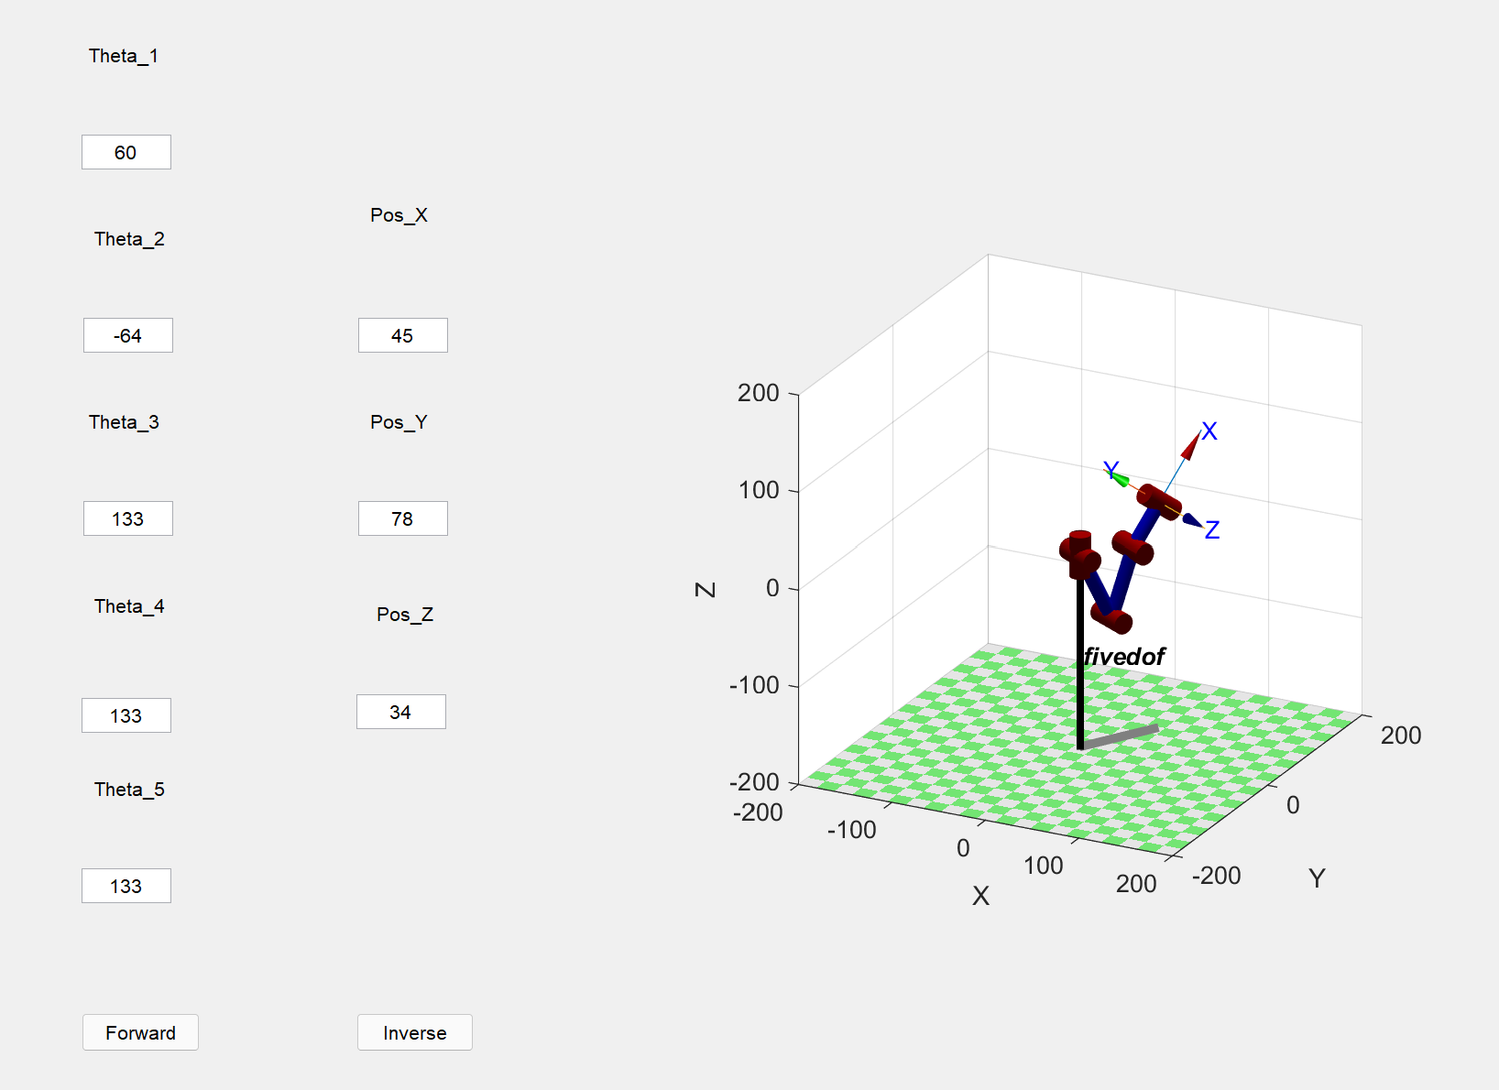
Inverse kinematics result 1
Inverse kinematics result 2

Slide 11
Discussion
In this work, Inverse kinematic analysis of 5 DOF robotic arm was accomplished using the MATLAB GUI program. Results indicates the usage of the geometric approach in inverse kinematics analysis to determine the joints angles of the robotic arm effectively.
Algorithm of the geometric approach was developed for the inverse kinematic analysis of the robotic arm and to compare the results of this method with results using an algebraic solution.
To test the efficiency of the geometric approach in the inverse kinematics analysis, several cases were studied. Inputs to the GUI program, is the position of the End-effector and the outputs were the joints angles of the robotic arm.
If we give values of the End –Effector out of its workspace, then we can’t find angle parameters, Code will show error. So, It is essential to give the values in workspace. Also, there exists multiple solutions for single end effector position.
3D representation of the robotic arm depending on the DH parameters is shown in figures in result slide. 3D simulation for the movement of the robotic arm was performed depending on the DH parameters in representing the links and joints of the robotic arm to help in understanding and representing the movement of the robotic arm.

Slide 12
Conclusion:
A complete analytical solution to the forward and inverse kinematics of 5 DOF Robotic arm is derived in this project.
The forward kinematic analysis of 5 DOF robotic arm is investigated. The mathematical model is prepared and solved for positioning and orienting the end effectors by preparing a programme in MATLAB.
The result of the forward kinematics can be crossed checked by the analytical method of inverse kinematic model.
Hence this proves the utility of the 5 DOF robotic arm as an educational tool for undergraduate robotics courses.

Slide 13
Descriptions on the code
function Theta_1_Callback(hObject, eventdata, handles)
This function is used to call the theta value
function Pos_X_Callback(hObject, eventdata, handles)
This function is used for calling the end effector position
function btn_Forward_Callback(hObject, eventdata, handles)
This function is used to callback the forward kinematics button
Th_1 = str2double(handles.Theta_1.String)*pi/180;
To convert angels into radians
L(1) = Link([0 L_1 0 pi/2]);
Defining links
Robot = SerialLink(L);
Defining robot with the given links
T = Robot.fkine([Th_1 Th_2 Th_3 Th_4 Th_5]);
Calculating forward kinematics

Slide 14
Contribution of each team member
NAME | Implementation (run code, test code in GUI) | Presentation Report | Contribution Percentage | Approval
Dhushetty Venkat Sai | Implementation of forward kinematics code in GUI | Problem statement, Forward Kinematics, Conclusion. | 50 | Satyajith reddy
Illuri Satyajith reddy | Implementation of Inverse kinemtatics code using GUI | Approach, Inverse Kinematics, Discussions. | 50 | Venkat sai

Slide 15
THANK YOU

