Slide 1
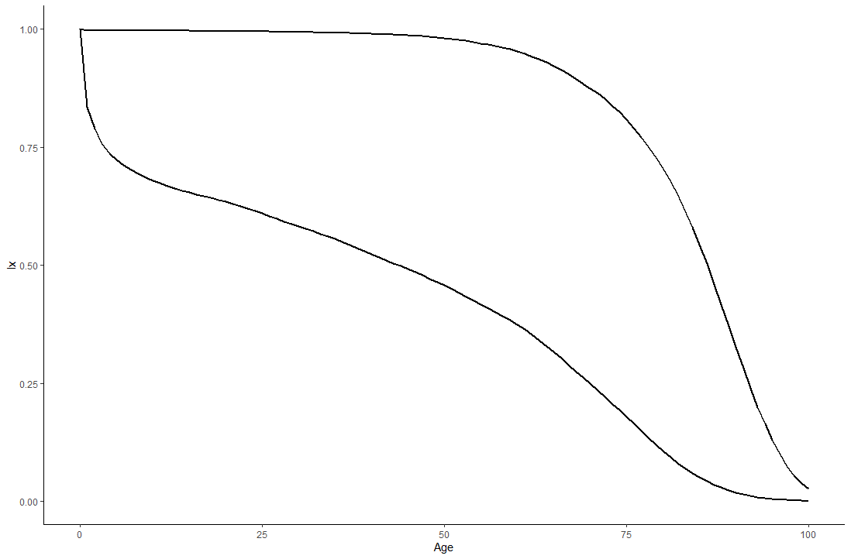



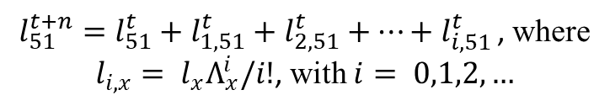

A
$$t+n$$
The new $l_{x}^{t+n}$ probability relates to the old probability $l_{x}^{t}$ by$Λ_{x}= ln\left(\frac{l_{x}^{t+n}}{l_{x}^{t}}\right)$
$$t$$
$l_{51}^{t+n}=l_{51}^{t}+l_{1,51}^{t}+l_{2,51}^{t}+…+l_{i,51 }^{t}$, where $l_{i,x}= l_{x}Λ_{x}^{i}/i!$, with $i= 0,1,2,…$
$$51$$

Slide 2
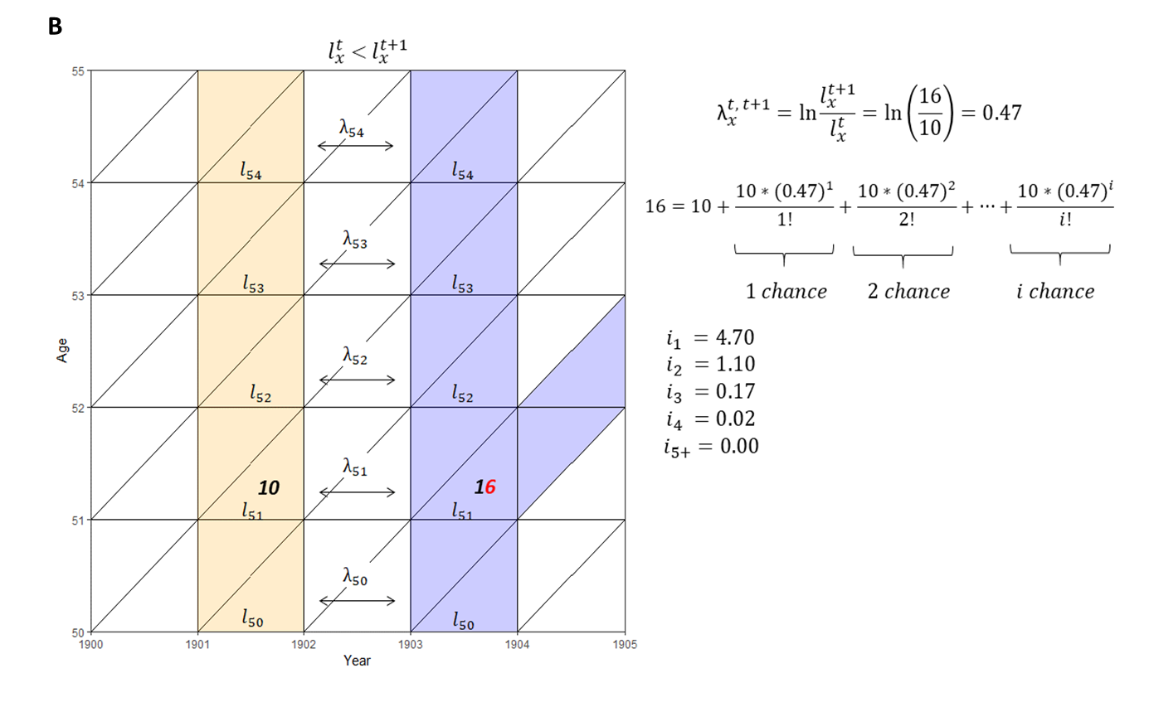

Slide 3
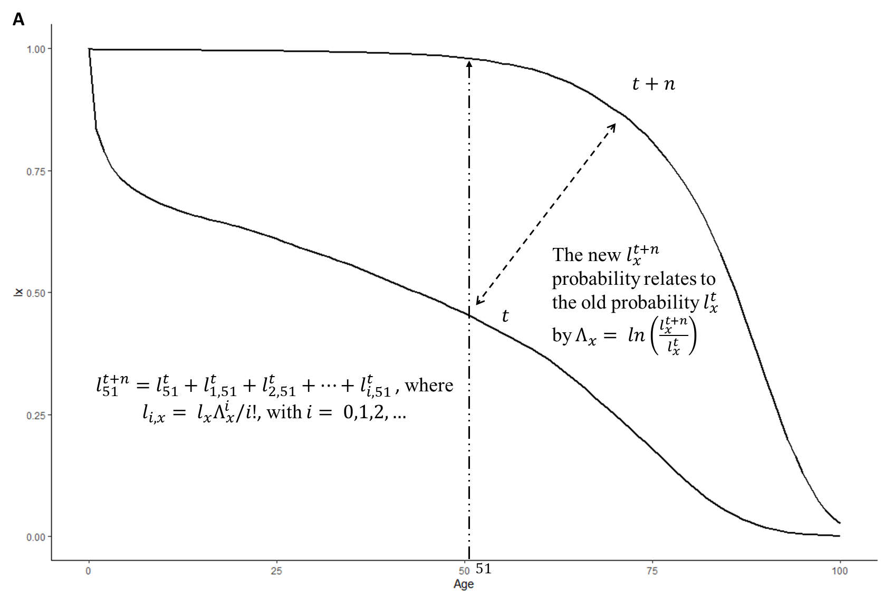

Slide 4
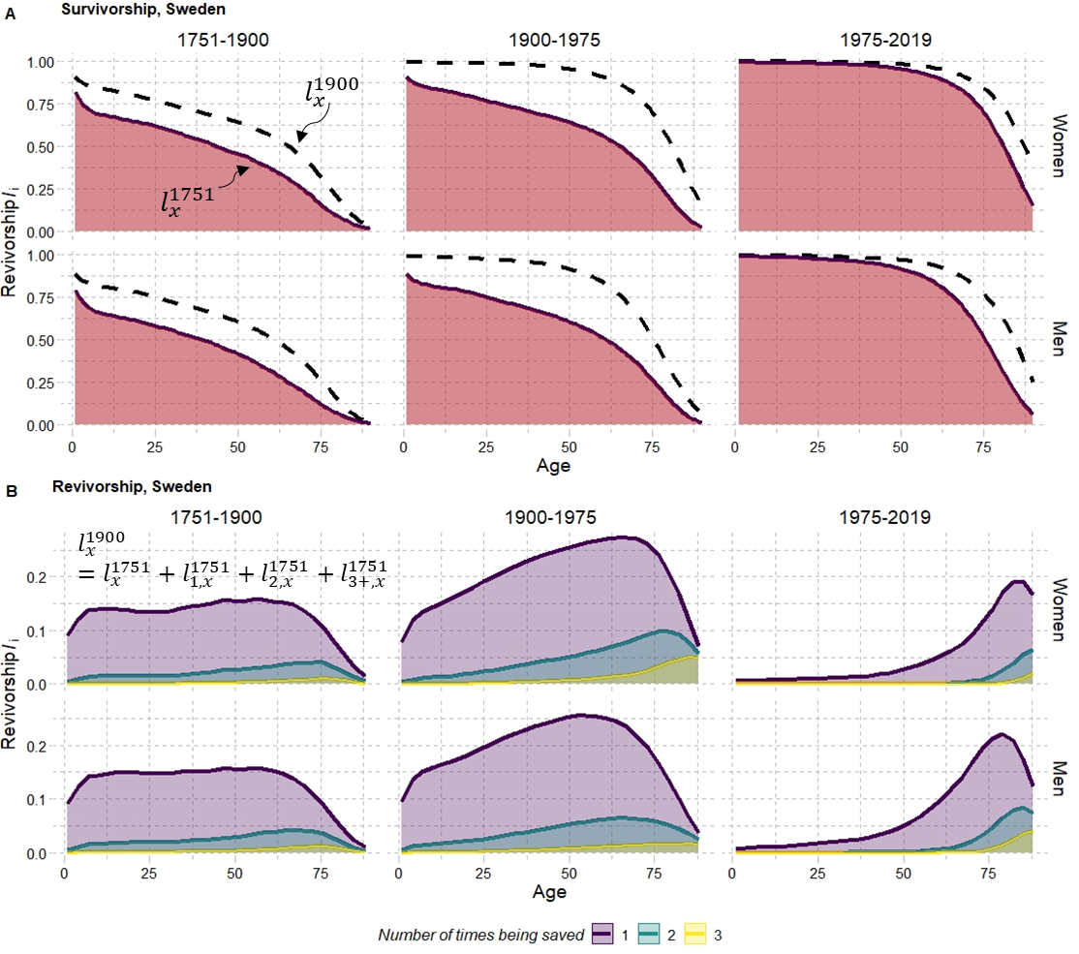

Slide 6
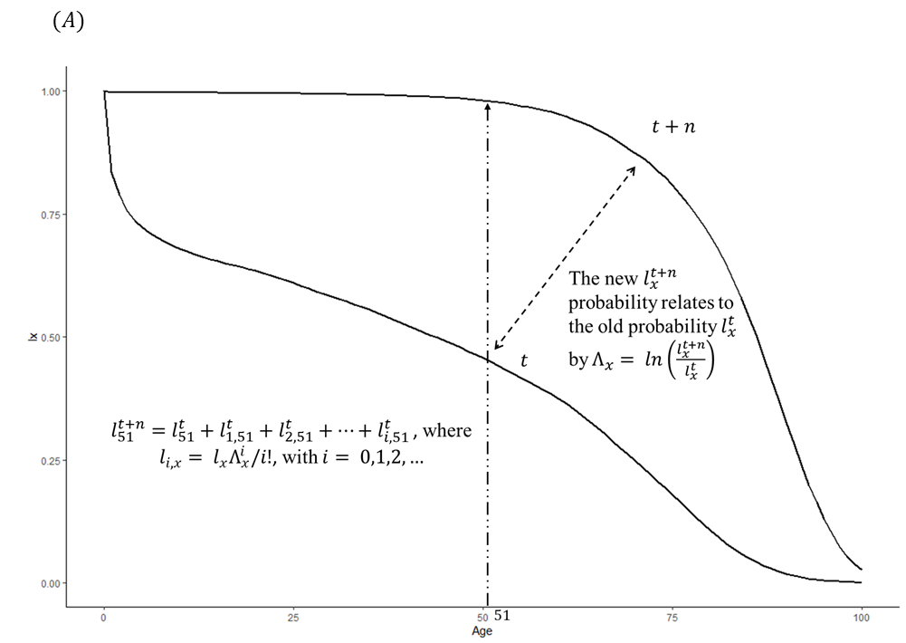

Slide 7
